Slide 1
Evaluating the Effectiveness of Algorithm Analysis Visualizations
Mohammed Farghally
Information Systems Department, Assiut University, Egypt
Kyu Han Koh
Department of Computer Science, CSU Stanislaus
Hossameldin Shahin and Clifford A. Shaffer
Department of Computer Science, Virginia Tech
Friday, March10, 2017
SIGGCSE 2017 Seattle WA

Slide 2
Agenda
Problem: Students tend to do poorly on Algorithm Analysis topics
Inspiration: Visual Presentation of Algorithm Analysis
Solution: Algorithm Analysis Visualizations (AAVs)
Evaluation: Evaluating AAVs

Slide 3
DSA concepts
Topics in Data Structures and Algorithms (DSA) courses include
Procedural dynamics
Algorithm analysis
Notes:
-

Slide 4
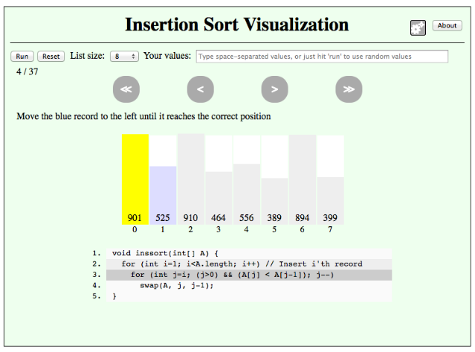
Algorithm Visualizations (AVs)
AVs focus mainly on procedural dynamics.
Historically, few AVs related to algorithm analysis material.
AV support libraries provide no direct support for presenting algorithm analysis aspects.

Slide 5
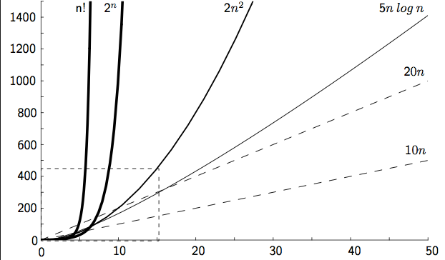
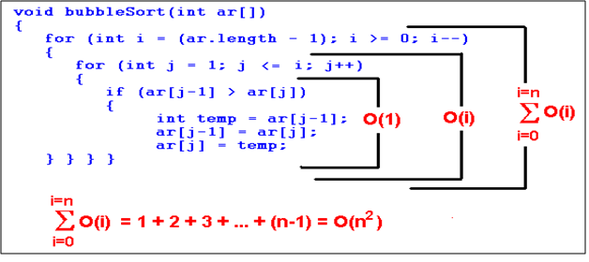
Algorithm Analysis
Algorithm analysis aspects include
Asymptotic analysis (i.e., Big-O)
Growth Rates
Running-time proofs
Best, average, and worst cases of an algorithm
Upper and Lower bounds of problems

Slide 6
Algorithm Analysis is Hard
We conducted a study* to investigate difficult topics in a typical CS3 course.
OpenDSA was used as the main textbook for the course.
Interactive eTextbook infrastructure and a body of content.
Automatically graded interactive exercises and visualizations.
Adopts a mastery level approach with the support of hints.
143 students at Virginia Tech during Fall 2014 in which OpenDSA exercises accounted for 20% of total grade.
* Fouh, Eric, Mohammed F. Farghally, Sally Hamouda, Kyu Han Koh, and Clifford A. Shaffer. "Investigating Difficult Topics in a Data Structures Course Using Item Response Theory and Logged Data Analysis.“In Proceedings of the 9th International Conference on Educational Data Mining, Raleigh, NC, 2016, pages 370-375.

Slide 7
Algorithm Analysis is Hard (3)
Topic | Hint Ratio | Incorrect Ratio
Algorithm Analysis | 0.24 | 0.77
Tree Overhead Analysis | 0.78 | 0.73
Quicksort Analysis | 0.32 | 0.67
Mathematical Background | 0.25 | 0.63
Shellsort | 0.16 | 0.61
List Overhead Analysis | 0.93 | 0.60
Quicksort partition | 0.27 | 0.58

Slide 8
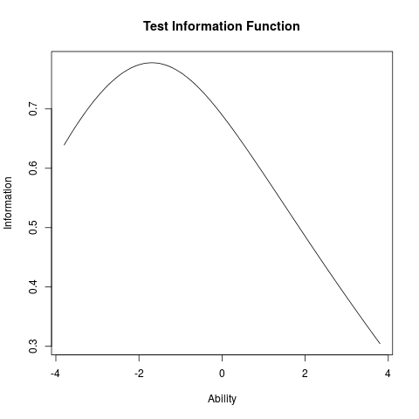
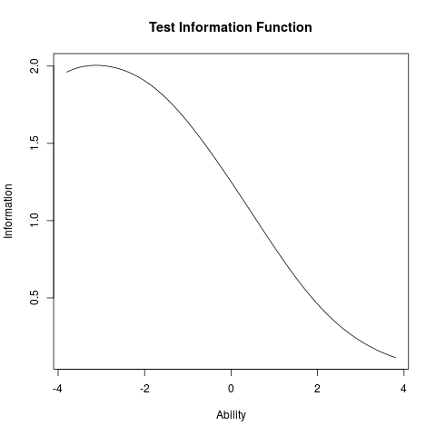
Algorithm Analysis is Hard (5)
Algorithm Analysis
Binary Trees
Linear Structures
(Thanks to Eric Fouh)

Slide 9
Algorithm Analysis is Hard (6)
A survey was sent to CS3 instructors through SIGCSE mailing list.
23 instructor responses were analyzed.
Topic | # of instructors | Percentage
Dynamic Programming | 7 | 18
Algorithm Analysis | 6 | 15
OOP and Design | 6 | 15
Recursion | 4 | 10
Trees and Heaps | 3 | 7
Proofs | 3 | 7
(Thanks to Eric Fouh, Thanks to Survey Respondents!!)

Slide 10
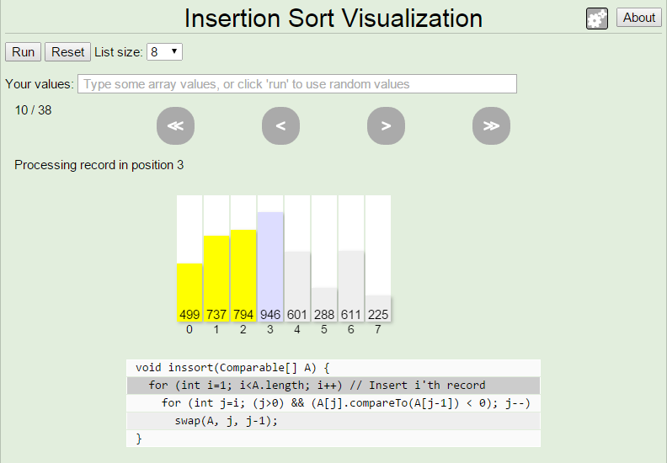
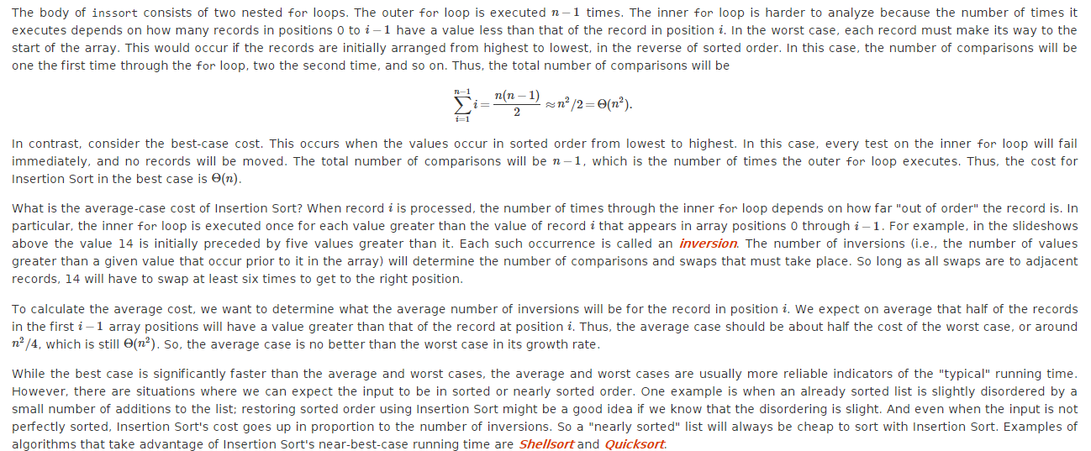
Why Algorithm Analysis is Hard? (2)

Slide 11
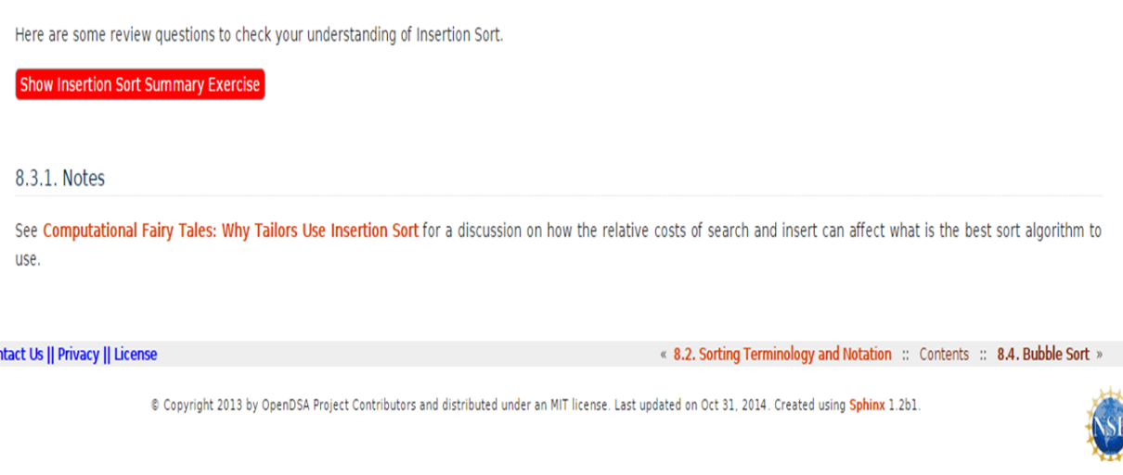
Why Algorithm Analysis is Hard? (2)
OpenDSA interaction logs were analyzed for CS3-level course offerings in 3 universities during Fall 2014 to see the time spent in Algorithm analysis content for the sorting chapter.
Text was wrapped behind a show/hide button.
Notes:
OpenDSA at that time didn’t have a direct way of measuring time spent in text.
Show/hide button support was added. We tried to find an evidence that the 22% of the students are actually true and the presentation really matters in the problem that AD is easier than AA.

Slide 12
Why Algorithm Analysis is Hard? (3)
University | Module | N | Mean (Sec) | % < 1 min
Virginia Tech | Insertionsort | 98 | 63.57 | 74.48
 | Mergesort | 96 | 39.79 | 78.12
 | Quicksort | 92 | 64.71 | 73.91
Texas El Paso | Insertionsort | 26 | 49.84 | 80.76
 | Mergesort | 22 | 41.45 | 77.27
 | Quicksort | 16 | 16.18 | 93.75
Florida | Insertionsort | 53 | 40.39 | 84.90
 | Mergesort | 44 | 18.63 | 95.45
 | Quicksort | 39 | 26.12 | 92.30
Notes:
Those 22% were right. There is a problem here in the presentation that we need to consider.

Slide 13
Visual Presentation of Algorithm Analysis
Challenges
More abstract than procedural dynamics
No dynamic process

Slide 14
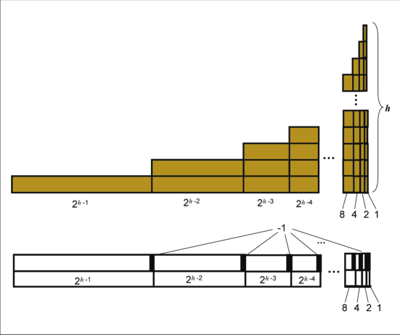
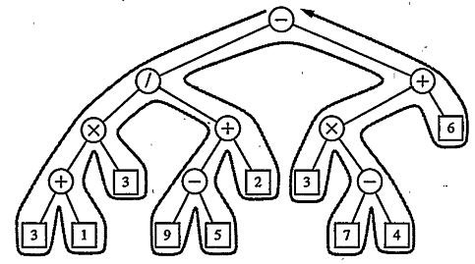
Visual Proofs
An Attempt to present AA concepts visually using static visual depictions.
Two main Principles
Area-to-Cost
Visual Description.
Passive.
Thompson and Chadhuri
Goodrich and Tamassia
Notes:
Paper based static depictions

Slide 15
Algorithm Analysis Visualizations (AAVs)
Inspired by Visual Proofs, 28 AAVs were developed.
Sorting Algorithms (14)
General AA concepts (14)
The JSAV library (Karavirta and Shaffer, 2013)
In pure HTML5 and javascript

Slide 16
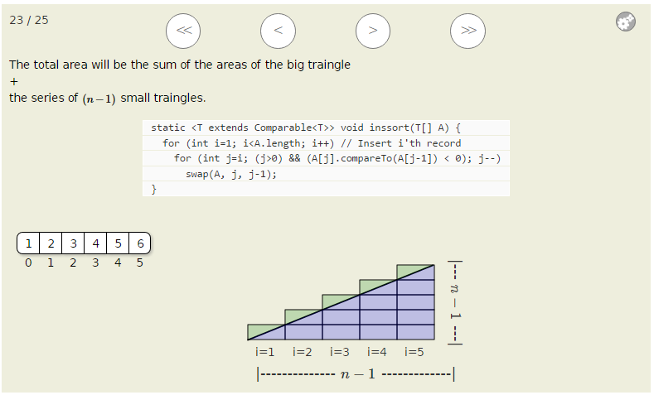
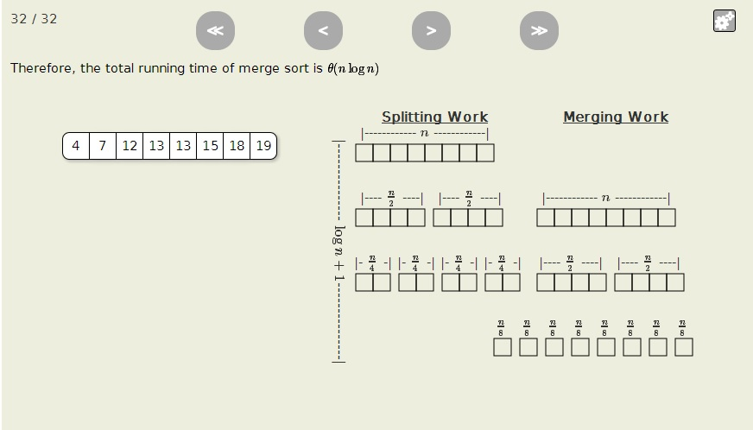
Area-to-Cost AAVs
Worst case Insertionsort
Mergesort
Notes:
Discuss the AAVs in detail
Control Buttons
Visual Part and text part
The Visual proof itself

Slide 17
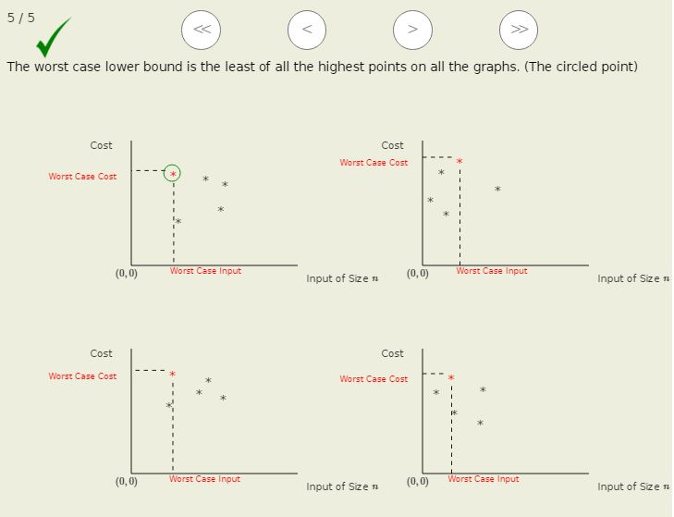
Visual Description AAVs
Sorting Lower Bound
Worst Case Lower Bound of a Problem

Slide 18
Evaluating AAVs: Quasi-Experiment
Participants
Virginia Tech Students taking CS3114 using OpenDSA.
67 Students served as the control group (Fall 2015).
155 Students served as the intervention group (Spring 2016).
Research Questions
Q1: Intervention group students more engaged with AAVs?
Q2: What feedback did intervention group students give about AAVs?
Q3: Intervention group students had better scores in the final exam?

Slide 19
Quasi-Experiment (2)
Material
The same OpenDSA material except for analysis (AAVs versus Text).
The same set of AA questions in the final exam (AACI).
Student survey at the end of the semester.
Procedure
Total Time spent in the material was used as a proxy for engagement.
Student scores on the algorithm analysis part of the final were compared.

Slide 20
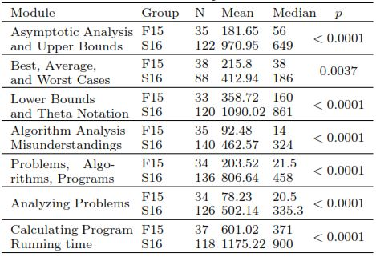
Student Engagement
Sorting Chapter
Algorithm Analysis Introduction Chapter

Slide 21
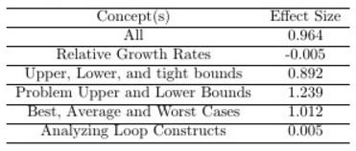
Student Performance
Notes:
Each set of items is testing a specific topic. Key point here: The ones in red DID NOT have AAVs! The ones in green DID. So this works as both a positive and a negative check.

Slide 22
Student Satisfaction
90 students responded to a survey given at the end of Spring 2016
85% reported that AA topics are harder than Algorithm dynamics
(They still like AVs better than AAVs)

Slide 23
Threats to Validity
Did not consistently account for students’ pre-knowledge. (1)
Are they different?
Fall 2014 students were not significantly different in a pre-test (p = 0.1727).
Fall 2015 and Spring 2016 are similar in terms of demographics.
Did not consistently account for students’ pre-knowledge. (2)
Did pretest affect outcome?
Apparently not, because topics without AAVs showed no differential improvement.

Slide 24
Future Work
More AAVs
Relative growth rates.
Analyzing loops.
Binary-tree traversals.
Graph traversals and shortest path algorithms.
Increase AAV level of engagement (Naps et.al 2002)
So far, AAVs are static, at the “Viewing” level
Responding?
Changing?
Construction?
Thank you! To NSF funding under grants DUE-1139861, IIS-1258471, and DUE-1432008.

