Slide 1
Evaluating the Integration of Online, Interactive Tutorials into a Data Structures and Algorithms Course
Master of Science
in
Computer Science and Application
Daniel Breakiron
May 2, 2013
Blacksburg, VA

Slide 2
Acknowledgements
Dr. Clifford Shaffer
Advisor and committee chair
Dr. Stephen Edwards and Dr. T. Simin Hall
Committee members
Eric Fouh and Dr. Ville Karavirta
OpenDSA and JSAV developers
NSF
Grants DUE-1139861 and IIS-1258571
Dr. Hicham Elmongui, Dr. Yang Cao, Dwight Barnette, and their students
Friends and family

Slide 3
Overview
The Problem
What is OpenDSA?
OpenDSA Client-side Framework
Experiment
Research Questions
Results
Conclusions
Limitations and Sources of Error
Future Work
Questions

Slide 4
The Problem (with Courses)
Lack of practice
Too few problems per topic
Assignments aren’t comprehensive
Feedback
Disconnected (received long after submission)
Variable-quality (depends on grader)
None provided (especially if homework is optional)
Existing techniques are not scalable

Slide 5
The Problem (with E-textbooks)
Pros
Cheaper
Easier to distribute
Easier to access
Cons
Still expensive
Content is static and identical to paper version
No videos
Not interactive
Never updated

Slide 6
What is OpenDSA?
“a collection of online, open-source tutorials which combine textbook-quality text with randomly generated instances of interactive examples and exercises”
Provides unlimited practice
Provides automatic assessment and immediate feedback
Free
Web-accessible
Interactive, engaging, dynamic material
Content is continually updated and improved

Slide 7
OpenDSA
Made up of modules written in reStructuredText and compiled into HTML5
Exercises written in HTML5, CSS and JavaScript
Extensive use of jQuery and the JavaScript Algorithm Visualization (JSAV) library
Mastery-based design
Concept of “proficiency”

Slide 8
Exercise Types
Slideshows
Mini-slideshows
Algorithm visualizations (AVs)
Proficiency exercises
Algorithm simulations
Calculators
Khan Academy-style exercises
Mini-proficiency exercises
Summary exercises

Slide 9
Mini-slideshow
Sorting a sublist in Shellsort

Slide 10
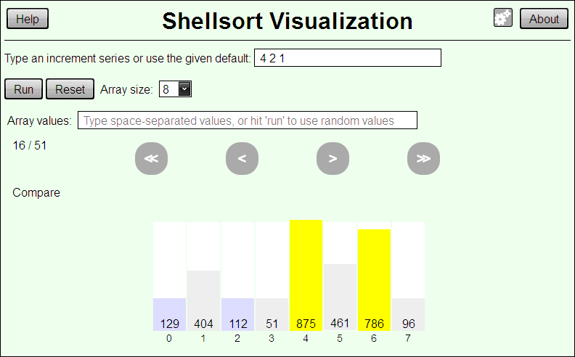
Algorithm Visualization

Slide 11
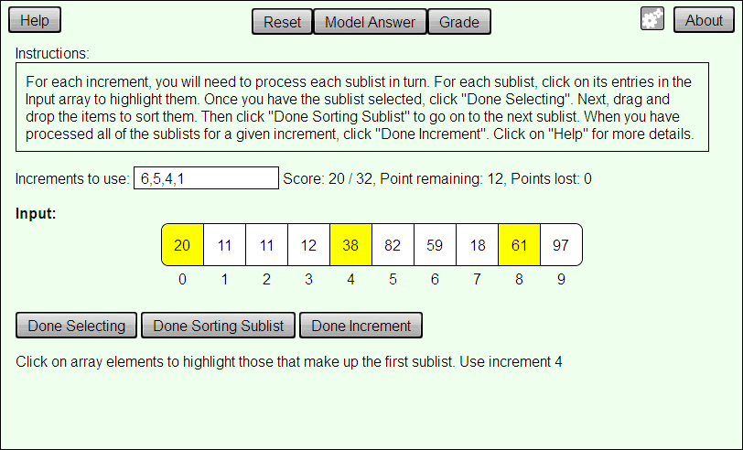
Algorithm Simulation

Slide 12
Calculator
Birthday problem calculator
Mid-square calculator

Slide 13
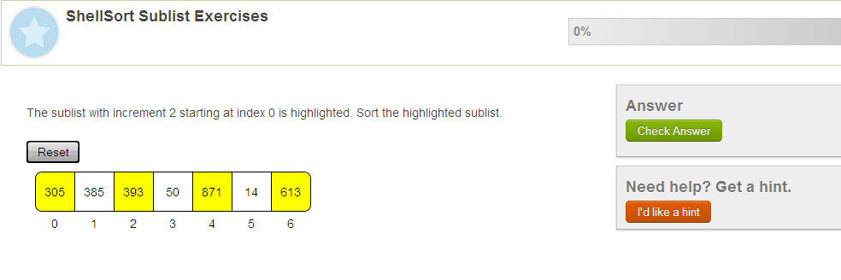
Mini-Proficiency Exercise

Slide 14
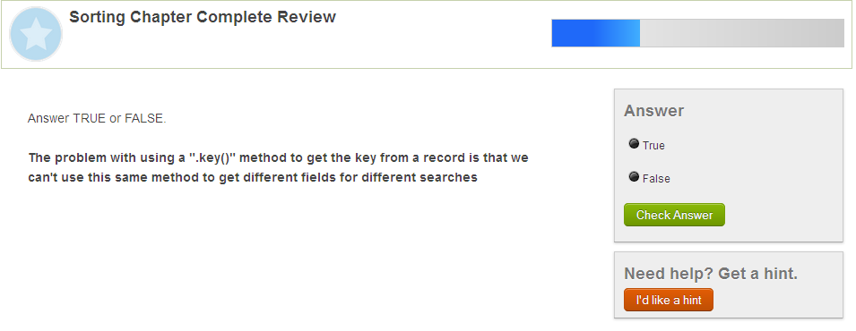
Summary Exercise

Slide 15
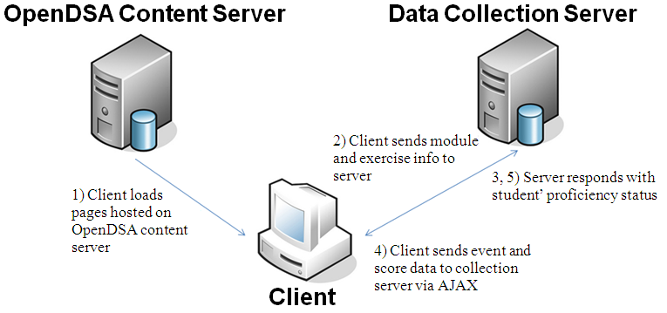
Infrastructure
Client-server architecture
Data Collection Server (DCS) is required for centralized score and interaction data collection
Client can function independently from the DCS

Slide 16
OpenDSA Client-side Framework
Allows users to login, logout, and register new accounts
Sends information to dynamically load new modules and exercises in the database
Buffers and sends exercise score and user interaction data to the DCS
Manages a user’s proficiency
Keeps multiple OpenDSA pages in sync

Slide 17
Proficiency Management
Determines whether a user obtains proficiency with a module or exercise
Caches the user's proficiency status locally
Maintains progress for guest users
Displays an appropriate proficiency indicators
Feedback mechanism
Ensures local proficiency cache remains in sync with the server

Slide 18
Experiment

Slide 19
Experiment
Data collected from 3 classes
CS223 – University of Alexandria, Egypt
OpenDSA assigned for homework, used during lecture
Covered hashing
Length: ~1 week

Slide 20
Experiment
CS3114A (Dr. Yang Cao) – Blacksburg, Virginia
OpenDSA assigned for homework, examples used during lecture
Covered sorting and hashing
Slideshows were not required and worth no credit
Length: ~3 weeks

Slide 21
Experiment
CS3114B (Dwight Barnette) – Blacksburg, Virginia
OpenDSA assigned for homework
Covered sorting and hashing
Sorting material was due 2 weeks before hashing
Sorting material assigned after exam was administered
Slideshows were required and worth credit
Length: ~5 weeks

Slide 22
Research Questions
Propose existence of groups defined by time when member begin completing exercises
How long does it take students to obtain proficiency on exercises?
How much do students:
Read the text?
Rush through slideshows?
Skip to the end of slideshows?
Use AVs for assistance on exercises?
Use slideshows when they are not required?

Slide 23
Results

Slide 24
Time Distribution of Activity
Propose existence of groups
Expected ~3 groups (proactive, normal, procrastinator)
Created bins for ranges of time, counted the number of exercises with “proficient” timestamps within each bin
Optimal bin size varied between classes
14 hour bins for CS223
22 hour bins for both CS3114 sections

Slide 25
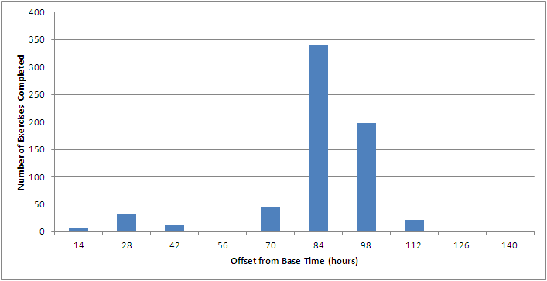
Time Distribution of Activity
CS223

Slide 26
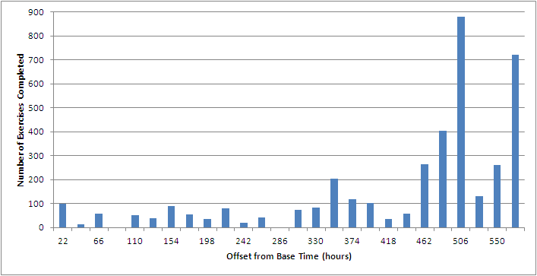
Time Distribution of Activity
CS3114A

Slide 27
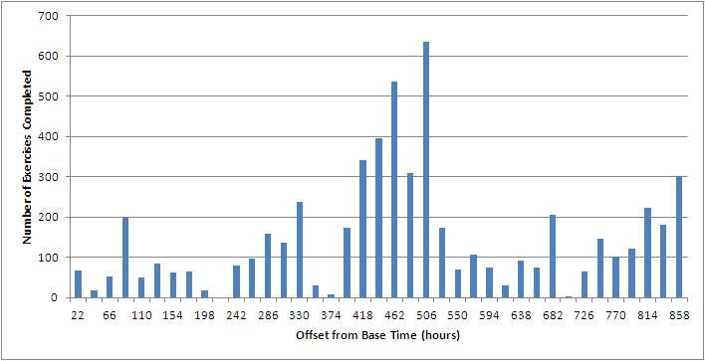
Time Distribution of Activity
Sorting Chapter
Deadline
CS3114B

Slide 28
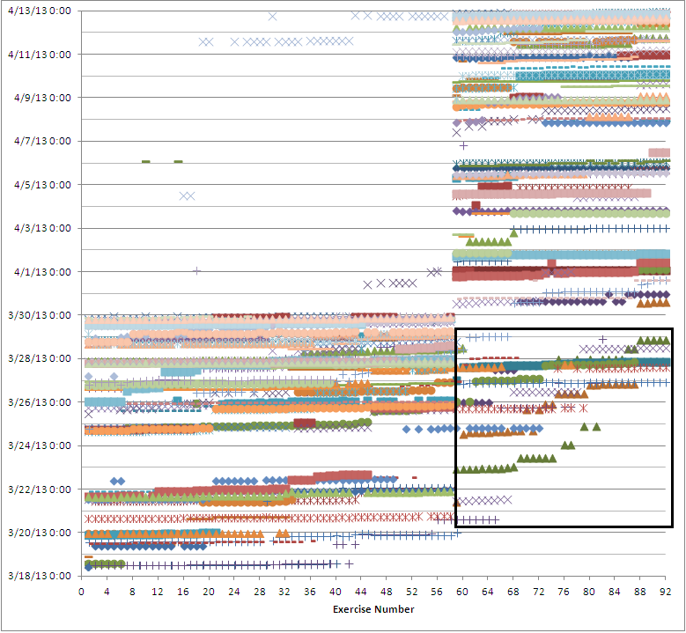
Time Distribution of Activity
CS3114B, Scatter plot of exercise proficiencies

Slide 29
Time Required for Proficiency
Determine consistency of time requirements
How accurately should we be able to predict future time spent?
Sum total time of all instances before proficiency was obtained, for each student, for each exercise
Recorded median time required for each exercise
Figures separated by exercise type

Slide 30
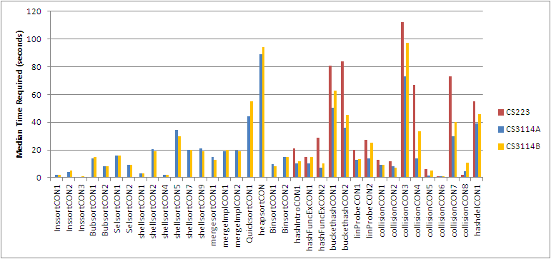
Time Required for Proficiency
Median time required for mini-slideshows

Slide 31
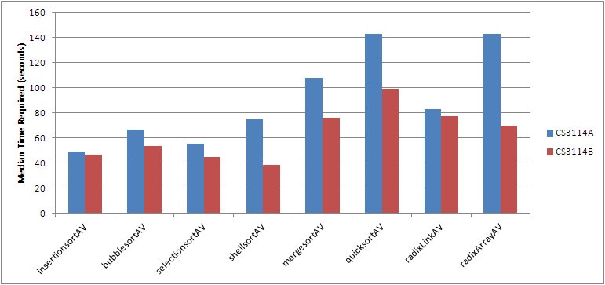
Time Required for Proficiency
Median time required for algorithm visualizations (AVs)

Slide 32
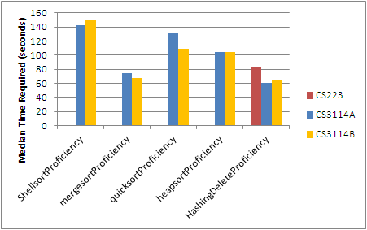
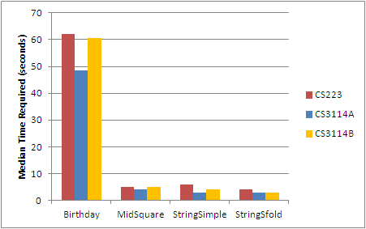
Time Required for Proficiency
Median time required for algorithm simulations
Median time required calculators

Slide 33
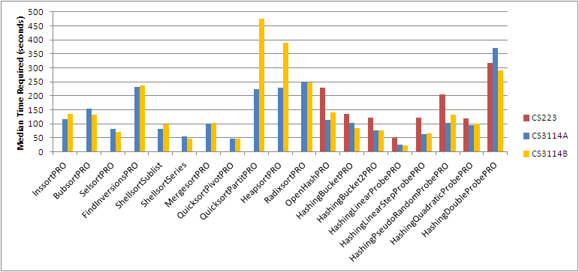
Time Required for Proficiency
Median time required for Khan Academy-style mini-proficiency exercises

Slide 34
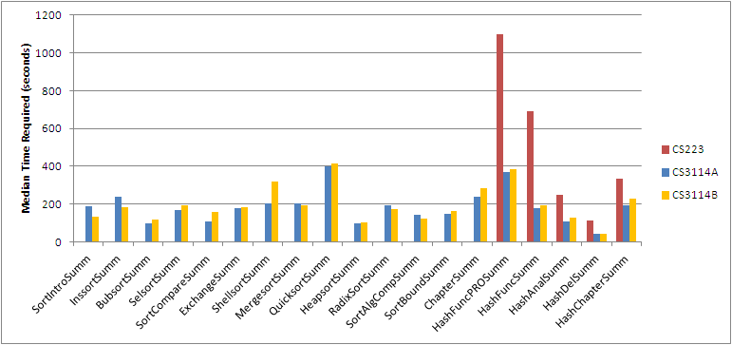
Time Required for Proficiency
Median time required for Khan Academy-style summary exercises

Slide 35
Amount of Reading
Determine to what extent students read the text
How quickly do students begin exercises?
Calculated time between first module load and first exercise event
Accounted for students closing and reopening the module later
Times grouped into 5-second bins
Figures display distribution across range of 5 minutes

Slide 36
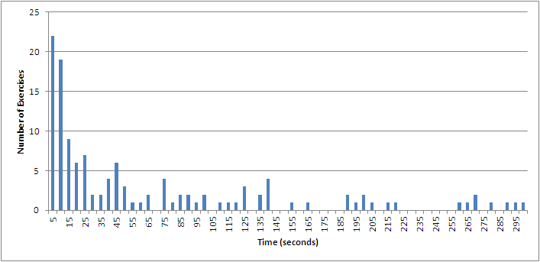
Amount of Reading
Number of exercises started X seconds after module load, CS223

Slide 37
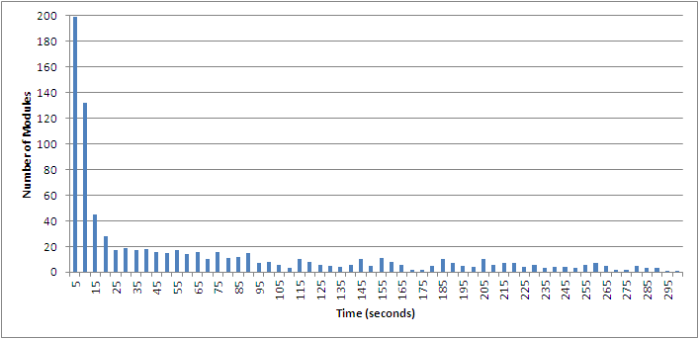
Amount of Reading
Number of exercises started X seconds after module load, CS3114A

Slide 38
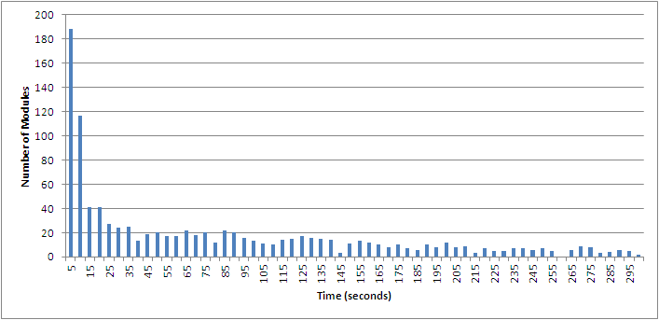
Amount of Reading
Number of exercises started X seconds after module load, CS3114B

Slide 39
Amount of Reading
 | 1st Quartile | 2nd Quartile | 3rd Quartile
CS223 | 15 sec | 90 sec | 440 sec
CS3114A | 10 sec | 70 sec | 290 sec
CS3114B | 20 sec | 120 sec | 420 sec

Slide 40
Clicking through Slideshows
Quantify amount of “learning” vs. “rushing” behavior
“Learning behavior” – reading slide descriptions, moving back and forth to examine operations
“Rushing behavior” – quickly clicking through all the slides
Calculated mean-time-per-slide of instances where students obtained proficiency, placed times in bins
Ultimately found mean-time-per-slide wasn’t detailed enough, need exact time per slide

Slide 41
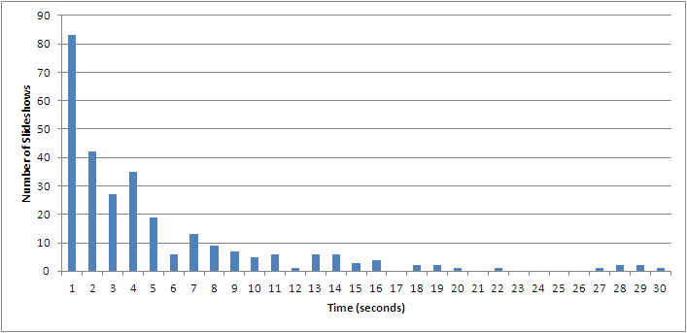
Clicking through Slideshows
Distribution of mean-time-per-slide for CS223

Slide 42
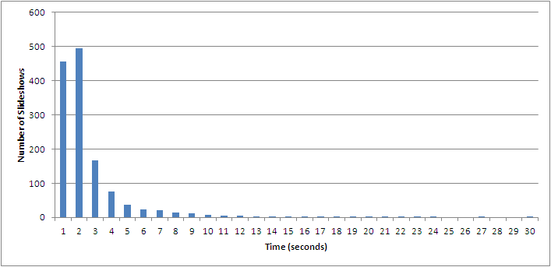
Clicking through Slideshows
Distribution of mean-time-per-slide for CS3114A

Slide 43
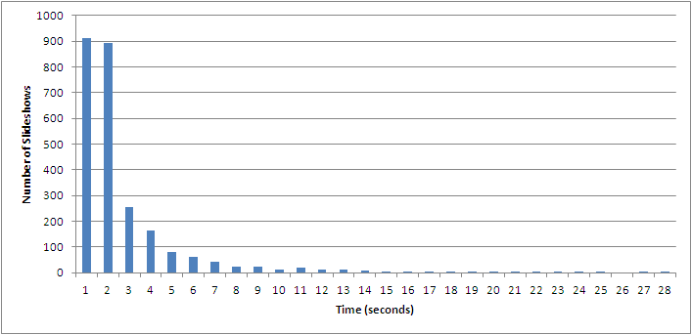
Clicking through Slideshows
Distribution of mean-time-per-slide for CS3114B

Slide 44
Skipping Slideshows
Intentionally left bug where students could obtain credit for slideshows without viewing all slides (“skipping” behavior)
When event encountered from first proficient instance, performed look ahead operation to determine if all steps were viewed
Found 2 types of behavior
“Learning behavior” + “skipping”
“Skipping”
Error bars indicate known missing event data
Positive = all event data missing
Negative = some event data missing

Slide 45
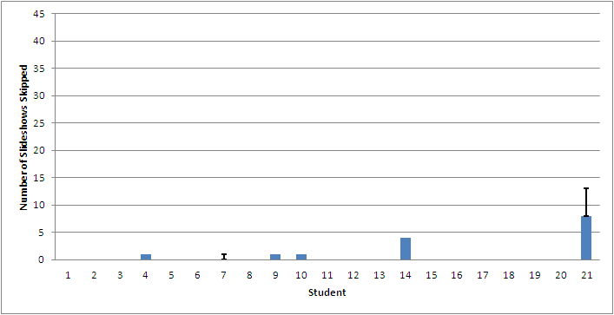
Skipping Slideshows
Number of slideshows skipped per student in CS223

Slide 46
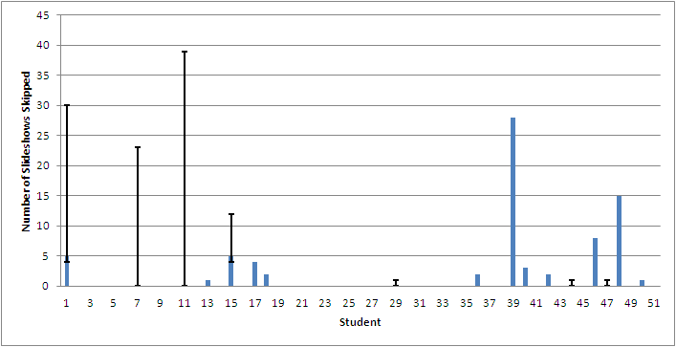
Skipping Slideshows
Number of slideshows skipped per student in CS3114A

Slide 47
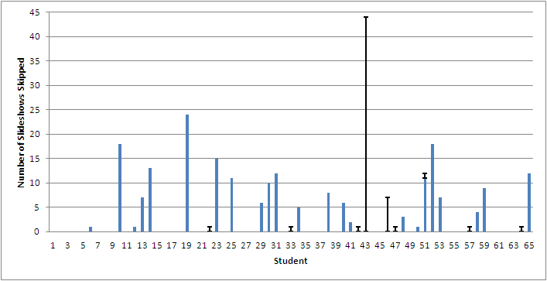
Skipping Slideshows
Number of slideshows skipped per student in CS3114B

Slide 48
AV Assistance on Exercises
Some algorithm simulations have matching AVs whose output can be mimicked to complete the exercise
Determine if associated AV was run with input matching the exercise before the exercise was completed or abandoned (reset or refresh)
Totaled number of assistances
Per exercise – identify confusing exercises
Per student – determine how widespread the behavior was

Slide 49
AV Assistance on Exercises
 | Exercise | Attempted | Complete | Proficient | Assisted
CS3114A | ShellsortProficiency | 671 | 67 | 57 | 1
 | mergesortProficiency | 263 | 181 | 181 | 0
 | quicksortProficiency | 1105 | 71 | 52 | 14
CS3114B | ShellsortProficiency | 561 | 90 | 68 | 2
 | mergesortProficiency | 127 | 68 | 67 | 0
 | quicksortProficiency | 1065 | 76 | 60 | 19

Slide 50
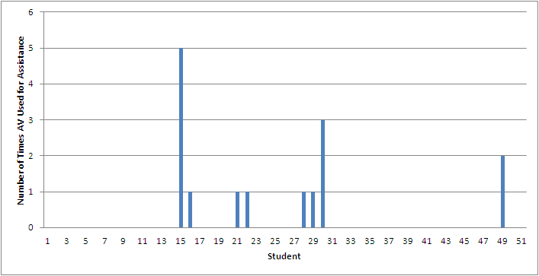
AV Assistance on Exercises
Number of times AVs used for assistance in CS3114A

Slide 51
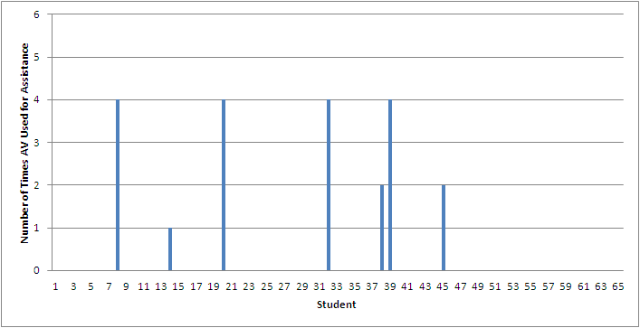
AV Assistance on Exercises
Number of times AVs used for assistance in CS3114B

Slide 52
Non-Required Slideshow Usage
Slideshows not required and worth no credit for CS3114A, required and worth credit for CS3114B
Expect CS3114A usage of slideshows to be learning oriented
Totaled number of slideshows each student started and obtained proficiency with
Substantial usage and less skipping observed in CS3114A
Positive error = number started but not completed
Negative error = number of slideshows missing all event data

Slide 53
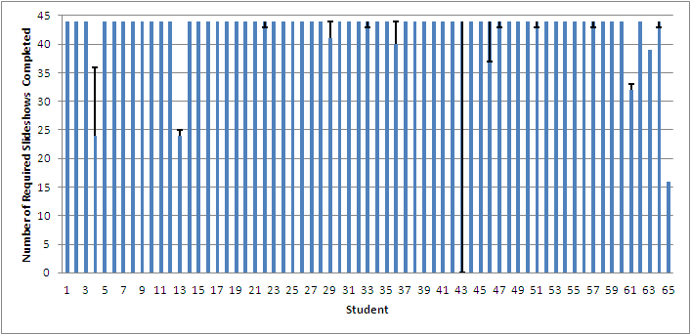
Non-Required Slideshow Usage
Number of required slideshows completed (proficient) in CS3114B

Slide 54
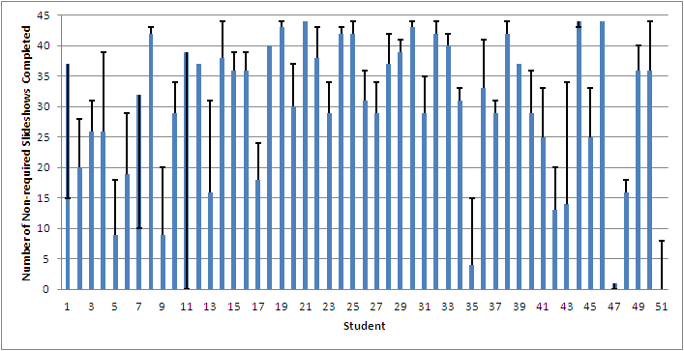
Non-Required Slideshow Usage
Number of non-required slideshows completed (proficient) in CS3114A

Slide 55
Conclusions
Clusters were identified in all classes
Little variation observed in CS3114 classes regarding time required
Estimates are likely to be accurate
Majority of students do not read the text
Higher rates of AV assistance observed on known-confusing exercise
May serve as indicator of exercises that need additional development

Slide 56
Conclusions
3 times as many proficient completions of Mergesort exercise than students in the class
Evidence that students review exercises
Observed substantial amount of slideshow usage even when not required
Skipping occurred more when slideshows were required, but occurred even when not required

Slide 57
Limitations and Sources of Error
Missing or incorrect data
Missing event data possibly from concurrency issue
Bug causing incorrect total time measurements (able to approximate)
Measurement of passive activities
Reading
Affect of software bugs on behavior
Abandoned accounts

Slide 58
Future Work
Studying behavior
Do students review modules and exercises after obtaining proficiency? How well do they perform?
Skipping Khan Academy-style exercises
Reloading
Using hints to avoid losing points
Feature usage
Model answer
Gradebook
Search

Slide 59
Future Work
Effect of incremental due dates
Making assignments due before or after lecture
Identification of confusing concepts
What operations are reviewed most in slideshows?
What steps are missed most in exercises?
More detailed analysis of slideshow usage
Time spent on each slide rather than in aggregate
Separate “learning + skipping” from “skipping”
Conditions surrounding exercise resets

Slide 60
Questions
?
?
?
?
?
?
?
?
?
?

