Slide 1
Information Technology @ Eastman
Notes:
Be a catalyst. Start something big ... in IT.
What could you do if you worked for a company that touches people’s lives every day? … Rather what couldn’t you do?
When you work for Eastman, you can help make a difference in countless ways. That’s because Eastman products and technologies make everyday products extraordinary. And Eastman employees spark brighter futures through discovery, technology, collaboration, and innovation—regardless of title.
Eastman Information Technology teams are responsible for delivering IT infrastructure, development, and support services that are globally standardized. It’s a big world; IT brings it all together. Your efforts in IT will help Eastman employees to work, learn, and collaborate effectively and efficiently all around the globe. And analysis, design, and implementation of e-commerce systems, information systems, and manufacturing systems continue to play a key part in the company.
In the end, that makes Eastman a great place to develop your career. Here, you’ll find opportunities to grow professionally, competitive salaries, outstanding benefits, and a global work environment. People don’t just start careers here. They start friendships. They start producing. And, when they do, they start something big.

Slide 2
Business Process Skills
Order to Cash, Forecasting & Budgeting, etc.
Process Modeling
Project Management
Technical Skills
Concepts, not just specific programming languages
ERP
Mobility
Service-Oriented Architecture (SOA)
Software as a Service (SaaS)
Cloud computing
Infrastructure
Soft Skills
Adaptable (lifelong learner)
Self Directed
Analytical
Leadership
Teamwork
Communication
Notes:
You may acquire some business skills in your college curriculum, these skills will help in your career as they will become an area of emphasis when you join Eastman. You will continue to grow these business skills or learn them from the ground up when you join Eastman. Growing competency in business coupled with strong technical skills is a recipe for success.

Slide 3
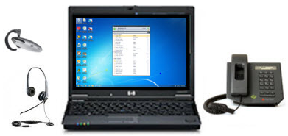
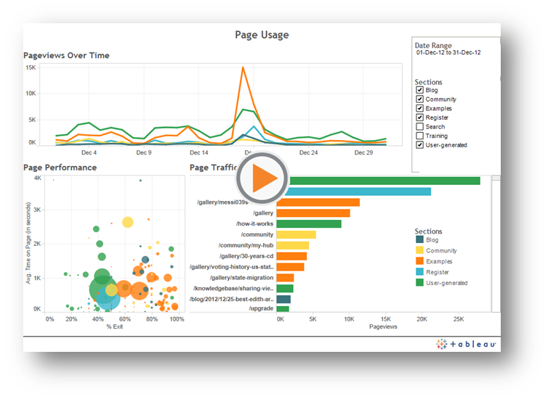
Possible Roles in IT
Program Office
Six Sigma
IT Security
Business Solutions (ERP)
SAP ERP
Application Dev
Data Sciences
Infrastructure Services
Notes:
As we look at the 'backend' of IT you think of servers that run applications, the disk space needed to store all that data, the networks needed to allow that data to traverse over it and the need to insure the data is backed up and restorable. We have an IT group responsible for managing all of those things and when you think about making data available 24, 7, 365 in every region of the world, there are some pretty exciting things we get to work on!

Slide 4
Why Eastman?
Career growth opportunities
Competitive compensation
Benefits including:
Work/life balance
Health care
80 hours vacation plus 11 paid holidays
Retirement contribution
Notes:
Eastman benefits….
Growth opportunities. A variety of assignments and projects to build technical and business skills. There are opportunities for training and development, development and leadership assignments and a tuition aid program. Every new hire – whether full time or intern -- is paired with a dedicated mentor to coach and position new hires for success.
Our compensation package is competitive. In addition to base pay, it also includes performance based incentives and rewards based on contribution
Our health and well-being benefits and programs. We offer a multitude of health and wellness programs to manage health risks along with incentives that can reduce health care expense.
Eastman is honored to receive the Glassdoor Employee’ Choice award for 2014. We believe it speaks to our culture and our beliefs. We work hard and value teamwork. We have very smart people know how to generate results. They understand our people are what makes Eastman great and take the time to invest in others and help them grow. That should be apparent from some of the comments of our newer employees that I shared earlier.
Interns…
Opportunities in both application development (Sharepoint, .net, web development – etc), Business Analytics and infrastructure (hardware, networking).
Service reinstatement. Credit for internship work periods count toward length of service from which vacation and other benefit eligibility is determined.
For people not familiar with the area, some of our local attractions include the Kingsport Aquatic Center, Bays Mtn, hiking and historic sites, BMS, many lakes for swimming and boating, Barter theatre, the Natural Tunnel State Park, Funfest, and more.

Slide 5
See the Careers section on www.eastman.com
Further Questions?
Contact Chad Drinnon at cdrinnon@eastman.com
Contact Melinda LaPrade, College Director of Career Services, at LAPRADE@mail.etsu.edu

Slide 6
Capstone project ideas from Eastman
Business Analytics Group

Slide 7
Comparison of Spark vs R
Business Analytics Group

Slide 8
R at Eastman
R is the primary tool for analyzing business data at Eastman
Analysis is done in-memory
Typical analyst workstation has 16Gb of RAM
Servers have more
Single threaded*
Are ways to leverage multiple cores/threads but doesn’t always work

Slide 9
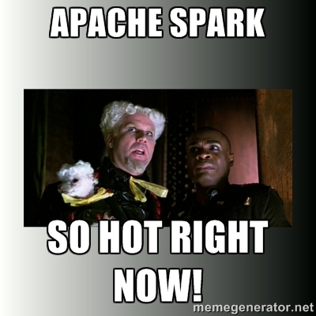
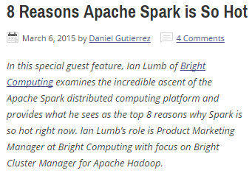
Apache Spark
Spark is so hot right now!
Includes machine learning, graph analytics and more
Fast and scalable
Replaces MapReduce with a SQL like language
Can use HDFS and other filesystems

Slide 10
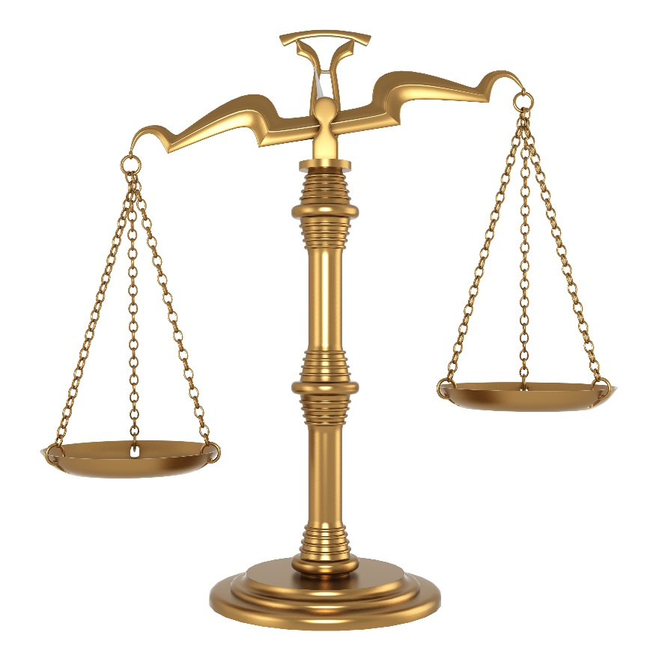
Tradeoff
Scalable to handle big data
Native multi-threading with machine learning should be faster even on medium size problems
Spark is new and unknown to us – requires training and change management
We know R very well
Most of our datasets today fit in memory
Development ecosystem and workflow is already established

Slide 11
Capstone project – When should one switch to Spark from R?
Given increasingly larger (rows and columns) data sets, how does Spark performance compare to R in fitting different basic models (e.g. linear regression)?
How does a single instance of Spark compare to a small cluster (in AWS for example)?

Slide 12
Deliverable
Eastman would like a report detailing at what point (size of data) the performance of Spark significantly exceeds that of R.
We would use this information to make decisions regarding when to begin implementing Spark for analytics at Eastman.

Slide 13
Support
Many large, public datasets are available to use with this project.
If needed, Eastman will recommend one or more specific large datasets
Eastman can provide analytics expertise (e.g. linear regression, logistic regression, etc.) if needed

Slide 14
Why choose this project?
A chance to get practical experience with Spark for your resume (it really is hot right now)
A chance to get practical experience (or more experience) with distributed processing
A chance to learn more about analytics (analytics + computer science = $$$ in the job market)

Slide 15
SQL vs NoSQL Performance with text
Business Analytics Group

Slide 16
Text Analytics at Eastman
Eastman generates a lot of text in the form of call reports written by our salesforce after visiting a customer.
Recently, web scraping has been added as a source of text data to help us identify consumer sentiment towards chemicals and products of interest.
Text analytics is performed on this data to help pull out significant themes and trends.

Slide 17
SQL at Eastman
The majority of Eastman’s data is stored in a SQL database of some type.
The data is typically modelled with a star schema
Avoids replication of dimensional data
Reasonably fast
Web scraped data is currently stored in a star schema form

Slide 18
NoSQL
“Not Only” SQL is a class of database management systems that are designed to handle specific types of data storage challenges
Key Value Pairs
Graph Databases
Document Stores
etc…

Slide 19
Why is there excitement about this emerging class of databases?
Data such as text is coming with more “variety” than traditional data sources and is increasingly a poor fit with relational databases and predefined data models
New database designs along with ever-increasing compute power are making schema-on-read feasible
Much better fit with unstructured or variable data such as text
New database designs work increasingly well in a distributed fashion and are more amenable to “big data”
Text is one of the bigger forms of data.

Slide 20
Deliverables
Eastman would like a report detailing performance comparisons of SQL (e.g. MySQL, SQL Server Express) vs NoSQL (e.g. MongoDB) on a database containing hundreds/thousands of reviews.
We would use this data to make decisions regarding our long-term technology strategy for storing text data.

Slide 21
Support
Eastman will provide review data, if needed
Publicly available text data sets are also available, which Eastman could recommend
Eastman will provide technical assistance, if needed, in web scraping new reviews

Slide 22
Why choose this project?
A chance to get practical experience with NoSQL databases, which are increasing rapidly in popularity and are a nice resume addition
A chance to get practical experience with web scraping
Interest in text as a data source is booming and web scraping is important as a way to acquire text data

