Slide 1
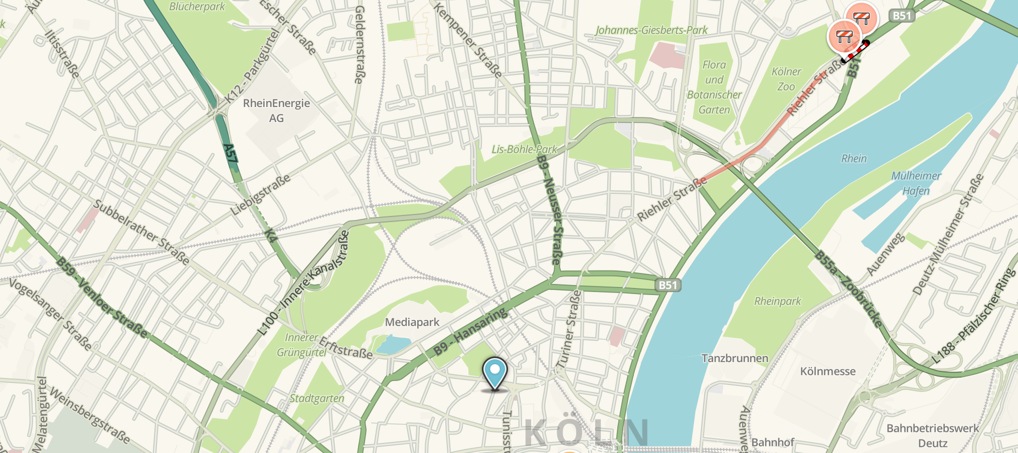
Understanding Bias and Misbehavior on Location-based Social Networks
“Will Check-in for Badges”
Gang Wang, Sarita Y. Schoenebeck†, Haitao Zheng, Ben Y. Zhao
UC Santa Barbara, †University of Michigan

Slide 2
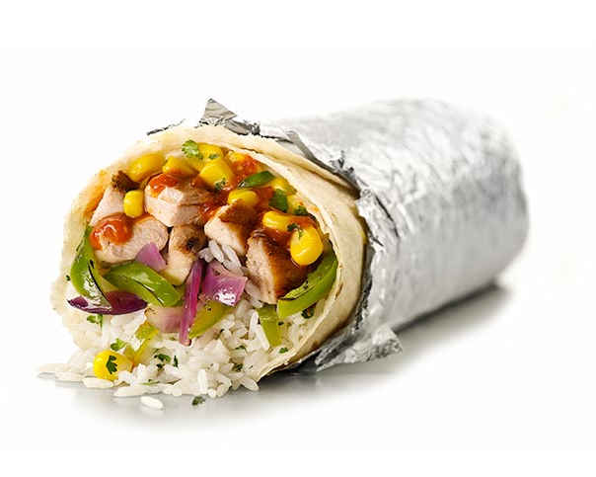
Chipotle on Foursquare
Chipotle reported its first quarterly loss this year
29% decline in sale
Foursquare predicted this accurately (30% of loss)
Significantly less check-ins and user visits!

Slide 3
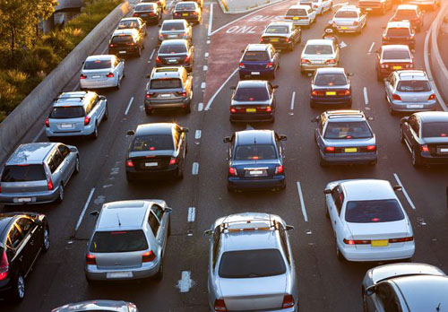
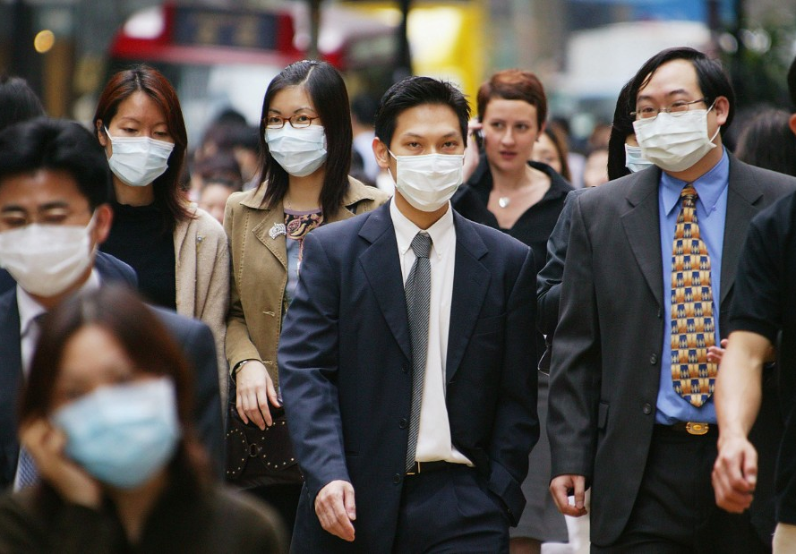
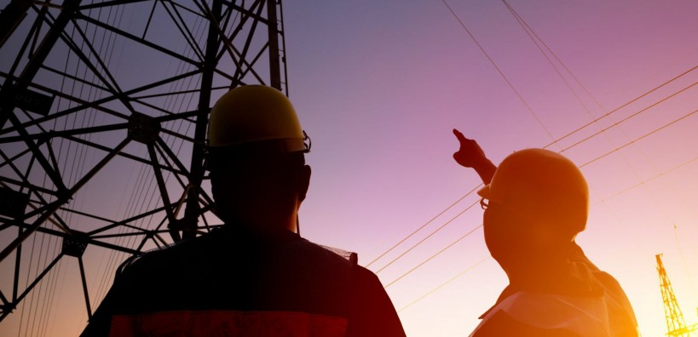
Understanding Human Mobility
Traffic Planning
Disease Control
Mobility data wanted
large-scale
detailed
accurate
Infrastructure Deployment
Picking Business Locations
Disaster Response
Notes:
Understanding human mobility has been a really important topic for many reasons
For example, from traffic planning in big cities to disease control.
From infrastructure deployment to picking locations for your business to rescuing lives from natural disasters.
To understand human mobility, we are always looking for large-scale, highly detailed and accurate mobility data.

Slide 4
Check-in Data to the Rescue
Location-based social networks (LBSN)
“Check-in” to locations, share with friends
Foursquare: 55 million users, 7 billion check-ins, 65 million venues as of 2015
Increasingly available check-in data
Large scale, public, crawl-able
Researchers use data for:
Inferring friendships; Predicting human movement; Urban planning;
Content delivery network design

Slide 5
Is This the Answer?
Concerns: data representativeness
Are check-ins a small sample of real mobility?
Are there biases in location check-ins?
Our initial effort: match check-ins with GPS traces
244 Foursquare users, data of two weeks [HotNets’13]
Our data
collection app
Temporal /
Spatial Matching
Check-in trace:
a list of 4square check-ins
GPS trace:
a list of visit events

Slide 6
Check-ins vs. Real Mobility
14,297 Check-ins
30,835 GPS visits
Extraneous
10772
Honest
3525
Missing
27310
Significant mismatch between Check-in and real mobility!
75% Check-ins are extraneous (“cheating”)
89% location visits have no check-ins

Slide 7
This Study Focuses on “Why”
User intent behind biased check-ins
Why do users miss check-ins?
Why certain check-ins don’t match physical visit (extraneous)?
Revisit conclusions of initial work
Representativeness of check-in data
New methodology: user study
Implications: check-in data for human mobility study

Slide 8
Outline
Introduction
Methodology: User Study
Result: Motivations of Biased Check-ins
Implications

Slide 9
User Study Methodology
Survey Foursquare users
Do users have extraneous/missing check-ins?
What’s the user intent behind biased check-ins?
“Primary”: data from our earlier study
Users who voluntarily installed our app, check-in/GPS
“Turker”: users recruited from Mechanical Turk
Broader set of users to validate conclusion
Self-selection Bias: would the app attract particular types of users? What’s the impact to conclusion?

Slide 10
Primary vs. Turkers
Examine self-selection bias
23 Primary Users
(out of 244 invited)
108 Turker Users
(Amazon Mturk)
Check-ins** | 1770.8 (2521.2) | 603.5 (91)
Badges** | 37.7 (29.2) | 13.8 (16.8)
Mayors** | 14.3 (26.9) | 0.2 (0.4)
Friends* | 45.4 (58.0) | 23.1 (39.7)
Foursquare Profile Attribute: Mean (STD)
The measurement app is likely attract more “active” users
**p<0.05, *P < 0.1
Compare survey answers from both user groups

Slide 11
Do You Make Extraneous Check-ins?
Check-ins that do not show up in GPS traces
Remote: check-in location >500m away
Extra: checking-in to many nearby locations
Driveby: check-in while moving at high speed
30%-40% users claim to have performed “cheating” check-ins
“How often do your friends making extraneous check-ins?”
Extraneous check-ins prevalent on Foursquare
More users claim they observe their friends cheat
[Turkers Friends]
[Turkers]
[Primary]

Slide 12
Why Extraneous Check-ins
 | Agreed Turkers | Agreed Primary
“To get extra points to get a badge” | 30% | 22%
“To get coupons, discounts or free stuff” | 29% | 13%
“To become the Mayor of those places” | 22% | 26%
“To appear cool or interesting” | 20% | 9%
“To win a competition among my friends” | 16% | 13%
“To impress my friends with my check-ins” | 15% | 0%
“To make new friends around those places” | 10% | 4%
Top 3 incentives related to 4square reward mechanisms
4Square rewards are primary incentives, can we remove them?
Our study: w/o rewards, 50% users claim they would use 4Square less
Anecdotal evidence: 4Sq removed badges in 2014, brought back in 2015
Matched well with trace analysis (Pearson Correlation)
Rate of remote check-ins vs. # of Badges: 0.49
Rate of extra check-ins vs. # of Mayorships: 0.34

Slide 13
Where Don’t You Check-in?
Top 3 places: home, work, school
Check-ins are only a biased sample of real movement
Disproportionally downsampling certain types of locations

Slide 14
Cause for Missing Check-ins
 | Agreed Turkers | Agreed Primary
“This place is not interesting” | 59% | 34%
“I have privacy concerns” | 56% | 39%
“Forgot to check-in” | 47% | 30%
“Avoid unwanted encounters” | 36% | 4.3%
“Concerned about being stalked” | 33% | 0.0%
“Avoid too many notifications to friends” | 32% | 17.3%
“Avoid being judged negatively” | 23% | 8.7%
Users ignore boring and private places
New 4Square app (Swarm)
Passive GPS location tracking
But data is no longer public

Slide 15
Summary
Check-ins do not represent real mobility
Extraneous: falsified location data
Missing: uneven downsample of real movements
Both types of biases are likely to persist
Removing reward mechanism discourages user engagement
Pervasive location tracking has privacy issues (non-public)
Questionable usage of Check-in
Represent real-world user population or density
Build user mobility models
Promising usage of Check-in
Social/cultural aspects in LBSN
Venue recommendation
Ad placement

Slide 16
Thank You! Questions?

