Slide 1

Serf and Turf:
Crowdturfing for Fun and Profit
Gang Wang, Christo Wilson, Xiaohan Zhao, Yibo Zhu, Manish Mohanlal, Haitao Zheng and Ben Y. Zhao
Computer Science Department, UC Santa Barbara

Slide 2

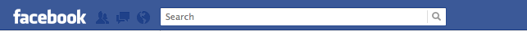


Online Spam Today
Review posted on Yelp
  Detailed content
  Even has a personal touch
Facebook profile
  Complete information
  Lots of friends
  Even married
FAKE
Stock Picture
Reviews for Brasserie Georges
Great lyonnese food: the "saucisson pistaché" is delicious.
Awesome athmosphere: everytime someone has his/her birthday, they turn the lights off and play "Happy birthday to you" while a waiter brings the birtday boy/girl an "omelette norvegienne".
FAKE
High quality fake reviews and fake accounts!
Been B.
West Lafayette
IN, USA

Slide 3
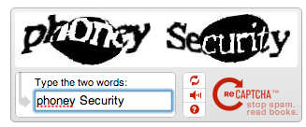
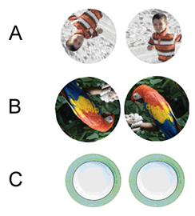
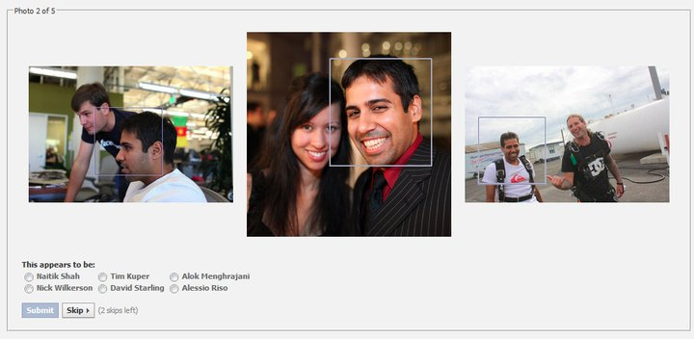
Defending Automated Spam
  Variety of CAPTCHA tests
    Read fuzzy text, solve logic questions
    Rotate images to natural orientation
    Identify friends (Social CAPTCHA)
  Detectors using behavioral models
    Detect bursts in per-IP application requests
    Detect bursts of new accounts
    Synchronized traffic from groups of accounts
Rotate below images
But what if the enemy is a real human being?
Who is tagged in the photo?

Slide 4
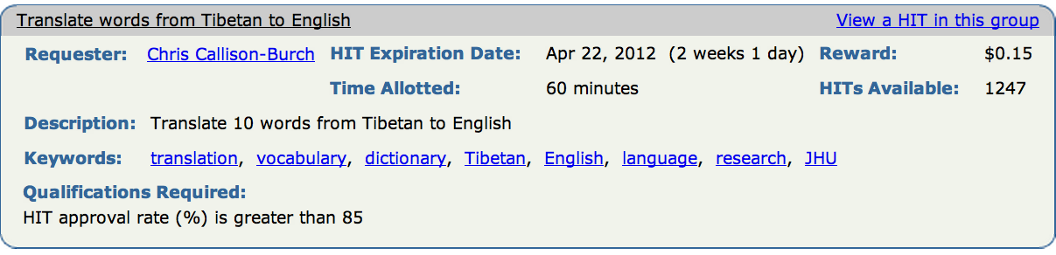
Black Market Crowdsourcing
  Online crowdsourcing (Amazon Mechanical Turk)
  Admins remove spammy jobs
NEW: Black market crowdsourcing sites
  Malicious content generated/spread by real-users
  Fake reviews, false ad., rumors, etc.
Crowdsourcing + Astroturfing = Crowdturfing

Slide 5

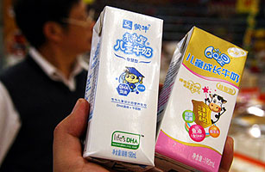
Real-world Crowdturfing
“Dairy giant Mengniu in smear scandal”
Biggest dairy company in China (Mengniu)
  Defame its competitors
  Hire Internet users to spread false stories
Impact
  Victim company (Shengyuan)
    Stock fell by 35.44%
    Revenue loss: $300 million
  National panic
M
Warning: Company Y’s baby formula contains dangerous hormones!

Slide 6
Questions Asked in Our Study…
How does crowdturfing work?
  Measure 2 largest crowdturfing sites
  Analyze growth, economics, workers, etc.
How effective is crowdturfing?
  Infiltrate the system
  Perform benign end-to-end experiment
What is next for Crowdturfing?
  Crowdturfing in US and elsewhere
  Defending against crowdturfers

Slide 7
Outline
Introduction
Crowdturfing in China
End-to-end Experiments
What’s Next

Slide 8


Crowdturfing Sites
Focus on the two largest sites
  Zhubajie (ZBJ)
  Sandaha (SDH)
Crawling ZBJ and SDH
  Details are completely open
  Complete campaign history since going online
    ZBJ 5-year history
    SDH 2-year history

Slide 9




Crowdturfing Workflow
Customers
Initiate campaigns
May be legitimate businesses
Campaign
Agents
Manage campaigns and workers
Verify completed tasks
Workers
Complete tasks for money
Control Sybils on other websites
Tasks
Reports
Company X
ZBJ/SDH
Worker Y

Slide 10
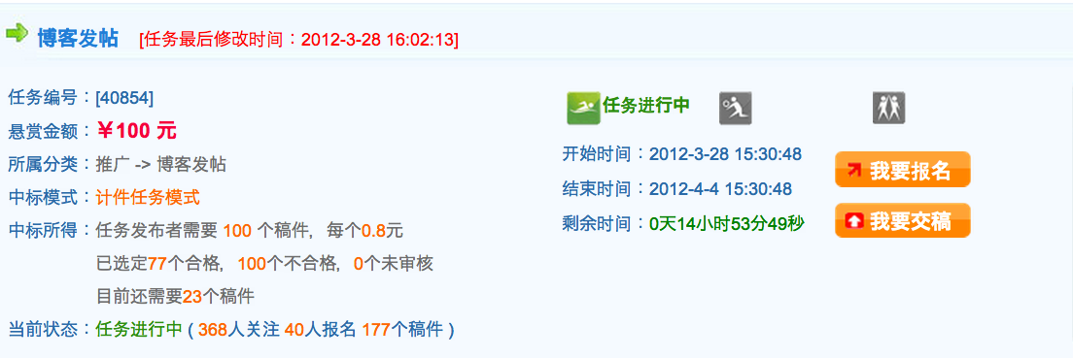

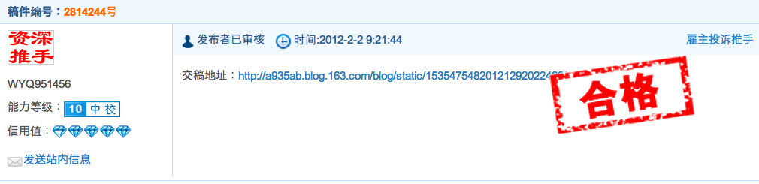

Campaign Information
Promote our product using your blog
Campaign ID
Input Money
Category
Blog Promtion
Get the Job
Rewards
Submit Report
100 tasks, each ￥0.8
77 submissions accepted
Still need 23 more
Status
Ongoing (177 reports submitted)
Check Details
Report generated by workers
Report ID
URL
Report Cheating
WorkerID
Experience
Accepted!
Reputation
Screenshot

Slide 11
High Level Statistics
Site | Active Since | Total Campaigns | Workers | Reports | $ for Workers | $ for Site
ZBJ | Nov. 2006 | 76K | 169K | 6.3M | $2.4M | $595K
10,000
1,000,000
receptif2.package@gl-events.com
100,000
1,000
ZBJ
10,000
$
1,000
$
SDH
Campaigns
Campaigns
Jan. 08
Jan. 09
Jan. 10
Jan. 11

Slide 12
Spam Per Worker
Transient workers
  Makes up majority of a diverse worker population
Prolific workers
  Major force of spam generation
Prolific workers
Large number of transient workers
ZBJ
SDH

Slide 13
Are Workers Real People?
Late Night/Early Morning
Work Day/Evening
Lunch
Dinner
ZBJ
SDH

Slide 14
Campaign Types
Top 5 Campaign Types on ZBJ
Campaign Target | # of Campaigns | $ per Campaign | $ per Spam | Monthly Growth
Account Registration | 29,413 | $71 | $0.35 | 16%
Forums | 17,753 | $16 | $0.27 | 19%
Instant Message Groups | 12,969 | $15 | $0.70 | 17%
Microblogs (e.g. Twitter/Weibo) | 4061 | $12 | $0.18 | 47%
Blogs | 3067 | $12 | $0.23 | 20%
Most campaigns are spam generation
Highest growth category is microblogging
  Weibo: increased by 300% (200 million users) in a single year (2011)
  $100 → audience of 100K Weibo users

Slide 15
Outline
Introduction
Crowdturfing in China
End-to-end Experiments
What’s Next

Slide 16

How Effective Is Crowdturfing?
What is missing?
Understanding end-to-end impact of Crowdturfing
Initiate campaigns as customer
  4 benign ad campaigns
    iPhone Store, Travel Agent, Raffle, Ocean Park
  Ask workers to promote products
Clicks?

Slide 17
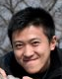





End-to-end Experiment
Campaign1: promote a Travel Agent
ZBJ (Crowdturfing Site)
Measurement
Server
Travel Agent
New Job Here!
Redirection
Check Details
Task Info
Trip Info
Great deal!
Trip to Maldives!
Workers
Create Spam
Weibo Users
Weibo (microblog)

Slide 18

Campaign Results
receptif2.package@gl-events.com
receptif2.package@gl-events.com
Campaign | About | Target | Input$ | Task/ Report | Clicks | Resp. Time
Trip | Advertise for a trip organized by travel agent | Weibo | $15 | 100/108 | 28 | 3hr
 |  | QQ | $15 | 100/118 | 187 | 4hr
 |  | Forums | $15 | 100/123 | 3 | 4hr
Averaged 2 sales/month before campaign
11 sales in 24 hours after campaign
Each trip sells for $1500
Settings:
  One-week Campaigns
  $45 per Campaign ($15 per target)
Cost per click (CPC)
  Weibo ($0.21), QQ ($0.09), Forum ($0.9)
  Price > Web display Ads ($0.01)
80% of reports are generated in the first few hours

Slide 19
Outline
Introduction
Crowdturfing in China
End-to-end Experiment
What’s Next

Slide 20
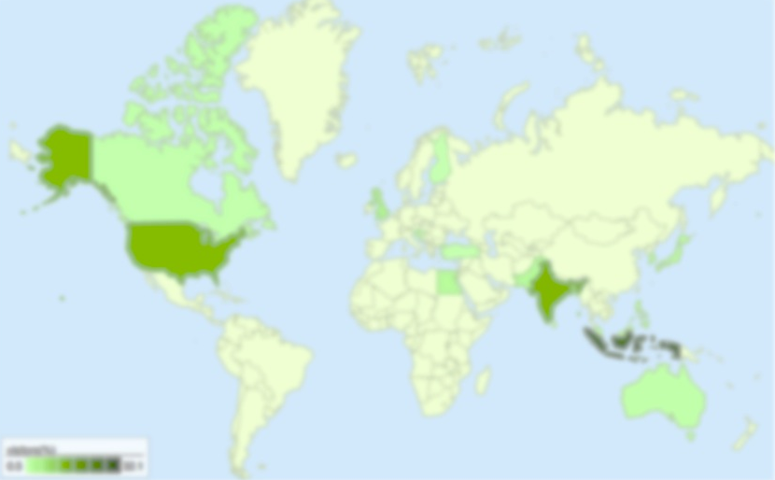
Crowdturfing in US
Sites | % Crowdturfing
MinuteWorkers | 70%
MyEasyTasks | 83%
Microworkers | 89%
ShortTasks | 95%
Growing problem in US
  More black market sites popping up
  International workers who speak English

Slide 21



Where Is Crowdturfing Going?
Growing awareness and pressure on crowdturfing
  Government intervention in China
  Researchers and media following our study
Crowdturfing sites will respond and adapt
  Hide campaign details/history
  Migrate to private communication channels
Defending against Crowdturfing will be very challenging!!

Slide 22

Ongoing Work: Defenses
Infiltrate and disrupt
  Masquerade as bad customers or workers
  Overwhelm the verifier with floods of bad reports
Detection using statistical models
  Identify patterns of workers and campaigns
  Temporal behavior models

Slide 23
Conclusion
Identified a new threat: Crowdturfing
  Growing exponentially in both size and revenue in China
  Start to grow in US and other countries
Detailed measurements of Crowdturfing systems
  End-to-end measurements from campaign to click-throughs
  Gained knowledge of social spams from the inside
Ongoing research focused on defense

Slide 24
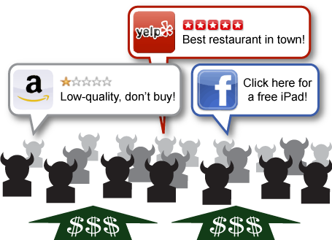
Thank you!
Questions?

