Slide 1
CCLearner: A Deep Learning-Based Clone Detection Approach
Liuqing Li, He Feng, Wenjie Zhuang, Na Meng and Barbara Ryder
{liuqing, fenghe, kaito, nm8247}@vt.edu, ryder@cs.vt.edu
Department of Computer Science
Virginia Polytechnic Institute and State University
Blacksburg, VA, USA
September 22, 2017
Notes:
Hello, everyone, thanks for your attendance. This is Liuqing Li, a second year PhD student from Virginia Tech.
Yesterday, I presented our artifact for code clone detection. Today I will talk about our research paper in detail. The title is CCLearner …
The other co-authors are …

Slide 2
Code Clone
Developers copy and paste code to improve programming productivity
Clone detections tools are needed to help bug fixes or program changes
19%
15-25%
Notes:
Code clone seems to be common in the programming process. Developers usually copy and paste code in order to improve programming productivity. In this process, they might keep the same code snippets or make some modifications.
Based on the prior research, there was about 19% duplicated code in X Window System (X11), and 15-25% duplicated code in Linux kernel. A recent study on 7,800 open-source projects written in C or C++ shows that 44% of the projects have at least one pair of identical code snippets.
Such code clones present challenges to software maintenance. For instance, when developers fix a bug in one code snippet, they may not want to use find or replace to fix the same bug in some other code snippets. Instead, clone detection tools might be needed to automatically search for other similar code snippets and help the developers consistently fix the bug in the same way. The same issue happens when t plan to change the programs

Slide 3
Related Work
Code Clone
Detection
Text-
based
Token-based
Tree-based
Metrics-based
Graph-based
Notes:
To detect those code clones, up to now, there are various clone detection tools built with carefully designed algorithms, such as text-based, token-based, metrics-based, tree-based and graph-based detection tools.
However, some algorithms work better for certain kinds of clones, but worse for the others. For instance, token-based clone detection tools are good at finding simple clones with minor differences, such as different variable names. Unfortunately, they cannot detect clones with more divergence. On the other hand, tree-based tools can detect more complicated clones, but they produce a lot of false alarms and incur high runtime overhead.

Slide 4
Research Question
How can we automatically characterize the similarity between clones?
How can we leverage the characteristics to detect clones?
Notes:
Let’s see our research questions.
In this project, we would like to investigate a new approach to detect clones without designing any complicated methods or algorithms. Instead, we would like to first automatically characterize the similarity between clones, and then leverage the characteristics to detect clones.
Different from prior work, we do not explicitly define special rules to detect clones. Instead, we rely on the inferred characteristics of clone pairs to reveal clones.

Slide 5
Methodology
Code Clone Detection Problem
Classification Problem
Notes:
How do we do that? We solved the problem from a different prospective.
Given a pair of code snippet, in order to decide whether they are clones to each other, we can convert the detection problem to a classification problem by determining whether the relationship between the snippets is clone or non-clone. In fact, we solved the problem by describing the code clones with patterns or features instead of focusing on specific algorithms.

Slide 6
Approach
Clone Pairs
Non-Clone Pairs
Training
Feature Extraction
Deep
Learning
Source code
Testing
Method Extraction
Classifier
Method Pair Enumerator
Clone Pairs
Non-Clone Pairs
Notes:
For our work, we combined the simple token-based detection with deep neural network, and designed our own tool cclearner.
Given the clone and non-clone method pairs, we extracts multiple features from each method and then describe each method pair with a similarity list and a class label. Then, we put the roughly processed training dataset into the deep learning framework to train a classifier. For testing clones in the source codes, we need to extract all the methods first, and start the pair-wise comparison. Then, convert each method pair into a similarity list and use the well-trained classifier to complete the classification task.

Slide 7
Hypothesis
Code clones are more likely to share certain kinds of tokens than other tokens
Tokens likely to be shared
Keywords, method names, …
Tokens less likely to be shared
Variable names, literals, …
Notes:
How do we describe the clone or non-clone pairs? We hypothesize that code clones are more likely to share certain types of tokens than other tokens. This is our assumption.
For instance, after copy and pasting code, developers probably rename variables or literals. However, based on our experience, they seldom modify the program structure and change the set of keywords or method names used.
Therefore, we extract these raw features to describe the clone and non-clone pairs.

Slide 8
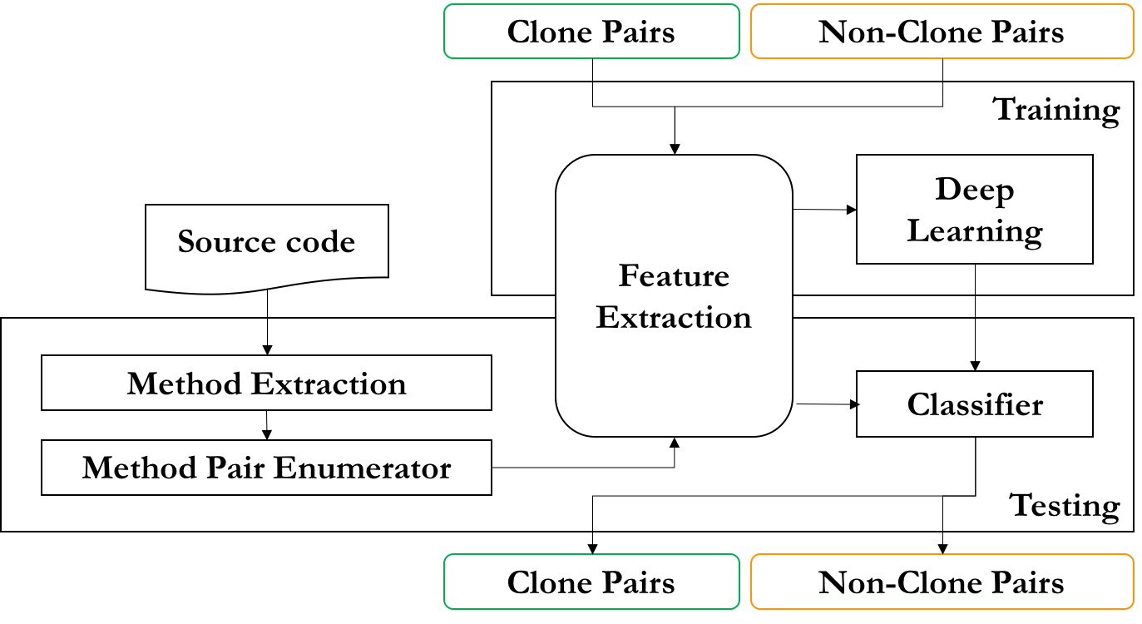
Feature Extraction
A method pair
method_{A}
method_{B}
token_freq_list_{A}
[token_freq_cat_{A1}, …, token_freq_cat_{A8}]
Category Name | Example | Category Name | Example
Reserved words | <if, 2> | Type identifiers | <URLConnection, 1>
Operators | <+=, 2> | Method identifiers | <openConnection, 1>
Markers | <;, 2> | Qualified names | <arr.length, 1>
Literals | <1.3, 2> | Variable identifiers | <conn, 2>
Notes:
Let’s go through the whole pipeline.
Given a method pair method A and method B. Let’s focus on method A first. We leverage Anltr Lexer and Eclipse AST Parser to extract all the tokens from method A, and create a token-frequency list.
For the clone pairs, intuitively, we believe some types of the tokens are more likely to be shared like reserved words and method identifiers. Therefore, we divide the tokens into 8 categories. The table below shows all 8 category names and examples. Each category list is still a token-frequency list and finally method A can be represented as a 8 dimensional vector

Slide 9
Feature Extraction
A method pair
method_{A}
method_{B}
token_freq_list_{A}
token_freq_list_{B}
[token_freq_cat_{A1}, …, token_freq_cat_{A8}]
[token_freq_cat_{B1}, …, token_freq_cat_{B8}]
[sim_score₁ , . . . , sim_score₈]
Notes:
Then, method B will be processed in the same way. After the above steps, we convert method A and B into two vectors, each of which has 8 dimensions. Later, we create our own strategy to calculate the similarity score for each dimension. Finally, we leverage a similarity vector to describe the given method pair. For calculating the similarity scores, please refer to our paper to get more details.

Slide 10
Training
Input
Clones
Non-clones
Training Process
DeepLearning4j*
Output
A well-trained classifier (.mdl)
<[sim_score₁ , . . . , sim_score₈], 1>
<[sim_score₁ , . . . , sim_score₈], 0>
* “Deeplearning4j,” http://deeplearning4j.org/, accessed: 2017-09-04
Notes:
Compared with feature extraction, training process seems much easier. The training data should be tagged as true or false, which represent the clone pairs or non-clone pairs.
Then, we dump all the data into DeepLearning4j, a deep learning framework based on Java, and train the classifier by using deep neutral network. Once the model is generated, it can be saved as a file and reused next time.

Slide 11
Testing
Input
A codebase
Output
2 nodes in DNN
Predict the likelihood of clones and non-clones
Challenges
Time cost O(n²)
Solution
Two filters
Notes:
Let’s go to testing.
Given a code base, cclearner gets all the methods, generate the method pairs and convert them into similarity vectors.
Then, the vectors will be the input of the classifier. There are two nodes for output, which separately predict the likelihood of clones and non-clones.
We need to do pair-wise comparison between methods in the codebase. Given n methods, the computation complexity is O(n^2), which is time-consuming. Therefore, we designed and implemented two filters to reduce pairwise comparison and speed up the clone detection process.
First, if the length of one method is three times larger than the length of the other, they are unlikely to be the clone candidate, so we skip the comparison.
Second, to be the same with the other popular tools, we skip the comparison if the lines of code in one method is less than 6.

Slide 12
Evaluation
Benchmark: BigCloneBench*
10 source code folders
Clone Type: T1, T2, VST3, ST3, MT3 and WT3/4
Data Set Construction
Training Data (Folder #4)
T1, T2, VST3 and ST3 clones
Randomly choose a subset of false clone pairs
Testing data (Other 9 folders)
All source files
* Jeffrey Svajlenko, Judith F. Islam, Iman Keivanloo, Chanchal K. Roy and Mohammad Mamun Mia, "Towards a Big Data Curated Benchmark of Inter-Project Code Clones", In Proceedings of the Early Research Achievements track of the 30th International Conference on Software Maintenance and Evolution (ICSME 2014), 5 pp., Victoria, Canada, September 2014.
Notes:
To evaluate cclearner, we leverage an existing benchmark BigCloneBench, which was once created by our chair’s research group. The codebase in the benchmark has 10 source code folders, each of which has a huge number of java source files. The database in the benchmark contains the tagged true and false clone pairs with different clone types, where the type 3 and type 4 have been redesigned by using similarity. The new types here are Type-1, Type-2, Very Strongly Type-3 (VST3), Strongly Type-3 (ST3), Moderately Type-3 (MT3) and Weakly Type-3/Type-4.
As I mentioned before, cclearner has the training and tesing stages. We chose one big folder (folder #4) for training. For the true clone pairs, we selected T1, T2, VST3, and ST3 the 4 types of clones. Meanwhile, we randomly built a subset of false clone method pairs from the same folder. Both true and false dataset have the same number of method pairs.
All source files in the other 9 folders are used for testing.

Slide 13
Evaluation
Recall
Precision
F-score
$$R_{T1−ST3}=\frac{\# of true clone pairs \left(of T1−ST3\right) }{Total \# of known true clone pairs \left(of T1−ST3\right)}$$
$$P_{estimated}=\frac{\# of true clone pairs}{385 detected clone pair samples}$$
$$F_{T1−ST3}=\frac{2∗P_{estimated}∗R_{T1−ST3}}{P_{estimated}+R_{T1−ST3}}$$
Notes:
We defined and calculated the following metrics to evaluate the effectiveness of several clone detection approaches.
Because the methods in MT3, WT3/T4 clones are usually less similar to each other, it is a bit difficult for us to verify these clones. Similar to prior work, we only leveraged T1-ST3 clones in our recall evaluation.
To properly evaluate the precision, sampling is needed. We randomly sampled the detected clone pairs, and manually examined the method pairs. To ensure that our sampled data is representative, we chose 385 detected clones for each approach. With a huge number of clone pairs, 385 is a statistically significant sample size with a 95% confidence level and plus or minus 5% confidence interval.
Here we redefine the F-score. It is the harmonic mean of the estimated precision and T1-ST3 recall rate to measure the overall accuracy of clone detection.

Slide 14
Evaluation
Inter-comparison Results
 | CCLearner | SourcererCC | NiCad | Deckard
T1 | 100 | 100 | 100 | 96
T2 | 98 | 97 | 85 | 82
VST3 | 98 | 92 | 98 | 78
ST3 | 89 | 67 | 77 | 78
$Recall$ (%)
$P_{estimated}$ (%)
CCLearner | SourcererCC | NiCad | Deckard
93 | 98 | 68 | 71
$F_{T1−ST3}$ (%)
CCLearner | SourcererCC | NiCad | Deckard
93 | 88 | 76 | 77
Notes:
For the inter-comparison, we compared CCLearner with three other popular clone detection tools. SoucererCC is a token-based detection tool, NiCad is text-based and Deckard is tree-based.
The tables shows our cclearner detected clones more accurately than other tools because its F-score was the highest, which means that cclearner has both high estimated precision and high T1-ST3 recall rate. Here, we also calculated the recall rate separately, CCLearner performed well in each type.
As you may know there is another deep-learning based code clone detection approach, which was published on ASE 2016 but different from CCLearner. Thus, we contacted the authors and hoped to compare CCLearner with their tool, but failed to get their code.
For the intra-comparison, due to the limited time, please refer to our paper.

Slide 15
Conclusion
Novel Approach
Use deep learning to characterize and detect clones
Comprehensive Empirical Study
Compare CCLearner with existing tools
Evaluate the importance of different features
E.g., reserved words, type identifiers, and method identifiers
Notes:
We believe CCLearner is a novel approach. We do not design algorithms for similarity detection, instead, extract different token features and rely on deep learning to characterize the clones, and then use the characteristics to detect clones.
Moreover, we conduct a comprehensive empirical study with CCLearner in two ways. First, we compared with several popular tools on a third-party data set called BigCloneBench, and observed that CCLearner obtains the best F-score. Second, we evaluated our tool with different settings, including the number of training iteration, the number of hidden layers and so on. Finally, we found that the usage of reserved words, type identifiers, and method identifiers seems to be more important than the others in the cloned snippets.
For the future work, we will mainly work on the following two parts. One is to leverage deep learning framework to automatically extract the clone-related features, the other is to compare our tool with some other machine learning approaches.

Slide 16
Thank you ! Questions?
http://people.cs.vt.edu/~liuqing/
https://github.com/liuqingli/CCLearner
https://goo.gl/k6rjDn
Notes:
If you want to rerun our experiments to check the results or need to compare any code clone detection tools with CCLearner, it is easy to download CCLearner by following the two links here. For more details, you can refer to our paper or feel free to contact our group. I will also share the slides on my webpage.
Thanks for your attention and any questions?

Slide 17
Backup

Slide 18
Backup

Slide 19
Backup

Slide 20
Backup

Slide 21
Backup

Slide 22
Backup

Slide 23
Backup

Slide 24
Backup

