Slide 1
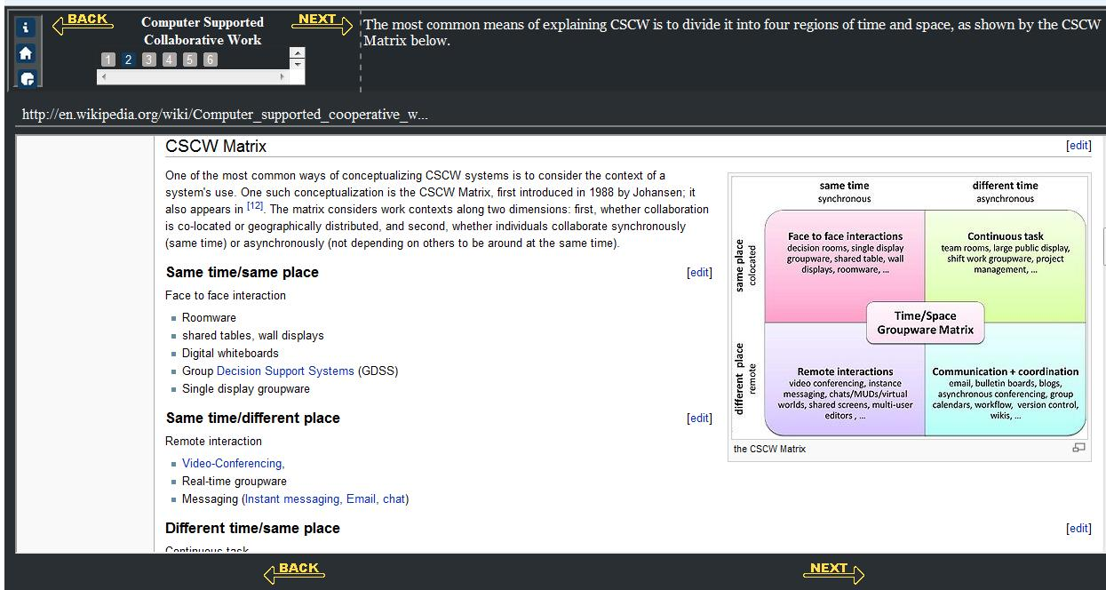
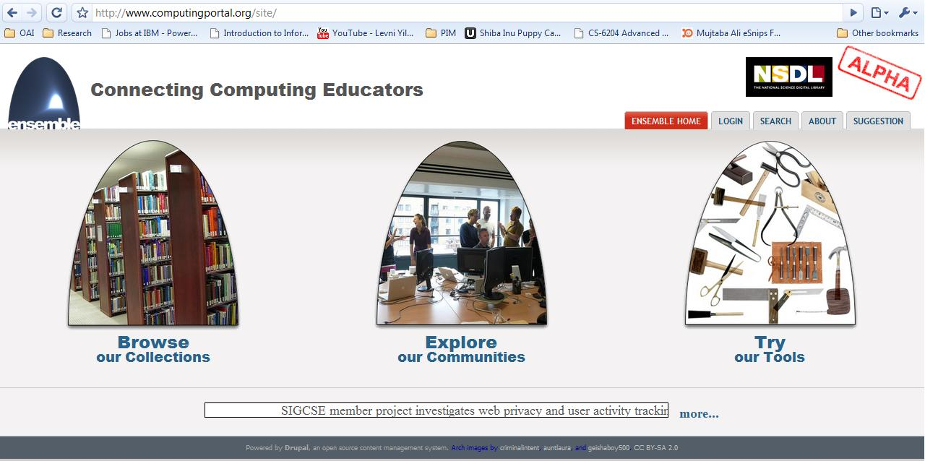
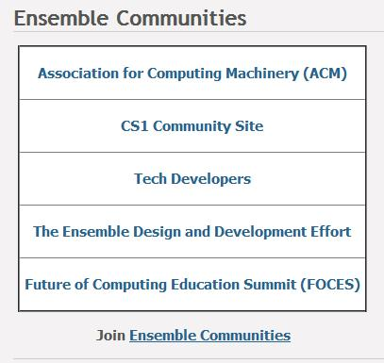
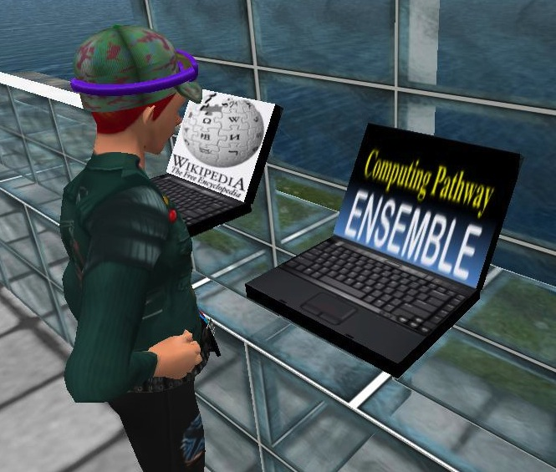
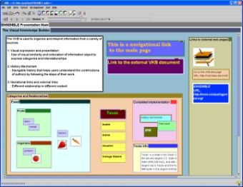
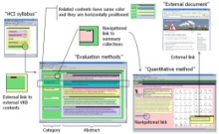
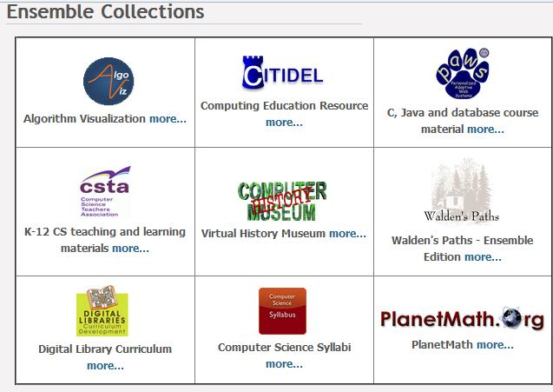
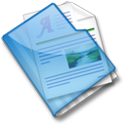
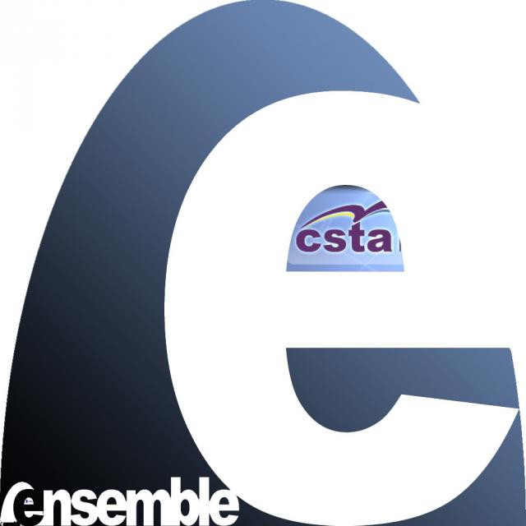
Ensemble:
Enriching Communities and Collections to Support Education in Computing
Monika Akbar, Yinlin Chen, Michael Stewart, Edward A. Fox, Clifford A. Shaffer, Stephen H. Edwards, Patrick Fan.
Department of Computer Science, Virginia Tech
Email: {amonika, ylchen, tgm, fox, shaffer, edwards, wfan}@vt.edu
Ensemble
NSF’s National Science Digital Library (NSDL) pathway project for computing education
Provides access to a broad range of computing education materials.
Allows users to share and adopt content, and to deploy and discuss teaching/learning resources.
Explore
Try
Computing Educators Communities
Create a community of users.
Connect to other education communities, platforms (Second Life), and social networking sites (Facebook).
Facilitate access to the portal (OpenID).
Reward and encourage social network behavior and contributions.
Knowledge Building Tools
WALDEN'S path – Organize and annotate web resources for others.
Visual Knowledge Builder (VKB) – Collect and organize resources in a hierarchy of 2D workspaces.
Services
Develop Collections – Find existing resources and
make them accessible.
Portal – Support communities in tailored ways to add
value and integrate with additional content and
services.
General Services – Searching, browsing, tagging,
forum, blog, group, recommending, and other services.
Content management – Create, share, accumulate,
preserve, and cross-reference material.
Browse
Education Materials Collections
Harvest and integrate content from diverse communities.
Cross-reference and index, using a growing and more integrated computing-wide ontology.
Facilitate ease of access to resources for computing educators.
Support searching, browsing, recommending, and other services.
AlgoViz
Computer History Museum
CSTA
Digital Libraries
A Web Repository of K-12 Computer Science Teaching and Learning Materials
Digital Libraries Curriculum Resources
Visualization for algorithms and data structures.
Computer Science Virtual History Museum
Syllabi
Syllabus collection: from computer science syllabi available on the Web
Computing and Information Technology Interactive Digital Educational Library
CITIDEL
Collections
Browse
Edit
Search
Share
Communities
http://www.computingportal.org
Grant Number: NSF DUE-0840719

