Slide 1
Hierarchical Trust Management for Wireless Sensor Networks and its Applications to Trust-Based Routing and Intrusion Detection
Presented by:
Vijay Kumar Chalasani

Slide 2
Introduction
This paper proposes “hierarchical trust management protocol”
Key design issues
Trust composition
Trust aggregation
Trust formation
Highlights of the scheme
Considers QoS trust and social trust
Dynamic learning
Validation of objective trust against subjective trust
Application level trust management

Slide 3
System Model
Cluster based WSN (wireless sensor network)
SN → CH → base station or sink or destination
Two level hierarchy
SN level
CH level
At SN level
Periodic peer to peer trust evaluation with an interval Δt
Send SN_{i}-SN_{j} trust evaluation result to CH

Slide 4
System Model
At CH level
Send CH_{i}-CH_{j} trust evaluation result to base station
Evaluate CH – SN trust towards all SNs in the cluster
Trust metric
Social trust : intimacy, honesty, privacy, centrality, connectivity
QoS trust : competence, cooperativeness, reliability, task completion capability, etc.
In this paper, intimacy and honesty are chosen to measure social trust. Energy and unselfishness are chosen to measure QoS trust.

Slide 5
Hierarchical Trust Management Protocol
Two levels of trust : SN level and CH level
Evaluations through
Direct observations
Indirect observations
Trust components : intimacy, honesty, energy, and unselfishness
T_{ij} = w₁T_{ij}^{intimacy} (t) + w₂T_{ij}^{honesty} (t)
+w₃T_{ij}^{energy} (t) + w₄T_{ij}^{unselfishness} (t)
w₁+w₂+w₃+w₄ = 1

Slide 6
Hierarchical Trust Management Protocol (cont.)
Peer to Peer Trust evaluation
For 1-hop neighbors
T_{ij}^{X} (t)= (1-α) T_{ij}^{X} (t- Δt) + α T_{ij}^{X,direct}
= trust based on past experiences + new
trust based on direct observations
(0 ≤ α ≤ 1) (decay of trust)
Otherwise
T_{ij}^{X} = avg_{k∈Ni} {(1-ϒ) T_{ij}^{X} (t- Δt) + ϒT_{kj}^{X,recom} (t) }

Slide 7
Obtaining trust component value T_{ij}^{X,direct} for 1-hop neighbors
T_{ij}^{intimacy, direct} (t) :
Ratio of # of interactions between i and j in (0, t) & # of interactions between i and any other node in (0, t)
T_{ij}^{honesty, direct} (t) :
Measured based on count of suspicious dishonest experiences
‘0’ when node j is dishonest
1-ratio of count to threshold

Slide 8
Obtaining trust component value T_{ij}^{X,direct} for 1-hop neighbors
T_{ij}^{energy, direct} (t) :
By keeping track of j’s remaining energy
T_{ij}^{unselfishness, direct} (t) :
By keeping track of j’s selfish behaviour

Slide 9
Obtaining trust component values for the nodes that are not 1-hop neighbors
T_{ij}^{X} (t)=avg_{k∈Ni} {(1-ϒ) T_{ij}^{X} (t- Δt) + ϒT_{kj}^{X,recom} (t) }
Past experiences + recommendations of 1-hop neighbors
ϒ = $\frac{β\text{T}\text{i}\text{k}\text{ (}\text{t}\text{)}}{1+β\text{T}\text{i}\text{k}\text{ (}\text{t})}$ ………..trust decay over time
$\text{T}\text{ik}\text{ (}\text{t}\text{)}$ is node i’s trust over k as recommender
$β≥0$ , specifies the impact of indirect recommendations

Slide 10
Trust Evaluations
CH to SN trust evaluation:
If T_{cj} (t) less than T^{th} , then node j is compromised else j is not compromised
CH also determines from whom to take trust recommendations
Station to CH trust evaluation:
Same fashion as of the above evaluation

Slide 11
Performance Model
Probability model based on SPN
Obtain objective trust
ENERGY
Indicates the remaining energy level
T_ENERGY
Rate of transition T_ENERGY is energy consumption rate
Energy

Slide 12
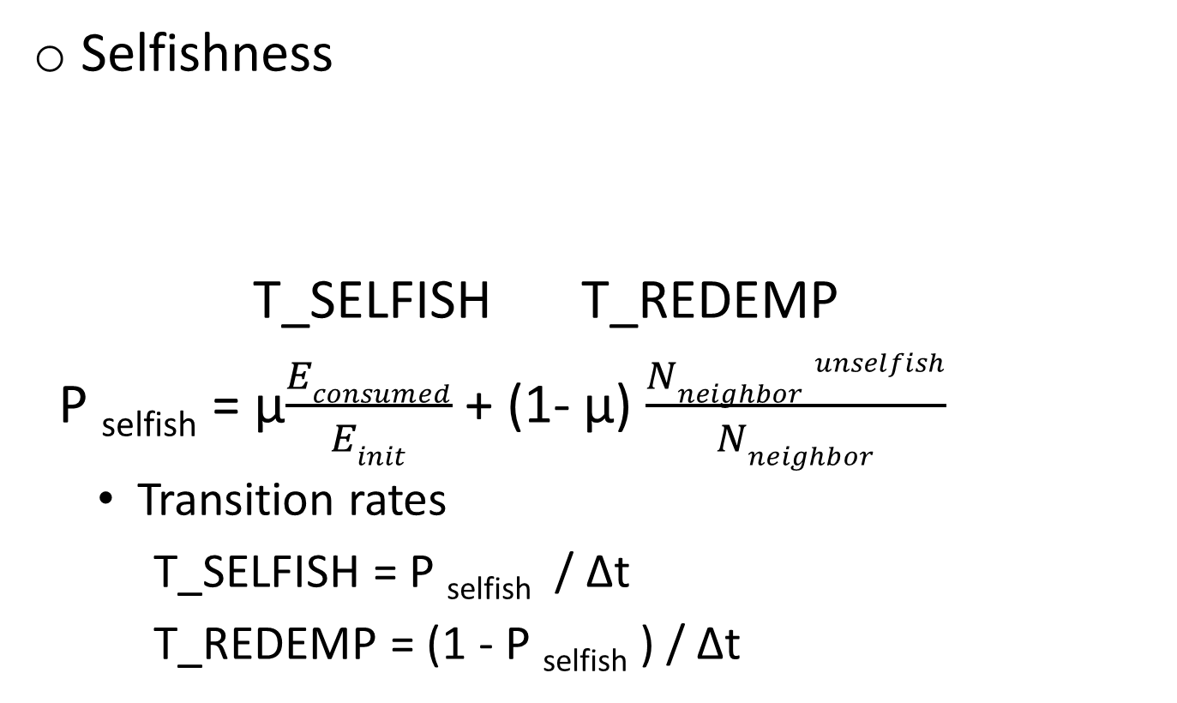
Performance Model
Selfishness
T_SELFISH T_REDEMP
P _{selfish} = µ$\frac{Econsumed}{Einit}$ + (1- µ) $\frac{Nneighbor unselfish}{Nneighbor}$
Transition rates
T_SELFISH = P _{selfish} / Δt
T_REDEMP = (1 - P _{selfish} ) / Δt
SN

Slide 13
Performance Model
Compromise
T_COMPRO
T_IDS
rate of T_COMPRO , λ = λ_{c-init} (#compromised 1-hop neighbors/#uncompromised 1-hop neighbors)
CN
DCN

Slide 14
Subjective trust evaluation
T_{ij}^{X,direct} (t) is close to actual status of node j at time t
T_{ij}^{honesty,direct} (t):
Status value of ‘0’ if j is compromised in that state. Else ‘1’
T_{ij}^{energy,direct}(t) :
Status value of Energy/E_{init}
T_{ij}^{unselfishness,direct}(t) :
Status value of ‘0’ if j is selfish in that state. Else ‘1’

Slide 15
Subjective Trust evaluation
T_{ij}^{intimacy,direct}(t) :
Is not directly available from state representations
Calculated based on interactions like : Requesting, Reply, Selection, Overhearing
If a, b, c are average # interactions with selfish node, compromised node , normal node respectively
a = 25% * 50% *3 + 25% *2 + 25% *2
b = 0 + 25% *2
c = 25% *3 + 25% *2
Status value a/c is given to states in which j is selfish. status value b/c is given to states in which j is compromised and c/c (1) to states where j is normal

Slide 16
Objective trust evaluation
Objective trust is computed based on the actual status as provided by the SPN model
T_{j,obj}(t) = w₁T_{j,obj}^{intimacy} (t) + w₂T_{j,obj}^{honesty} (t)
+w₃T_{j,obj}^{energy} (t) + w₄T_{j,obj}^{unselfishness} (t)
The objective trust components reflect node j’s ground truth status at time t

Slide 17
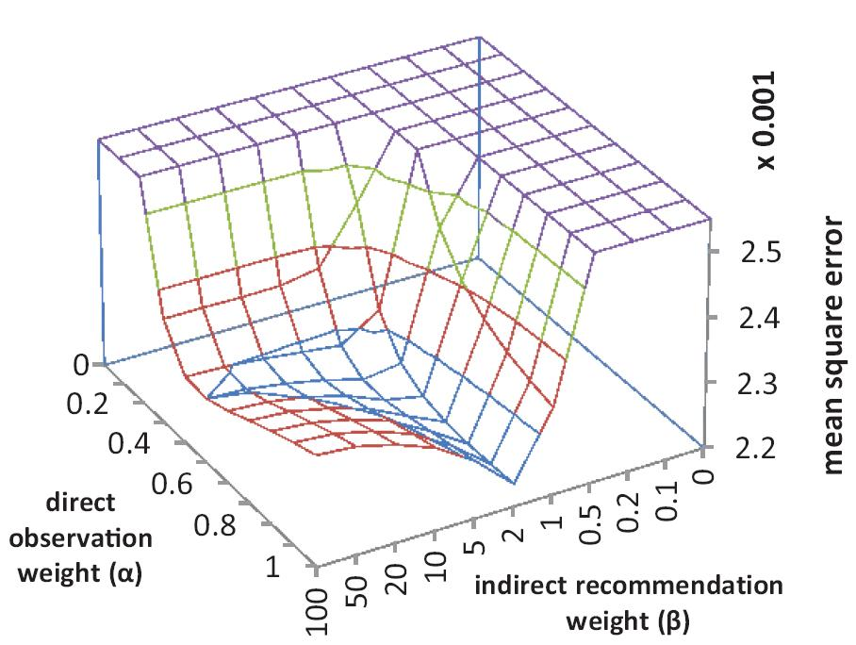
Trust Evaluation Results
Here, graph is plotted for X = intimacy
As α increases, sbj trust approaches obj trust initially. But deviates after cross over
As β increases, sbj trust approaches obj trust initially. But deviates more after cross over
best α, β values depend on nature of each trust property and given set of parameter values.

Slide 18
Trust Based Geographic Routing
Geographic Routing: A node disseminates a message to L neighbors closest to the destination
In trust based Geographic routing, not only closeness but also trust values are taken into account

Slide 19
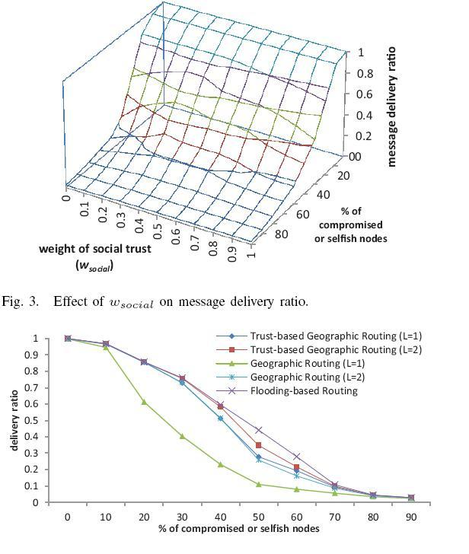
Trust Based Geographic Routing
Assuming weights assigned to social trust properties are same (similar assumption to Qos trust)
Balance between W_{social} & W_{QoS}
It can dynamically adjust W_{social} to optimize application performance

Slide 20
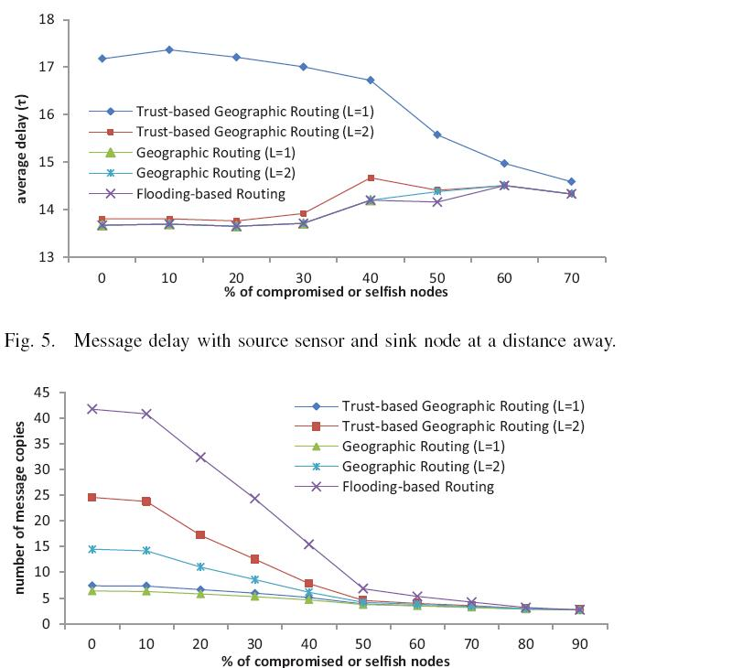
Trust Based Geographic Routing: performance comparison
Delay increases with increase of compromised nodes
Message delay in GR is less than Message delay in Trust based GR
Trust base GR has more message overhead as compared to traditional GR
# messages propagated = 3 when compromised or selfish nodes are >80%

Slide 21
Trust Based Intrusion Detection
Based on the idea of minimum trust threshold
CH evaluates a SN with the help of trust evaluations received from the other SNs
Considering trust value towards node j a random variable
$$xj(t)=\frac{ \overline{Tij(t)}\text{ - µ}\text{j}\text{(}\text{t}\text{)}}{Sj(t)/\sqrt{n}}$$
(n sample values of T_{ij}(t) are provided by n SNs)
$\overline{Tij(t)}$ , $Sj(t$), and $\text{µ}\text{j}\text{(}\text{t}\text{)}$ are sample mean, sample standard deviation, and true mean respectively

Slide 22
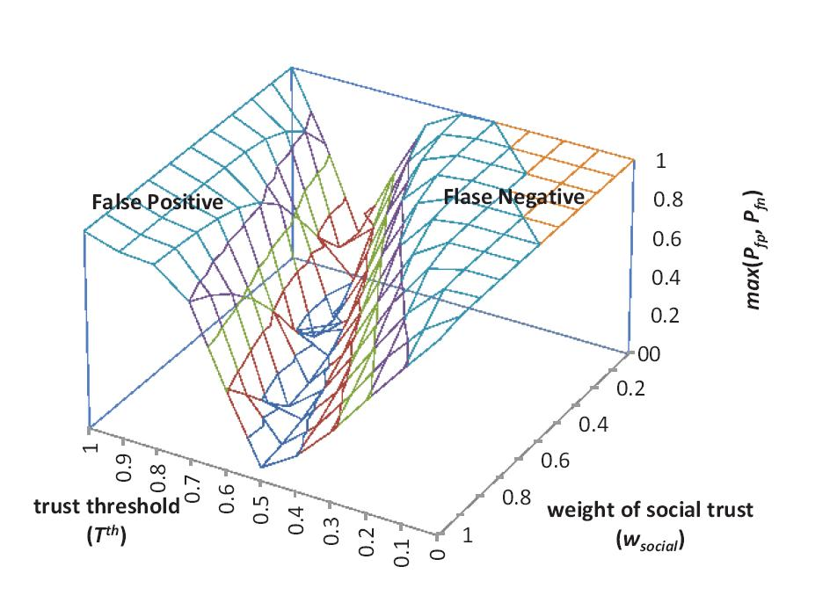
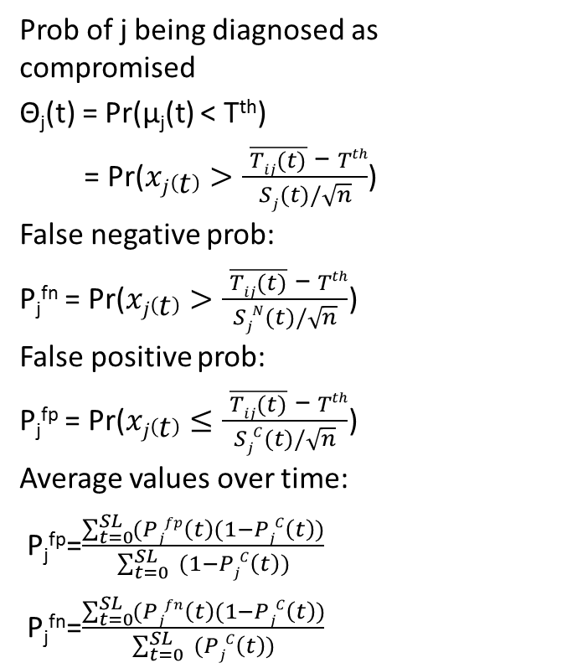
Trust Based Intrusion Detection
Prob of j being diagnosed as compromised
Θ_{j}(t) = Pr($\text{µ}\text{j}\text{(}\text{t}\text{)}$ < T^{th})
= Pr($xj\left(t\right)>\frac{ \overline{Tij(t)}\text{ − }Tth}{Sj(t)/\sqrt{n}}$)
False negative prob:
P_{j}^{fn} = Pr($xj\left(t\right)>\frac{ \overline{Tij(t)}\text{ − }Tth}{SjN(t)/\sqrt{n}}$)
False positive prob:
P_{j}^{fp} = Pr($xj\left(t\right)≤\frac{ \overline{Tij(t)}\text{ − }Tth}{SjC(t)/\sqrt{n}}$)
Average values over time:
P_{j}^{fp}=$\frac{\sum_{t=0}^{SL}{(Pjfp\left(t\right)(1−PjC\left(t\right))}}{\sum_{t=0}^{SL}{ (1−PjC\left(t\right))}}$
P_{j}^{fn}=$\frac{\sum_{t=0}^{SL}{(Pjfn\left(t\right)(1−PjC\left(t\right))}}{\sum_{t=0}^{SL}{ (PjC\left(t\right))}}$

Slide 23
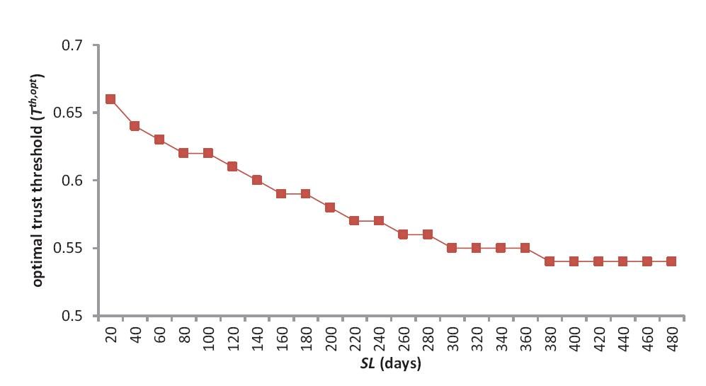
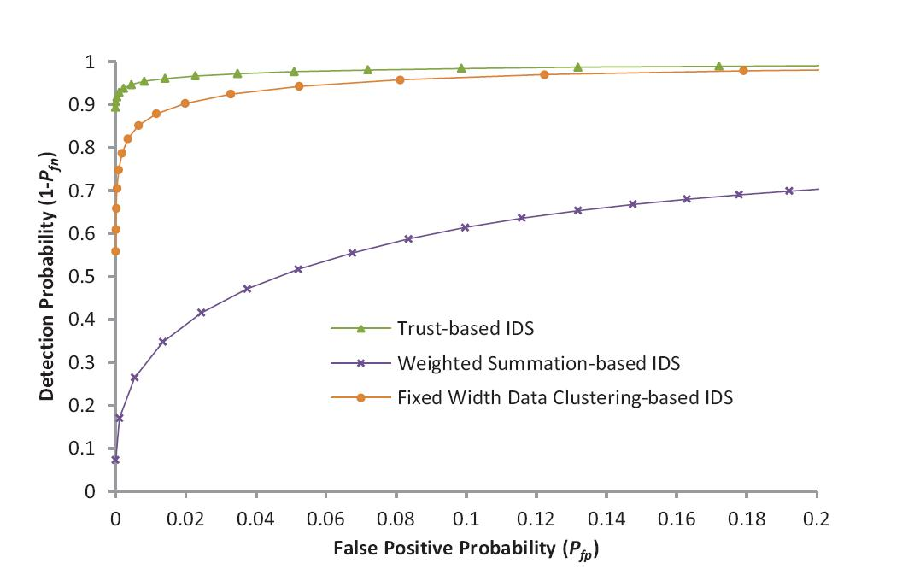
Trust Based Intrusion Detection: Comparisons

Slide 24
Conclusion
Approach considered two aspects of trustworthiness : Social and QoS
Made use of SPN to analyze and validate protocol performance
Comparisons are made with other techniques

