Slide 1
Parameterizing Moving Target Defenses
Lei Zhang and Wei Wang
Nov. 10th, 2016

Slide 2
Content
Introduction
Literature Search
Model
Experiments & Evaluation
Q&A

Slide 3
Introduction
This paper proposes “MTD modeling and evaluation”
Two Methods
Closed-Form Mathematical Model
Stochastic Petri Net
Some results (Cross-validation)

Slide 4
Introduction - MTD
MTD: Moving Target Defense
A class of methods that protect web servers or operator workstations from attacks and probing

Slide 5
Introduction - MTD
Main idea:
Controlling change across multiple system dimensions in order to increase uncertainty and apparent complexity

Slide 6
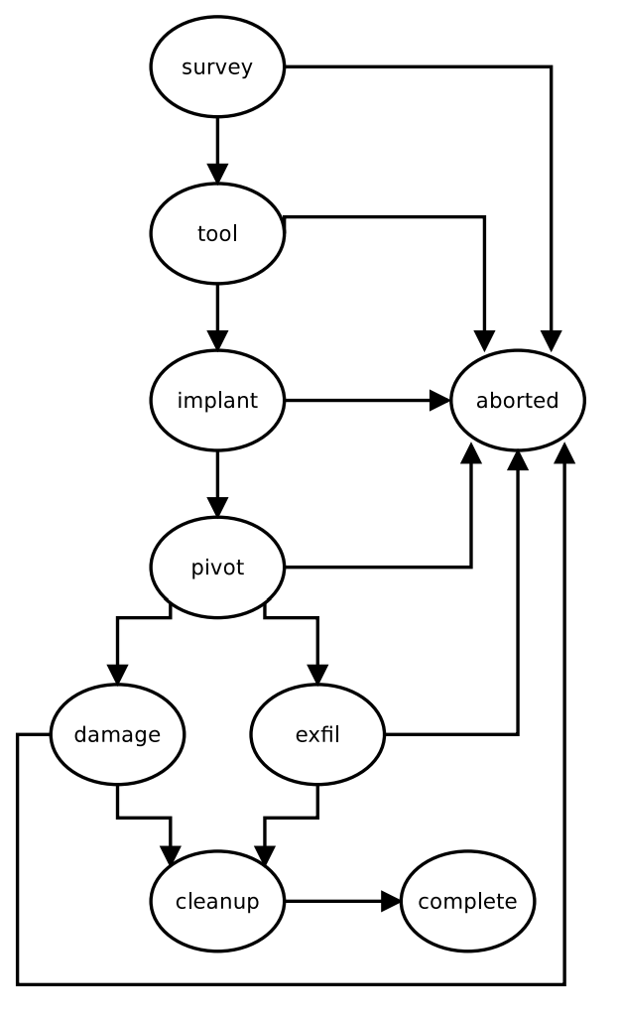
Introduction – Attack sequence
1. Survey:
identifies the key locations for the attack:
vulnerable node
critical nodes
intermediate nodes Survey data may include host name, subnet, network address, MAC address, operating system and security and application software

Slide 7
Introduction – Attack sequence
2. Tool
configures existing attack tools
creates new tools

Slide 8
Introduction – Attack sequence
3. Implant
establishes a presence on the defender system. This could be from attacking a webserver, phishing a human operator or tasking an insider

Slide 9
Introduction – Attack sequence
4. Pivot
attacker will transition from the entry node to the critical node

Slide 10
Introduction – Attack sequence
5. Damage/exfiltration
perform some application specific action to disrupt the defender’s core mission
transfer the defender’s critical data

Slide 11
Introduction – Attack sequence
6. Cleanup activities
remove all artifacts from the attack (e.g., registry entries, covert file systems or tainted applications or libraries)

Slide 12
Introduction – MTD
Intrusion preventions across Five stages:
1. Survey phase: distorts the adversary’s picture of the protected resource
2. Tooling phase: prompts the attacker to spend time and money developing exploits for multiple platforms

Slide 13
Introduction – MTD
3. Implant phase: it stops the adversary from placing and persisting malware in the.
4. Pivoting phase: it obscures the identity of the true target.
5. Exfiltration phases, it complicates the damage and

Slide 14
Literature Search
There is a lack of progress in MTD modeling and evaluation to test the effectiveness of MTD techniques.
There are still several papers tried to assess MTD (by different definitions) for different aspects using different methods.

Slide 15
Literature Search
J. Hong and D. Kim, “Assessing the Effectiveness of Moving Target Defenses using Security Models,” IEEE Transactions on Dependable and Secure Computing, vol. PP, no. 99, pp. 1–1, 2015.
Method: Hierarchical Attack Representation Model (HARM)
Metrics: risk (unitless), probability of attack success and reliability
Definition: shuffling, diversity or redundancy
Comment: closed-form mathematical model we propose is more intuitive

Slide 16
Literature Search
M. P. Collins, “A Cost-Based Mechanism for Evaluating the Effectiveness of Moving Target Defenses,” in Decision and Game Theory for Security, ser. Lecture Notes in Computer Science, J. Grossklags and J. Walrand, Eds., 2012, vol. 7638, pp. 221–233.
Method: game theoretic analysis
Definition: permutation, ephemeralization and replication techniques
Comment: while this works well for network based MTDs, the model we propose can analyze both network based and host based MTDs

Slide 17
Literature Search
D. Evans, A. Nguyen-Tuong, and J. Knight, “Effectiveness of Moving Target Defenses,” in Moving Target Defense, ser. Advances in Information Security, S. Jajodia, A. K. Ghosh, V. Swarup, C. Wang, and X. S. Wang, Eds., 2011, vol. 54, pp. 29–48.
Definition: MTD utilized against various attack classes.
Comment: While their investigation focuses on evaluating dynamic runtime environment and dynamic application code and data based MTDs, our proposal in addition can analyze dynamic platform MTDs

Slide 18
Literature Search
H. Okhravi, et. al, “Quantitative Evaluation of Dynamic Platform Techniques as a Defensive Mechanism,” in Research in Attacks, Intrusions and Defenses, ser. Lecture Notes in Computer Science, A. Stavrou, H. Bos, and G. Portokalidis, Eds., 2014, vol. 8688, pp. 405–425.
Definition: DPT based MTD: Diversity, multi-instance, limited duration and cleanup
Comment: parameterize the attacker based on how long they seek to disrupt the protected resource, we parameterize the attacker based on how long they seek to persist on the protected resource and how well skilled the attacker is

Slide 19
Literature Search
K. Zaffarano, J. Taylor, and S. Hamilton, “A Quantitative Framework for Moving Target Defense Effectiveness Evaluation,” in Second ACM Workshop on Moving Target Defense, ser. MTD ’15, Denver, CO, USA, October 2015, pp. 3–10.
Method: Confidentiality, Integrity, Availability (CIA) model
Metrics: productivity, success, confidentiality and integrity
Definition: productivity, success, confidentiality and integrity

Slide 20
Literature Search
M. Crouse, B. Prosser, and E. W. Fulp, “Probabilistic Performance Analysis of Moving Target and Deception Reconnaissance Defenses,” in Second ACM Workshop on Moving Target Defense, ser. MTD ’15, Denver, CO, USA, October 2015, pp. 21–29.
Metrics: probability of success
Definition: movement or deception
Comment: The drawback is that good data for survey activity is hard to come by because of the large amount of noise from legitimate scanning and recreational hacking

Slide 21
Literature Search
R. Zhuang, S. A. DeLoach, and X. Ou, “A Model for Analyzing the Effect of Moving Target Defenses on Enterprise Networks,” in 9th Annual Cyber and Information Security Research Conference, ser. CISR ’14, Oak Ridge, TN, USA, April 2014, pp. 73–76.
Method: Consider attack interval, adaptation interval, number of nodes, adaptations per adaptation interval and attack success likelihood
Comment: does not consider a persistent attacker. In contrast, our study focuses on the attacker who persists on the target system for a long time.

Slide 22
Literature Search
J. Xu, P. Guo, M. Zhao, R. F. Erbacher, M. Zhu, and P. Liu, “Comparing Different Moving Target Defense Techniques,” in First ACM Workshop on Moving Target Defense, ser. MTD ’14, Scottsdale, AZ, USA, November 2014, pp. 97–107.
Method: attack based experiments, probability models, simulation based evaluation and hybrid approaches
Definition: software based diversification, runtime based diversification, communication diversification and DPTs
Comment: different methods. We used two methods.

Slide 23
Model
Two DPT-based MTD Model
Closed-Form Mathematical Model
Stochastic Petri Net (SPN) Model
Modeling and Evaluation Two Model for the purpose of Cross-Validation

Slide 24
Model
DPT-based MTD Models
DPT: Dynamic Platform Techniques
Techniques that change platform properties (e.g., CPU, OS) dynamically. This can include the OS version, CPU architecture, OS instance, platform data format, etc.

Slide 25
Model - Assumption
A persistent attack that takes a certain amount of time and can be resumed
The attacker must implant some malware and persist on a targeted host
Detecting and attributing an attacker will deter further efforts
A nondeterministic implant detection process
Notes:
nondeterministic algorithm is an algorithm that, even for the same input, can exhibit different behaviors on different runs, as opposed to a deterministic algorithm.

Slide 26
Model 1: Closed-Form Model
Intuitively, the probability a cyber attack will succeed is the probability an exploit is available for the target (1st term) multiplied by the likelihood the implemented technique is successful (2nd term)
Two simplifying assumption:
The probability an exploit is available is the same for all configurations
Configurations are distributed uniformly so the attacker will need to wait out half of the configurations on average
Notes:
An equation is said to be a closed-form solution if it solves a given problem in terms of functions and mathematical operations from a given generally-accepted set. For example, an infinite sum would generally not be considered closed-form.

Slide 27
Model 1: Closed-Form Model

Slide 28
Model 2: SPN Model
SPN Model
A continuous-time semi-Markov process with state PID, PSI1, PSI200, PCAS
PID – Binary
1: detected attacker
0: attacker is undetected
PCAS – Binary
1: cyber attack succeed
0: other

Slide 29
Model 2: SPN Model
PSI1 – No. of implanted malware
PSI200 – No. of implanted malware divided by 200
PID is absorbing state because attackers want to avoid cost, and will abort attack after being detected
PCAS is absorbing state because attackers will end the mission once accomplish objectives

Slide 30
Model 2: SPN Model
Initial state (0, 0, 0, 0)
TCHURN models an MTD reconfiguration
TDETECTION models the detecting of attacker
TSUCCES models the attacker implanting malware
TSUFFICIENT models the attacker persisting long enough to complete the attack

Slide 31
Model 2: SPN Model

Slide 32
Result 1: Closed-Form Model
Figure 3 plots the prob. of cyber attack success as a function of config. count for different attack length
Shorter cyber attacks are more likely to succeed
Shorter cyber attacks require fewer implants
Less prob. to be detected

Slide 33
Result 1: Closed-Form Model
Figure 4 plots the prob. of cyber attack success as a function of config. count for different exploit prob.
Cyber attacks are more likely to succeed if an exploit is more likely to be aviliable
More config. are vulnerable to a piece of malware

Slide 34
Result 1: Closed-Form Model
Figure 5 plots the prob. of cyber attack success as a function of config. count for different churn time
Cyber attacks are more likely to succeed for higher churn time
Less frequent churns will require fewer implants

Slide 35
Result 1: Closed-Form Model
Figure 6 plots the prob. of cyber attack success as a function of config. count for different detection prob.
Cyber attacks are more likely to succeed if detection prob. Is lower
Implants will be less likely to be detected

Slide 36
Result 2: SPN Model

Slide 37
Result 2: SPN Model

Slide 38
Result Analysis
For all 8 results, we can see two interesting phenomena
It is possible to make a system less secure if the parameterization is unfavorable.
DPT-based MTD is beneficial when the config. count is above some breakeven point

Slide 39
Q&A
Thank you!

