Slide 1
A Trust-Aware System for Personalized User
Recommendations in Social Networks
Magdalini Eirinaki, Malamati D. Louta, Member, IEEE, and Iraklis Varlamis, Member, IEEE
Presented by Zhiqian Chen, Jia Guo

Slide 2
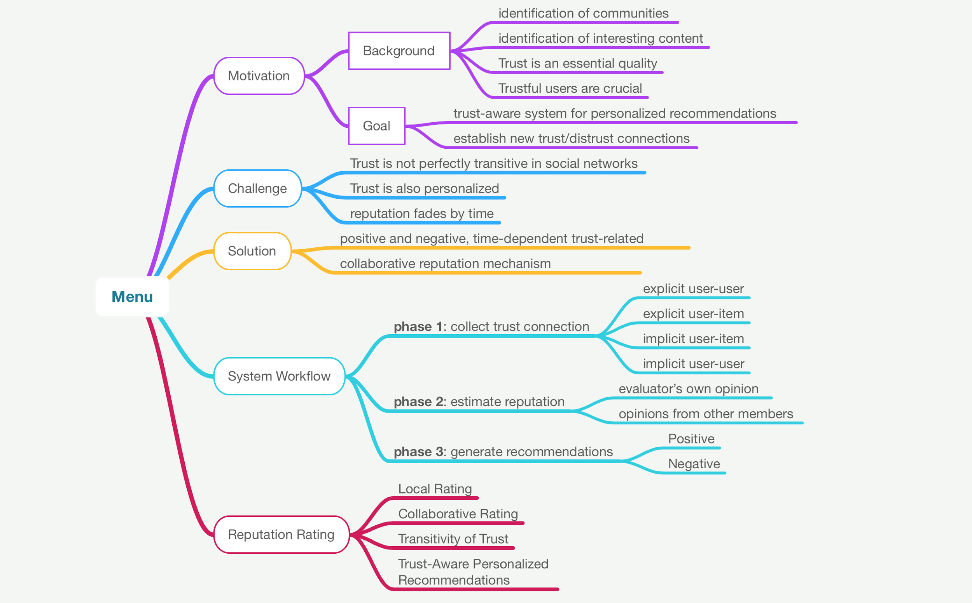

Slide 3
Motivation
Background:
Social Networks analysis is popular:
Identification of communities of users with similar interests
Identification of content that could be of potential interest
Issue
In social environment, trust is becoming an essential quality among user interactions and the recommendation for useful content
Trustful user is crucial for all the members of the network.
Previous works do not incorporate trust
Goal
This paper focus trust-aware system for personalized user recommendations
The proposed system provides personalized recommendations that is used to establish new trust/distrust connections in the social network.

Slide 4
Challenge
Challenge
Trust is not perfectly transitive in that trust decays along the transition path, but it is generally agreed that it can be communicated between people.
Trust is personalized in that it is subjective
In order to address the social network dynamics, we have incorporated in our system the element of time. (reputation fades by time)
Solution
We exploit positive and negative, time-dependent and trust-related information.
We propose a collaborative reputation mechanism that quantiﬁes the users’ connections and capitalizes on trust propagation and on the dynamics of the social network.

Slide 6
System Workflow
This paper proposes a trust-aware system based on a robust reputation management model. Speciﬁcally,
phase 1: Form connections that bear trust semantics between members
phase 2: Estimate reputation rating
phase 3: Generated personalized recommendations
These recommendations are the basis for creating new trust and/or distrust connections in the social network.

Slide 7
System Workflow
1) Phase 1: User Connection Formation.
(1) explicit user- to-user connections
Each member maintains two lists:
1) a friend list
2) an enemy list
(2) explicit user-to-item connections
the user provides a like/dislike comment to a speciﬁc item published by another user
(3) implicit user-to-item connections
comment on the comment from other users, such as retweet.
(4) implicit user-to-user connections
Explicit and implicit user-to-item connections from a user to the items of another user can be used to infer the implicit user-to-user connection between the two users.

Slide 8
System Workflow
2) Phase 2: Reputation Rating Estimation.
The reputation mechanism quantiﬁes the trust connections in the social network
provides personalized ratings expressing the local belief of a user (the evaluator user) with respect to other members of the network (target users).
Reputation ratings are collectively formed, incorporating
the evaluator’s own view
the opinion of a number of other members of the social network (witnesses)
The users’ referral network (i.e., set of witnesses) is formed within speciﬁc circles of trust and distrust from the evaluator user based on concepts drawn from sociology.
Speciﬁcally, we consider in a breadth-ﬁrst search fashion the opinion of the evaluator’s friends and enemies

Slide 9
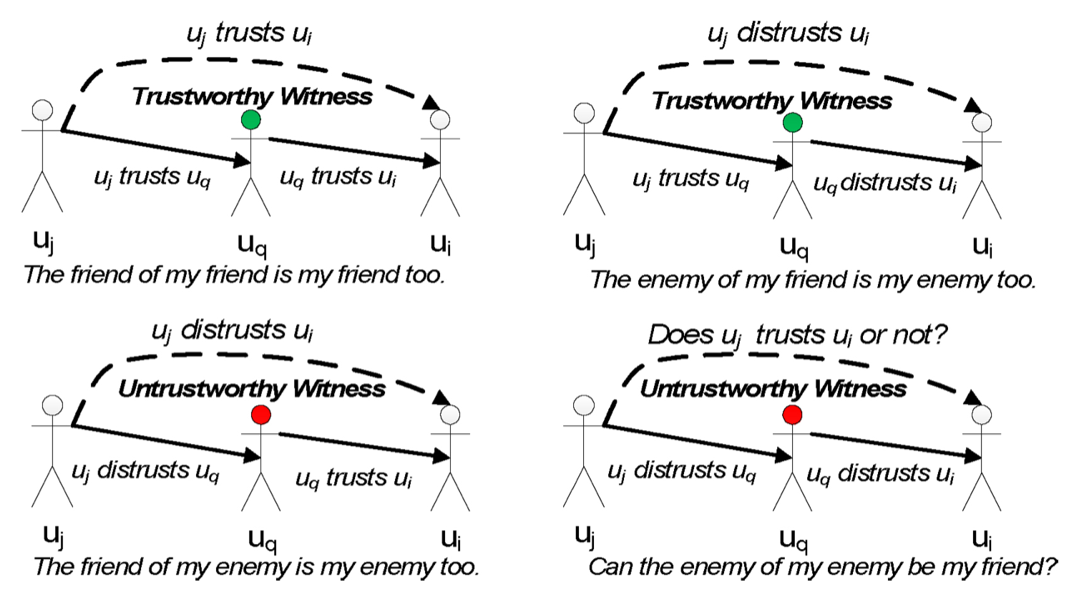
System Workflow
Basic Concept
user u_j is the evaluator,
user u_i is considered as a target user,
u_q is a witness who shares with u_j his/her beliefs for u_i .
Trust Value
Trust/distrust can be expressed with
discrete positive and negative reputation values (e.g., +1 and −1),
or by real values in the same range.
A zero value denotes the absence of a connection between two users.
j
q
i

Slide 10
System Workflow
2) Phase 2: Reputation Rating Estimation. (cont.)
Time Factor
The proposed reputation rating mechanism captures the effect of time (e.g., freshness of links) by modeling the fact that more recent events should weigh more
The use of time information allows us to distinguish between
users who attain a high reputation for a short time period and
users who manage to maintain their reputation at a constantly high level.
Thus, the social network’s dynamic aspect is taken into account and is effectively addressed.

Slide 11
System Workflow
3) Phase 3: Recommendations Generation.
Based on the overall reputation ratings, the proposed system generates personalized positive and/or negative user recommendations, which can be used to form new trust and/or distrust connections.
Positive recommendations
connect to new people (in social networking sites)
subscribe to new blogs (in the blogosphere),
share resources (in social bookmarking applications)
Negative recommendations
alert users when content items are published from such negative users
discourage them from linking or browsing such content,
ﬁlter it out from their content feed.

Slide 13
Reputation Rating
Basic Assumption
the presence of N users U = {u_1 , u_2 , ..., u_N } in a social network.
Every member u_j ∈ U publishes several content items
F(u_j ) and E(u_j ) denote the friend list and the enemy list maintained by user u_j.
A. Local Rating
B. Collaborative Rating
C. Transitivity of Trust
D. Trust-Aware Personalized Recommendations

Slide 14
Reputation Rating
A. Local Rating
Rating of u_i(target user) from u_j(evaluator) at time period t_k
Rating(u_j → u_i , t_k ) is weighted combination of three factors:
w_user · UserConn(u_j → u_i , t_k ) +
w_expl · ExplConn(u_j → u i , t k ) +
w_impl· ImplConn(u_j → u i , t k ) ,
(where where w user + w expl + w impl =1)
The 1st factor corresponds to the explicit user-to-user connections
can be modeled as a binary decision variable taking values 1(friend) or −1(enemy)
or take any value in the [−1, 1] range
The 2nd factor corresponds to the explicit user-to-item connections
as expressed by comments of user u j to content items published by u i at time period t_k .

Slide 15
Reputation Rating
A. Local Rating (cont.)
Numerator: the number of positive and negative user-to-item explicit opinions, as expressed by user u_j , at time period t_k , on the content items published by user u_i ,
Denominator: the total number of opinions expressed by user u_j in time period t_k on any published content item.
The 3rd factor : implicit user-to-item connections
Numerator: the number of positive and negative user-to-item implicit connections, as expressed by links from the content items published by user u_j at time period t_k on the content items published by user u_i , respectively,
Denominator : the total number of links (expressing both positive and negative interest) from the content items published by user u j in time period t k on any published content item.

Slide 16
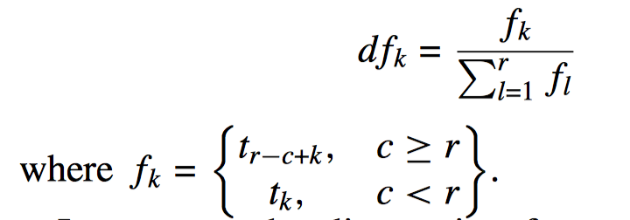
Reputation Rating
A. Local Rating (cont.)
The evaluator considers only the r more recent ratings(last r memory) formed by the user. The local reputation rating LocalRating(u_j → u_i , t_c )
discount factor calculation:
Out of the memory, consider all the data from t_1
In the memory
Notes:
t_(r-c+k) starts from t_(t-c+c-r+1)=t_1

Slide 17
Reputation Rating
B. Collaborative Rating
Get opinion from witness people
LocalRating(u j → u j , t c ) = 1
The weight cred(u_j → u_q , t_c ) is the credibility of witness u_q
Own opinions
Witness’ opinions

Slide 18
Reputation Rating
C. Transitivity of Trust
Witness category:
1) friends of friends
According to the sociology axiom, “the friend of my friend is my friend” and experimental results in online social networks, positive trust can be safely propagated in a wider transitivity horizon (depth > 2).
2) enemies of friends
The enemy of my friend is my enemy and consequently all friends of my enemy (i.e., in deeper levels) are also enemies.
3) friends of enemies
The intuition lies behind the axiom the friend of my enemy is my enemy and consequently all friends of my enemy (i.e., in deeper levels) are also enemies.
4) enemies of enemies
As it is experimentally showed, we cannot draw safe conclusions on whether these users are friends or enemies of the evaluator user u j
The ﬁrst category is expected to contribute signiﬁcantly to the generation of positive recommendations,
The second and third categories are expected to contribute signiﬁcantly to the generation of negative recommendations.
The fourth category seems to raise a controversial issue, as there are contradicting opinions expressed in related research literature, on whether “the enemy of my enemy is my friend” or not
Conclusion: It is obvious, from the aforementioned analysis, that the transitivity of trust or distrust is safe only in paths that contain at most one negative (distrust) edge. In all other cases, we decide not to propagate trust.

Slide 19
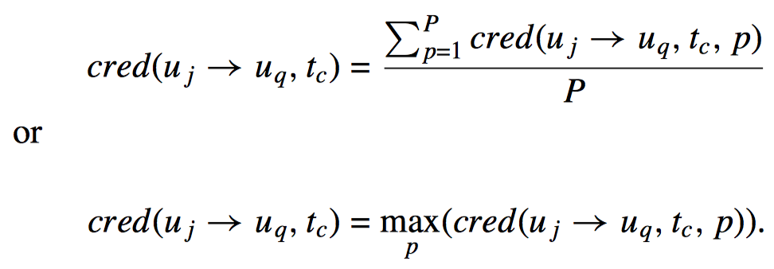
Reputation Rating
C. Transitivity of Trust (cont.)
What if the witness is very far from evaluator? Let there be P distinct paths of various depths d that connect u_j to u_q through a number of witnesses u q(d) which in line form a trust chain.
The weight cred(u_j → u_q , t_c , p) for a single path p ∈ P of depth d = n is deﬁned as follows:
For all the paths, the overall weight is deﬁned as the average or the maximum weight

Slide 20
Reputation Rating
D. Trust-Aware Personalized Recommendations
At the end of this process, the model assigns a personalized collaborative reputation rating CollRating(u_j → u_i , t_c ) for all users u_i who are connected directly or indirectly with the evaluator u_j
From this ranking,
the top-k users (who are not yet connected to u_j ) are provided to the evaluator as positive recommendations (thus, they could be added to the friend list F(u j ) of the evaluator user u j ),
the bottom-k users are provided as negative recommendations (thus, they could be added to the enemy list E(u j ) of the evaluator user).

Slide 21
Experimental Evaluation
Challenge:
It is difficult to find a social network dataset that combines implicit and explicit trust statements, time information, and both positive and negative connections.
It is difficult to find a dataset for testing the ability of our recommender in making proper friends and enemies suggestions to the users.
In Section V-A, this paper presents results on the extended Epinions dataset. This dataset contains both explicit and implicit trust statements between users.
In Section V-B, this paper evaluates the ability of the system in recommending trustful connections to the network members using only explicit user-to-user connections on the Advogato dataset.
In Section V-C, this paper evaluates the performance of the model in predicting positive or negative edges in trust networks with different characteristics and compare with state-of-the-art (SoA) algorithms in the extended Epinions and Wikipedia vote network datasets.

Slide 22
Experiments on Epinions
Epinions:
a large product review community that contains a lot of explicit user-to-user trust statements and product reviews.
It contains 841,372 explicit user-to-user statements for 95,318 users
user ratings denotes which users are trusted or distrusted (1 and −1) by which users
It contains 136 million explicit user-to-item statements for 755,760 different items.
ratings for product reviews range from 1 to 6.
It provides the timestamp of each explicit user-to-user trust statement.
It contains information about the author and subject of each review, giving us evidence on each author’s interests.

Slide 23
To evaluate recommendations, this paper use cosine similarity to measure the average similarity between a user’s interests and those of users in the top-k (i.e., friend) or bottom-k (i.e., enemy) positions in the recommendation list of their model.
Similarity of users’ interests is measured on the corresponding article rating vectors.

Slide 24
First experiment
For each user, we compare the lists of recommended users by the local and the collaborative rating formation and compare against the DFL and DEL.
direct friend list-DFL
direct enemy list-DEL
In the case of the local rating score,
Positive trust statements push the trustee to the top of the trustor’s friend list
Negative statements push the trustee to the top of the trustor’s enemy list.
In the case of the collaborative rating formation, this paper uses a two-step transitivity horizon
For positive recommendations, it aggregates information on the friends list and on friends of the friends list.
For negative recommendations, it examines the enemies list, the enemies of friend list, and the friends of enemies list.

Slide 25
First experiment
the local and the collaborative rating formations take into account the direct user-to-user statements. So users in the original DFL (or DEL) have a great chance to appear in the top (or bottom) places of the local or collaborative rating lists.
Recommending users that are already in the direct friend (or enemy) list is meaningless. So, before evaluating the top-k or bottom-k lists, the direct friend or enemies are removed. Then only new friends are recommended.

Slide 26
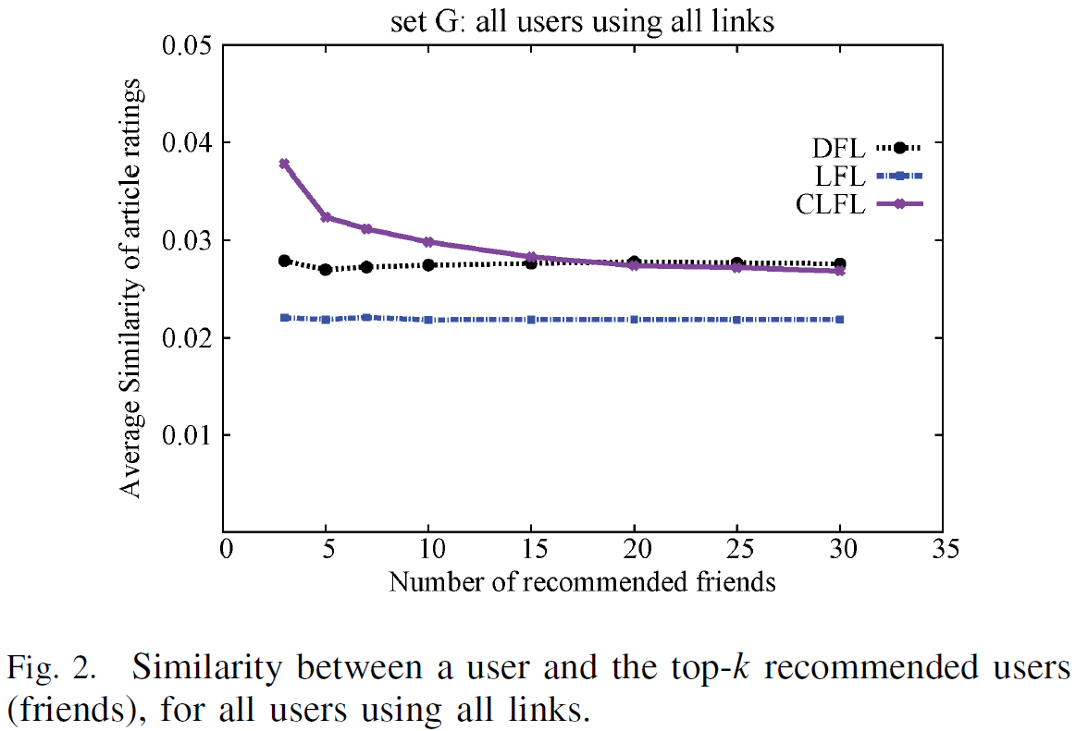
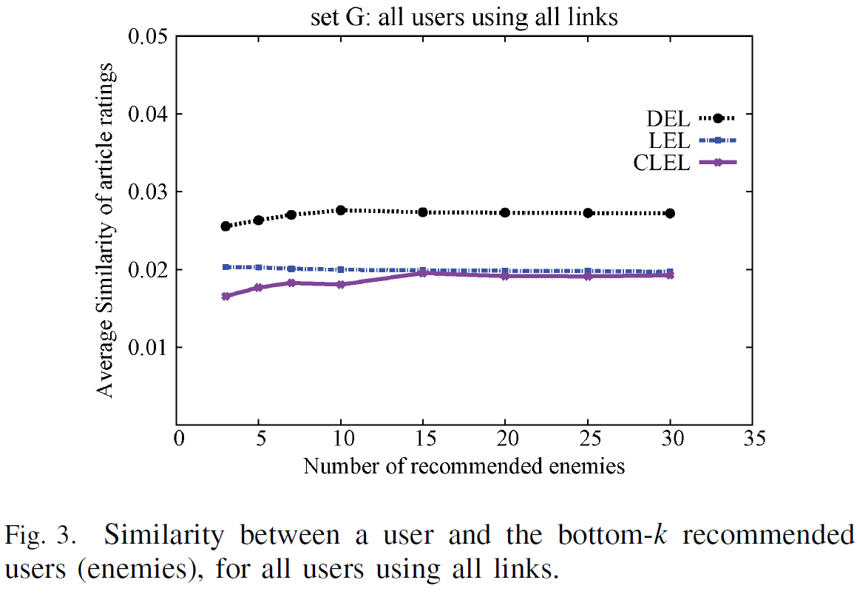
First experiment
First, this paper process the complete graph, containing trust and distrust user-to-user statements and all implicit connections that emerge from article ratings (setG: all network members). It evaluates the top-k (friend) user recommendations in Fig. 2 and bottom-k (enemy) user recommendations in Fig. 3, with k ranging from 3 to 30.

Slide 27
First experiment
Results show that the average similarity is independent of k, which is reasonable since all friends (or enemies) in Epinions get the same trust (or distrust) score +1 (or .1).
The performance of the local friend list (LFL) formation based on the local reputation rating is worse than that of DFL
recommending new friends who are not in the DFL is a hard task.
The performance of the collaborative local friend list (CLFL) formation based on the collaborative rating is quite promising, especially when less than the top ten friend recommendations are evaluated.

Slide 28
First experiment
Results in Fig. 3 show that the local enemy list (LEL) that is based on the local rating formation and the collaborative local enemy list (CLEL) that is based on the collaborative rating formation outperform DEL
(the average similarity between a user and the top direct enemies is higher than that between the user and the recommended enemies).
It indicates that both methods recommend as enemies users that strongly differ in interests from the target user.

Slide 29
Then, we use all user nodes but only trust statements and article ratings (setE: all members that add positive edges to the network) and evaluate the top-k user recommendations in Fig. 4.
We also evaluate the bottom-k user recommendations in Fig. 5, when all user nodes but only distrust user statements and article ratings are used (setF: all members that add negative edges to the network).

Slide 30
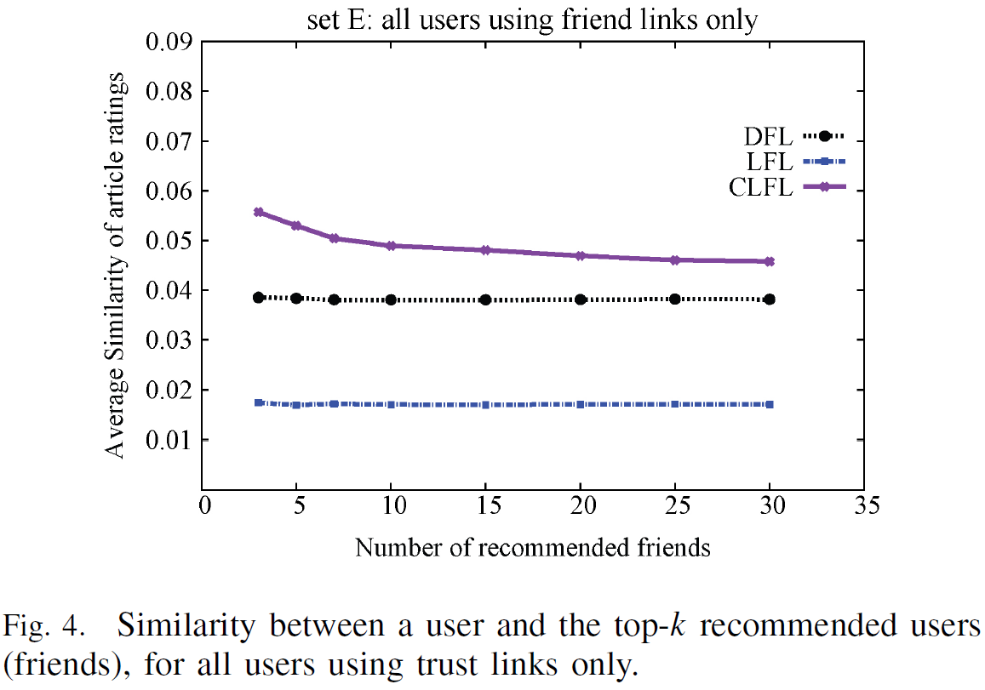
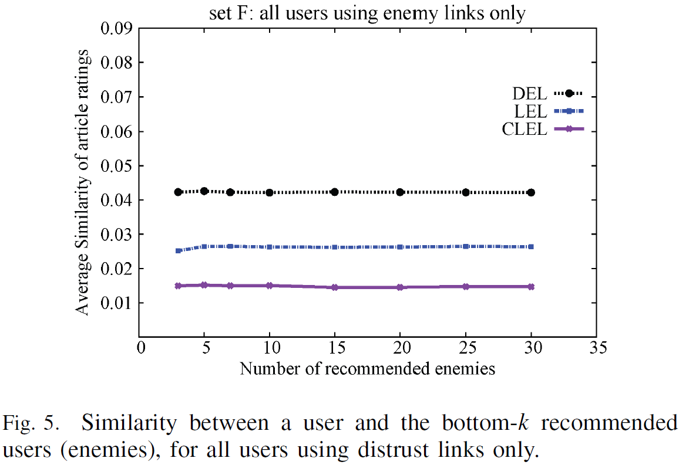
In order to study the effect of trust link polarity in the quality of recommendations, we examine the Epinions graph using separately positive (see Fig. 4) and negative (see Fig. 5) trust statements. This results in a subset of the original user set (setE) comprising 88 180 users, which are connected with positive trust links and another subset (setF) comprising 18 499 users connected with negative trust links only. We observe that the local rating formation is not sufficient to provide good friend recommendations, but its performance in providing enemy recommendations is acceptable. On the other hand, the improvement in the performance of the collaborative rating formation for both enemy and friend recommendations is better even for higher values of k.

Slide 31
Second experiment
In order to better understand when the two models are able to provide good positive or negative recommendations, we run a second set of experiments on subsets of the Epinions dataset.
The subsets contain
1) 5057 members with 5–10 friends (setA)
2) 4927 members with more than 30 friends (setB)
3) 778 members with 5–10 enemies (setC)
4) 731 members with more than 30 enemies (setD)

Slide 32
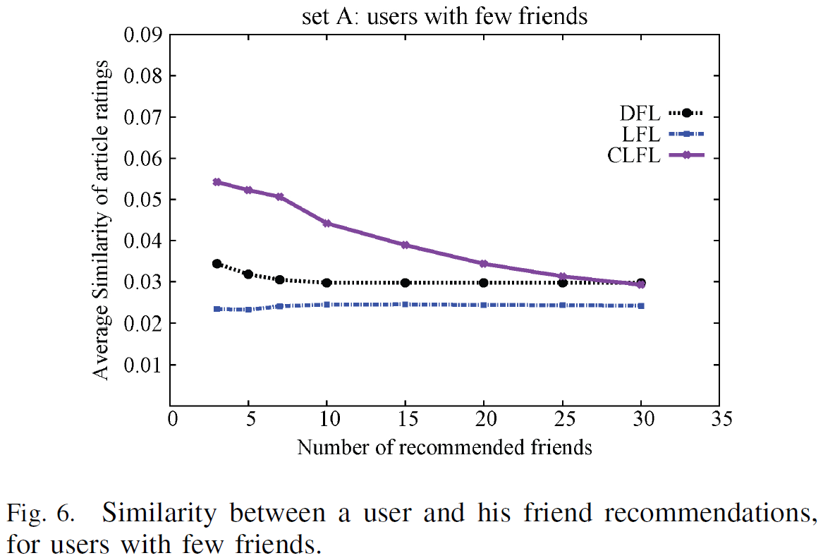
As far as the friend list is concerned, the average similarity decreases for big values of k, since less relevant users are added to a long list. This happens mainly with the collaborative rating metric (setA CLFL) and less with the local one (setA LFL); however, CLFL outperforms both LFL and DFL (see Fig. 6). This proves the ability of the collaborative mechanism to find users of trust in the extended neighborhood of a user and enriching his/her circle of friends.

Slide 33
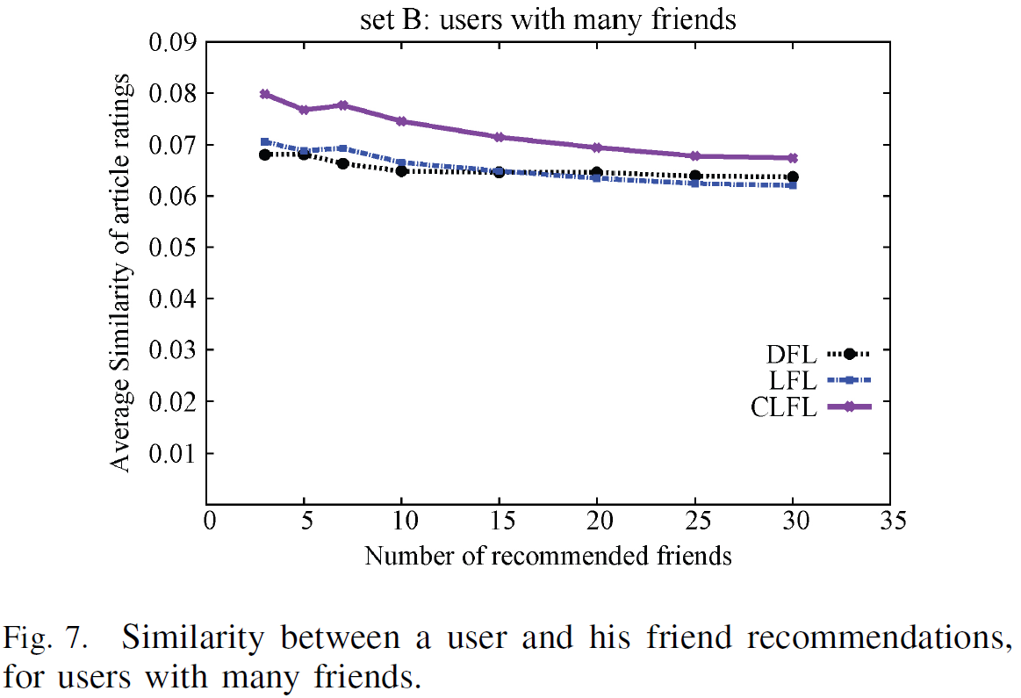
For users with many direct friends (SetB), CLFL still outperforms the DFL and provides better recommendations than LFL (see Fig. 7). A reason for this is that long lists of friends result in an overall decrease to the similarity between their interests and those of the user. Thus, members with many friends can benefit from our system, since they can distill their existing friends and find additional friends of high interest to them, as suggested by the recommender system.

Slide 34
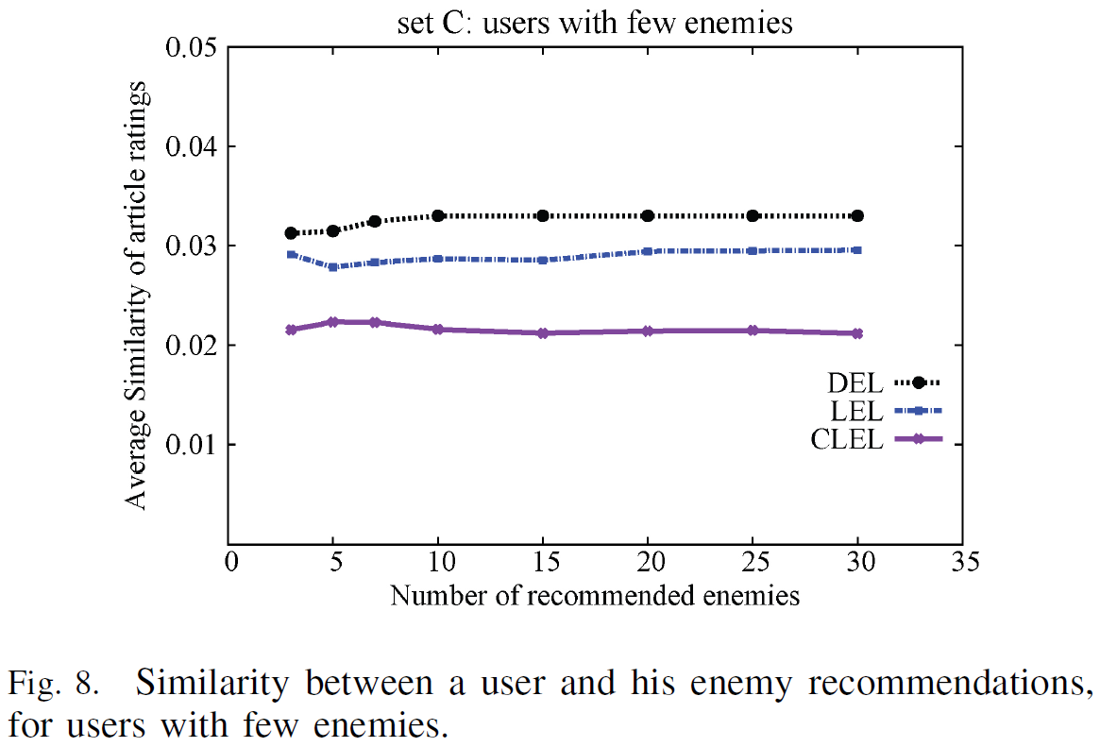
In the case of enemy lists, the similarity between the user and the recommended enemies decreases when compared to the DEL.
As shown in Fig. 8, for users with few direct enemies (setC), the enemy recommendation list based on local rating (LEL) has a higher average similarity than the respective list that is based on the collaborative local rating (CLEL). Both LEL and CLEL achieve average similarity in article ratings between the evaluator and the recommended users less than DEL.

Slide 35
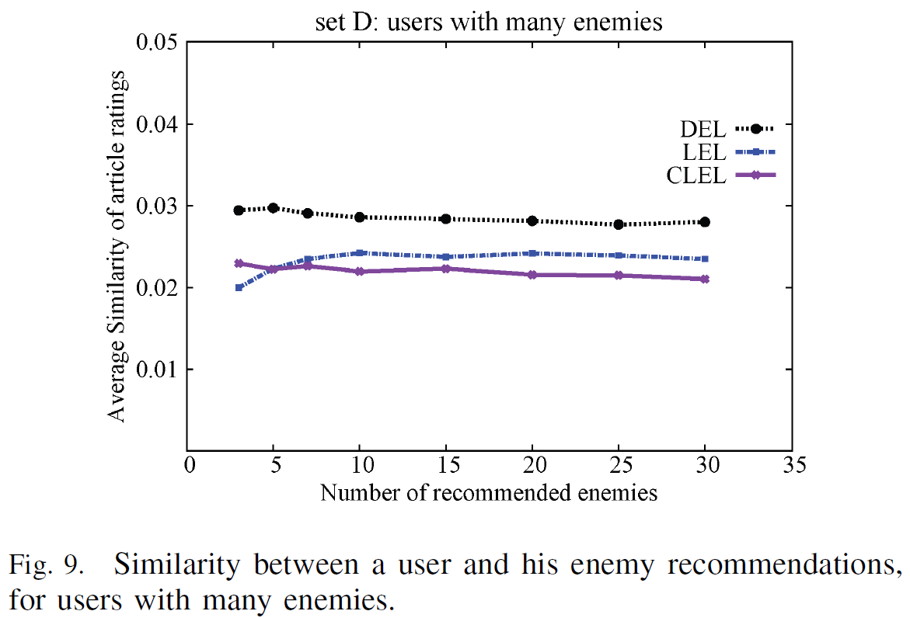
For users with many enemies (setD) (see Fig. 9) the average similarity in article ratings between the user and the recommended users (using either LEL or CLEL) is smaller than that between the user and his/her direct enemies (DEL). This shows that our system recommends as enemies users with few similarities (in article ratings) to the user. For users with a long enemy list, the system can provide recommendations that will further distill this list.

Slide 36
In order to measure the effect of the time decay factor on the quality of recommendations, we repeat the whole set of experiments in sets A–G, this time ignoring the time information. Table I presents the difference between the average similarity values with and without the time decay factor. The difference is averaged on all the top-k cases examined for each dataset. The results in the case of friend recommendations (i.e., sets A, B, E, Gtop) show that the average performance of LFL always decreases when time decay is ignored, whereas the performance of CLFL decreases for sets A and B. In these sets, we consider positive edges only, so an interpretation of the aforementioned results can be that in networks with many positive trust statements, it is important to consider the freshness of these statements in order to provide better friend recommendations. In the case of enemy recommendations (i.e., sets C, D, F, G bottom), results in almost all cases demonstrate a decrease in performance when time decay is ignored (the average similarity scores are higher than in the case of using time decay). The decrease is maximum for setD, where we consider only negative edges and densely interconnected users.

Slide 37
Experiments on Advogato
Advogato is an online community.
evaluate the ability of the reputation management model to predict users’ reputation
Advogato users can certify each other at four levels:
observer; 2) apprentice; 3) journeyer; or 4) master.
(observer=0.25, apprentice=0.5, journeyer=0.75, and master=1)
This corresponds to the explicit user-to-user statements of our model.
No user-to-item information available in the Advogato dataset,

Slide 38
Experiments on Advogato
Using the leave-one-out cross-validation technique for comparison:
we remove only one trust edge from the graph and then we use our reputation model and the remaining graph in order to predict the value of the removed edge.
since it has the minimum possible effect on the graph structure (only one edge is removed each time).
The collaborative rating model is evaluated with two different transitivity horizon values
transitivity horizon 2 (CL2)
the evaluator considers the statements of the people he/she trusts
2) transitivity horizon 3 (CL3)
the evaluator also considers the statements of the people trusted by the people he/she trusts.
We evaluate two path selection methods:
1) one that takes the average trust score when multiple trust paths exist, which is called CLavg [equation (10)]
2) one that considers the maximum trust score over any of the paths, which is called CLmax [equation (11)].
This results in four combinations of transitivity horizon and path selection method, namely CL2avg, CL2max, CL3avg, and CL3max.

Slide 39
Experiments on Advogato
Some baseline methods:
Random (i.e., predict a random trust score in the range [0, 1]), AlwaysMaster, AlwaysJourneyer, AlwaysApprentice,
AlwaysObserver (i.e., always predict a Master, Journeyer,score, etc.), Outuj (i.e., the trust that uj assigns to any other user ui is always the average trust score assigned by uj ), and Inui (i.e., the trust assigned to a user ui by any user uj equals to the average trust score assigned to ui by the users that trust ui).
In our implementation, we assume a depth of 3 and propagate trust through all reachable witnesses, using CertProp as suggested in [44] with γ = 100%. Additionally, we estimate trust for all the unreachable witnesses and keep the path that gives the highest trust score.

Slide 40
Experiments on Advogato
The predicted values are either compared to the real values or are mapped to a binary problem and evaluated using
1) the mean absolute error for n edges, which averages the absolute difference between the real and predicted values,
2) recall
3) precision
4) F1 score.
5) F1 bal score.
an equal number of positive and negative examples (5000 observers and 5000 from the other three levels).
The mean absolute error is applied on the exact values predicted by each model,
Recall, precision, and F1 are a binary classification problem
(a trust score >= 0.5 is a positive and a trust score < 0.5 is a negative example).

Slide 41
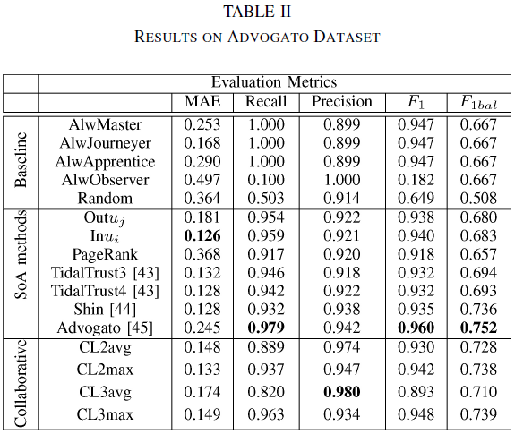
The results in the first zone of Table II (baseline methods) are strongly related to the distribution of edges’ values in the Advogato dataset.
Journeyer is the most common edge value and as a consequence, a trust metric that always predicts this value has better chances than the other three metrics (i.e., AlwMaster, AlwApprentice, and AlwObserver) and of course better than the random prediction.
When we examine the binary classification problem, the first three edge types map to the same class (i.e., edge) and significantly outnumber the observer type (i.e., no edge). As a result, we have high chances to predict accurately when we always predict an edge in this leave-one-out experiment.

Slide 42
CL2avg and CL3avg take the average score for all paths,
CL2max and CL3max take the maximum score, which correspond to trusting the path with the most trustworthy nodes.
Comparing between average and maximum values, we see that when multiple paths exist between the evaluator and the target user in the Advogato dataset, it is better to consider the path with the maximum value, since it is based on the most trustworthy path of witnesses.

Slide 43
According to the results presented in Table II,
CL2max and CL2avg provide the second and third best results (in MAE), with CL2max having a slight advantage in performance over CL2avg.
The lower performance of CL3 metrics, when compared to their CL2 equivalents, can be due to the arbitrary quantification of nominal trust statements (master, journeyer, apprentice, and observer) to numerical values (1, 0.75, 0.5, 0.25). However, in the binary classification problem, CL3avg demonstrates the highest precision score among all other methods.
When an equal number of positive and negative examples is employed as shown in the F1bal column, then our metrics outperform all other metrics, except Advogato.
Once again, the results show that information from the circle of trust can assist in predicting trust connections and may provide useful user recommendations to the network members.

Slide 44
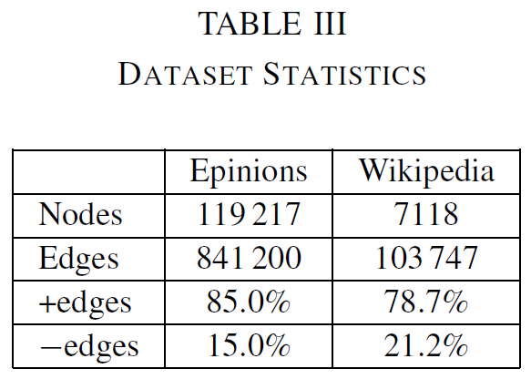
Generalization Across Datasets
In this section, we evaluate the generalization of our model and its applicability in trust networks with different topologies and trust semantics. In this set of experiments, we compare our system with the most related SoA work of Leskovec et al. [23].
We apply our model on two datasets:
the extended Epinions.
the Wikipedia vote network.
We try to predict both positive and negative edges, which in our model may result in a positive, negative, or zero score. Since in some cases the edge is not predicted at all from our model, we give evidence on the coverage of our model in the case of positive and negative edges. The statistics of the two datasets are reported in Table III.

Slide 45
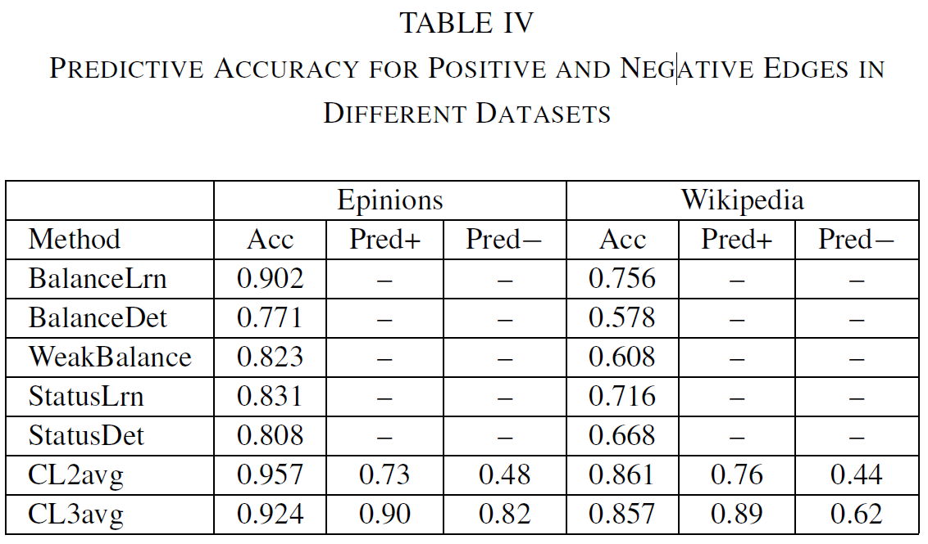
Table IV shows the results of our experiments (using CL2avg and CL3avg as in Section V-B), along with the best results presented in [23].
The comparison shows that both CL2avg and CL3avg outperform the best methods reported in [23].
The accuracy of CL2avg is higher; however, its ability in predicting an edge, either positive or negative, is worse than that of CL3avg.

Slide 46
Conclusion
This paper presented a trust-aware system for generating personalized user recommendations in social networks. This system exploited special features of social networks:
(1) the difference between explicit trust statements and implicit trust statements
(2) the model was able to handle negative trust (distrust) statements
(3) Timestamp information of a connection between users.
(4) Support transitivity of trust under conditions.
Experiments in three real-life datasets showed the effectiveness:
The proposed model outperformed other local metrics
The collaborative rating metric performed better than the local one.
For users with few connections, the recommender system suggested new users of high interest
For users that already have long lists of friends or enemies, the system can provide recommendations that will help them to further distill these lists.

