Slide 1
Trust Evaluation in Online Social Networks Using Generalized Network Flow
Wenjun Jiang, Jie Wu, Fellow, IEEE, Feng Li, Member, IEEE, Guojun Wang, Member, IEEE, and Huanyang Zheng
Presenters: Adeela Huma, Lijing Wang, Xuchao Zhang

Slide 2
Introduction
source s is interested in a single target d in online social networks (OSNs)
OSNs bear the small-world characteristic of high clustering
Types of opinions:
Preconceived opinions
Aggregated opinions
Trust formation
Direct contact– first hand; directed link between two nodes
Recommendation – second hand; such as a trusted path (s, u, d) representing s’s trust of d via u’s recommendation
Paths – sequential and parallel

Slide 3
Introduction

Slide 4
Motivation
Two open challenges are
how to aggregate the trust of overlapped paths
how to calibrate trust decay over iterative recommendations

Slide 5
Main Idea
propose a computational approach for calculating trust, based on a modified network flow model with leakage.
given an initial flow of 1 (i.e., f0 = 1 representing full trust) at s, what is the final flow (i.e., fsd representing total aggregated trust) that d can get?
The flow model addresses
path dependence - by allowing flow split and merge at each node.
Trust decay - introduces a notion of leakage associated with each recommendation node, which is analogous to a leakage in a water pipe. At each node other than s and d, a certain percentage of incoming flow will be leaked before redirecting to outgoing links
Credit Card analogy

Slide 6
Background & Related Work
Path Dependence
Previous models use shortest path or shortest, strongest path or overlapping paths are independent paths
Trust Decay
s fully trusts v1, and vi fully trusts vi+1 , i ε [2, n-1] , and finally vn fully trusts d
Two approaches for trust calculation:
Multiplication
Taking the minimum
Drawback: s will trust many indirectly connected nodes
Aggregation Rule
Sequential Rule
Parallel Rule
Can not solve both problems simultaneously

Slide 7
Problem Definition
Given a trusted graph G = (V, E), V is the set of nodes and E is the set of edges. For two indirectly connected nodes, s and d in V , s is the source and d is the destination.
In OSNs, trust evidence can be collected from three main sources: attitudes, behaviors, and experience.
Its is assumed that the direct trust values between any two connected users are already known ( 0 to 1)
goal is to infer indirect trust values for any two unconnected users, based on the known ones.

Slide 8
Problem Definition
The generalized network flow problem is an extension of standard network flow, in which flow leaks as it is sent through the network. It is represented by a gain function in each edge, g : E →R
For each unit of flow that enters an edge e(u, v) at node u, g(u,v) units will arrive at node v.
Capacity Constraint
0 <= f(u,v) <= c(u, v)
Anti Symmetry constraint
For all e(u, v) ε E : f(u, v) = - g(v, u) . f(v, u), where g(v, u) = -1/ g(u, v), and the minus sign means that the flow is going in the opposite direction.

Slide 9
Problem Definition
Most of the existing network flow algorithms are based on the Ford-Fulkerson method, the two key concepts of which are
residual network - Let f be a flow in a network N = (V, E), where c(u, v) and g(u, v) are the capacity and gain factor of edge e(u, v) ε E, respectively. With respect to the flow f , the residual network is Nf = (V, Ef ), in which the residual capacity is defined by cf (u, v) = c(u, v) - f (u, v)
augmenting path - An augmenting path is a path in the residual network, where the capacity on each edge is larger than 0. A new flow can pass through an augmenting path.

Slide 10
Problem Definition
Augmentation Path example

Slide 11
Notations Used

Slide 12
GFTrust
Initial trust assumption
GFTrust modeled using network flow with three tasks as follow:
Modeling trust decay with node leakage
Constructing generalized flow network
Calculating a near-optimal generalized flow

Slide 13
5. GFTrust
Lijing Wang

Slide 14
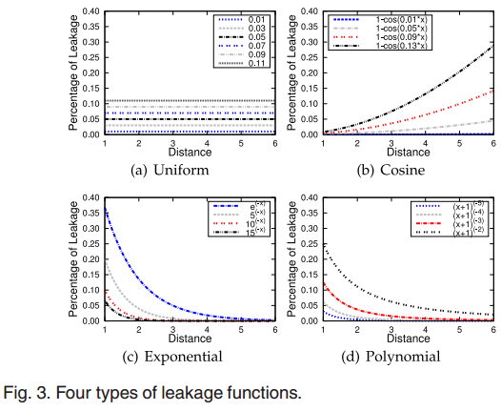
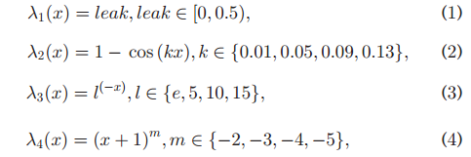
Modeling Trust Decay with Node Leakage
Assumption: the trusted graph is already known.
Leakage functions:
According to node’s distance from
the source
Favor the shorter paths over the
longer ones!

Slide 15
Constructing Generalized Flow Network
For each (directed) edge:
Capacity ($c(u,v)$) = Trust value ($t(u,v)$)
Gain ( $g(u,v)$)
Outgoing edge from s: 1
Incoming edge to d: 1
Intermediate edges: < 1
transform the leakage of a node into the gain factor of an edge
$c(v^{+}, v^{−}) = 1$
$g\left(v^{+}, v^{−}\right)=1 −leak(v)$

Slide 16
Calculating Near-Optimal Generalized Flow
Challenges: path dependence and trust decay
Objective: predict trust levels that are close to the truth

Slide 17
Calculating Near-Optimal Generalized Flow
Obs. 1. In original trusted graph, a shorter path makes a higher gain.
Obs. 2. In the original trusted graph, the trusted paths with the same length have the same efficiency of sending flow.
$$u_{i}$$
$$f_{q_{1}} = 0.6 ∗ 0.9 = 0.54$$
$$f_{s} = 0.8$$
$$f_{s} = 0.6$$
$${q_{1}→q_{2}: f}_{d} = 0.6∗0.9 +0.2∗0.9∗0.9$$
$$= 0.702$$
$$f_{d} = 0.54$$
$${q_{2}→q_{1}: f}_{d}= 0.7∗0.9∗0.9+0.1∗0.9$$
$$= 0.657$$
$$f_{q_{2}}= 0.6 ∗ 0.9 ∗ 0.9 = 0.486$$

Slide 18
Calculating Near-Optimal Generalized Flow
Greedy algorithm:
Search shortest path: breadth-first search
Augmenting flow
?

Slide 19
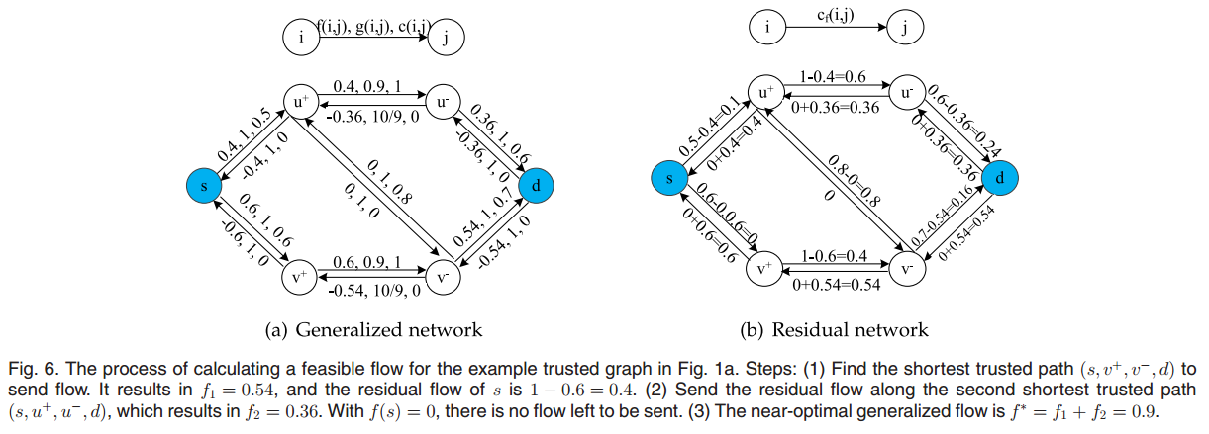
Calculating Near-Optimal Generalized Flow
$$c_{f}=c−f$$
$$(f,g,c)$$
$$(−fg,\frac{1}{g}, c)$$

Slide 20
6. Analysis of GFTrust
Lijing Wang

Slide 21
Efficiency
Obs. 3. In most cases, the iterative number of augmenting flows in GFTrust is a small constant.
Theorem 1. The total time complexity of Algorithm 1 and 2 in GFTrust is $O(\left|V\right|{\left|E\right|}^{2})$.
According to Obs. 3., in most cases, the total complexity of GFTrust will be $O(|E|)$.
GFTrust is a local trust metric which is based on a small trusted graph from source s to sink d, instead of the whole large OSNs.

Slide 22
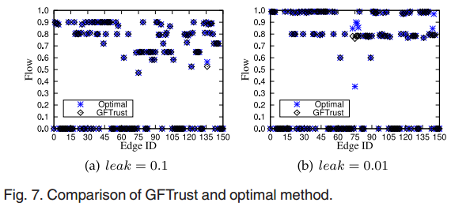
Near-Optimal Effect
GFTrust v.s. Linear Programming
Dataset : Kaitiaki (64 nodes, 178 links)

Slide 23
Basic Desirable Properties
Ability to solve Path Dependence
No information reuse or loss
Ability to solve Trust Decay
Leakage functions
No need to Normalize
Resulting flow falls in the range of [0,1]
False positive effect, doesn’t matter
Generality
Others as a special case of leak = 0

Slide 24
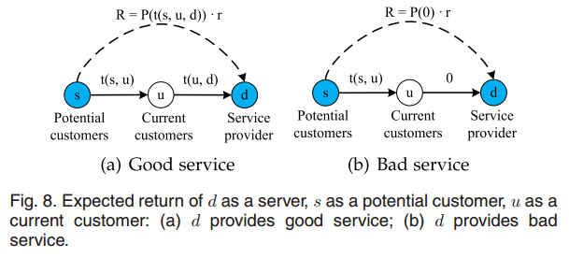
Special Desirable Properties
$$p_{1}(s,u,d)$$
$$p_{2}(s,u,v,d)$$
$$p_{3}\left(s,u,v,r,d\right)$$
$$p_{s}\left(s,u,d^{′},d\right)$$
Senario 1: d’ increases path length
Senario 2: d’ doesn’t increases path length

Slide 25
Experiment
Evaluation Technique: Leave one out
If there is an edge between two nodes, that edge is masked. The masked value is the ground truth value to be compared with calculated value.
Dataset: Epinions (www.epinions.com)
an online community website where users can write reviews and rate other users’ reviews.
3,168 nodes and 51,888 edges

Slide 26
Experiment
Evaluation Metrics
Mean Error: $\sum{\left|t^{c}−t^{d}\right|}/D$
$t^{c}$ is the calculated trust, $t^{d}$ is the ground truth trust. $D$ is the total number of edges whose trust can be predicted.
Precision & Recall
FScore: ${2∙Recall∙Precision}/{Recall+Precision}$
Connection Coverage

Slide 27
Experiment
Basic Operations in the Reliability Model
Propagation: calculates the reliability of a trusted path
Aggregation: calculates the final trust value
Compared Methods
AveR-MaxT, AveR-WAveT, MaxR-MaxT, MaxR-WAveT
AveR: take the average path weight as the reliability; MaxR: take the maximum one
SWTrust: use the idea of TidalTrust (Golbeck [2]) which takes the weighted average trust value of all shortest and strongest paths

Slide 28
Experiment
Effects of Max Length
Max Length from 2 to 3, Fscore changes a little; from 3 to 6, no change

Slide 29
Experiment
Effects of Trust Threshold
As threshold increases, fewer paths will be trusted => less evidence can be used

Slide 30
Experiment
Effects of Leakage in uniform setting
Leakage has more positive effects on Mean Error than on FScore.
Changes are sharper with respect to threshold, smoother with respect to maximum length.
When leakage is large enough, the accuracy begins to reduce.

Slide 31
Experiment
Effects of Leakage in Non-uniform setting
The effects are even more various with different settings
No apparent conclusion can be made based on the experiment result.
Leave it as future work

Slide 32
Experiment
Coverage
Trust threshold impact coverage more than Max Length.

Slide 33
Conclusion
Solve the challenges of path dependence during aggregation
Solve the challenges of trust decay through propagation
First work to introduce the modified generalized flow model into a trust evaluation system.
Save the normalization process and bear two good properties of social incentive compatibility and Sybil tolerance.

Slide 34
Thank you !!

