Slide 1
The Beta Reputation System
Jøsang and R. Ismail
15th Bled Electronic Commerce Conference, Bled, Slovenia, June 2002, pp. 1-14

Slide 2
Outline
Introduction
Building Blocks in the Beta Reputation System
Belief Discounting in the Beta Reputation System
Performance of the Beta Reputation System
Conclusion

Slide 3
Introduction
Reputation systems
Encouraging good behavior and adherence to contracts
Fostering trust amongst strangers in e-commerce transactions
Providing incentive for honest behavior and helping people make decisions about who to trust.
Without a reputation system taking past experiences into account, strangers might prefer to act deceptively for immediate gain instead of behaving honestly.

Slide 4
Introduction
Fundamental aspects
Reputation engine
Take reputation ratings from various inputs including feedback about other users
Use mathematical operations to compute a reputation score
Propagation mechanism
Two approaches:
Centralized (e.g., eBay)
Reputation data are stored in a central server
Users send a query to the central server for the reputation score
Decentralized
Everybody keeps and manages reputation of other users
Users can ask others for feedbacks

Slide 5
Contribution
A reputation engine (called Beta Reputation System) is proposed based on the beta probability density function which can be used to represent probability distributions of binary events (1/0 for success/failure or satisfactory/unsatisfactory)
Posteriori probabilities of binary events can be represented as beta distributions
A sound basis in the theory of statistics
Applicable to both centralized and distributed systems

Slide 6
Building Blocks in the Beta Reputation System
The Beta Reputation System:
The beta-family of probability density functions is a continuous family of functions indexed by the two parameters α and β .

Slide 7
Building Blocks in the Beta Reputation System
“When observing binary processes with two possible outcomes , the beta function takes the integer number of past observations of and to estimate the probability of , or in other words, to predict the expected relative frequency with which will happen in the future.”

Slide 8
Building Blocks in the Beta Reputation System
Initially α=1 and β=1 yielding the initial reputation score of 0.5, meaning no information

Slide 9
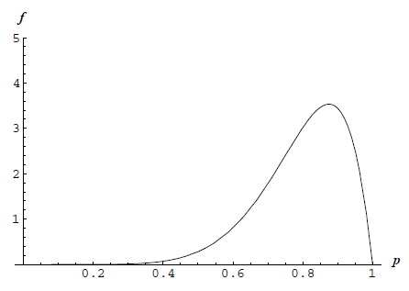
Building Blocks in the Beta Reputation System
Example:
A process with two possible outcomes
Produced outcome 7 times
Produced outcome 1 time
The Beta function is plotted below:

Slide 10
Building Blocks in the Beta Reputation System
Example (cont’):
represents the probability of an event
represents the
probability that the first-order variable has a specific value
The curve represents the probability that the
process will produce outcome
during future observations
The probability expectation value
-> the most likely value of the
relative frequency of outcome
is 0.8
8 / (8 + 2)

Slide 11
Building Blocks in the Beta Reputation System
In e-commerce, an agent’s perceived satisfaction after a transaction is not binary - not the same as statistical observations of a binary event.
Beta reputation system can be extended to non-binary events by representing positive and negative feedbacks as a pair (r, s) of continuous values.
Degree of dissatisfaction (a real number)
Degree of satisfaction (a real number)

Slide 12
Building Blocks in the Beta Reputation System
. Compact notation:

Slide 13
Building Blocks in the Beta Reputation System
T’s reputation function by X is subjective (as seen by X)
Superscript (X): feedback provider (the trustor)
Subscript (T): feedback target (the trustee)

Slide 14
Building Blocks in the Beta Reputation System
A reputation rating is how an entity is expected to behave in the future
When the reputation rating is within a range [0, 1], from Definition 1:
When the reputation rating is within a range [-1, 1],

Slide 15
Building Blocks in the Beta Reputation System
One can combine positive and negative feedback from multiple sources, e.g., combine feedback from X and Y about target T
Combine positive feedback
Combine negative feedback
Operation is both commutative and associative

Slide 16
Belief Discounting in Beta Reputation System
Belief discounting is done by varying the weight of the feedback based on the agent’s reputation
Jøsang’s belief model uses a metric called opinion to describe beliefs about the truth of a proposition
interpreted as probability that proposition x is true
interpreted as probability that proposition x is false
interpreted as uncertainty

Slide 17
Belief Discounting in Beta Reputation System
Y: a recommender who provides a feedback to X about T
X: a trustor who has its opinion about Y
Objective: X wants to form an opinion about T, taking into account its opinion about Y
Y’s opinion about T

Slide 18
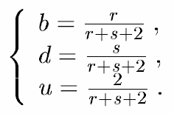
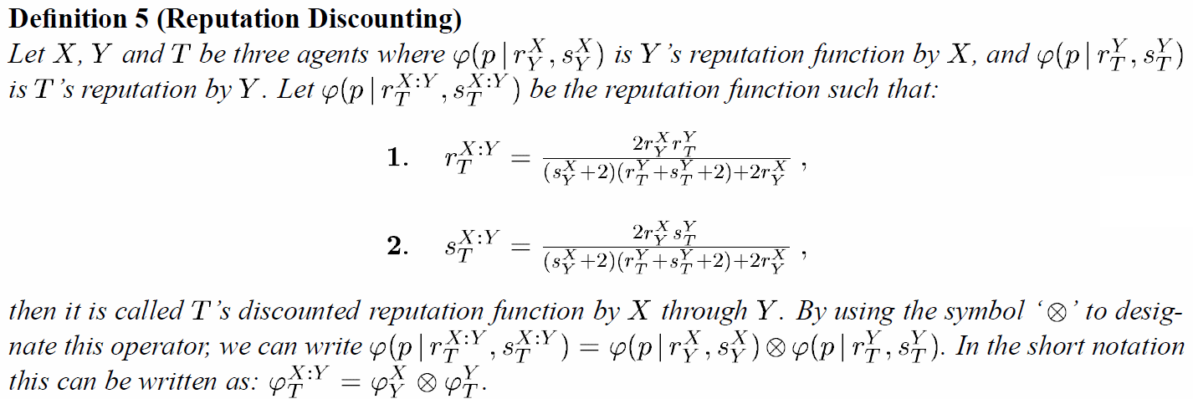
Belief Discounting in Beta Reputation System
The opinion metric can be interpreted equivalently to the Beta function by mapping:
Inserting (b,d,u) defined above into the three equations in Definition 4, one can obtain T’s discounted reputation function by X through Y, , as follows:
Associative but not
commutative

Slide 19
Belief Discounting in Beta Reputation System
Q: Prove or show by example
on slide #18

Slide 20
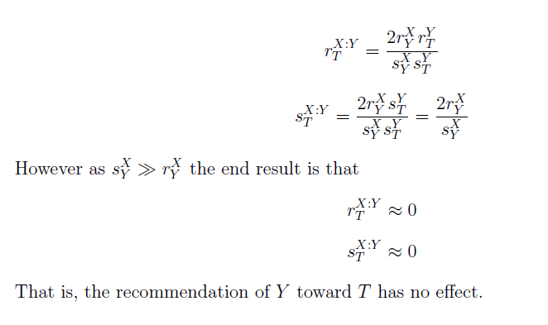
Belief Discounting in the Beta Reputation System
Q: Prove or show by example
(Continuation from slide #19)

Slide 21
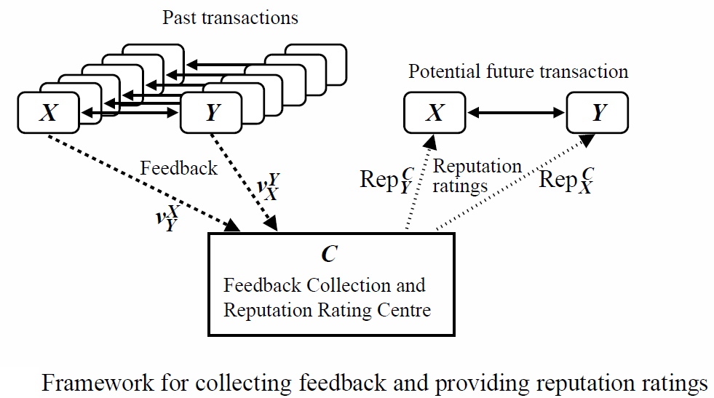
Providing and Collecting Feedback
Feedback is received and stored by a feedback collection center C
Assume that all agents are authenticated and that no agent can change identity
Agents provide feedback about transactions
C discounts received feedback based on providers reputation and updates the target’s reputation function and rating accordingly
C provides updated reputation ratings to requesting entities

Slide 22
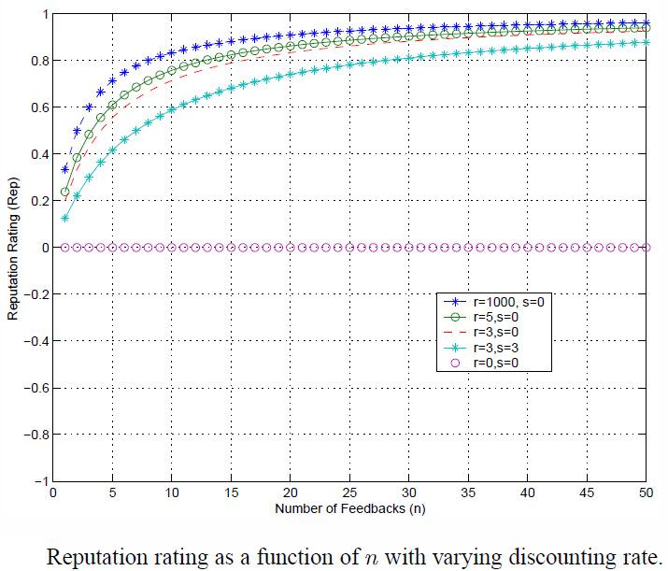
Performance: Effect of Discounting
Center C receives a sequence of n identical feedback values (r=n, s=0) from X about T
Blue line is (r=1000, s=0) meaning no discounting at all, i.e., C takes X’s feedback as is
Pink line is (r=0, s=0) under which T’s rating is not influenced by X’s feedback at all. i.e., C ignores X’s feedback
Varying X’s
reputation function parameters
Conclusion: As X’s reputation function gets weaker, T’s rating is less influenced by the feedback From X

Slide 23
Conclusions
The Beta reputation system uses beta probability density function to combine feedback and derive reputation ratings, with a strong foundation in the theory of statistics
Belief discounting can deal with bad-mouthing or ballot-stuffing attacks when trust is accurate (i.e., when Center C is accurate in assessing a recommender X’s reputation).
Discounted feedbacks are combined by Center C to yield the reputation score of a target node.
Flexibility and simplicity make it suitable for supporting electronic contracts and for building trust between players in e-commerce applications (centralized or distributed).

