Slide 1
CloudArmor: Supporting Reputation-Based Trust Management for Cloud Services
Talal H. Noor, Quan Z. Sheng, Lina Yao,
Schahram Dustdar, Anne H.H. Ngu

Slide 2
Outline
Introduction
The CloudArmor Framework
Zero-Knowledge Credibility Proof Protocol
The Credibility Model
The Availability Model
Implementation and Experimental Evaluation
Conclusion

Slide 3
Key Issues of Trust Management
Cloud services are highly dynamic, distributed, and non-transparent.
Challenges:
  Privacy: Consumer’s privacy.
  Sensitive information, behavioral information, consumers’ data.
  Security: Cloud services protection.
  Misleading feedbacks, creating several accounts,
  Hard to predict when the malicious behaviors occur.
  Availability: Trust management service’s (TMS) availability.
  Should be adaptive and highly scalable.

Slide 4
Features of the CloudArmor
Zero-knowledge credibility proof protocol. (Section 3)
Preserve the consumer’s privacy
Enable TMS to prove the credibility of a particular consumer’s feedback.
A credibility model. (Section 4)
Collusion detection: Feedback Density, Occasional Feedback Collusion.
Sybil attack detection: Multi-identity recognition, occasional Sybil attacks.
An availability model. (Section 5)
#TMS nodes – operational power metric.
#replicas for each node – replication determination metric.

Slide 5
Architecture of the CloudArmor

Slide 6
Zero-Knowledge Credibility Proof Protocol
Sybil attacks
Identity management service
Trust management service
Invocations history records:
Trust Results:

Slide 7
Assumptions and attack models
Assumptions:
TMS is handled by a Trusted Third Party.
TMS communications are secure.
Attacks Models:
  Collusion attacks, also known as collusive malicious feedback behaviors.
  self-promoting attacks.
  slander attacks.
  can occur in a non-collusive way.
  Sybil attacks.
  malicious users have multiple identities to give misleading feedbacks.
  whitewashing attacks.

Slide 8
The Credibility Model
Feedback Collusion Detection
  Feedback Density
  Occasional Feedback Collusion
Sybil Attacks Detection
  Multi-Identity Recognition
  Occasional Sybil Attacks
Feedback Credibility
Change Rate of Trust Results

Slide 9
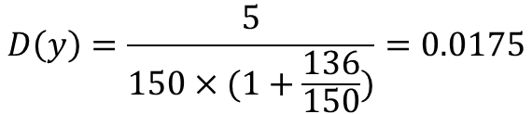
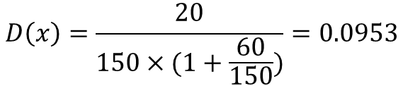


Feedback Density
$$s_{x}=89\%$$
$$s_{y}=92\%$$
The feedback density of a certain cloud service:
The feedback volume collusion factor:
$$D\left(x\right)=\frac{20}{150×(1+\frac{60}{150})}=0.0953$$
$$D\left(y\right)=\frac{5}{150×(1+\frac{136}{150})}=0.0175$$

Slide 10

Occasional Feedback Collusion
Since collusion attacks against cloud services occur sporadically, we consider time as an important factor in detecting occasional and periodic collusion attacks.
The occasional feedback collusion factor $𝒪_{f}\left(s,t_{0},t\right)$ of cloud service $s$ in a period of time $[t_{0},t]$:

Slide 11
Multi-Identity Recognition
The main goal of this factor is to protect cloud services from malicious users who use multiple identities (i.e., Sybil attacks) to manipulate the trust results.
The frequency of a particular credential attribute:
The multi-identity recognition factor:
Trust Identity Registry
Consumer’s Primary Identity-Credentials’ Attributes Matrix (IM)
Multi-identity Recognition Matrix (MIRM)

Slide 12

Occasional Sybil Attacks
The sudden changes in the total number of established identities indicates a possible occasional Sybil attack.
The occasional Sybil attacks factor $𝒪_{i}\left(s,t_{0},t\right)$ of cloud service $s$ in a period of time $[t_{0},t]$:

Slide 13
Feedback Credibility
TMS dilutes the influence of those misleading feedbacks by assigning the credibility aggregated weights to each trust feedback as shown in
The aggregated weights:

Slide 14
Change Rate of Trust Results
To allow TMS to adjust trust results for cloud services that have been affected by malicious behaviors, we introduce an additional factor called the change rate of trust results.
The change rate of trust results factor:
The change rate of trust results is designed to limit the rewards to cloud services that are affected by slandering attacks because TMS can dilute the increased trust results from self-promoting attacks using the credibility factors.

Slide 15
The Availability Model
Factors used to spread distributed TMS nodes to manage trust feedbacks.
  Operational power: Compare the workload for a particular TMS node with the average workload of all TMS nodes
  Replication determination: Minimize the possibility of the crashing of a node hosting a TMS instance.

Slide 16
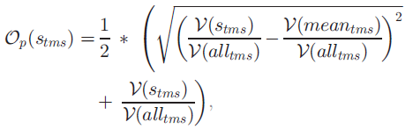

Operational power
The operational power factor of a particular TIMS node is calculated as the mean of Euclidean distance and the TMS node workload.
Based on operational power, TMS uses a workload threshold to automatically adjust the number of nodes as follows.

Slide 17



Replication determination
To predict the availability of a node, TMS instance’s availability is modeled using the point availability model d, where the point availability probability is denoted as
The failure free density function:
The renewal density function:

Slide 18


Replication determination
The Laplace transform of the point availability probability:
In time domain, it can be obtained using

Slide 19
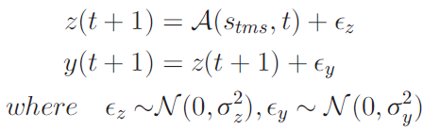
TMS instance’s availability prediction
The prediction model is defined via state function and measurement function.
The particle filtering technique is used to estimate and track the availability.

Slide 20
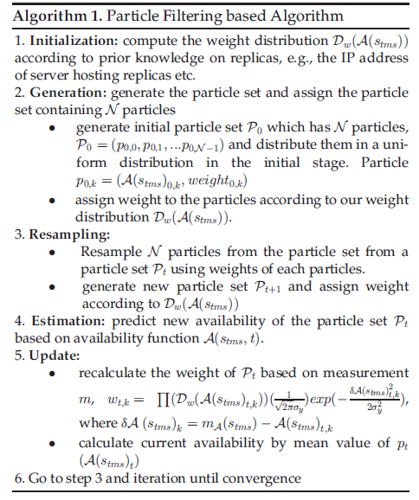
Particle filtering algorithm

Slide 21


The number of replicas
At least one replica is available, represented as
Then the optimal number of TMS instance’s replicas is calculated as

Slide 22
Trust result caching
Used to cache the trust results and credibility weights based on the number of new trust feedbacks to avoid unnecessary computations.
Two thresholds controls the TMS update of the trust result in the cache:
  The number of new trust feedbacks given by a particular consumer
  The number of new feedbacks given to a particular cloud service

Slide 23
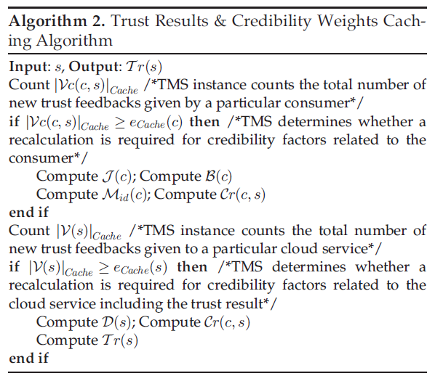
Trust results caching

Slide 24
Instances management
Main instance (one):
  Optimal number of nodes estimation
  Feedbacks reallocation
  Trust result caching (consumer side)
  Availability of each node prediction
  TMS instance replication
Normal instances (the rest):
  Trust assessment and feedback storage
  Trust result caching (cloud service side)
  Frequency table update

Slide 25
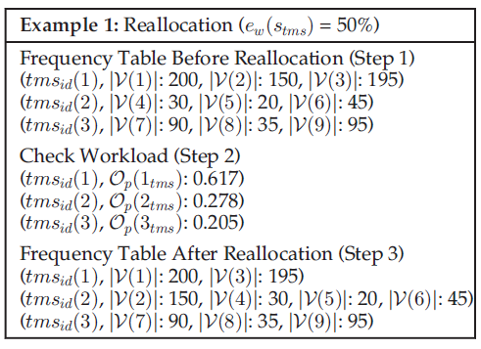
Instances management
Each TMS instance is responsible for feedbacks given to asset of cloud services and updates the frequency table.

Slide 26
Credibility model evaluation – Attacking behavior models

Slide 27
Credibility model evaluation
Collusion attacks
Sybil
attacks

Slide 28
Availability model evaluation

Slide 29
Availability model evaluation--Reallocation

Slide 30
Conclusion
Cloud service users’ feedback is a good source to assess the overall trustworthiness of cloud services.
Introduce a credibility model that not only identifies misleading trust feedbacks from collusion attacks but also detects Sybil attacks.
Develop an availability model that maintains the trust management service at a desired level.
The experimental results demonstrate the applicability of the approach and show the capability of detecting such malicious behaviors.

Slide 31
Thanks

