Slide 1
A Probabilistic Misbehavior Detection Scheme toward Efficient Trust Establishment in Delay-Tolerant Networks
Haojin Zhu, Suguo Du, Zhaoyu Gao, Mianxiong Dong, and Zhenfu Cao

Slide 2
Introduction

Slide 3
Delay Tolerant Networks (DTN)
Store
A
Heterogeneous networks
Lack continuous network connectivity
Store-carry-and-forward communication
B
Carry
B
Forward
D
C
Store

Slide 4
Misbehavior in DTN
Dropping packets intentionally even when it has the capability to forward the data
Selfish nodes
Try to maximize their own benefits, refuse to forward packets for others
Malicious nodes
Drop or modify packets to launch attacks
Black hole attack

Slide 5
Inspection Game
Inspector
Check
Reputation System
A
B
C
Ensure the security of DTN routing
at a reduced cost via choosing an
appropriate investigation probability
Prone to violate rules

Slide 6
iTrust Scheme for Misbehavior Detection in DTNs

Slide 7
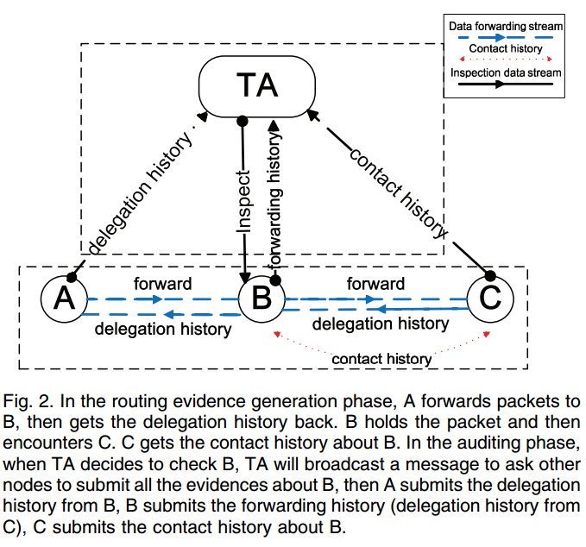
iTrust Scheme for misbehavior detection in DTNs
Routing Evidence Generation Phase
Generate contact and data forwarding evidence
Auditing Phase
Trust Authority (TA) distinguishes normal nodes from misbehavior node

Slide 8
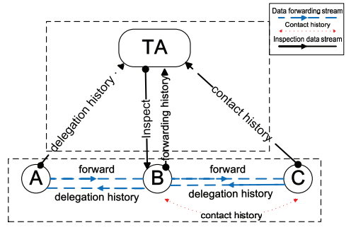
Routing Evidence Generation Phase
Delegation Task Evidence
Demonstrate a new task has been delegated from upstream node to target node
Include three parts: , Sig(i), Sig(j).
Record the number of routing tasks assigned from upstream nodes to target node
Stored at upstream nodes

Slide 9
Routing Evidence Generation Phase
Forwarding History Evidence
Meet with an intermediate node, checks if it is desirable
Demonstrate the intermediate node has finished the forwarding task
Include: , Sig(k)
Stored at itself

Slide 10
Routing Evidence Generation Phase
Contact history evidence
Demonstrate the presence of two nodes when they meet
Include: , Sig(j), Sig(k)
Stored at both nodes

Slide 11
Auditing Phase
TA launches an investigation request toward target node.
Each node submit its Evidences.
Definition:
set of next-hop nodes chosen for message forwarding
R set of contacted nodes satisfying the requirement of DTN routing protocols
D number of copies required by DTN routing.
Misbehavior Detection

Slide 12
Auditing Phase
Case I: honest data forwarding with sufficient contacts
Given message
Message should has been forwarded to the next hop,
The chosen next-hop nodes are desirable nodes
The number of forwarding copies satisfy the requirement

Slide 13
Auditing Phase
Case II: honest data forwarding with insufficient contacts
Given message
Subcase I: no contact
Subcase II: limited number of contacts

Slide 14
Auditing Phase
Case III: misbehaving data forwarding with/without sufficient contacts
Given message
Subcase I: forwarder refuses to forward the data even when the forwarding opportunity is available
Subcase II: forwarder has forwarded the data but failed to follow the routing protocol
Subcase III: forwarder agrees to forward the data but fails to propagate enough copies

Slide 15
Auditing Phase
BasicDetection()
Fake evidences
Check the authenticity of each evidence by verifying the signatures
Result in high transmission and signature verification overhead

Slide 16
Auditing Phase
BasicDetection()
Fake evidences
Check the authenticity of each evidence by verifying the signatures
Result in high transmission and signature verification overhead
Solution: probabilistic misbehavior detection scheme

Slide 17
Probabilistic Misbehavior Detection Scheme
Check nodes at a certain probability
If a node could pass the investigation, TA will pay the node a compensation ω (omega)
Otherwise, node will receive a punishment C
If investigation of node i didn’t launch, TA will also pay the node a compensation ω
Others:
Each node costs g to make a packet forwarding, while TA benefits from each successful data forwarding by gaining v
Investigation cost h, charged from TA

Slide 18
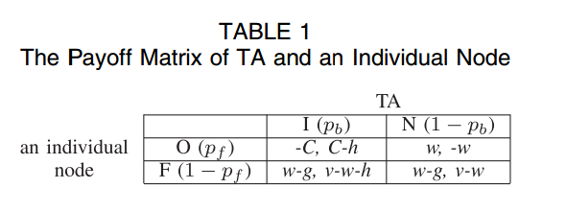
iTrust: Game Theory Analysis
TA has two strategies: inspecting (I) or not inspecting (N)
Each node has two strategies: forwarding (F) or offending (O)

Slide 19
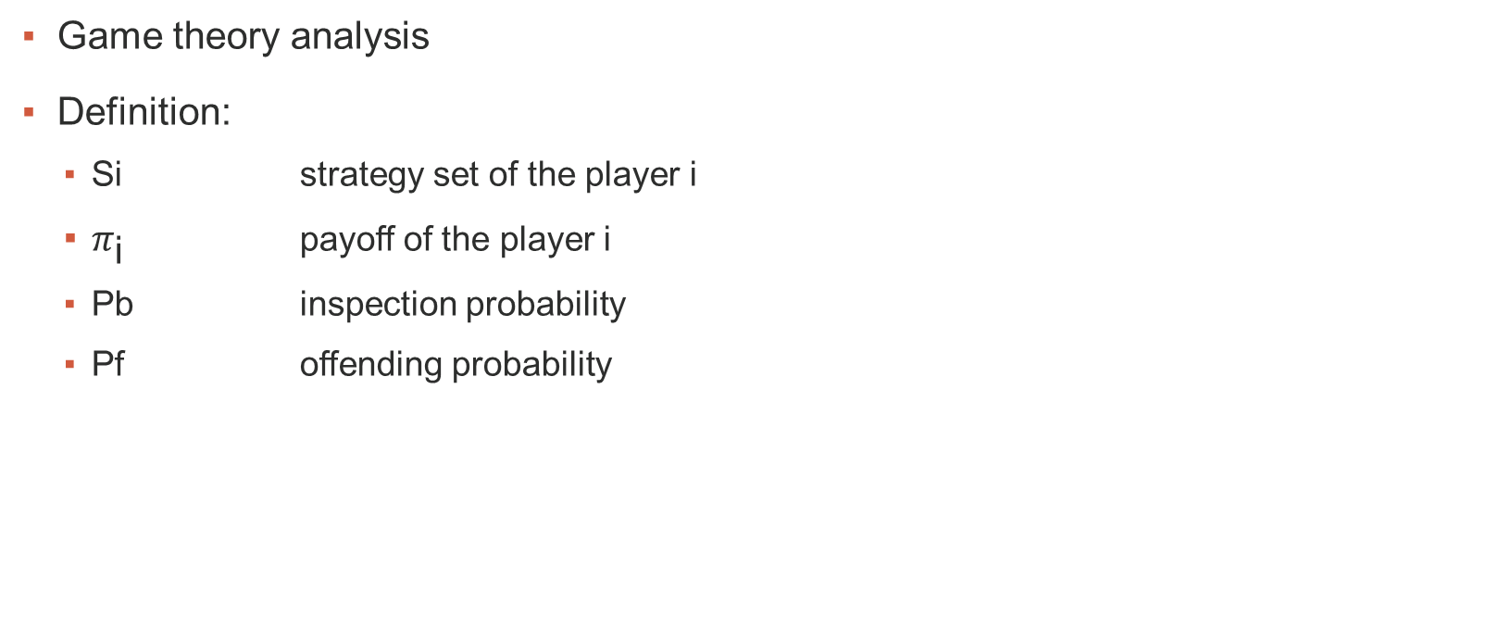
iTrust: Game Theory Analysis
Game theory analysis
Definition:
Si strategy set of the player i
$π_{\text{i}}$ payoff of the player i
Pb inspection probability
Pf offending probability

Slide 20
iTrust: Game Theory Analysis
Game theory analysis
Definition:
Si strategy set of the player i
$π_{\text{i}}$ payoff of the player i
P(b) inspection probability
P(f) offending probability

Slide 21
iTrust: Game Theory Analysis
Theorem 1. If TA inspects at , a rational node must choose forwarding strategy, and TA will get a higher profit than it checks all the nodes in the same round.
Proof:
If node chooses to offend, its payoff is:
If node chooses to forward, its payoff is:
(1- )

Slide 22
iTrust: Misbehavior Detection Cost
Misbehavior detection cost incurred by evidence transmission and verification
Definition:
$λ_{ij}$ contact rate between Ni and Nj
E[t] = $\frac{1}{λ_{ij}}$ contact interval
T inspection period
Number of contacts
Expectation of transmission and verification cost

Slide 23
iTrust: Further improvement
Check nodes at different probabilities
Combine with reputation system
Define the inspection probability P(b) to be the inverse function of node reputation r

Slide 24
Experiments & Evaluation

Slide 25
Evaluation Metrics
Metric | Description
PLR | Packet loss rate, [0, 1]. 0 stands for normal nodes, 1 for black hole nodes
Misidentified Rate | Measure the false negative rate.
Detected Rate | Measure the effectiveness to detect malicious nodes
Cost_{transmission} | The number of evidence transmission for misbehavior detection
Cost_{verification} | The number of evidence verification for misbehavior detection

Slide 26
Scalability
iTrust has little impact on the performance of DTN users.
Therefore, iTrust achieves a good scalability

Slide 27
Impact of Percentage of Malicious Nodes
Malicious node rate has little effect on
the detected rate of malicious nodes
The increase of malicious nodes will reduce
the proportion of the misidentified nodes

Slide 28
Impact of Various Packet Loss Rate
PLRs have little effect on the performance
The misidentified rate is not affected by PLRS
Notes:
Legends are wrong, should be Packet Loss Rate instead of Malicious Node Rate.

Slide 29
Impact of Choosing Different Detection Probabilities
Reduced inspection cost
Significantly reduce transmission overhead

Slide 30
Impact of Nodes’ Mobility
The variation of speed will not affect the detected rate and misidentified rate

Slide 31
Impact of Message Generation Interval
The messages propagation in the network
does not involve all malicious nodes
Due to the same reason, the misidentified
rate will also decrease

Slide 32
Conclusion
Introduced data forwarding evidences
Proposed probabilistic misbehavior detection scheme that significantly reduced cost without compromising detection performance
Simulation result confirmed that the model is able to detect malicious nodes with lower cost

Slide 33
Q&A
Thank you!

