Slide 1
Learning styles II (E-learning & case study)
Presented by:
Mohammed Seyam

Slide 2
Outline
About learning styles
Issues in learning styles models
Learning styles & E-learning
Dunn’s Model
Design issues in learning style systems
Case study: iWeaver

Slide 3
Learning Styles
Many definitions
“The way in which each learner begins to concentrate, process and retain new and difficult information. That interaction occurs differently for everyone.” (Dunn & Dunn).
There are no good and no bad learning styles.
What is measured is PREFERENCE, not competence

Slide 4
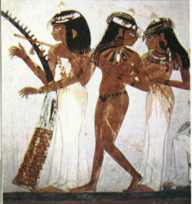
Egypt!
Ancient Egyptians believed the heart was the centre of intelligence and emotion.
They also thought so little of the brain that during mummification, they removed the brain entirely from bodies!

Slide 5
Problems with Learning style models
The major critique to the Learning Style Inventory as a measurement of learning styles is lack of its objectivity, reliability and validity.
Other complains are connected to its generalizability as it has been used within a fairly limited range of cultures. For its broader use further studies are needed.

Slide 6
Problems with Learning style models
The practice is "nonsense" from a neuroscientific point of view: "Humans have evolved to build a picture of the world through our senses working in unison, exploiting the immense interconnectivity that exists in the brain.“
According to Stahl, there has been an "utter failure to find that assessing children's learning styles and matching to instructional methods has any effect on their learning."

Slide 7
Problems with Learning style models
The Association for Psychological Science (APS) panel concluded: “at present, there is no adequate evidence base to justify incorporating learning styles assessments into general educational practice”

Slide 8
Problems with Learning style models
Clearly people have learning preferences, but they are most likely not because they are a specific type of learner.
Labelling learners may actually do more harm than good

Slide 9
Elearning
Flexible, non-linear format enabling self-directed learning
Synonymous with distance learning, web-based learning, online education
E-learning environments are unable to produce successful students if learning styles, age, maturity level and students’ interest are not considered in the design process

Slide 10
Learning Styles and e-learning
Alomyan (2004) review: Adaptability is suggested to be an important factor in the design of online learning systems to enable a variety of individuals to use the system
Further research is needed using the author’s proposed learning model to study the relationship of individual differences within web-based learning systems

Slide 11
Learning Styles and e-learning
Yilmaz-Soylu & Akkoyunlu (2009) experimental study:
Results: Surprisingly, the authors found that learning styles did not significantly affect students’ achievements in different learning environments.

Slide 12
Learning Styles and e-learning
Battalio (2009) quantitative study:
Found that online learning privileges those who are self-directed, independent and goal-oriented.

Slide 13
Learning Styles and e-learning
Clayton, Blumberg & Auld (2010):
Examined how students’ achievement goals, self-efficacy and learning strategies influenced their choice of an online, hybrid or traditional learning environment.
Results: most students who preferred traditional learning environments differed in their motivational beliefs and learning strategies.

Slide 14
Learning Styles and e-learning
How? -> Students who preferred traditional environments showed a mastery of goal orientation and greater willingness to apply effort while learning
whereas those who preferred online environments were more confident that they could manage a non-traditional class

Slide 15
Issues in learning styles research in E-learning field
Curry (Delahoussaye, 2002) summarised several issues that plagued learning styles research:
(1) design flaws due to overgeneralisation
(2) assessment of styles on only one occasion by one instrument
(3) uncontrolled confounding factors such as ability, gender, time-on-task, and prior knowledge.

Slide 16
Issues in learning styles research in e-learning field
(4) selection of extreme rather than moderate styles for matching studies
(5) weaknesses in the validity and reliability of models
(6) external threats such as the Hawthorne effect, experimenter bias and pre-testing (training) effects.
For these reasons, Curry conceded that the learning style research base was not as strong as it could be.

Slide 17
Selecting an assessment instrument
Three criteria were established for selecting a learning style model and the accompanying assessment instrument. They must:
1. encompass the perceptual and information processing dimensions,
2. be based on a strong research base, and
3. have a high degree of model validity and (to a lesser extent) instrument reliability.

Slide 18
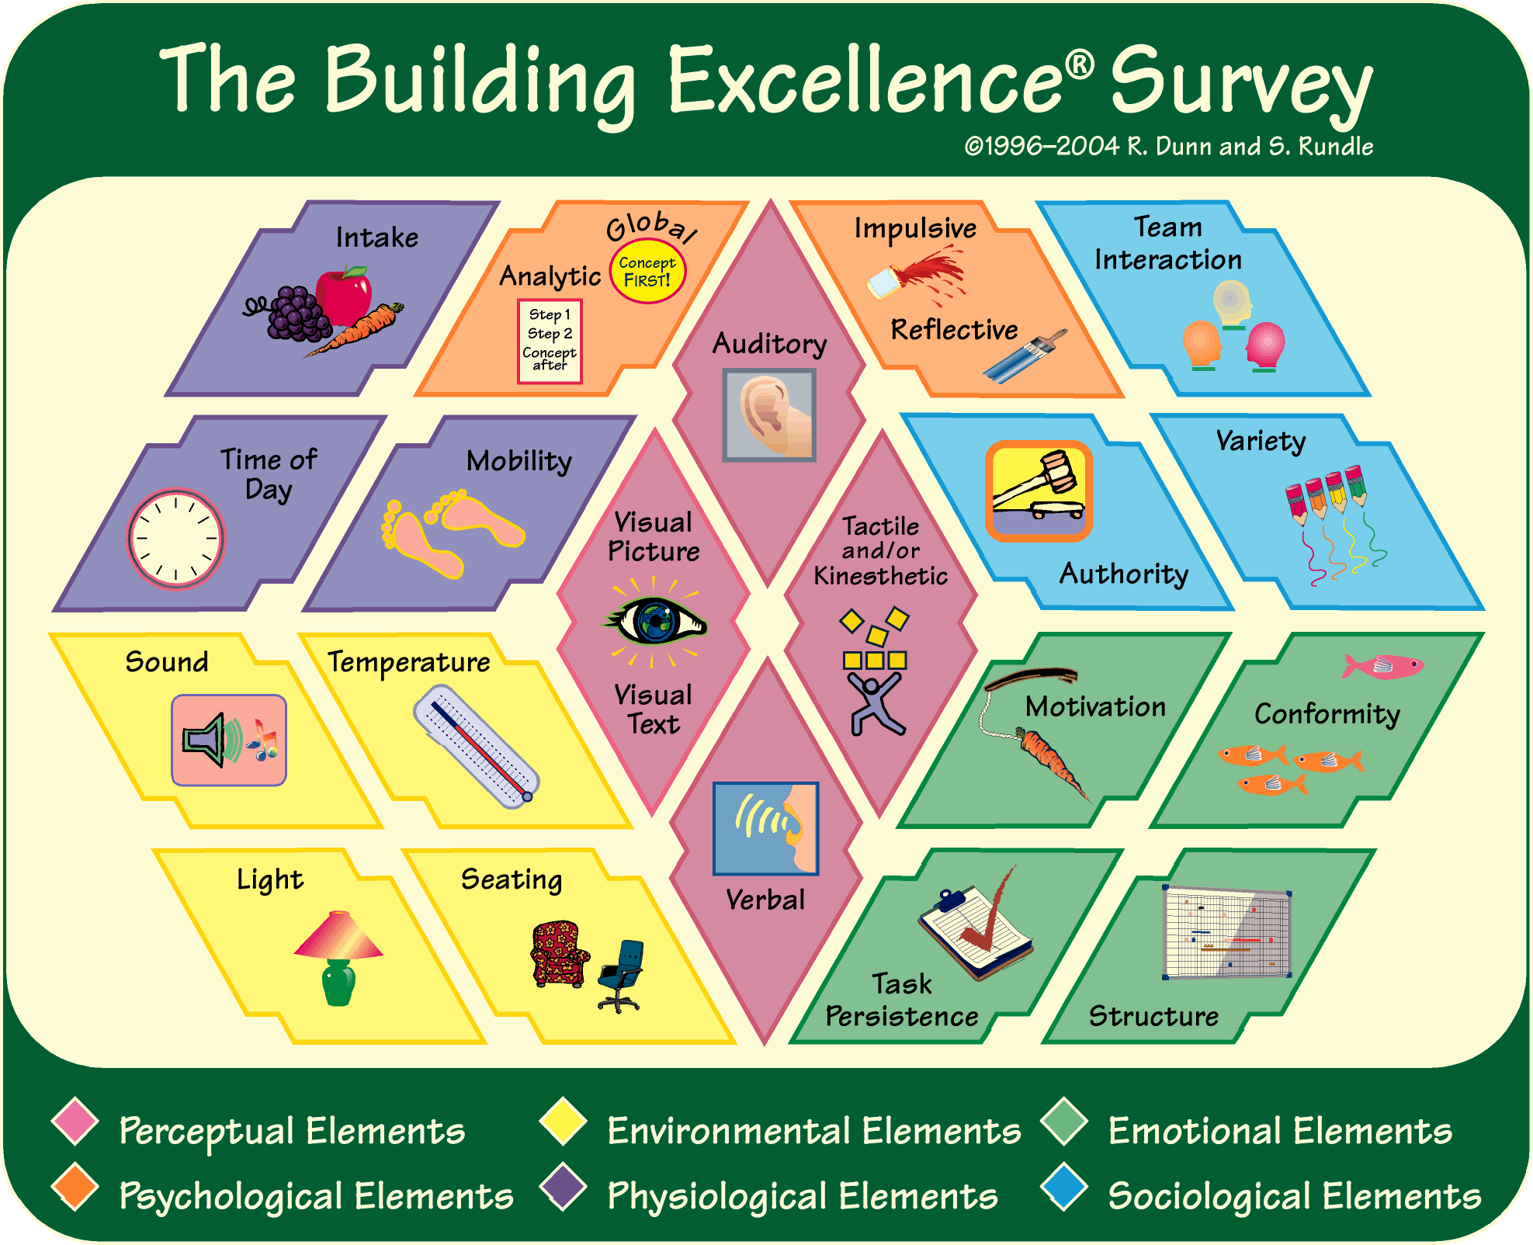
Dunn’s BE survey and model

Slide 19
Dunn’s BE survey and model

Slide 20
Dunn’s BE survey and model

Slide 21
Dunn’s BE survey and model

Slide 22
Dunn’s BE survey and model

Slide 23
Dunn’s BE survey and model

Slide 24
Dunn’s BE survey and model

Slide 25
Design issues in learning styles-based systems
Three general design issues were identified in existing environments:
1) the applied learning style models had limitations. Several were based on self-assessment; others did not include the perceptual dimension.
2) adaptive components were rarely custom-designed. Instead, existing media were often re-used from earlier courses.
3) existing environments often restricted learner control.

Slide 26
Design issues in learning styles-based systems
The iWeaver project attempted to overcome the identified limitations by:
(1) using a well-researched and more comprehensive learning style model
(2) using custom-designed media representations and learning tools
(3) allowing learners to choose and switch between styles at any time.

Slide 27
iWeaver
When learners enter the iWeaver environment for the first time, they complete the standardised “Building Excellence Inventory” form

Slide 28
iWeaver
The user interface design of an exemplary learning unit about the switch-statement.

Slide 29
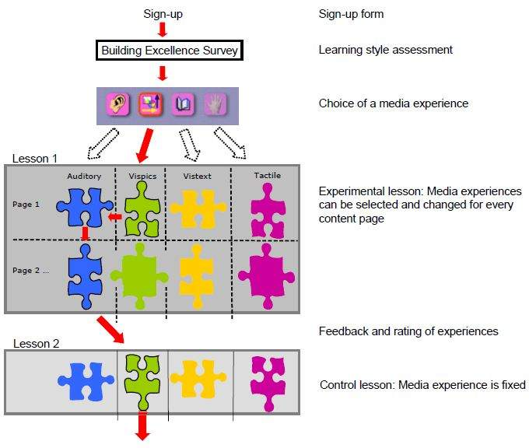
iWeaver: Adaptability

Slide 30
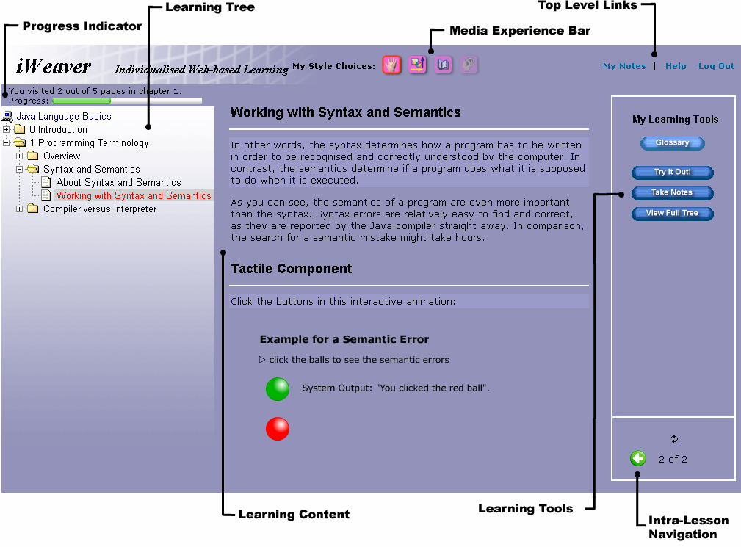
iWeaver: Main interface

Slide 31
iWeaver: Media Experiences
iWeaver offers four different media experiences that are tailored towards the perceptual domain of the Dunn & Dunn learning styles model.
1- visual text
2- visual pictures
3- interactivelets (visually interactive through kb or mouse)
4- Auditory

Slide 32
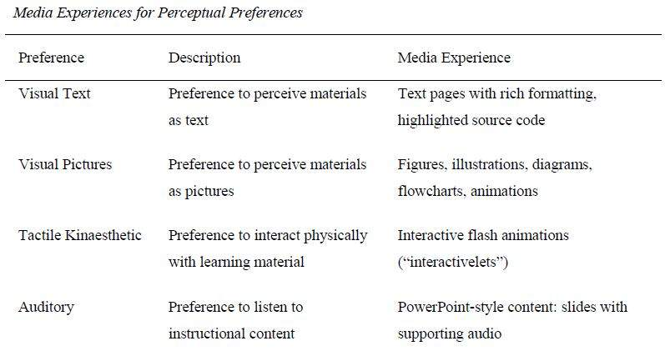
iWeaver: Media Experiences

Slide 33
iWeaver: Visual text

Slide 34
iWeaver: Visual Pictures

Slide 35
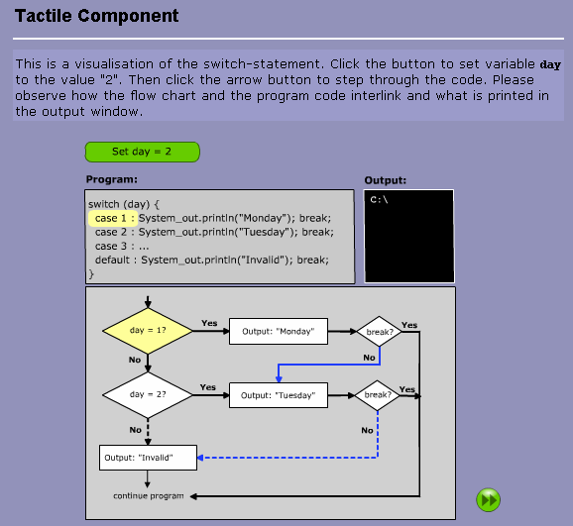
iWeaver: Tactile Component

Slide 36
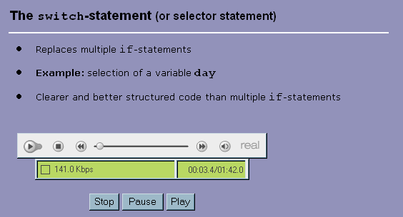
iWeaver: Auditory

Slide 37
iWeaver: Learning Tools
iWeaver offers a number of learning tools as an addition to the described media experiences.
These tools are tailored towards the different learning styles in the psychological domain of the Dunn & Dunn learning styles model.

Slide 38
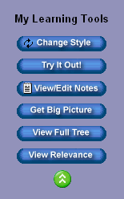
iWeaver: Learning tools menu
Accommodates different psychological styles
Global learners can access mind-map diagrams to understand the sense of the big picture
Learners who like to make connections can access additional examples.
Reflective learners have the opportunity to take notes and answer reflective questions with a note-taking tool.
Impulsive learners can immediately try out example code with the help of an online compiler.

Slide 39
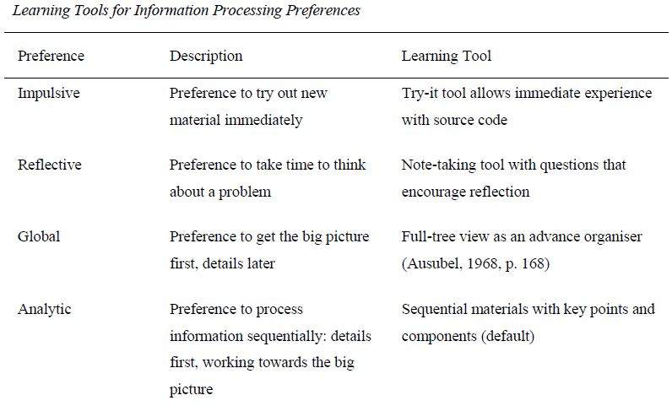
iWeaver: Learning tools menu

Slide 40
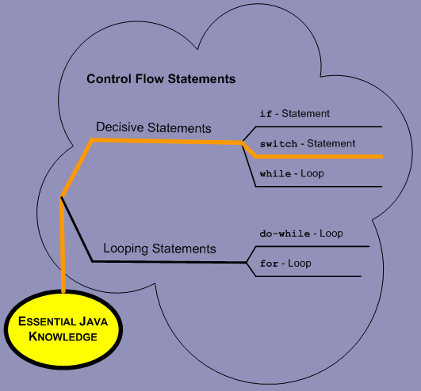
iWeaver: Mind maps

Slide 41
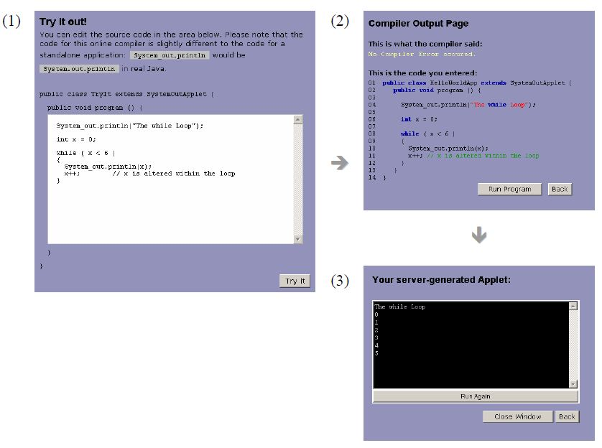
iWeaver: Try it out

Slide 42
iWeaver: Adaptability
The current version of iWeaver implements a combination of adaptive navigation and adaptive content presentation techniques
Adaptive link ordering, which has been shown to improve selection time
Adaptive link hiding is implemented by hiding links to experiences that are unlikely to be chosen

Slide 43
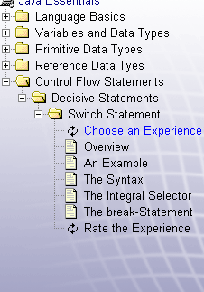
iWeaver: Adaptability
The content navigation is also designed in an adaptive manner.
The navigation is based on the familiar Windows Explorer tree metaphor with expandable / collapsible submenus and content leaves.
The more learning units and modules the learner covers, the more complex the tree becomes.

Slide 44
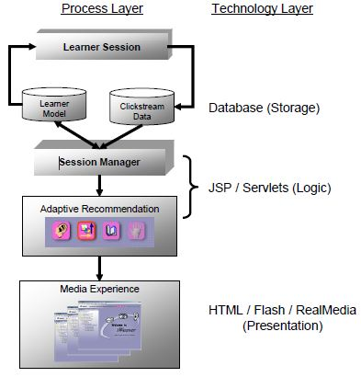
iWeaver: Technology

Slide 45
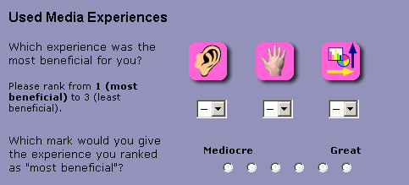
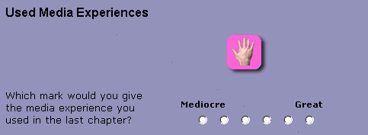
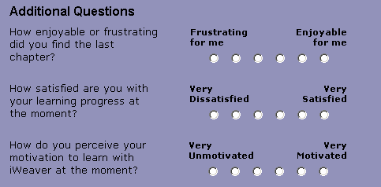
iWeaver: Feedback

Slide 46
iWeaver: Evaluation Criteria
1. The learning style approach can be catered for by computer-based learning.
2. The learning style methodology must be able to be modelled computationally.
3. There must be no, or very low, costs involved in using the tool (copyright, IPR etc).
4. The learning styles tool must have a good degree of internal validity
5. It should be suitable for use with a variety of media used to represent information, such as images, text, animation, audio and video.

Slide 47
iWeaver: Evaluation Criteria
In Brown’s Study, when applied the previous criteria on iWeaver, the results where:
1. The learning style approach can be catered for by computer-based learning. (Partially)
2. The learning style methodology must be able to be modelled computationally. (Partially)
3. There must be no, or very low, costs involved in using the tool (copyright, IPR etc). (No)
4. The learning styles tool must have a good degree of internal validity (No)
5. It should be suitable for use with a variety of media used to represent information, such as images, text, animation, audio and video. (Yes)

Slide 48
Thank You ...

Slide 49
Selected References (1/2)
Alomyan, H. (2004). Individual differences: Implications for web-based learning design. International Education Journal, 4(4), 188-196.
Battalio, J. (2009). Success in distance education: Do learning styles and multiple formats matter? American Journal of Distance Education, 23(2), 71-87.
Clayton, K., Blumberg, F., & Auld, D. P. (2010). The relationship between motivation, learning strategies and choice of environment whether traditional or including an online component. British Journal of Educational Technology, 41(3), 349-364.
Dennis, K., Bunkowski, L., & Eskey, M. (2007). The little engine that could--how to start the motor? Motivating the online student. InSight: A Collection of Faculty Scholarship, 2, 37-49.
DUNN, R., DUNN, K. and FREELEY, M.E. (1984): Practical applications of the research: Responding to students’ learning styles-step one. Illinois State Research and Development Journal 21(1):1-21.

Slide 50
Selected References (2/2)
Stahl, G., T. Koschmann and D. Suthers (2006). Computer-supported collaborative learning: An historical perspective. in The Cambridge Handbook of the Learning Sciences. R. K. Sawyer. Cambridge, UK, Cambridge University Press: 409-426.
West, W., Rosser, B., Monani, S., & Gurak, L. (2006). How learning styles impact e-learning: A case comparative study of undergraduate students who excelled, passed, or failed an online course in scientific/technical writing. E-Learning, 3(4), 534-543.
Yilmaz-Soylu, M., & Akkoyunlu, B. (2009). The effect of learning styles on achievement in different learning environments. Turkish Online Journal of Educational Technology, 8(4), 43-50.
http://www.eurodl.org/index.php?article=61

