Slide 1
Blended learning (traditional versus and online courses)
Alex Cioaca

Slide 2
Talk Outline
Core ideas
Research study
Some theory
Online tools
Conclusions

Slide 3
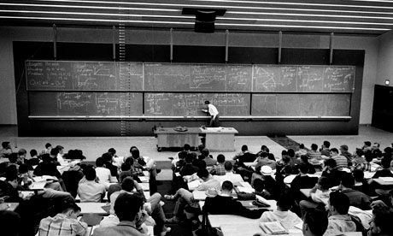
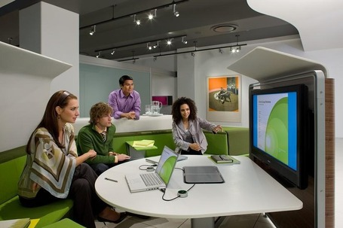
Paradigm shift in education
Before
Deliver instruction
After
Produce and sustain learning
Use technology for distance edu
Build sense of community
“.. with the move from an agrarian to an industrial economy, the small rural schoolhouse was supplanted by the big brick schoolhouse. Four decades ago we began to move to another economy but we have yet to develop a new educational paradigm, let alone create the ‘schoolhouse’ of the future, which may be neither school nor house” - Davis and Botkin (1994)

Slide 4
Producing learning
Involves active group construction of knowledge, rather than transfer of knowledge.
Schools
setting the basis for lifelong, independent learning
moving from a lecture-based paradigm to a model where learners are the focus
Teachers
in charge with the design of learning environments
attending to the students’ intellectual growth, autonomy and social awareness
Students
practicing their ability to become productive members of society
learning how to think, learn, produce, and evaluate knowledge

Slide 5
Producing learning
Challenges
employing new pedagogies and technologies
estimating the depth and speed of the changes required to stay competitive
inside pressure to preserve the status quo

Slide 6
Distance education
The shift from providing exclusively traditional classroom instruction to reaching out to students by delivering courses at distance using technology.
Remarks
students and teachers react to new educational technologies with varied emotions, ranging from enthusiasm to disabling fear (Collins, 1999)
some experience difficulty adjusting to the structure of online courses and managing their time in such environments (Marino, 2000)
distance education requires students who are self-regulated and independent (Abrahamson, 1998)
electronic tools provide a level of reflective interaction that is often lacking in a face-to-face, teacher-centered classroom

Slide 7
Distance education
Challenges
bad course design and pedagogy for teachers with limited skills in CMC
the absence of facial expressions and voice inflections
confusion, anxiety, and frustration due to the perceived lack of prompt or clear feedback from the instructor through electronic media

Slide 8
Sense of community
The need for authentic community in schools, a tie binding learners and teachers through shared values, ideals, and goals.
Represents a major cause of
dropouts among students because of:
insufficient interaction with peers and faculty
differences with the value patterns of the group
general feeling of not fitting in or being isolated

Slide 9
Blended Learning
Definition
The hybrid of traditional face-to-face and online learning so that instruction occurs both in the classroom and online
offers students and teachers both flexibility and convenience
makes efficient use of existing university infrastructure and the student resources
the face to-face component can be either on the main university campus or the professor can travel to a remote site in order to meet with students
the online component becomes a natural extension of traditional classroom learning
the design of a blended course can lie anywhere between opposite ends of fully face-to-face and fully online learning environments

Slide 10
Research study
Assumption
In blended learning, students feel a greater sense of community
(Also, what about the learning experience?)
Reasoning
A combination of face-to-face and online learning environments provides a greater range of opportunities for students to interact with each other and with their professor.
These interactions should increase:
socialization
sense of being connected to each other
construction of knowledge through discourse

Slide 11
Research study
Location
Small accredited university located in an urban area of southeastern Virginia
Subjects
68 graduate students enrolled in three graduate-level education courses during the same semester.
.

Slide 12
Course methodologies
Traditional
Met on-campus
One 3-hour session per week (48 hours total)
Blended
Also met on-campus
One 1-hour session per week (16 hours total)
Fully online
Blackboard LSM
Group discussion boards, 12-15 students each
No online tech
Textbook study assignment
Lecture with class-wide discussion
Collaborative and individual group work (2-3 students)
Blackboard LSM for course material and conversations
Textbook study assignment
Practical applications
Collaborative action research
Group project
Individual work
Collaborative work as a weekly problem-oriented discussion topic

Slide 13
Procedure and instrumentation
Connectedness and learning measured with the Classroom Community Scale (CCS)
20 self-report items such as “feel isolated” / “feels like a family”
5-point Likert scale (strongly agree, agree etc)
Connectedness subscale = the feelings of students regarding their cohesion, community spirit, trust, and interdependence
Learning subscale = the feelings of students regarding the degree to which they reached and shared educational goals
Scores on each subscale can range from 0 to 40
There were no significant differences in the composition of the three courses by gender, age, or ethnicity

Slide 14
Procedure and instrumentation
Traditional and blended course participants completed the CCS in-class
Pretest – 2nd week; Posttest – the final two weeks of the semester
Participants were unaware of their final grades when doing the CCS test
A causal-comparative design was used to determine whether the mean differences in sense of community at the end of each course were larger than expected by chance.
Since random assignment of participants to groups was not possible, the data was analyzed using a multivariate analysis of covariance (MANCOVA) to provide statistical matching of groups based on the pretest results
Effect size was calculated using the eta-squared statistic and interpretation was based on Cohen’s thresholds (.01 small / .06 moderate / .14 large)

Slide 15
Results
PRETEST
4.12
2.39
4.10
2.76
3.83
4.61
POSTTEST
4.85
3.55
4.42
3.74
8.45
6.20

Slide 16
Interaction in (distance) education
Learner-Teacher
Learner-Learner
Learner-Content
Learner-Interface
Vicarious and passive
Teacher-Content, Content-Content, Teacher-Teacher

Slide 17
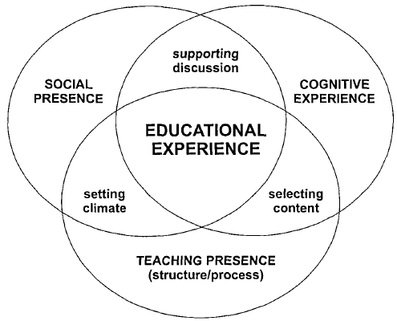
Interaction in (distance) education

Slide 18
Teacher presence
Definition
The design, facilitation, and direction of cognitive and social processes for realizing learning outcomes that are meaningful and educational.
Behavioral indicators
clearly communicating course objectives and instructions
facilitating student progress and learning
providing meaningful feedback

Slide 19
Cognitive presence
Definition
The ability of participants to construct and confirm meaning through sustained reflection and discourse.
Behavioral indicators
events triggering exploration of the subject
integrating new knowledge to construct meaning
resolutions enabling learners’ application of new knowledge to authentic contexts beyond the classroom

Slide 20
Social presence
Definition
The ability to establish a sense of immediacy, connection, and co-presence between participants in spite of a distributed medium.
Behavioral indicators
humor
self-disclosure
the use of informal language

Slide 21
Online tools for blended learning
Top-level Universities are already offering blended learning courses that take advantage of new technology
For reasons of platform compatibility, web-based tools (SaaS) are gaining more popularity. Mobile apps available, too
Some tools are free to use, and some not
They need to bring clear improvements on the learning process
Must fulfill the teaching, cognitive or social presence

Slide 22
Collaborative work environments
Social presence? Cognitive presence?
Allow students to collaborate on tasks and projects
Many possible types of resources: text, pictures, sound, diagrams etc
Traditional way = iterating over work, one person at a time
More advanced = CVS (github, mercurial)
Real-time collaborative work environments
Most popular example – Google Docs

Slide 23
Collaborative work – Etherpad

Slide 24
Collaborative work – Twiddla

Slide 25
Brainstorming – Bubbl.us

Slide 26
Brainstorming - Mindmeister

Slide 27
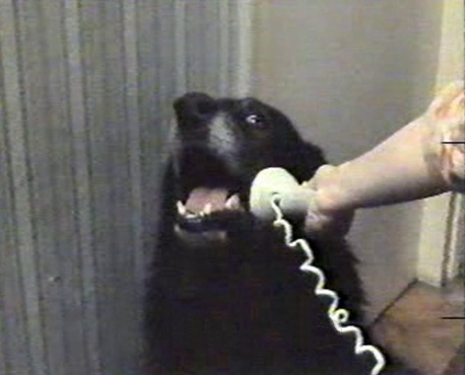
Communication
Online campuses (better suited for fully-online courses)
Forums
Q & A sites
Piazza
Tutorhub
Quora
Notice boards
Wallwisher
Stixy
Integration with social networks
Inigral
GoingOn

Slide 28
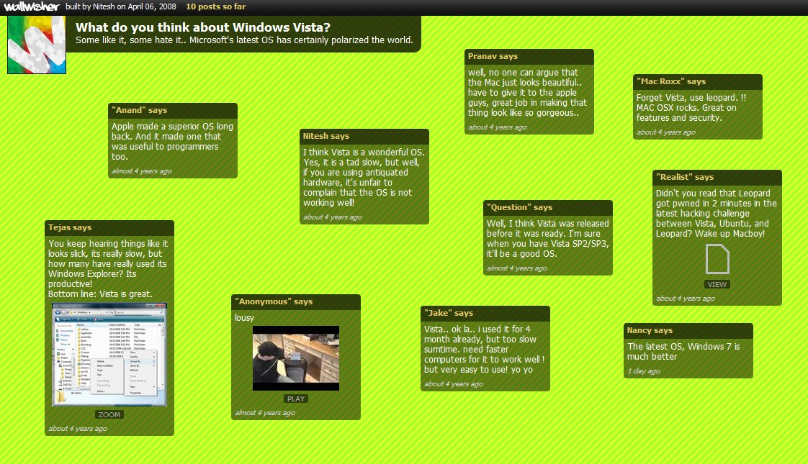
Notice boards – Wallwisher

Slide 29
Notice boards – Linoit

Slide 30
Course management tools
Quizzes
Google Docs + Flubaroo
Proprofs
Classmaker
Polls
Poll Everywhere
Gradebooks
LearnBoost
Miscellaneous

Slide 31
Management – LearnBoost

Slide 32
Management – Three Ring

Slide 33
Personalized learning
Customized learning path
OpenEnglish
Knewton
Learning through games
Quizlet
Mindsnacks
Lumosity
Building online reputation
Openstudy
Top Hat Monocle

Slide 34
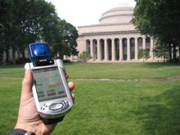
Augmented Reality
AR is a live, direct or indirect, view of the real-world environment whose elements are augmented by computer-generated sensory input such as sound, video, graphics or GPS data.
AR became popular over the last years because of smartphones.
MIT course designed by “The Education Arcade” where students are sent on the field to investigate a toxic spill. Clues about the subject are virtual and generated by a central computer, which makes the game different each time. Students use mobile devices

Slide 35
Augmented Reality – Leafsnap
For botanical sciences, forestry etc
Identifies plant by leaf shape

Slide 36
Augmented Reality – Audobon
For zoology, wildlife sciences etc
Identifies birds from the sound they make

Slide 37
Wikis
Easy to “use” (aka read) and edit
Free of charge
Types of knowledge
theory, facts, data, photos etc
relations and categories
refinement processes
Roles in education
Learning source
Test-bench or class project
Assessment (Wikipedia game)

Slide 38
Virtual classroom
Has to provide an environment resembling to the classroom
Ability to broadcast
Audio
Video
Text
Other resources
Software-based tools are more popular for now
Web-based are starting to gain some popularity (HTML5?)

Slide 39
VC – Big Blue Button

Slide 40
Learning management systems
Integrates most of the tools presented so far
Should communicate (import / export) with standalone tools
Design question: do we need all these features?
Examples: Moodle, Blackboard, Mindtap, Coursekit

Slide 41
LMS – Coursekit

Slide 42
LMS – Instructure

Slide 43
eTextbooks
Readers
Kno
ElevenLearning
eTextbook readers usually contain features such as highlighting, annotation, thesaurus, exporting etc
Content creators, editors and distributors
Cengage
Wiley
McGraw-Hill

Slide 44
eTextbooks – Kno

Slide 45
eTextbooks – Kno

Slide 46
eTextbooks – CourseSmart

Slide 47
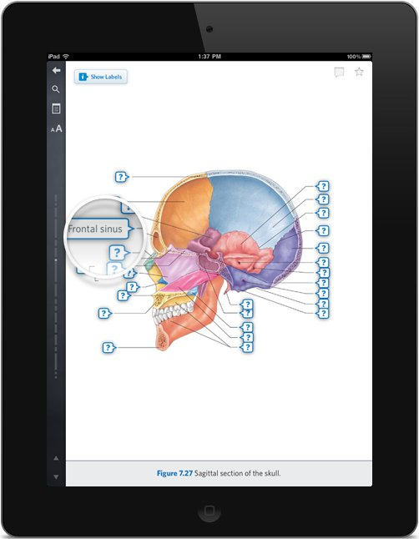
eTextbooks – Inkling

Slide 48
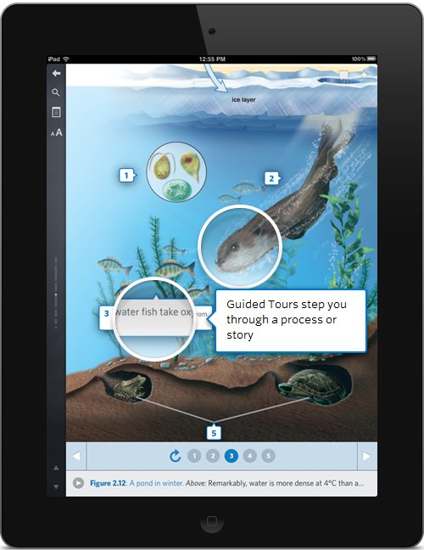
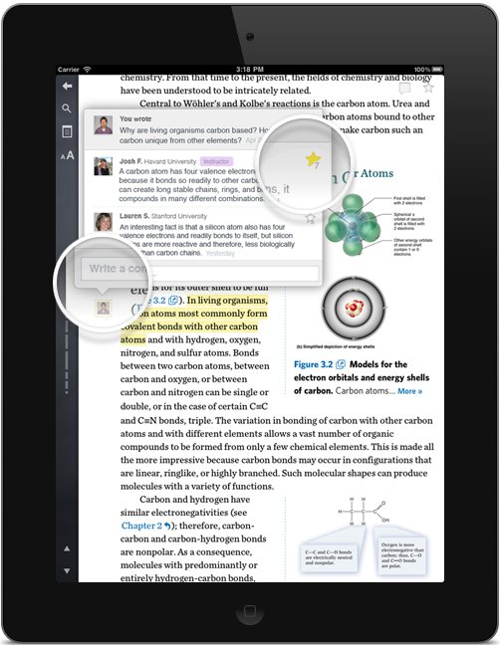
eTextbooks – Inkling

Slide 49
Conclusions
Blended learning is a (proven) better alternative than traditional or fully online courses
With recent advances in technology, there is a rich offering of tools that can help instructors and students in blended learning
However, these tools fall under only 6-7 categories. There is still room on the market for even more products
No such thing as a critical mass of tools or a single swissknife. Choosing a set of tools has to take into account the education level and the curricula
Tools that are not created specifically for education can still be used in blended learning, by changing the perspective on how to use them
eTextbooks trends similar to Web 2.0: working and logging in the cloud, integration with social networks, heavy use of multimedia

Slide 50
References
“Blended Learning and Sense of Community: A comparative analysis with traditional and fully online graduate courses” – Rovai, Jordan
“Virtual interaction: Design factors affecting student satisfaction and perceived learning in asynchronous online courses” - Swan
American Journal of Distance Education
Journal of Computer-Assisted Education
Canadian Journal of Distance Education
http://www.classroom-aid.com
http://c4lpt.co.uk (Center for Learning and Performing Training)

Slide 51
The end

