Slide 1
e-Assessment Systems and Question Banks
Ambika Karanth
Cs 6604 Designing and implementing online education systems
April 9, 2015

Slide 2
The Challenge
How can an instructor evaluate if learning objectives are being met?

Slide 3
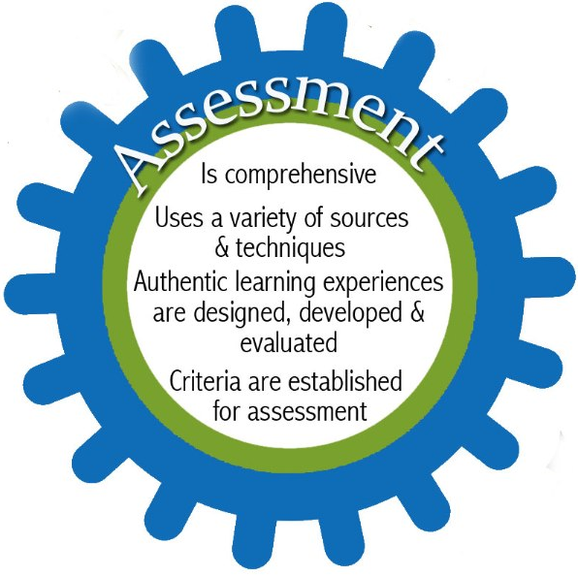
The Solution

Slide 4
Trend
Number of research papers available
Google Scholar search results for ‘Automated Assessments + Question Banks’
Year

Slide 5
Outline
Introduction
e-Assessment
    What is e-Assessment?
    Types of e-Assessment
    Motivations
    Important Considerations
    Assessment and Learning
    Learners’ Need
    Enhancing Assessment Methods
    Case Study 1 – The TRIADS
    Case Study 2 – Summative Assessment
    Case Study 3 – Merging formative and summative Assessment
    Challenges
Question Banks
    Standard Question Types
    Standard Question Format
    GIFT – Moodle Format with several examples
    Case Study 4 – COLA Project
Conclusion

Slide 6
What is e-Assessment?
Broad Definition:
      Any assessment that involves use of digital technology for the following activities :
          Designing and delivery of assessments
          Grading by computers or by human-assisted scanners
          Reporting, storing, transferring of data associated
Joint Information System Committee (JISC) Definition :
      e-Assessment is the end-to-end electronic assessment processes where Information and Communication Technology (ICT) is used for the presentation of assessment activity, and the recording of responses.

Slide 7
Classifications
Assessments are classified based on two types :
Activity –based : CAA and CBA
Nature – based : Diagnostic, Formative and Summative

Slide 8
Based on Activity
To differentiate between different activities :
Computer-assisted Assessment (CAA) :
      Use of computers to assess students’ progress
      Can vary in format:
        Consist of pre-printed paper test on to which students can mark their response and automatically processed using optical mark reader
        Involve the direct input of students’ response into a computer terminal
Computer-based Assessment (CBA) :
      It is stand alone and is specific to certain machines within a local network ( intranet)

Slide 9
Based on Nature of Assessments
Diagnostic :
      Determine students’ knowledge prior to starting a course
      Potentially allows amendments to their specific course design
Formative :
      Include ongoing feedback either during assessment or after
      Provides developmental feedback to learner in his/her understanding skills
      Called “Assessment for learning”
      Example : Weekly-Assignments, Exercises
Summative :
      Contributes to students’ end-of-year mark
      Final Assessment of a learners’ achievement
      Example : Final- Exam

Slide 10
Motivations
Can lead to more effective learning
  Better way to identify support needs of learner
  Evidence of both cognitive and skill based achievements in ways that are durable and transferable
  Encourage deeper learning
Supports personalization
  Benefits learners for whom traditional assessment regime presents difficulties due to distance, disabilities, illness or other work commitments
  Students can be fast tracked

Slide 11
Motivations
Reduced workload
Timely feedback/evaluations
Improved quality of feedback/evaluations
Multiple tests are possible

Slide 12
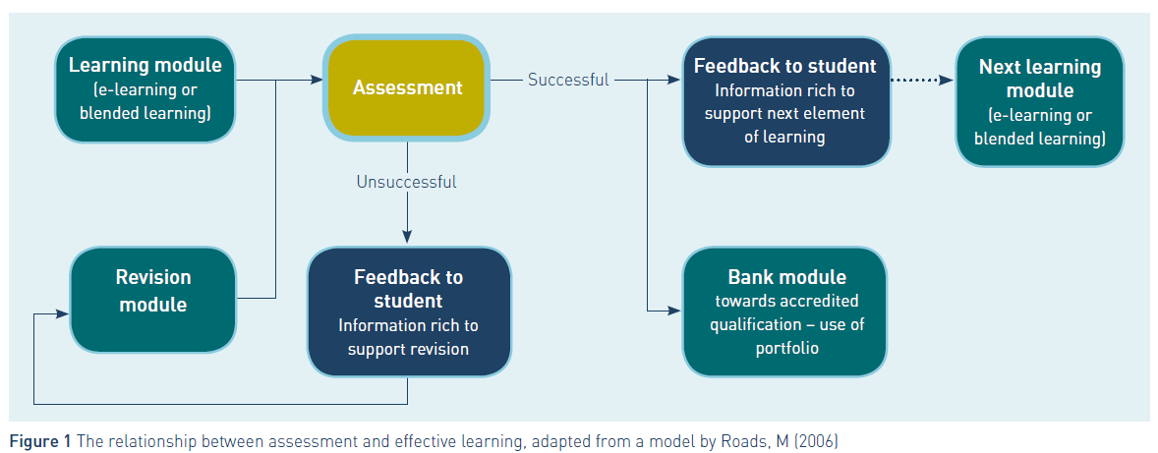
Assessment and Learning

Slide 13
Brainstorm – Question 1
Do you as students feel comfortable with doing assessments on computers?

Slide 14
Brainstorm – Question 2
Do you consider e-Assessment as a practical, secure and reliable alternative to traditional paper-based assessment?

Slide 15
Learners’ Need
‘I feel that assessment on a computer is better than writing because usually you forget what you are going to write…before you write it. The brain works faster than your handwriting.’
- Student, University of Derby

Slide 16
Learners’ Need
Access to assessment resources out of school
High-quality web-based assessments for learning
Opportunities to personalize their learning, by taking some assessments online on-demand
Innovative game-based assessments for learning
Online peer and tutor support
High-quality feedback on online formative assessments

Slide 17
Enhancing assessment methods
Following are important considerations when rethinking assessment practices:
Timeliness
Relevance
Accessibility
Quality of supporting systems
Validity and Security

Slide 18
Case Study 1 – The TRIADS
Background :
Tripartite Interactive Assessment Delivery System – TRIADS
It is a multimedia interactive e-Assessment system
Developed at the University of Derby in 1992 and further developed in partnership with the University of Liverpool and The Open University
In 2005-2006, it delivered assessments to 10000 students in Derby

Slide 19
Case Study 1 – The TRIADS
Systems and Technology:
  Flexible design structure
  Capability to build in simulations and multimedia
  Code templates for generic question styles that can be used in singly or in combination
  Contain full error trapping routines
  Facilitate partial credits for methods, stages in answer and final answer
  Detail candidate performance reporting is provided helping to pinpoint atypical result
  Supports randomized selection and sequencing of questions
  Delivered over web, LAN or CD

Slide 20
Case Study 1 – The TRIADS
Outcome :
  Despite sophistication offered, 70% of use in 1st year, 20% in 2nd year and 10% in 3rd year
Reduced the workload for staff
‘Something I always try to point out is that it is intellectually a lot more stimulating to design an online or e-assessment than it is to sit there marking 300 scripts.’
-Professor Don Mackenzie, Senior e-Assessment Manager, Innovation 4 Learning, University of Derby
Notes:
He recognizes that the staff had double burden in developing the e-assessments while still undertaking marking generated by traditional practice and it is worth the effort.

Slide 21
Case Study 1 – The TRIADS
Outcome :
  Frequency and timing of access to test revealed information on how and when students study and retake tests
  Many students retake multimedia interactive TRIADS tests, enjoying the challenge of competing to improve their previous scores, as in computer games
  Suggests that students are more likely to test themselves with e-assessment than with pen-paper test
Notes:
He recognizes that the staff had double burden in developing the e-assessments while still undertaking marking generated by traditional practice and it is worth the effort.

Slide 22
Case Study 2 – Summative Assessment
Background:
  At the School of Pharmacy and Pharmaceutical Science, University of Manchester
  Had experience with diagnostic and formative tests before trying summative tests
  Security of the assessment was the main concern
  240 students, some with disabilities, taking first year module in cell biology and biochemistry.
Notes:
He recognizes that the staff had double burden in developing the e-assessments while still undertaking marking generated by traditional practice and it is worth the effort.

Slide 23
Case Study 2 – Summative Assessment
System and Technology:
  Tests delivered on WebCT – the VLE tool
  Questions written in Microsoft Word, imported into WebCT using Respondus 3.0 –a tool for creating tests offline using Windows Interface
  Student identity authenticated by university username and password and photo ID check by the invigilator
  Timed release of exam plus the test-specific password was issued during commencement of the test
  Students could enter response online or on an optical marker sheet
Notes:
He recognizes that the staff had double burden in developing the e-assessments while still undertaking marking generated by traditional practice and it is worth the effort.

Slide 24
Case Study 2 – Summative Assessment
Challenges:
  Possibility of technical failure
    Paper-version of the test was used as a backup
    Students were asked to enter their response on OMR sheets
    Partially computer-based one
    Random ordering of questions
  Problem with importing questions with decimal points.
    Editing has to be carried out in VLE
  WebCT’s inability to work around spelling mistakes.
    List of subject specific keywords provided to students to paste correct spelling
    Reduced discrepancy between hand marking and computer based marking
Notes:
He recognizes that the staff had double burden in developing the e-assessments while still undertaking marking generated by traditional practice and it is worth the effort.

Slide 25
Case Study 2 – Summative Assessment
Outcome:
  Computer-based summative tests are more accurate than the substantially slower traditional method, in which scripts are marked manually
  Cascading style sheet allowed to customize display and helped students with dyslexia
Notes:
He recognizes that the staff had double burden in developing the e-assessments while still undertaking marking generated by traditional practice and it is worth the effort.

Slide 26
Case Study 3 – Merging Formative and Summative Assessment
Challenge and Outcome:
Developed for an online BTEC Intermediate and Advanced Award in IT skills for learners in small scale businesses
Delivered via the Internet with online tutor support
Assessment ongoing and incorporated into course structure and content
Learners progress at their own pace
True or false questions
Wrong answers advise learners to revisit activity
Maintains confidence and morale on a distance learning course
Notes:
He recognizes that the staff had double burden in developing the e-assessments while still undertaking marking generated by traditional practice and it is worth the effort.

Slide 27
e-Assessment: Some challenges
Provide customized views
Needs staff for technical support
Increased effort before test instead of after
Interoperability.
Preparing question banks that can be shared between departments and schools
Need of standard question formats
To make sure all students get test of equal measure
Ability to mark text answers
Notes:
He recognizes that the staff had double burden in developing the e-assessments while still undertaking marking generated by traditional practice and it is worth the effort.

Slide 28
Question Banks

Slide 29
Question Banks
Question format requirements:
  Question types
  Standardization
  Shared and personalized question banks
  Question versioning
Question Interface Requirements:
  Easy but powerful searching
  Rendering questions of equal measure
  Easy organization
  Customized views

Slide 30
Standard Question Types
Description :
This is not a real question. It simply prints some text (and possibly graphics) without requiring an answer
Essay :
In response to a question the respondent writes an answer in essay format.
Matching:
A list of sub-questions is provided, along with a list of answers. The respondent must "match" the correct answers with each question
True/False :
In response to a question, the respondent selects from two options: True or False

Slide 31
Standard Question Types
Fill-in-the-blanks:
These very flexible questions consist of a passage of text that has various answers embedded within it, including multiple choice, short answers and numerical answers
Multiple Choice :
In response to a question the respondent chooses from multiple answers. There are two types of multiple choice questions - single answer and multiple answer
Short Answer :
In response to a question ,the respondent types a word or phrase. There may several possible correct answers, with different grades. Answers may or may not be sensitive to case.
Numerical :
From the student perspective, a numerical question looks just like a short-answer question. The difference is that numerical answers are allowed to have an accepted error. This allows a continuous range of answers to be set

Slide 32
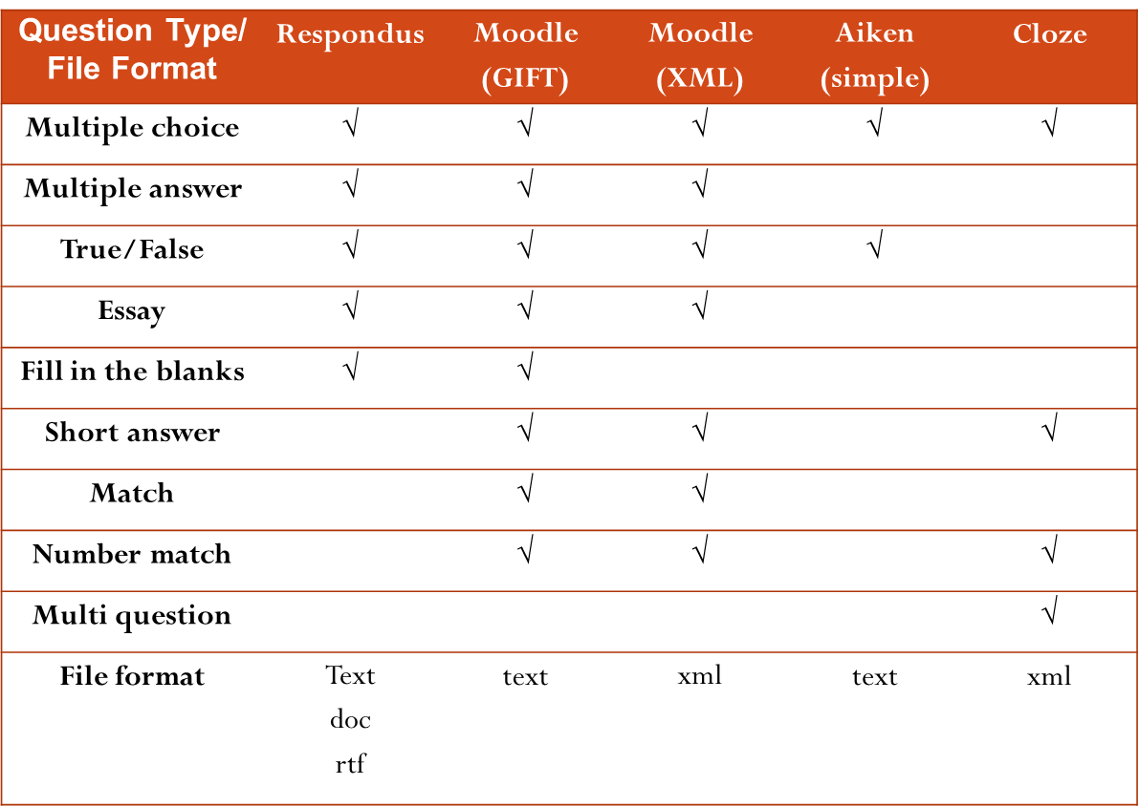
Standard Question Formats

Slide 33
GIFT: Moodle Format
GIFT format allows someone to use a text editor to write multiple-choice, true-false, short answer, matching missing word and numerical questions in a simple format that can be imported
It is also an export file format
The format has been developed within the Moodle Community but other softwares may support it to a greater or lesser degree
Standard Question Format of GIFT :
      Use double colons around the question title
      :: Question 1 ::
      Add the question text on the next line
      :: Question 1 ::
      Question text goes here.
      The answer goes between { }
      :: Question 1 ::
      Question text goes here. { Answer goes here}

Slide 34
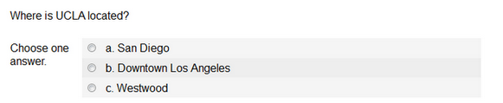
GIFT: Moodle Format – Example 1
Multiple Choice : List all possible answers between the brackets.
Wrong answers are prefixed with a tilde (~) and the correct answer is prefixed with an equal sign (=).
  ::Question 1 - Multiple Choice::
  Where is UCLA located?
  {=Westwood ~San Diego ~Downtown Los Angeles}

Slide 35
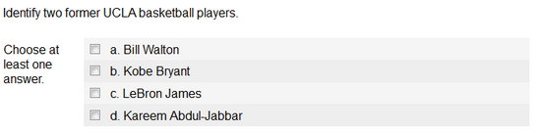
GIFT: Moodle Format – Example 2
Multiple Choice with multiple correct answers : Used when two or more answers must be selected to receive full credit.
  ::Question 3 - Multiple Choice with multiple correct answers::
  Identify two former UCLA basketball players.{
  ~%50%Kareem Abdul-Jabbar
  ~%50%Bill Walton
  ~Kobe Bryant
  ~LeBron James
  }

Slide 36

GIFT: Moodle Format – Example 3
Fill in the blank : A fill-in-the-blank line is automatically inserted when the answer text is inserted into the question.
  ::Question 4 - Fill in the blank::
  The UCLA colors are blue and {=gold}.

Slide 37

GIFT: Moodle Format – Example 4
True or False : The answer should be written as {TRUE} or {FALSE}, or can be abbreviated to {T} or {F}.
  ::Question 5 - True or False::
  The UCLA mascots are Joe and Josephine Bruin. {T}

Slide 38

GIFT: Moodle Format – Example 5
Short Answer : Answers are prefixed by an equal sign. Answers must not contain a tilde.
  ::Question 6 - Short answer::
  What is the name of UCLA's library? {=Powell =Powell Library}

Slide 39
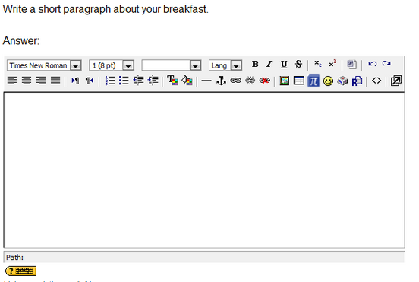
GIFT: Moodle Format – Example 6
Essay : Essay questions have an empty answer field {}.
Note: Essay questions must be manually graded, Moodle won't automatically grade them.
  ::Question 7 - Essay::
  Write a short paragraph about your breakfast. {}

Slide 40
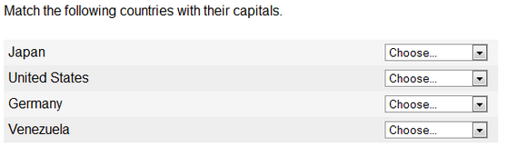
GIFT: Moodle Format – Example 7
Matching - Matching pairs begin with an equal sign and are separated by "->". There must be at least three matching pairs.
  ::Question 8 - Matching::
  Match the following countries with their capitals. {
  =United States -> Washington DC
  =Japan -> Tokyo
  =Germany -> Berlin
  =Venezuela -> Caracas
  }

Slide 41
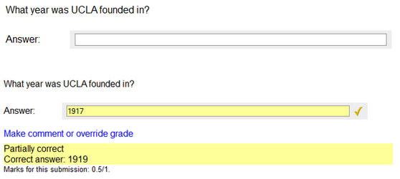
GIFT: Moodle Format – Example 8
Number Range - To allow a range of possible numerical answers, prefix the answer with # and separate the number answer from the range with a colon. You can use this to give partial credit for close answers as well by adding the %#% before the partial credit range
  ::Question 9 - Number range::
  What year was UCLA founded in? {#
  =1919:0
  =%50%1919:2
  }

Slide 42
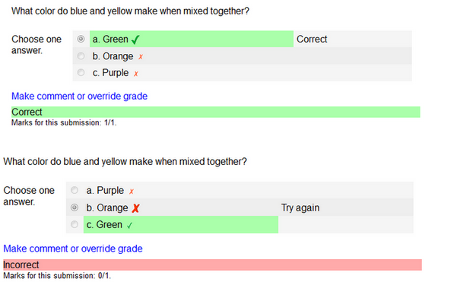
GIFT: Moodle Format – Example 9
Adding Feedback : Feedback for an answer can be added by following the answer with a ‘#’ sign and the feedback.
  ::Question 2 - Multiple Choice with feedback::
  What color do blue and yellow make when mixed together?
  {=Green #Correct ~Purple #Try again ~Orange #Try again}

Slide 43
Case Study 4 : The COLA Project
Background:
  COLEG Online Assessment project (COLA) is run by Scotland's College Open Learning Exchange Group (COLEG)
  The aim is to create an online formative question bank across wide range of courses and levels
  Assessments are objective tests containing up to 20 questions available in 17 subject areas
  Question writers attended workshops to develop best practice techniques and ensure good understanding of objective testing and online delivery

Slide 44
Case Study 4 : The COLA Project
Challenges:
  Developed assessment for four Virtual Learning Environments:
    Blackboard
    Moodle
    Serco (Teknical) Virtual Campus
    WebCT
  The final question bank was delivered in IMS Question and Test Interoperability (QTI) standard compliant form
  None of the VLEs complied with IMS QTI standard
  Solution was that question bank holds only IMS QTI format questions
  Conversion tools were developed for different platforms.

Slide 45
Case Study 4 : The COLA Project
  Question types:
    Multiple choice
    Multiple response
    True or false
    Match
    Fill in the blanks
    Challenges :
  Due to issues with fill in the blanks, they were later removed from the question bank
  Problem with user tracking and scoring in some VLEs
  Accessibility of questions also affected by the way VLEs render them
  Influenced some colleges to upgrade or change VLE.

Slide 46
Case Study 4 : The COLA Project
Outcome:
  Around 500 formative tests have been written between 2005 to 2007
  Practitioners and learners have found them useful
  Raised the profile of e-learning in Scotland
  Highlighted need of innovation in interoperability of systems.

Slide 47
Conclusion
Benefits of e-Assessment:
  More interactive and a better engaging environment
  Quality feedback
  Immediate feedback
  Helps in effective learning
  Helps students with disabilities
  Reduces workload on academic staff
Some challenges:
  Need better ways to incorporate in learning
  Need more sophisticated question formats
  Need better converters for question formats
  Interoperability

Slide 48


Slide 49
References
Joint Information Systems Committee, Effective Practice with e-Assessment, 2007
http://docs.moodle.org
http://classes.sscnet.ucla.edu/docs/Using_GIFT_format_to_create_multiple_questions_at_once

Slide 50
Thank you !

