Slide 1
Pedagogy: Motivation and related issues in online settings
Vanessa Cedeno
CS6604 – Online Education System
02/19/15

Slide 2
Outline
MOOC: Massive Open Online Course
MIT Research into edX’s First MOOC
Stanford Research: Deconstructing disengagement
“Why did you enroll in this course?” Survey

Slide 3
MOOC’s
MIT Open Courseware
Coursera

Slide 4
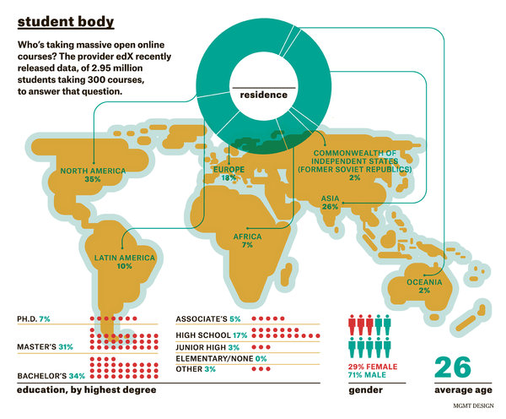
Selingo, Jeffrey J. (2014, October 29). Demystifying the MOOC. The New York Times. Retrieved February 13, 2014,
from http://www.nytimes.com/2014/11/02/education/edlife/demystifying-the-mooc.html?ref=topics
Notes:
Over the past few years millions of people across the world have enrolled in hundreds of MOOCs across many platforms.
Globally distributed population
Great diversity of learner background

Slide 5
Why people enroll in MOOCs?
No cost to entry or exit
Enrollment numbers are just an indication of interest
Number of actively participants learners is overestimated
Low completion rate, which averages no more than 10%
Modolfsky, Mitch. (2014, April 18). Chalkles: Hey MOOC! [Comic]. The EdReach Network. Retrieved February 13, 2014,
from http://edreach.us/2014/04/18/chalkles-hey-mooc-comic/

Slide 6
Research into edX’s First MOOC
“Circuits and Electronics” (6.002x)
Required undergraduate course in the Department of Electric Eng. and CS at MIT
Began in March 2012
155,000 students
14 weeks duration
Ended in June 2012
Lead instructor: MIT faculty member who has taught the on-campus version for many years
3 other instructors: 2 MIT professors and edX’s chief scientist
5 TA’s
3 lab assistatns

Slide 7
Educational Research
One of edX’s core missions
Analyze students use of resources by time spent on each
Who were the 6.002x students?
How their own background and capabilities related to their achievement and persistence?
How their interactions with 6.002x’s curricular and pedagogical components contributed to their level of success in the course?
Notes:
Participation rates tend to decline steadily as the course progress

Slide 8
Course structure
Video lectures releases each week
Less than 10 minutes each, illustrations, text, equations
Interactive problems
Tutorials
Online laboratories
Textbook accessible electronically
Discussion forum
Wiki
A | 87 - 100
B | 86 - 70
C | 60 - 69
15% | 12 homework assignments (2 could be dropped)
15% | 12 laboratory assignments (2 could be dropped)
30% | midterm
40% | final exam

Slide 9
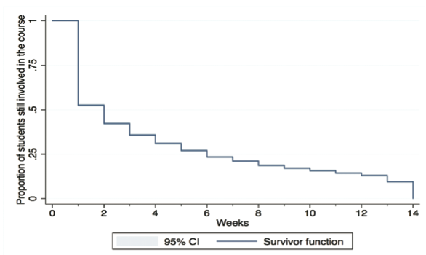
Completion rate
Less than 5% of the registered students completed the course

Slide 10
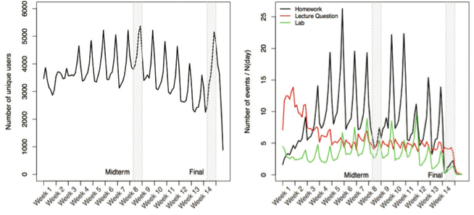
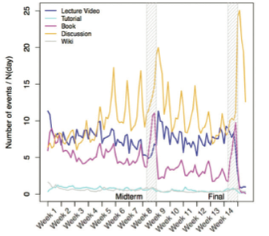
Time and attention allocation

Slide 11
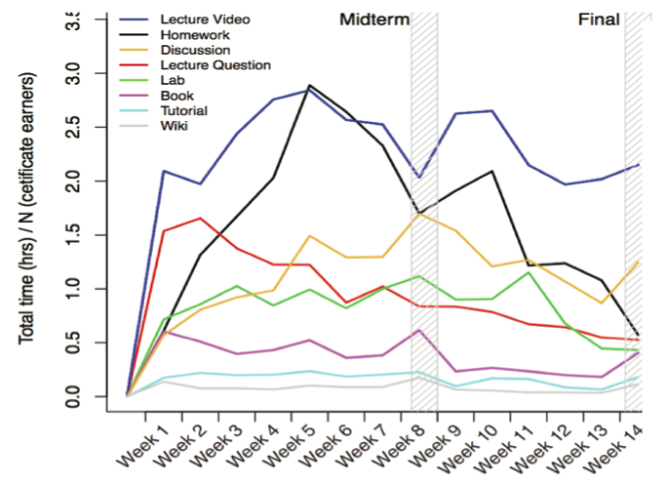
Students use of resources
Notes:
Use of the discussion forum was very popular considering that posting on the forum was neither for credit nor part of the main “course sequence” of prescribed activities. It should be stressed that over 90% of the activity on the discussion forum resulted from students who simply viewed preexisting discussion threads, without posting questions, answers, or comments.

Slide 12
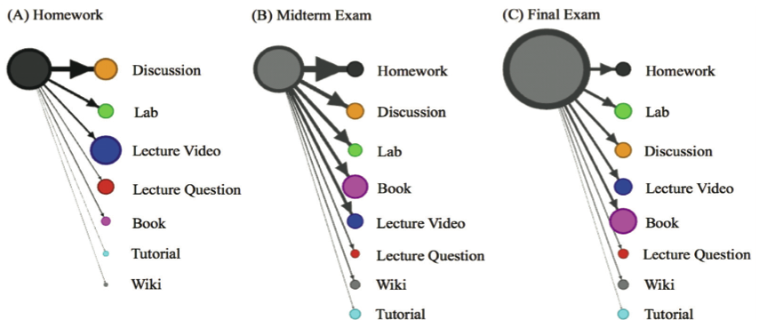
Student strategy
Discussions most frequently used resource while doing homework problems
Lecture videos consumed the most time.
During exams, old homework problems were most often referred to, and most time was spent with the book.

Slide 13
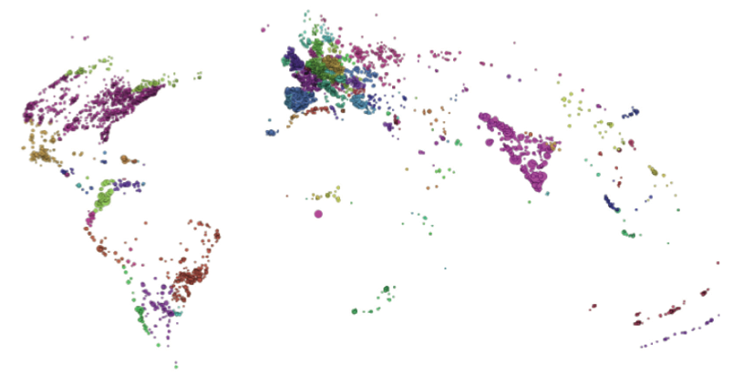
Who were the 6.002x students?
Geolocation database to identify login locations
Notes:
Students who were not native English speakers formed Facebook groups to help each other with the course, and we noted a small number of posts on the discussion forum in languages other than English.

Slide 14
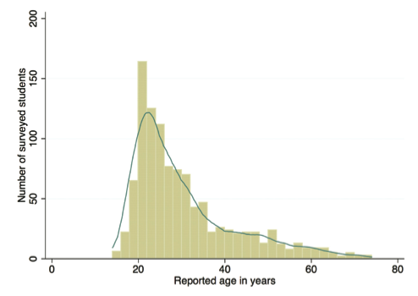
Age distribution
^{88% male}
^{37% had a bachelor’s degree}
28% had a master’s or professional degree
^{27% were high school graduates}
Three-quarters had studied vector calculus or differential equations.
Notes:
Of the 7,161 students who completed the survey, the largest group by far, 6,381 respondents, were certificate earners. However, over 800 of the respondents had not earned a certificate, so we assume some students were continuing to follow the course even if they were not doing the assignments or taking the exams.

Slide 15
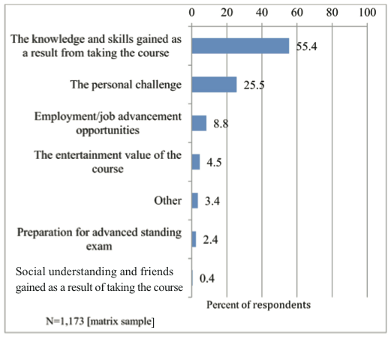
Reasons for enrolling

Slide 16
What Contributed to Student “Success”? Predictive Modeling as the Next Step in the Analysis
No correlations between motivation for enrollment and success in the course
No relationship between age and achievement or between gender and achievement
Marginal relationship between highest degree earned and achievement
There is a correlation between students’ previous course experience in mathematics and achievement
A student who worked offline with someone else in the class or someone who had expertise in the subject would have a predicted score almost three points higher than someone working by him or herself
Notes:
Students were told at the onset of the course that they needed to know basic calculus and linear algebra, as well as have some familiarity with differential equations

Slide 17
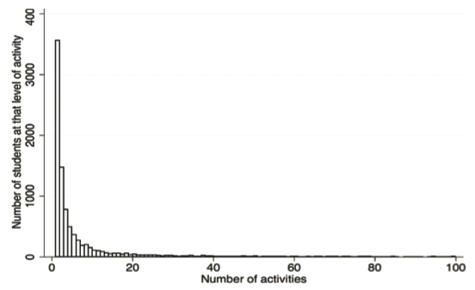
Discussion forum
Is the number of comments posted predictive of that individual’s level of achievement or persistence?
3% of all students participated in the discussion forum
Certificate earners: 52% were active on the forum
27.7% asked a question
40.6% answered a question
36% made a comment
Notes:
some students utilized the forum to describe how they were struggling with the material, while others offered comments that were tangential to the actual topics of the course.

Slide 18
Future Research
How different representations of complex concepts and phenomena (textual, graphical, mathematical) can best be used to help students master them?
How can we help students learn more per unit time?
What are students’ goals when they enroll in a MOOC?
How do those goals relate to the interaction with various modes of instruction or course components?
What facilitates or impedes their motivation to learn during a course?
How can course content and its delivery support students’ self-efficacy for learning?

Slide 19
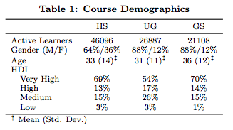
Deconstructing disengagement
Allow MOOC designers to target interventions or develop adaptive course features for particular subpopulations of learners
Analysis of learner trajectories with 3 CS courses
Computer Science 101 (high school level content)
Algorithms: Design and Analysis (undergraduate level content)
Probabilistic Graphical Models (graduate level course)
Notes:
Human Development Index (HDI)– a composite measure of life expectancy, education, and income indices. The distribution in the GS- and HS-level courses is very similar, with over two-thirds of active learners from very high HDI countries. The distribution in the UG-level course is less skewed between very high, high, and medium HDI countries, though low HDI countries account for a similarly low 3% of learners.

Slide 20
Prototypical engagement trajectories
Completing
Auditing
Disengaging
Sampling

Slide 21
Completing
Learners who completed the majority of the assessments offered in the class.
Participants varied in how well they performed on the assessment, they all at least attempted the assignments.
This engagement pattern is most similar to a student in a traditional class.

Slide 22
Auditing
Learners who did assessments infrequently if at all and engaged instead by watching video lectures.
Students in this cluster followed the course for the majority of its duration.
No students in this cluster obtained course credit.
Notes:
Prototypical engagement trajectories

Slide 23
Disengaging
Learners who did assessments at the beginning of the course but then have a marked decrease in engagement, disappears from the course entirely or sparsely watches video lectures.
The moments at which the learners disengage differ, but it is generally in the first third of the class.
Notes:
Prototypical engagement trajectories

Slide 24
Sampling
Learners who watched video lectures for only one or two assessment periods
Generally learners in this category watch just a single video.
Though many learners “sample” at the beginning of the course, there are many others that briefly explore the material when the class is already fully under way.
Notes:
Prototypical engagement trajectories

Slide 25
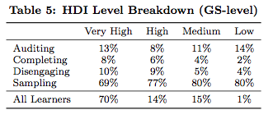
Results
Survey Demographics
all three courses enrolled more male than female learners
gender is not associated with engagement trajectories
Geographical Location
As HDI increases, the proportion of Completing and Disengaging learners increases, while the proportion of Sampling learners decreases.

Slide 26
Results
Intentions
They find it fun and challenging
They are interested in the topic
Enrolling to enhance their resume (high for Completing learners)
15% in the HS
33% in the UG
20% in GS-level course

Slide 27
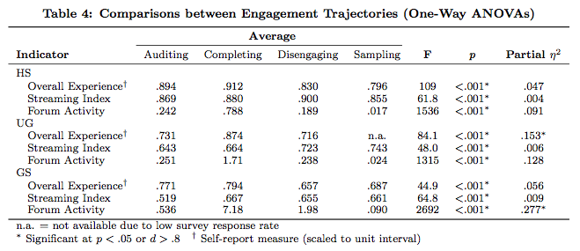
Results
Notes:
Consistent pattern in all three courses is an average Streaming Index (SI) above 0.5 for each engagement trajectory, which indicates that streaming is the dominant form of access to video lectures.
In the HS-level course, the SI is consistently higher than the other courses across all engagement patterns: streaming accounts for around 88% of video consumption, compared 70% in the UG-level and 63% in GS-level courses.
that Completing learners in the UG-level course tend to watch lectures offline less than Disengaging learners

Slide 28
Discussion
Extension of Analytics Methodology
See what details in learning patterns can be expressed through a finer grained time slices and the incorporation of more user information.
A finer view of time could allow the understanding of students to delve into the details of user work sessions.
Incorporate an understanding of the high level ways in which students engage.
Interpretation of Results
Auditing learners report similar high levels of overall experience to Completing learners in two of three courses.
Completing learners exhibit the highest level of activity on the forum, much higher than that of Disengaging learners, who are initially assessment oriented and then disengage from the course.
Most prominent reasons for disengaging were:
personal commitment(s)
work conflict
course workload
Notes:
opportunity to design features to actively support these engagement trajectories
However, evidence from cognitive psychology suggests that testing not only assess learning but facilitates it

Slide 29
Development of simple “cognitive tools”
Integrated note-taking or concept-mapping system that would allow learners to actively interpret the course content
Task lists and calendar features for staying organized
Addressing learners’ prior knowledge in the field

Slide 30
Why did you enroll in this course?
Mistake: Assume students varying goals and behavior should converge.
“Learners’ goal orientation and attitudes towards the value of achieving their goals are intimately tied to their engagement with learning experiences.”
Standardized survey item for measuring learners’ reasons to enroll
Minimize response biases by adhering to best practices from survey design research
Meeyajae. Mini 1D: Types of students. Retrieved February 13, 2014, from http://www.polyvore.com/mini_1d_types_students/set?id=51167229

Slide 31
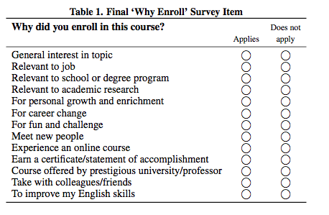
“Why Enroll” Survey Item
Survey has been included in all Stanford MOOC surveys since September 2013 and will remain in the survey template for future courses.
They encourage other institutions to adopt this item to facilitate comparative research and unified metrics.
Currently investigating the associations between engagement patterns and learners’ goals
Notes:
Response options are frequently presented in random order, as presentation order can influence the respondent’s choice (order effect).
the first response option Table 1, “General interest in topic”, is more general than the other options and should always be placed first; if possible, the remaining items should be presented in random order to address order effects.

Slide 32
Conclusions
Correlations between motivations for enrollment and certain course success metrics?
Understanding motivations for enrolling in MOOCs is key for personalizing and scaling the online learning experience

Slide 33
References
Emily Schneider and René F. Kizilcec. 2014. "Why did you enroll in this course?": Developing a standardized survey question for reasons to enroll. In Proceedings of the first ACM conference on Learning @ scale conference (L@S '14). ACM, New York, NY, USA, 147-148.
Breslow, L. B., Pritchard, D. E., DeBoer, J., Stump, G. S., Ho, A. D., & Seaton, D. T. (2013). Studying learning in the worldwide classroom: Research into edX's first MOOC. Research & Practice in Assessment 8, 13-25.
Kizilcec, R. F., Piech, C., and Schneider, E. Deconstructing disengagement: Analyzing learner subpopulations in massive open online courses. In Proceedings of the Third International Conference on Learning Analytics and Knowledge, ACM (2013), 170–179.

