Slide 1
Cognative Theory and the Design of Multimedia Instruction

Slide 2
Who do you trust?
A fundamental issue when reading educational literature
There are many bad studies
“Extraordinary claims need extraordinary evidence”.
Studies are more credible when:
The evidence appears to support the claims
The claims are backed up by multiple studies from multiple investigators

Slide 3
“Multimedia Learning”
“Cognitive theory of multimedia learning” sometimes referred to simply as “multimedia learning”
Related: “Dual-coding theory”
R.E. Mayer, "Cognitive Theory and the Design of Multimedia Instruction: An Example of the Two-Way Street Between Cognition and Instruction", in New Directions for Teaching and Learning, Spring 2002, 55-71.
R.E. Mayer, " Applying the Science of Learning: Evidence-Based Principles for the Design of Multimedia Instruction American Psychologist, 63(8), 760-769.

Slide 4
Cognitive Load Theory
Mayer’s multimedia learning theory comes out of “Cognitive load theory” associated with John Sweller
Learning is affected by how well the instructional technique manages cognitive load on working memory

Slide 5
Effect Size
Effect size is how much effect something has. Like “lose 20 pounds in a week” or “gain one letter grade” from an intervention.
Mayer uses Cohen’s d (a standardized measure):
(control mean –experimental mean)/std deviation
0.2 is small, 0.5 medium, 0.8 large

Slide 6
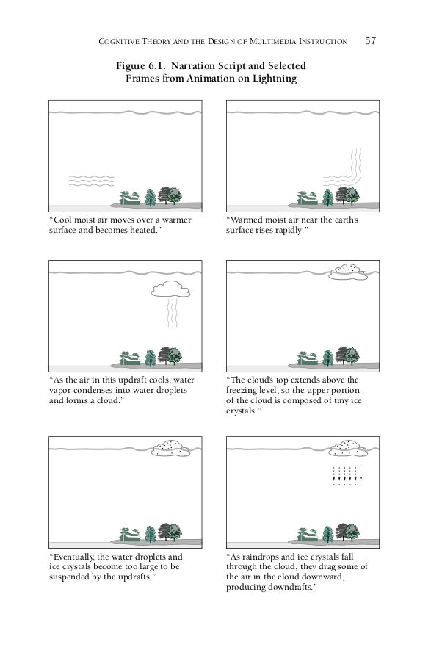
Example

Slide 7
Assumptions
Dual Channel Assumption: There is a visual-pictorial channel and an auditory-verbal channel.
Limited Capacity Assumption: Each channel has limited capacity.
Active Processing Assumption: Meaningful learning occurs when learners engage in active processing (including selecting and ogranizing). Learning is most likely when both verbal and pictorial information is in working memory at the same time.

Slide 8
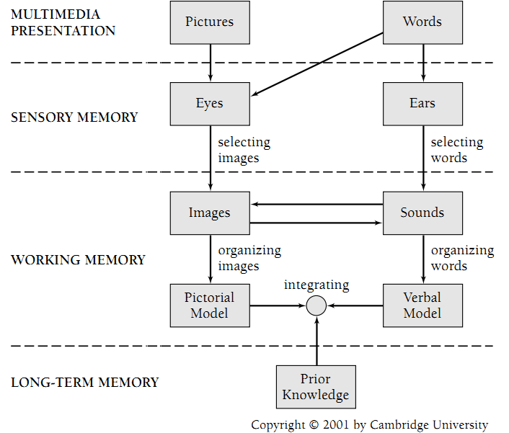
A Cognitive Theory of Multimedia Learning

Slide 9
Question 1
Does adding pictures to a verbal explanation help learners to understand the explanation better?
Note that both convey the same information, so adding the pictures is redundant.

Slide 10
Multimedia Principle
Cognitive theory predicts: Deeper learning from
words and pictures than from words alone.
11 studies confirm. Effect size: 1.39

Slide 11
Question 2
How should words and pictures be coordinated in Multimedia presentations?
Present words and pictures simultaneously
Present one (such as full narration), then present the other (such as showing an animation)
Perhaps seeing both at once lets you get more. Perhaps seeing one than the other lets you reflect in between, and get more from the second round.
Doing one than the other typically gives students more exposure time to the content

Slide 12
Spatial Contiguity Principle
Cognitive Theory Predicts: Deeper learning from presenting words and pictures simultaneously rather than successively.
Showing both at once takes advantage of dual processing, and gets both into working memory at the same time.
8 studies support. Effect size: 1.31

Slide 13
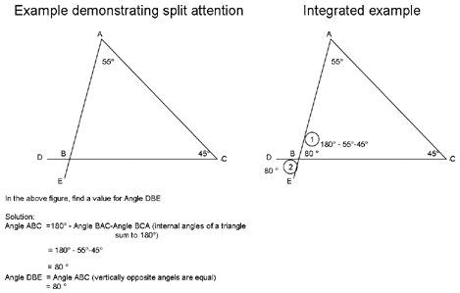
Question 3
Is there any significant difference between these two presentations?

Slide 14
Split Attention Effect
Spatial contiguity principle: Put words right next to the corresponding images
5 studies support. Effect size: 1.12

Slide 15
Question 4
How can we make multimedia presentations more interesting?
We can make things more appealing with extra features that provide some human interest. In the lightening example, content on people affected by lightening.
This should motivate learners.
Example: Add human interest story about being struck by lightning to the lightning tutorial.

Slide 16
Coherence Principle
Cognitive Theory Predicts: Deeper learning when extraneous words, sounds, or pictures are excluded rather than included
13 of 14 studies support. Effect size: 0.97

Slide 17
Question 5
Should the “verbal” content be presented as text, or as narration? Or does it not matter if the content is identical?
Note: Using audio narration limits conditions under which the material can be used (noisy environments, lab settings, etc.)

Slide 18
Modality Principle
Cognitive Theory predicts: Deeper learning when words are presented as narration rather than as on-screen text
17 studies support. Effect size: 1.02

Slide 19
Question 6
So narration is better than text. But, should we still include the text alongside the narration?
Giving more ways to access the information should appeal to a wider range of learning styles.

Slide 20
Redundancy principle
Cognitive Theory predicts: Deeper learning when words are presented as narration rather than as both narration and on-screen text
5 studies support. Effect size: 0.72

Slide 21
Question 7
Is there another way to make it more engaging? Can we engage students in “social interaction” by personalizing the text. Use “you”, speak directly to reader (not third person), say “congratulations”.
This sounds a lot like Question 4.

Slide 22
Personalization principle
Deeper learning when words are presented in conversational style rather than formal style
11 studies support. Effect size: 1.11

Slide 23
Question 8
The lightning example has 16 segments, each with about 10 seconds of narration. Should there be a “continue” button to hit after each one, or should there be a single narrative segment of 160 seconds?
On the one hand, it might give students time to reflect if they pause.
On the other hand, it might be an unnecessary annoyance.

Slide 24
Interactivity principle
Cognitive Theory predicts: Deeper learning when learners are allowed to control the presentation rate than when they are not
The goal is to avoid cognitive overload
3 studies support. Effect size: 0.98
My own study related to AVs strongly supports this.

Slide 25
Question 9
Should we add or emphasize “signaling” phrases? For example, if there is a 3-step description, do we emphasize “First”, “Second”, etc? Should “heading” phrases be emphasized in the narration? And so on.
Sounds a lot like the extraneous distracters from earlier question.

Slide 26
Signaling principle
Cognitive Theory predicts: Deeper learning when key steps in the narration are signaled rather than non-signaled
Directs learners’ attention to key phrases
5 studies support. Effect size: 0.52

Slide 27
Question 10
Say you have a concept to get across, and there are also definitions to know to understand the concepts. Is it better to break the lesson into two with a “pre-training” phase that presents the definitions, before giving the actual lesson with the concepts?

Slide 28
Pre-training principle
Cognitive Theory predicts: People learn better from a narrated animation when they already know the names and characteristics of essential components.
Five studies support. Effect size: 0.85
I find this a lot in writing: It is often best to break a sentence with definitions and content into two sentences.

Slide 29
Question 11
Does it help to show worked examples of a problem, or is it better to have students work on instances of the problem?
Working the problem yourself is more interactive
Seeing worked examples provides expert mental model

Slide 30
Worked-example Effect (Sweller)
A worked example is a step-by-step demonstration of how to perform a task or solve a problem
This is often a more effective form of instruction than solving problems
Worked examples provide expert mental models
Does not help people already familiar with the topic
Visualization/multimedia presentation serves as an example of a worked problem

Slide 31
Question 12
When processing words-and-images material, does it matter if there is music/noise in the background?

Slide 32
Split attention principle
Introducing distracters will reduce learning, even if they are in the other channel.

