Slide 1
Visual Presentation of Quantitative Data

Slide 2
What is the issue?
Most of us work with and present (in talks or publications) quantitative data.
Quantitative data are a part of content in online course materials.
We want to be effective in getting our message across
Minimal goals:
Don’t lie (at least not by accident)
Display graphical stylistic competence
Similar to writing stylistic competence: stick to point, don’t be verbose, etc.)

Slide 3
Visual Presentation of Quantitative Information
Edward Tufte, John Tukey, etc have popularized better visualization of quantitative data.
Statistical information

Slide 4
Quantitative Information
Graphical displays of quantitative information should have Power, Truth, Grace
Show the data
Induce viewer to think about substance
Not methodology, graphic design, graphical technique, etc.
Avoid distorting what they data have to say
Present many numbers in a small space
Make large data sets coherent
Be closely integrated with statistical and verbal descriptions

Slide 5
Power

Slide 6
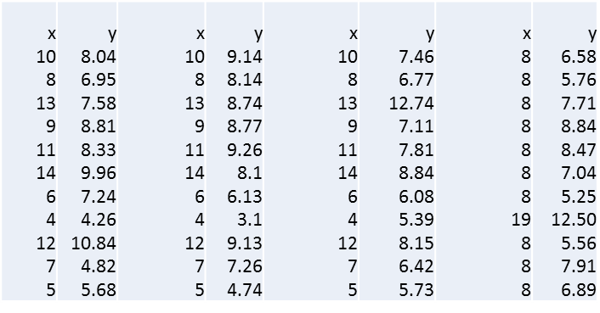
4 Data Sets (Tufte)
What is “interesting” about this information?

Slide 7
4 Data Sets (Tufte)
What is “interesting” about this information?
N = 11, mean of x: 9.0, mean of y: 7.5
Regression equation: y = 3 + 0.5x; Sum of squares: 110.0
Correlation coefficient: .82; r2 = .67

Slide 8
Visualize It

Slide 9
Data need to have meaning to have power
Notes:
How might be be clued in that there is something to be suspicious about?
Scales are not comparable. Radiation in hundredths of a percent, vs. a 50% change in stock prices
Stock price is a ratio scale: There is a zero
Solar radiation is on an arbitrary measurement scale

Slide 10
Map-based presentations
Notes:
Pro: Lots of data. Interesting things to explore.
Con: Wrongly equates visual importance of counties to geographic size, not population size

Slide 11
No Power
We can calculate Data Density: # of entries/area of graphic

Slide 12
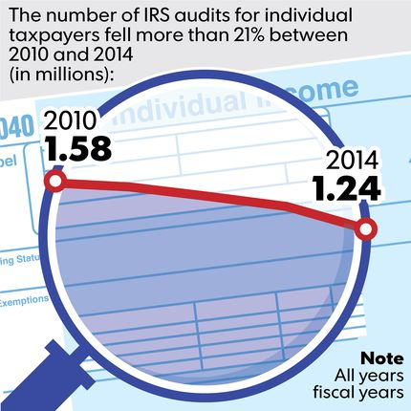
Newspaper Graphics
Notes:
Neither example has much power. The one on the right has a floating baseline and it is hard to interpret (the key is in the caption, not the graphic).

Slide 13
Another Powerful Example

Slide 14
Train Schedule

Slide 15
Train Schedule

Slide 16
Napoleon’s Invasion of Russia

Slide 17
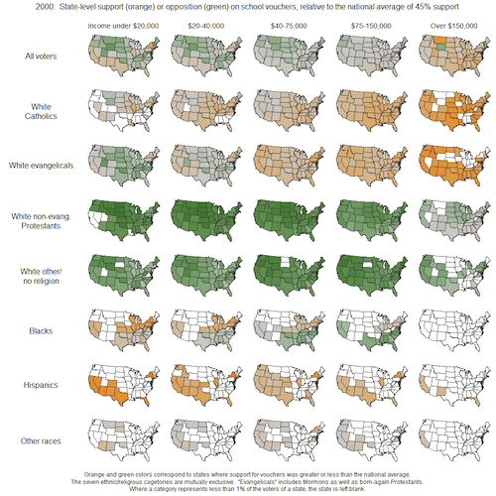
Small Multiples
Notes:
I will say a word. What is the first word that pops into your head in response? Statistics. A: Lie

Slide 18
Truth
Notes:
I will say a word. What is the first word that pops into your head in response? Statistics. A: Lie.

Slide 19
Hiding the Truth (1)
Notes:
How is this company doing? It looks OK.

Slide 20
Hiding the Truth (2)
Notes:
It doesn’t look so good when you realize that they have carefully manipulated the baseline to give misleading results.

Slide 21
Lying by Accident (?)
Notes:
This is (probably) a simple example of incompetence. The rightmost bar for each airline is showing only part of the year. So it appears to be down.

Slide 22
Misleading (for whatever reason)

Slide 23
Fuel Economy Standards (1)

Slide 24
Fuel Economy Standards (2)

Slide 25
Fuel Economy Standards (3)

Slide 26
More Binning Problems

Slide 27
Grace

Slide 28
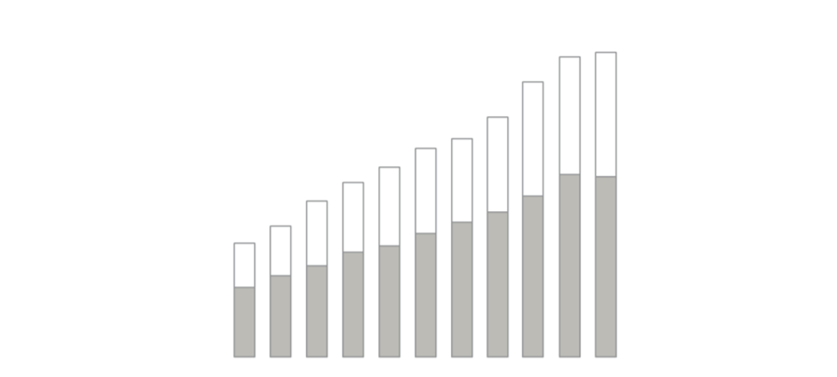
Avoid chart junk

Slide 29
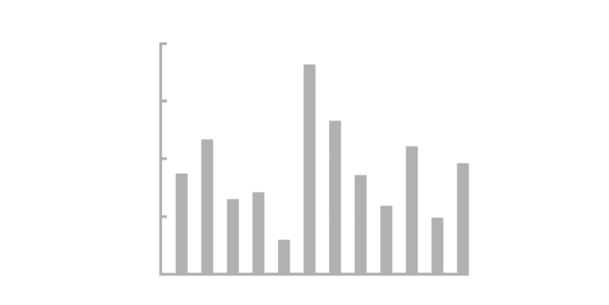
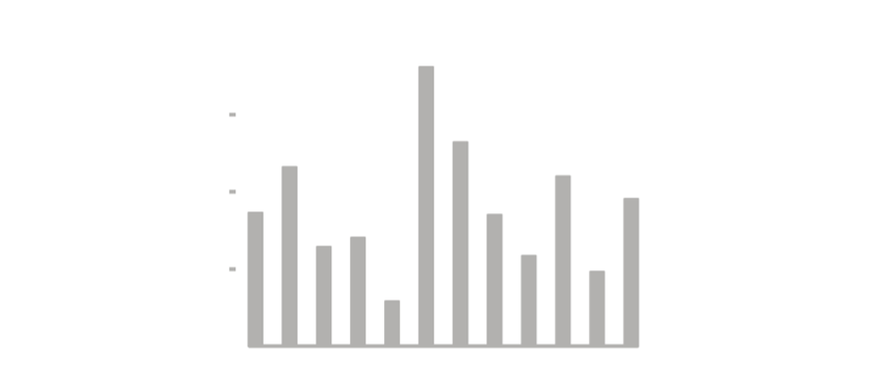
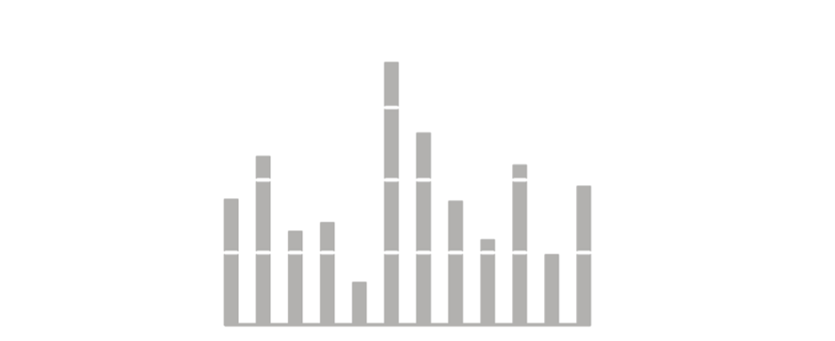
Minimize data ink

Slide 30
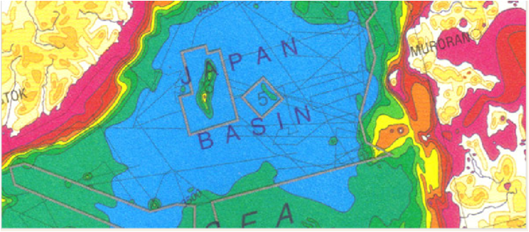
Use of Color

