Slide 1
Evaluating the pedagogical effectiveness of educational interventions
Presented by
Mohammed Farghally
PhD student, Computer Science Department, Virginia Tech
Blacksburg, Virginia
Thursday, February 26, 2015

Slide 2
Agenda
What is an intervention?
Types of interventions
Pedagogical evaluation
Experiment Design
Instrument design

Slide 3
What is an Intervention
Instructors are using some method of instruction or certain kind of material(s).
Some problems may exist
Poor student performance (i.e. low grades)
Less student retention to class (i.e. high drop rates)
Instructors strive to seek a solution!

Slide 4
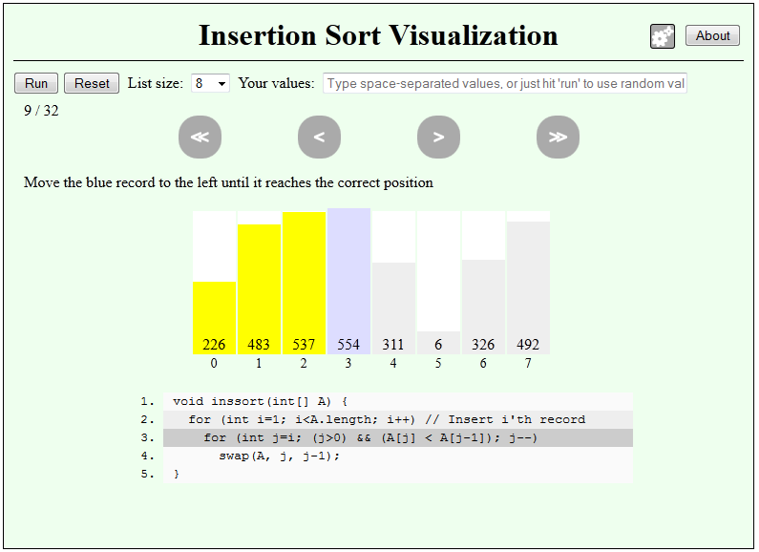
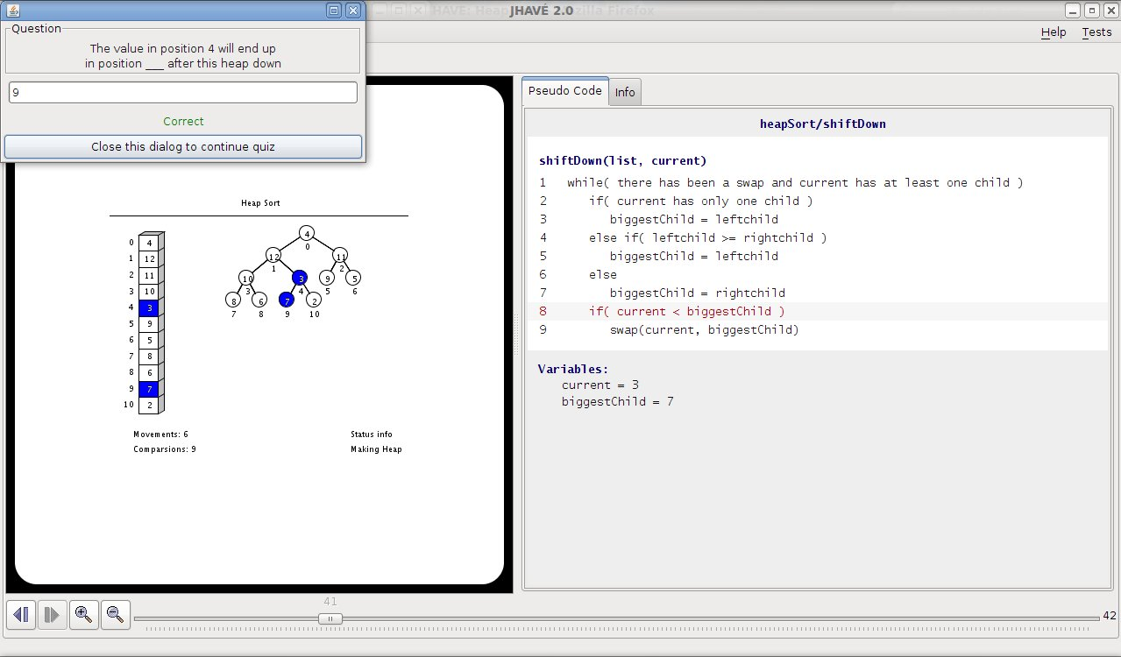
Types of Interventions
Program and Algorithm animations
JSAV framework (Karavirta & Shaffer 2013)
Ville program animation tool (Rajala et.al. 2008)
JHave (Naps et.al. 2000)

Slide 5
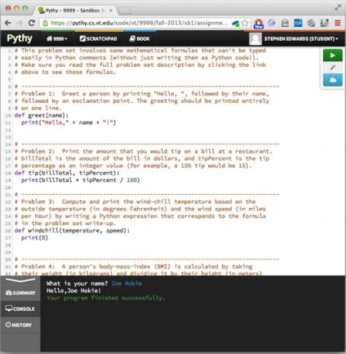
Types of Interventions
Online Tutorials
Pythy (Edwards et.al 2014)
CS Circles (Pritchard, Vasiga 2014)

Slide 6
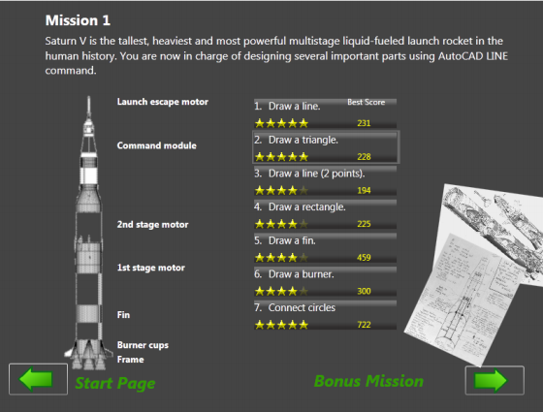
Types of Interventions
Gamification
LearnMem1 (Papastergiou 2008)
GamiCAD (Li et.al. 2012)

Slide 7
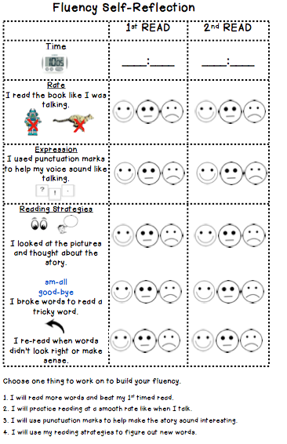
Types of Interventions
Non-technological
Group Discussion (Getinet 2012)
Student Self Reflection (Getinet 2012)

Slide 8
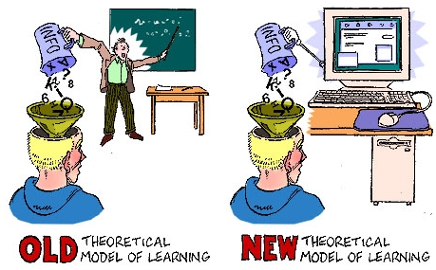
Pedagogical Evaluation
Does the intervention enhances learning?
Different forms of evaluation
Summative
Usually quantitative
After the student use of the intervention
Ex: Grades, retention, time
Formative
Usually qualitative
During the student use of the intervention
Ex: Student attention, intermediate student feedback

Slide 9
Pedagogical Evaluation
Learning outcomes
Cognitive
Skill based
Affective
Challenging
The insignificance problem
Lurking variables (i.e. previous experience, learning styles, gender,…)
Controlled experiments can issue ethical concerns
Quasi-experiment is used to measure cognitive learning gains
Notes:
Cognitive: Refers to the quantity and type of knowledge and knowledge interconnections
Skill: Refers to technical or motor skills
Affective: Focus on students attitudes towards the intervention

Slide 10
Quasi-Experiment
Define participants
State the hypothesis
Describe the materials
Describe the procedure
Data analysis

Slide 11
Define Participants
Subjects are selected
Usually students taking a course
From multiple institutes to reduce bias
Subjects are divided into
One group is the control group using the current material.
The other group is the test group using the treatment (intervention).

Slide 12
State the hypotheses
The experiment is conducted to test the validity of a one or more hypothesis.
Examples
“The students of the test group will exhibit significantly greater achievement in terms of computer memory knowledge than those of the control group“ (Papastergiou, 2009)
“Practicing with the online tutor will be at least as effective as practicing with a printed workbook that includes answers to problems as an appendix” (Kumar, 2005)
“The changing level of engagement will result in significantly better learning than the viewing level, and the constructing level is expected to yield significantly better results than changing” (Lauer, 2006)

Slide 13
Describe the Materials
Traditional method
Intervention
Pre- and post-tests (Instruments)

Slide 14
Describe the procedure
The level of prior knowledge of the control and test group should be similar.
Group according to pre-test scores
Scores
(Control)
Pre-test
(Control)
Similar?
Compare
Scores
(Test)
Pre-test
(Test)
Use entire population

Slide 15
Describe the procedure
Pre-test
(Control)
Pre-test
Scores
(Control)
Post (control) –Pre (Control)
Post-test
(Control)
Post-test
Scores
(Control)
Learning gains
(Traditional)
Pre-test
(Test)
Pre-test
Scores
(Test)
Learning gains
(Treatment)
Post (Test) –Pre (Test)
Post-test
(Test)
Post-test
Scores
(Test)

Slide 16
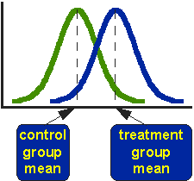
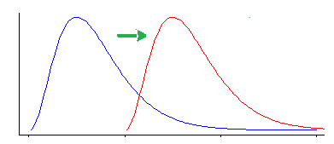
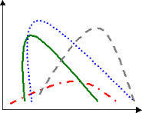
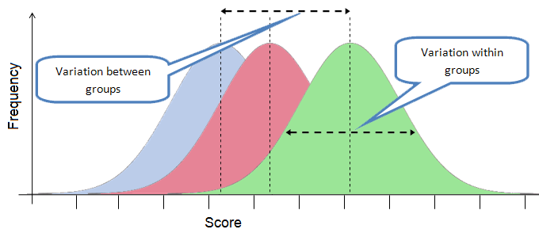
Data Analysis
Conduct appropriate statistical test to see if there is an evidence of significant difference in learning gains for both methods.
Two sample t-test
Wilcoxon test
Kruskal Wallis test
ANOVA test

Slide 17
Instrument Design
For more robust evaluation, standardized pre- and post-tests are required to measure learning gains.
A Concept Inventory (CI) is required to serve as a pre- and post-test.
CI

Slide 18
Instrument Design
Defining the scope
Identifying misconceptions
Designing items
Validity and reliability

Slide 19
Defining the scope
Start with an initial list of concepts
Consult a group of experts
Delphi process : a structured process for collecting information and reaching consensus among a group of experts
Diversity, no bias
Experts are anonymous
15-30 experts recommended (Clayton 1997)

Slide 20
Phase1 : Initial Rating
1- Initial list of concepts
2- Concept ratings (Importance, Difficulty)
3- Medians and IQRs
Phase2 : Negotiation
4- Calculated medians and IQRs for each concept
5- Concept ratings (Importance, Difficulty)
6- Rating justification if outside IQR
7- Medians and IQRs
Phase3 : Final Rating
8- Calculated medians and IQRs for each concept
9- Anonymous rating justifications
10- Concept ratings (Importance, Difficulty)
11- Medians and IQRs
Experts
Researchers

Slide 21
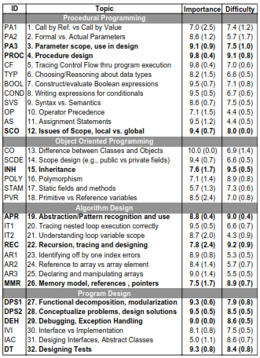
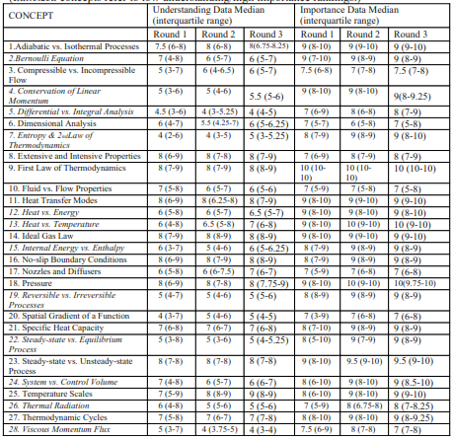
(Goldman et.al 2008)
(Nelson et.al 2007)

Slide 22
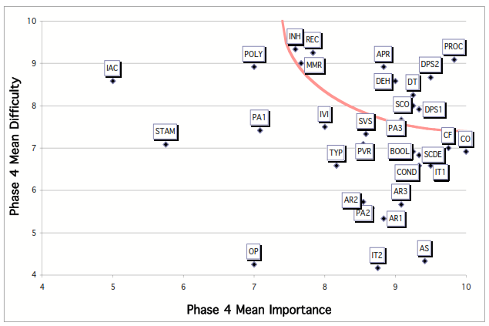
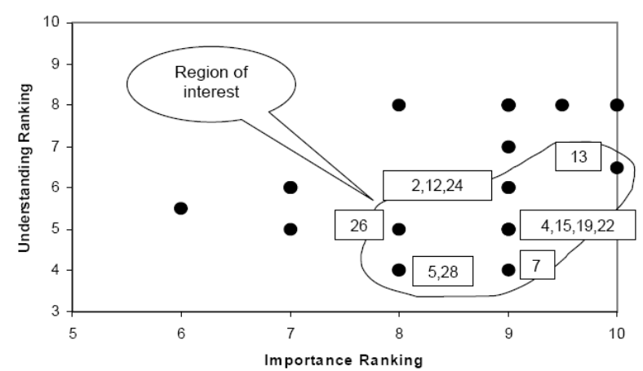
(Goldman et.al 2008)
(Nelson et.al 2007)

Slide 23
Identifying misconceptions
Start with an initial list of misconceptions
Conduct student interviews
Consult experts

Slide 24
Designing Items
MCQ will be developed for each defined concept
Each MCQ distractor will represent a misconception
CI alpha administration validate misconceptions
Question: Targeting a concept
Misconception 1
Misconception 2
Misconception 3
.
.
.

Slide 25
Validity and Reliability
To be widely accepted, a CI should be both valid and reliable
A CI validation test answers
“Are we measuring what we think we are measuring?”
“Have we covered the required concepts?”
A CI reliability test answers
“Do all test items measure the same construct?”
“Do repeated administrations of the test yield the same results?”

Slide 26
Validation
There are 3 well known measures of a CI validity (Allen and Yen, 2001)
Content validity
“Does the test contains items from the desired domain?”
Based on subjective judgments
Criteria-related validity
Based on statistical measures
Measures the correlation between test scores and other related measure
Construct validity
“Does the test actually measures the required construct”
Can be tested through a within-subject group experiment

Slide 27
Reliability
Reliability can be tested in two ways (Herman et.al 2010)
Single administration measures
Measures the internal consistency of items
Cronbach’s alpha
KR-20
KR-21

Slide 28
Reliability
Multiple administration measures
Students retake the test again
Observe if their result changes

Slide 29
Item Analysis
Provides information about the usefulness of a test item and how it relates to other items in the test.
Grounded in Classical Test Theory (CTT)
Some useful measures include
Descriptive statistics
Difficulty index
Discrimination index
Item curves

Slide 30
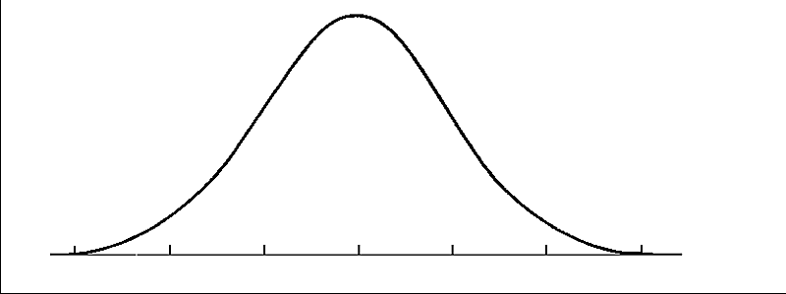
Descriptive statistics
The means and standard deviations of items can provide clues about the item usefulness
The ideal situation of an item is when it has large σ and centered µ
Probability
σ
µ
Item scores

Slide 31
Difficulty index
Items of are ideal as they provide the highest degree of discrimination among students.
Items close to or may be useless as they provide little discrimination between respondents.
If all items have , then a test with 100 items is the same as a test with a single item.
A good instrument should have items with various difficulty levels.

Slide 32
Discrimination index
The discrimination index of an item determines to what extent this item is good in differentiating between respondents.
is calculated using the extreme group method.
Upper group
27% best performers
Respondents
Lower group
27% poorest performers

Slide 33
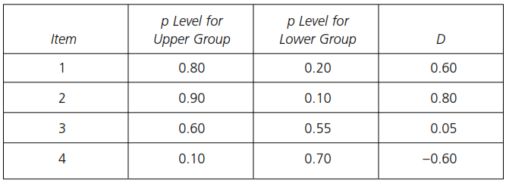
Discrimination index
Example
(Kline, 2005)

Slide 34
Item Curves
The total scores are grouped into percentiles
Each of the percentiles is plotted against the difficulty level associated with that item for this percentile.
Is a good way of showing item discrimination at different groups of performance.

Slide 35
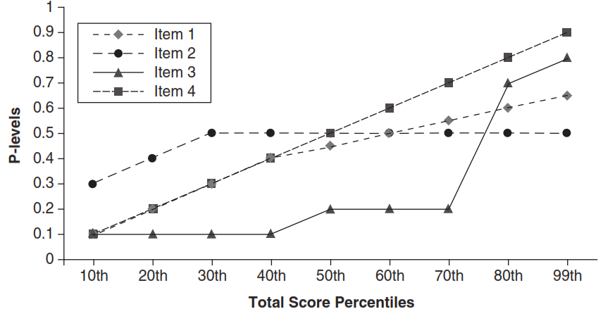
Item Curves
Example
(Kline, 2005)

Slide 36
Putting it altogether
Problem with the traditional method
Develop intervention
Design the instrument
Test the validity and reliability of the instrument
Conduct item analysis
Design the evaluation experiment
Apply the instrument in the evaluation

Slide 37
References
Karavirta, V., & Shaffer, C. A. (2013, July). JSAV: the JavaScript algorithm visualization library. In Proceedings of the 18th ACM conference on Innovation and technology in computer science education (pp. 159-164). ACM.
Laakso, T. R. M. J., Kaila, E., & Salakoski, T. (2008). Effectiveness of program visualization: A case study with the ViLLE tool. Journal of Information Technology Education, 7.
Naps, T. L., Eagan, J. R., & Norton, L. L. (2000). JHAVÉ—an environment to actively engage students in Web-based algorithm visualizations. ACM SIGCSE Bulletin, 32(1), 109-113.
Edwards, S. H., Tilden, D. S., & Allevato, A. (2014, March). Pythy: improving the introductory python programming experience. In Proceedings of the 45th ACM technical symposium on Computer science education (pp. 641-646). ACM.
Pritchard, D., & Vasiga, T. (2013, March). CS circles: an in-browser python course for beginners. In Proceeding of the 44th ACM technical symposium on Computer science education (pp. 591-596). ACM.
Papastergiou, M. (2009). Digital game-based learning in high school computer science education: Impact on educational effectiveness and student motivation. Computers & Education, 52(1), 1-12.
Li, W., Grossman, T., & Fitzmaurice, G. (2012, October). Gamicad: a gamified tutorial system for first time autocad users. In Proceedings of the 25th annual ACM symposium on User interface software and technology (pp. 103-112). ACM.
Tesfaye Getinet. Eect of instructional interventions on students learning gains: An experimental research. Lat. Am. J. Phys. Educ. Vol, 6(2):187, 2012.

Slide 38
References
M. J. Clayton. Delphi: A Technique to Harness Expert Opinion for Critical Decision-Making Task in Education. Educational Psychology, 17:373–386, 1997.
Amruth N Kumar. Results from the evaluation of the effectiveness of an online tutor on expression evaluation. In ACM SIGCSE Bulletin, volume 37, pages 216-220. ACM, 2005.
Tobias Lauer. Learner interaction with algorithm visualizations: viewing vs. changing vs. constructing. In ACM SIGCSE Bulletin, volume 38, pages 202-206. ACM, 2006.
Mary A Nelson, Monica R Geist, Ronald L Miller, Ruth A Streveler, and Barbara M Olds. How to create a concept inventory: The thermal and transport concept inventory. In Annual Conference of the American Educational Research Association, Chicago, IL, 2007.
Ken Goldman, Paul Gross, Cinda Heeren, Georey Herman, Lisa Kaczmarczyk, Michael C Loui, and Craig Zilles. Identifying important and dicult concepts in introductory computing courses using a delphi process. ACM SIGCSE Bulletin, 40(1):256-260, 2008.
Mary J Allen and Wendy M Yen. Introduction to measurement theory. Waveland Press, 2001.
Georey L Herman, Michael C Loui, and Craig Zilles. Creating the digital logic concept inventory. In Proceedings of the 41st ACM technical symposium on Computer science education, pages 102-106. ACM, 2010.
Theresa J.B. Kline. Classical Test Theory: Assumptions, Equations, Limitations, and Item Analyses. Book chapter Sage Publications, 2005

Slide 39
Questions

