Slide 1
Improving MOOCs

Slide 2
Background
Keep in mind what we have learned from the principles from Cognitive Theory of Multimedia Presentation
P.J. Guo, J. Kim, and R. Rubin, How Video Production Affects Student Engagement: An Empirical Study of MOOC Videos, in Proceedings of Learning at Scale 2014.

Slide 3
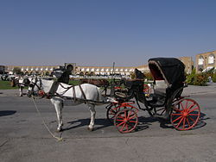
Traditional Classroom Lecture

Slide 4
Online Education: What We Want

Slide 5
The First MOOCs

Slide 6
How Can We Improve?
Guo et al propose (based on empirical evaluation) several improvements to current MOOC presentation.

Slide 7
Use Shorter Video Segments
After six minutes, fraction of video viewed drops off.

Slide 8
Less Formal Style
Users prefer a less formal appearance in video presentation
This fits the CTMP principles.

Slide 9
Use Head Shots?
Intersperse head shots with the slide content.

Slide 10
Khan-Style Drawing vs. Powerpoint
Better to see dynamic presentation in the form of drawing on the slide than present most static slides.

Slide 11
Craft Videos for the Web
Lectures developed for an hour-long class are somewhat different from lectures designed as a series of six-minute segments.

Slide 12
Use the Right Speaking Rate
Don’t want too fast, or too slow.
This fits CTMP.
But in general, instructors are not speaking too fast in this context (videos).
Enthusiasm might be the key, not speaking rate.
Provide built-in pauses.

Slide 13
Tutorial vs. Lecture
Students engage “tutorials” (worked exercises) differently from lecture (content presentation)
Tend to pause/restart tutorials more.
Add support in form of indexing, navigation
Tend to watch lecture once-through

Slide 14
Another Perspective

Slide 15
Traditional Classroom Lecture

Slide 16
Online Education: What We Want

Slide 17
The First MOOCs

Slide 18
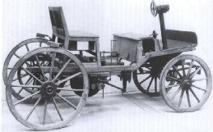
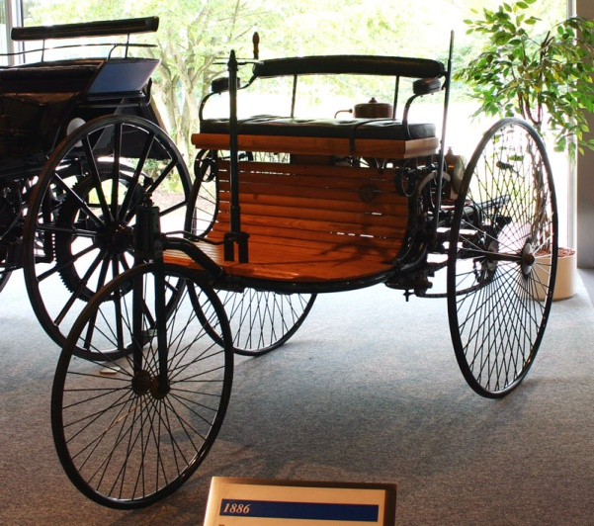
Improved Video-based MOOCs

Slide 19
Why Are We Here?
Some expert instructor has been teaching a course for 20 years.
They have good classroom presentation materials (but nothing geared for online)
It is a quick-and-dirty solution to videotape the lectures and stick them online.
Should be a transition, or something that we optimize for?

Slide 20
A Fundamental Philosophical Question
Is “online coursewhare” fundamentally a lecture, or is it a textbook?

Slide 21
Mitigating Problems with Lectures
Design Choice
Informal Style
Use Head Shots
Khan-style dynamic presentation
Mitigation
Reduce the length of a video segment (6 min?)
“Design for web” with a series of segments
Navigation support
Use the right speaking pace, provide built-in pauses
Worked problem (tutorial) vs. Content Presentation (lecture)

Slide 22
The “eTextbook” Approach
Coming from the perspective of eTextbook:
Chunk in slides, not uncontrolled video.
Present on each slide the best presentation of that piece of content.
Use all of the CTMP principles as appropriate.
Eliminate the “lecturer” from the picture (literally) (unless you are explicitly trying to show off a particular person for historical reasons, or demonstrating human anatomy, etc.)

