Slide 1
Khan Academy
Vivek Bharath Akupatni
CS6604: Designing and Implementing Online Education Systems

Slide 2
The Challenge
Reaching every student at their own level

Slide 3
The Solution
A personalized learning experience with content customized for each student

Slide 4
Outline
Khan Academy
Roles
Sample exercise
Student Report and analytics
Pilot Study on Khan Academy implementation in schools
Tools for Developer

Slide 5
Khan Academy
Digital learning environment focus: K-12 education
Aim: a free, world-class education for anyone, anywhere.
6000 videos and 1 million problems

Slide 6
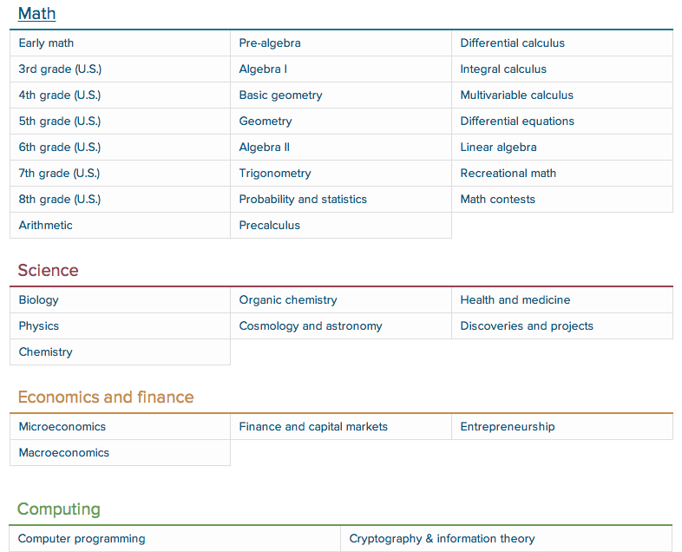
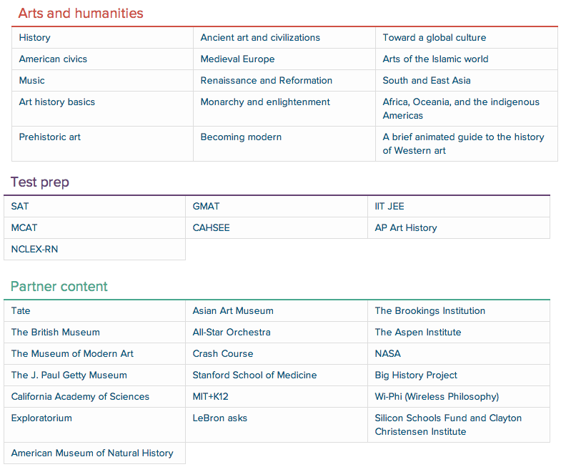
Subjects
Math (dominant)
Science
Economic And Finance
Arts and Humanities
Computer Science courses (HTML, Intro to Algorithms, Cryptography, SQL )
Notes:
khanacademy.org/commoncore

Slide 7
Different Roles
Coach
Helping others learn on Khan Academy
Parent
Track child’s progress to support their individual needs
Instructor Account
Track students’ progress to support their learning
Learner Account
General User Account
Notes:
The Khan Academy supports the following roles:

Slide 8
190
Countries
500,000+
registered educators
10,000,000+
unique monthly users
2,500,000,000+
problems answered
Scale

Slide 9
How this works
Students watch the videos
Work on a problem set based on the lesson
If they pass, they can move on to the next lesson
If it looks like they don't understand the concept, the website takes them back through what they missed.
Notes:
This is how it works for any user who is registered as student. This is can be used outside the classroom .
Student need not necessarily watch videos to complete a problem set

Slide 10
Sample Exercise
Notes:
You get immediate feedback whether you are right or wrong.

Slide 11
Sample Exercise

Slide 12
Learning with Khan Academy is…

Slide 13
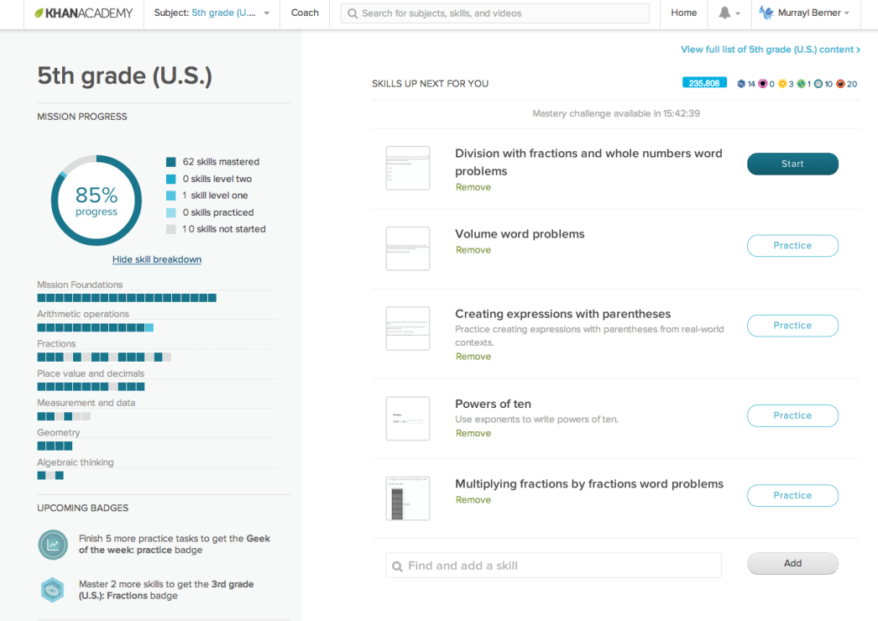
Personalized…
Gives each learner control over their own learning path

Slide 14
Mastery-based…
Builds strong foundations and confidence for learners.
Breaking down content into skills that build and connect

Slide 15
Mastery-based… (Knowledge Map)

Slide 16
Encouraging…
Strengthens motivation and persistence in learning through points, badges, and avatars
Data Driven…
Accurate and Real-time information so that students and teachers can achieve optimal learning outcomes

Slide 17
Student Leveling up
BOOKLET P. 8
Needs Practice
Practiced
Level One
Level Two
Mastered
Practice a skill
Complete mastery challenges

Slide 18
Student Reports & Analytics
Generates actionable real-time progress to teachers and parents
Students Progress Report
Students Skill Progress
Activity Report
Parent’s Dashboard

Slide 19
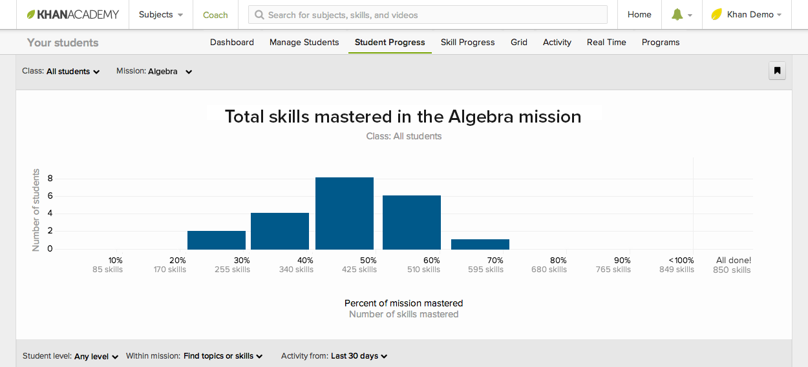
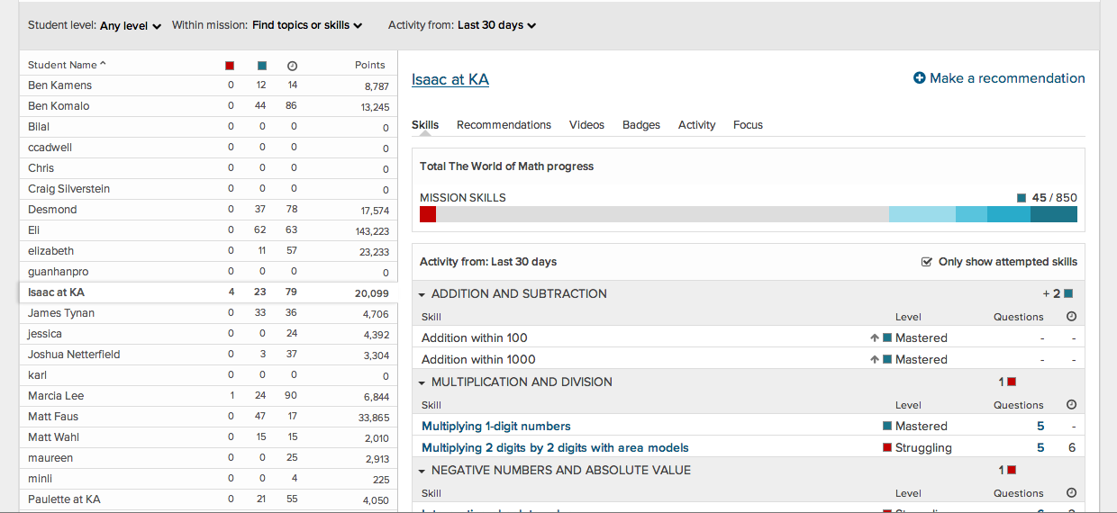
Student Progress Report
BOOKLET P. 10
Notes:
Courtesy from:

Slide 20
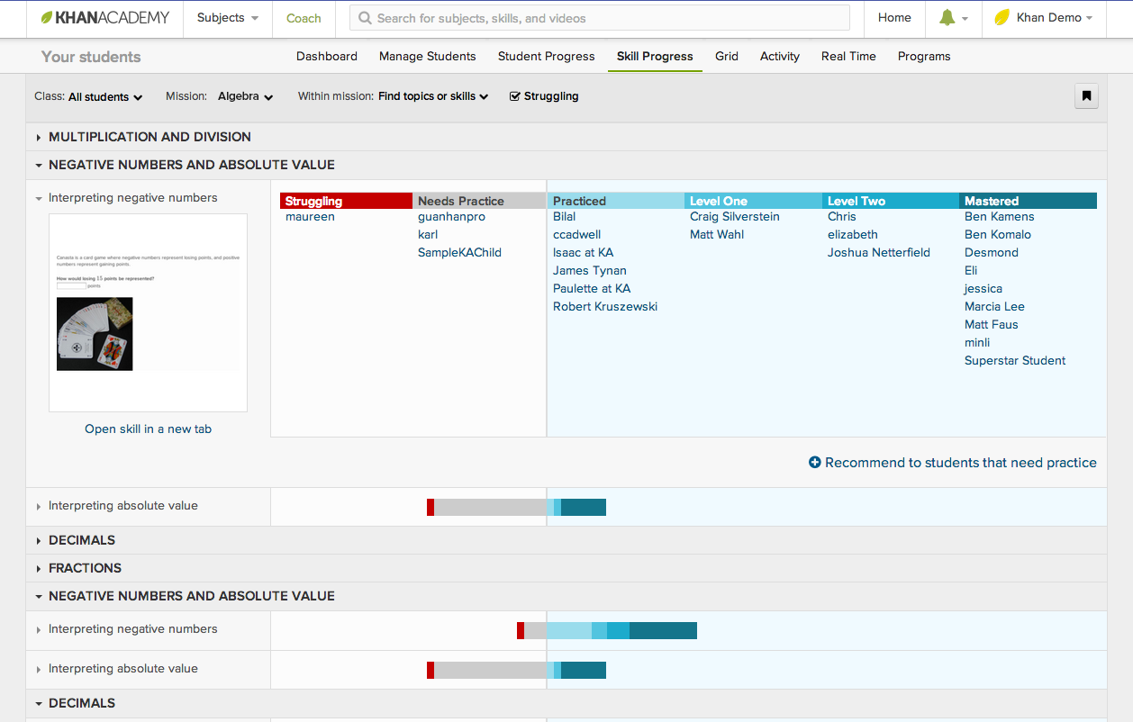
Skill Progress Report
BOOKLET P. 10
Intervention
Notes:
Intervention

Slide 21
Activity Report

Slide 22
Activity Report (Focus)

Slide 23
Activity Report (Energy points)

Slide 24
Activity Report (Detailed)

Slide 25
Parent’s Dashboard

Slide 26
Forum and Discussions
Notes:
Parents and Teachers can both view what question student as posted, answered etc.
Provides a stackoverlow kind of metaphor.
Khan Academy tries to provide a completely immersed environment and does a good job at it.

Slide 27
Pilot study on Khan Academy implementation in Schools

Slide 28
Pilot Study
Conducted pilot study in 9 sites in California from 2011 – 2013
Goals:
Potential link between Khan Academy usage and math achievement?
How to use Khan Academy or similar learning tools/resources to support personalized math learning?
Develop best practice models for implementation in schools.
Notes:
SY = Student Year
The broad questions that researchers were trying to ask and find out?

Slide 29
Participating Sites
9 different sites selected
Represent different governance structures:
Public
Private
Chartered
Different school levels:
Elementary
Middle
High School
Notes:
Just summarize what are there in previous tables

Slide 30
Participating Sites
All participants were volunteers
Study sites had complete discretion:
How to use Khan Academy
In some sites, teachers decided how to use it
Majority of students at this sites were serving lower income population.
Notes:
All the study sites were volunteers and they can drop out of study any time without any reason

Slide 31
Participating Sites
Research on the Use of Khan Academy in Schools. Robert Murphy Larry Gallagher Andrew Krumm Jessica Mislevy Amy Hafter
Notes:
Details of the participating sites.

Slide 32
Student Demographics from Participating Sites

Slide 33
Pilot Study: Learning models
Popular models associated with Khan Academy:
Blended model
Flipped model
Sites majority Usage models:
Blended model
Notes:
Flipped model: Teachers assign videos on new concepts to students as homework and
Class room is used to extend video lectures, solve problems or useful discussion or interactive exercises.
In Blended learning model, you try to integrate digital content with instructor led classroom

Slide 34
Pilot Study
Not possible to test rigorous evaluation Khan Academy’s effect
Product Changes
Significant changes to its platform and content.
Notes:
Product Changes:
New features were added, search functionality was introduced, videos and problem sets were added and standardized.

Slide 35
Pilot Study
Different approaches by Teachers:
Intervention to slow learning students
Enrichment activity for advanced students
As accountability tool
Additional practice problems for reinforcements of concepts
Changing teacher practices

Slide 36
Pilot Study
Variance in usage patterns:
Usage increased at some schools after participants became more at ease Khan academy technology
Access to more computers in classrooms

Slide 37
Khan Academy implementation at various sites

Slide 38
Sample Case: Site 8
Khan Academy was used to support teacher-lead whole class instruction
1/3rd of incoming ninth graders were behind grade level in math ( Algebra 1 section)
Students earning lowest marks assigned to Algebra Readiness class.

Slide 39
Sample Case: Site 8
Algebra Readiness
Focused on filling in the student gaps
Every Monday, students were assigned problems from Khan Academy
From previous week concepts for mastery and reinforcement
Pretesting current week topics
Struggling students:
Receive special instruction from teacher in small groups

Slide 40
Sample Case: Site 8
Algebra 1 class
20 minutes of teacher led instruction
Spent 40 minutes in completing assigned weekly problems
Khan academy reports:
Student strength
Student weakness
Students who need help meet teacher in small groups

Slide 41
Sample Case: Site 8
Evaluating Effectiveness of new methodology
Spring math test scores on the state standardized test (California Standards Test— CST) were compared to previous year students.
Result:
Statistically significant effect favoring students who attended the school after Khan Academy was introduced.
These are just preliminary findings. Coincides with other changes done by school
Notes:
Extra period for Math and mandatory extra-session for students who failed to complete their assignment after school.

Slide 42
Data Collection
Collected over 2-year period
Sources:
Khan Academy usage and log files
classroom observations
Interviewing teachers, students and parents
Surveys: Student, teacher
Standardized achievement test scores
Attitude and interest towards Math
Effort: Any correlation exists with khan academy usage
Notes:
Researchers visited each of these sites and made classroom observations.
At the end of all this data collection, they were trying to find if there exists any correlation between Khan Academy usage and any change in outcomes in all above factors

Slide 43
Pilot study: Findings
Student use and Perceptions
Time spent on Khan Academy was highly positive
71% enjoyed Khan Academy
32% reported they liked math more
High student engagement level during the sessions.
Students perceived that usage encouraged greater independence in learning
Notes:
Teachers reported that 8/10 students liked the time they spent working on Khan Academy
45% of students respondents said that with Khan Academy they were able to learn new things on their own without help of teacher.
Immediate feedback, hits, contextualized videos ensured that they were not struck for long time and experienced success even when content became challenging.

Slide 44
Pilot study: Findings
Teacher use and Perceptions
Majority happy with Khan Academy experience
86 % would recommend it
89 % planned to use in the future
Teacher perception of Khan Academy’s impact on students
usage positively effected student overall understanding of material – 85%

Slide 45
Pilot study: Findings
Student Outcomes
Positive association found between more Khan Academy usage (videos and problem sets) with the following outcomes:
Improvements in student test scores
Improvements in non-achievement metrics
Reduced Math anxiety
Higher confidence in their ability to do math

Slide 46
Pilot study
What Attracted teachers:
Free of cost
Facilitated Differentiation
Immediate feedback
Module set of videos and exercise
Engagement of students
Maintains detail student progress
Provides opportunity for students to direct their own learning

Slide 47
Pilot study
Challenges:
Limited Access to technology
Resistance to changing traditional teacher roles
Organization of the content
Grade level curriculum
Data reporting function
These were relatively underused (4 in 10 teachers)
70% of teachers relied on information outside to class to gauge student progress

Slide 48
Backend Infrastructure
Backend:
Google App Engine
Python, webapp2 and Flask microframeworks
“NoSQL” data store
Jinga2 templates
Front end:
Draws heavily from open source projects
jQuery, Backbone, FB react, Hight charts, less, Raphaël—JavaScript Library, handlerbar.js templates
Notes:
Less is css preprocessor
Raphaël—JavaScript Library – vector graphics used to create doing interactive exercises

Slide 49
Developers…

Slide 50
Developers
Khan Academy github repository
https://github.com/Khan
Khan Academy development documentation:
https://sites.google.com/a/khanacademy.org/forge/for-developers
Khan Academy API
http://api-explorer.khanacademy.org/group/api/
https://github.com/Khan/khan-api#readme
Information about videos links, playlist, badges, exercises etc.
Running Khan Academy offline
https://learningequality.org/ka-lite/

Slide 51
Khan Academy Exercise Framework
Framework for building questions
Notes:
Less is css preprocessor
Raphaël—JavaScript Library – vector graphics used to create doing interactive exercises

Slide 52
Khan Academy Exercise Framework
Questions written in single html file
Addition of two numbers:
Notes:
Less is css preprocessor
Raphaël—JavaScript Library – vector graphics used to create doing interactive exercises

Slide 53
Khan Academy Exercise Framework
Addition of two numbers (Rendered page)
Notes:
Less is css preprocessor
Raphaël—JavaScript Library – vector graphics used to create doing interactive exercises

Slide 54
StructuredJs
Javascript library that verifying the structure of Javascript code.
Used in Khan Academy CS exercises
Documentation:
https://github.com/Khan/structuredjs
Notes:
Less is css preprocessor
Raphaël—JavaScript Library – vector graphics used to create doing interactive exercises

Slide 55
StructuredJs
Demo:
Notes:
Less is css preprocessor
Raphaël—JavaScript Library – vector graphics used to create doing interactive exercises

Slide 56
Any Questions?

Slide 57
Thank You

