Slide 1
Student Data Analytics
Joe Luke
CS 6604
3/17/2015

Slide 2
Overview
Academic Analytics
Definition
Institutional
Learning
Developmental
Case studies
PACE
Signals
BoSCO
Notes:
Progress and Course Engagement- Rio Salado Community College
Browser of Student and Course Objects – University of Minnesota Rochester

Slide 3
Bounded Rationality
Herbert Simon
Rational decisions of individuals limited by:
Available information
Cognitive limitations
Available time

Slide 4
Academic Analytics
Analytics: “the use of data, statistical and quantitative methods, and explanatory and predictive models to allow organizations and individuals to gain insights into and act on complex issues”
Academic analytics: where this is applied to academic issues and organizations

Slide 5
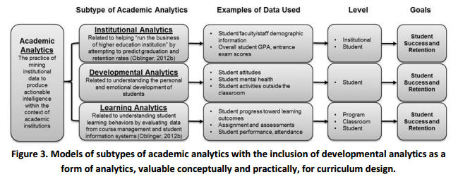
Academic Analytics
Institutional
Learning
Developmental
Notes:
Developmental: “student experiences, skills, and affective and personality traits, both inside and outside of the classroom”

Slide 6
Goals of Academic Analytics
Student retention
Student success
Curriculum and course design

Slide 7
Questions to Answer
Descriptive
What happened?
Where was the problem?
What actions are needed?
Predictive
Why is this happening?
What if these trends continue?
What will happen next?
What is the best/worst that can happen?

Slide 8
Using Learning Analytics
Five Stages (Goldstein and Katz)
Data extraction
Performance analysis
What-if decision support
Predictive modeling
Automatic response triggers

Slide 9
Academic Analytics Data
Final and assignment grades
Resource access frequency
Time of access
Type of resources accessed
Discussion posts
Frequency generated and read
Number and type of questions asked
Emails sent to instructor

Slide 10
Analytics for Achievement
Monitoring individual student performance
Disaggregating student performance by selected characteristics such as major, year of study, ethnicity, etc.
Identifying outliers for early intervention
Predicting potential so that all students achieve optimally
Preventing attrition from a course or program
Identifying and developing effective instructional techniques
Analyzing standard assessment techniques and instruments (i.e. departmental and licensing exams)
Testing and evaluation of curricula
Notes:
Categories of instructional applications

Slide 11
Learning Analytics Tools

Slide 12
PACE
Rio Salado Community College in Arizona
Progress and Course Engagement
Predictors of success:
Frequency of online use
Student engagement
Actual grades
Predictions
C or better: 70% accuracy after one week
Weekly updates

Slide 13
Signals
Purdue University
Student risk identification
Automatic interventions
Student messages
More than 11,000 students
Student Success Algorithms (SSA)
Notes:
Ssas customized to class, include performance and effort (as measured by LMS time and help-seeking behavior)

Slide 14
Signals Interventions
Generated by instructors
Posting of a traffic signal indicator on a student’s CMS home page
E-mail messages or reminders
Text messages
Referral to academic advisor or academic resource centers
Face to face meetings with the instructor

Slide 15
Signals (student view)

Slide 16
Signals (instructor view)

Slide 17
Analyze, Design, Develop, Implement, and Evaluate (ADDIE)
Notes:
Middle arrow is ‘art’ of teaching: anecdotes, informal student feedback, instructor observations; does not use rigorous data analysis.

Slide 18
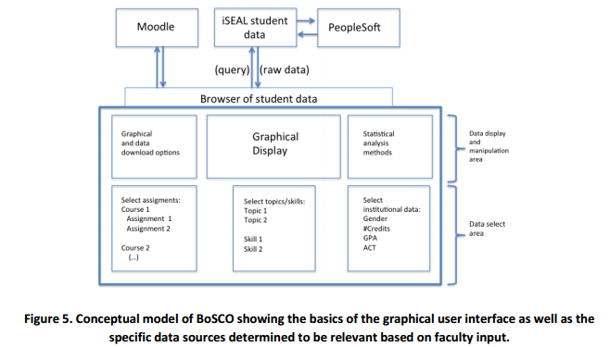
Browser of Student and Course Objects
BoSCO
Goal: Connect analytics to course and curriculum design and implementation
Notes:
University of Minnesota Rochester, Center for Learning Innovation
iSEAL: intelligent System for Education, Assessment, and Learning

Slide 19
BoSCO (cont.)
Templated uploads
File types
Course
Student performance
Demographic
IRB handled internally
No review required for internal quality control or curriculum design
Notes:
Directly from iSEAL, or manually copying/pasting from csv

Slide 20
BoSCO (cont.)

Slide 21
BoSCO (cont.)
Notes:
Figure 7. The user can further explore matrix results using bar charts or scatterplots, and filtering by demographic variables like sex or race, or filtering by specific assignments. The straight diagonal line in these scatterplots represents x=y, and can be used to compare whether students performed better in the y-axis category or the x-axis category

Slide 22
BoSCO (cont.)
Notes:
Group assignments, social self-efficacy: belief in competence in social situations

Slide 23
Issues with Academic Analytics
Student perception/involvement
Faculty perception/involvement
Profiling/Expectations
Privacy
IRB/FERPA
Data theft
“…a wealth of information creates a poverty of attention…” –H. Simon
Is this enough?
What can’t we measure?

Slide 24
Conclusions
Student data analytics are heavily used, and their use is likely to grow.
Long-term benefits for students, instructors, institutions, and courses can be promoted through analytics.
Analytics provide both descriptive and predictive power.
Many issues must still be addressed, including privacy and involvement.

Slide 25
References
Arnold, K. E. (2010). Signals: Applying Academic Analytics. Educause Quarterly, 33(1), n1.
Dietz-Uhler, B., & Hurn, J. E. (2013). Using learning analytics to predict (and improve) student success: a faculty perspective. Journal of Interactive Online Learning, 12(1), 17-26.
Dunbar, R. L., Dingel, M. J., & Prat-Resina, X. (2014). Connecting Analytics and Curriculum Design: Process and Outcomes of Building a Tool to Browse Data Relevant to Course Designers. Journal of Learning Analytics, 1(3), 220-240.
Goldstein, P. & Katz, D. (2005). Academic analytics: The uses of management information and technology in higher education. EDUCAUSE Center for Applied Research.
IBM Software Group. Analytics for achievement. Ottawa, Ontario, 2001.
May, T. A. (2011). Analytics, University 3.0, and the future of information technology. EDUCAUSE Review Online.
Picciano, A. G. (2012). The Evolution of Big Data and Learning Analytics in American Higher Education. Journal of Asynchronous Learning Networks, 16(3), 9-20.

