Slide 1
Mobile Learning in Higher Education
Peeratham Techapalokul
CS 6604 – Online Education Systems
3/24/2015 at 2PM in Randolph 110

Slide 2
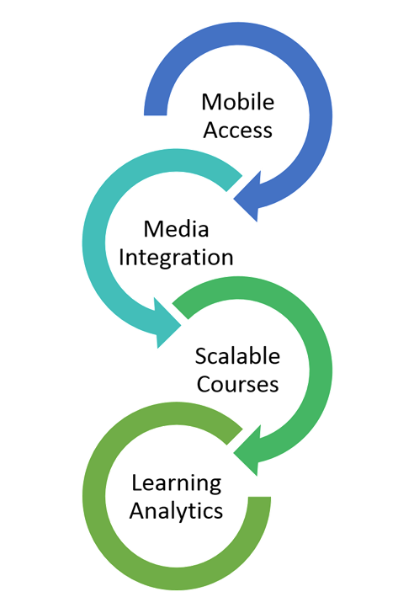
Virginia Tech Searching for New LMS
Notes:
VT Search for new LMS; mobile access as one of the key requirement
It somehow reflect the growing importance of mobile devices to the learning experience of students
that people who make decision are quite confident that
having mobile support is worthwhile (money, time invested (maintenance, technical supports) students ,instructor will make use of it)
Evidence/Data to back up the decision
Trends to support decision

Slide 3
Current Trends: The Use of Mobile Devices for Academics
Educause conducted studies on IT trends in higher education
partnered with 213 higher education institutions across 45 U.S. states and 15 countries
Online survey on students’ experience with technology
More than 75,000 students responded
ECAR Study of Undergraduate Students and Information Technology, 2014
Notes:
2014
EDUCAUSE, an educational nonprofit association, [IT leaders and professionals committed to advancing higher education]
Conduct studies designed to help academic institution to predict, plan for, and act on IT trends in higher education
partnered with 213 higher education institutions across 45 U.S. states and 15 countries to investigate
Undergrad IT experiences and expectations
They conduct online survey where more than 75,000 students responded.
They asked them what devices students own, how they use them, and their perception of technology at their institutions.

Slide 4
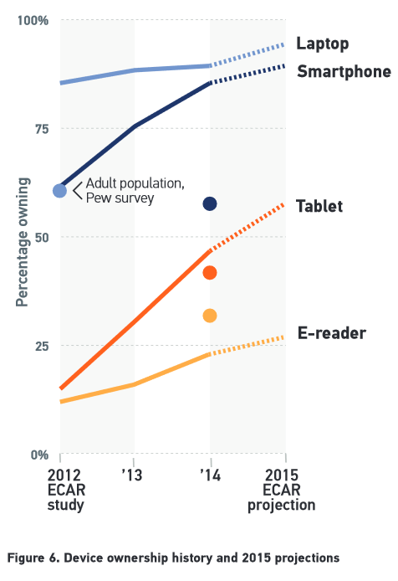
More students own mobile devices now than ever
86% own a smartphone in 2014 (up from 76% in 2013)
47% own a tablet (up from 31% in 2013)
90% own a laptop (up 1% from 2013).
Notes:
More students own mobile devices now than ever.
Mobile device ownership continues to increase, with 86% of undergrad students owning a smartphone in 2014 (up from 76% in 2013) and
nearly half of students (47%) owning a tablet (up from 31% in 2013).
Laptop ownership has leveled off, with 90% of students owning one in
2014 (up 1% from 2013).
Owning mobile devices doesn’t mean they are using it for academics!

Slide 5
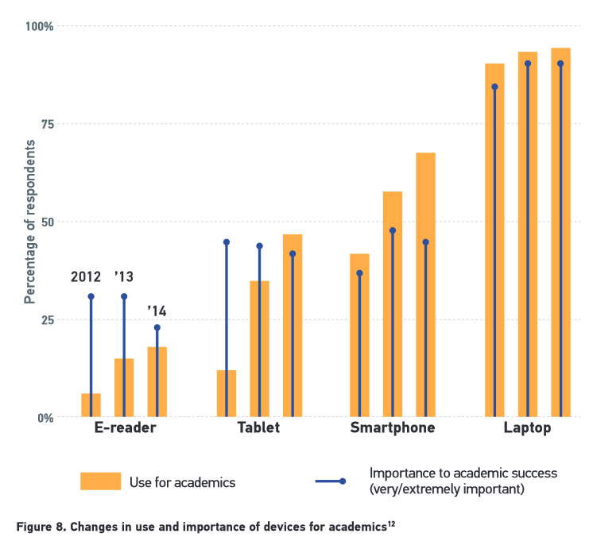
Many students use mobile devices for academic purposes
Notes:
Noticeably more students used their smartphones, tablets, and e-readers for academics in 2014 than in previous years, a finding that corresponds with the general trend in increased device ownership. among students who use these devices for academic work, attitudes about the importance of these devices hasn’t changed much during this same time period. Students that are more tech-inclined , the more likely they are to use device for academic purposes and rate them as important to academic success.

Slide 6
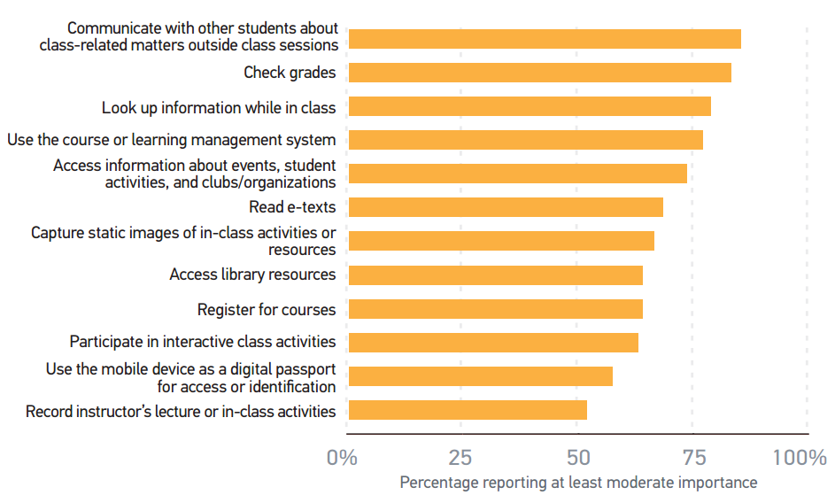
Importance of using a mobile device for various student related activities
Notes:
top 5 issues are a mix of administrative tasks (checking grades and accessing the LMS) and engagement activities (communicating with other students outside class and looking up information while in class)

Slide 7
Attitudes about the importance of mobile devices for academic success haven’t changed much
30% of instructors create assignments that incorporate mobile technology
67% of instructors agree in-class use of mobile devices is distracting; over half (55%) banning or discouraging their use
47% of undergraduates are also concerned that in-class use of mobile devices can be distracting
Survey by the EDUCAUSE Center for Analysis and Research (ECAR)
Notes:
Although increased use of personal digital devices for academics corresponds with trend increases in device
ownership, attitudes about the importance of these devices for academic success haven’t changed much.
A few data points may help explain this:
Few instructors (30%) create assignments that incorporate mobile technology,
Report suggests no widespread strategy for leveraging personal mobile technology in the classroom.
Many instructors (67%) agree that in-class use of mobile devices is distracting, with over half (55%) banning or discouraging their use.
About half of under graduates (47%) are also concerned that in-class use of mobile devices can be distracting.
We are not quite prepared to take advantage of their benefits in higher education.

Slide 8
Overview
Definition of Mobile Learning
Affordances
Learning Activities Supported by Mobile Learning
Challenges
Standard for Mobile Learning App Development
Notes:
mobile technology intersect with learning
certainly not just the conjunction of mobile‘ and learning‘

Slide 9
Definitions of Mobile Learning
“the intersection of mobile computing and e-learning” (Quinn, 2000)
The exploitation of ubiquitous handheld technologies, together with wireless and mobile phone networks, to facilitate, support, enhance and extend the reach of teaching and learning (MoLeNET, 2007)
"Leveraging ubiquitous mobile technology for the adoption or augmentation of knowledge, behaviors, or skills through education, training, or performance support while the mobility of the learner may be independent of time, location, and space.“(ADL, 2012)
Notes:
Obviously, it’s not just e-learning on a smaller screen.
It’s implicitly meant mobile E-Learning‘ and its history and development have to be understood as both a continuation of conventional‘ E-Learning and a reaction to this conventional‘ E-Learning and to its perceived inadequacies and limitations. The mobile aspect of the mobile learning make it unique.
Specifically it’s about designing learning experiences that exploit the opportunities that mobility can offer us. More learner-focused and device-focused, and the mobility of the learner (anytime anywhere)
ADL Advanced Distributed Learning Initiative

Slide 10
Mobile learning has been called…
Bite size
handy learning
Ubiquitous
Portable
Pocketable
learning on the go
my learning
Untethered
Informal
opportunistic
Personal
Private
Situational
Unstructured
learning in the moment
snack-learning
Courselets
"bus stop" learning
a learning nugget
a learning pill
Mobile Learning Handbook (ADL Mobile Learning Team)
Notes:
Learning can occurred at anytime and any place
The learning can happen intentionally or unintentionally
It can be both formal , in class and informal outside of classroom
It gives the sense of that the student takes ownership of learning;
Student personalize their own learning experience, have control over the place, time , and learning content.
It’s a sense of intimacy and convenience with their personal devices (different than a laptop)
Extra:
A courselet is a short, 10 to 15 minute, learning module.
The ability to capture their own learning moments (take photos, videos, notes) and share their insights or questions with others using social media and LMS.

Slide 11
Affordances for Learning
Portability of device + a specific combination of capabilities (hardware and software) could result in an affordance for learning.
Accessing (on-demand)
Augmenting
Data Capturing
Communicating
Contextualizing
e-Reading
Media Playing
Notifying / Reminding
http://www.adlnet.gov/the-affordances-of-mobile-learning/
Notes:
Where do I start in deciding which capability to use?
Define the problem to be solved, and then examine mobile technologies systematically, pointing to their technical capabilities and matching them to their affordance.
Accessing: on-demand access to reference information, Wikipedia, course content, LMS
Augmenting (camera, GPS) Overlaying still image, audio, or video over real world objects or settings
Augmenting : augmented reality
Data Capturing (microphone, camera) Documenting audio, visual content (image or video)
Collaborative learning : information gathering and sharing among users
Communicating: (chat application) One-way, two-way, or group messaging as part of informal or formal learning activity
Examples: Group collaboration, instructor/student discussion, and chat
Can be both synchronous (real time) and asynchronous
Contextualizing: Notifications and linked interactions, proximity or location sensors to provide context-aware content
QR Codes, mobile tours, games, and interactive stories
e-Reading: Accessing and reading documents on multiple devices anytime, anywhere
Media Playing: Accessing media anytime, anywhere
Notifying / Reminding: (push notification service) Event triggers, instant reminders, and alerts that illicit immediate responses or deeper engagement with a learning activity
Spaced repetition/learning, flash cards, language learning

Slide 12
Learning Activities
Behaviorist Learning- Quick feedback or reinforcement can be facilitated through mobile devices.
Constructivist Learning - Enable immersive experiences such as those provided by simulations or games.
Situated Learning - learning within an authentic context and culture
Notes:
Different teachers and disciplines will have different conceptions of teaching (Kember, 1997) that they will attempt to bring to education.
http://www.irrodl.org/index.php/irrodl/article/view/346/875
Pedagogical Affordances of mobile devices go beyond content delivery.
In some case, one might be concerned with supporting students learning (i.e., by discussion and collaboration) over the delivery of content
Behaviorist Learning
Fairy basic application of mobile devices
Approach : Present content, gather responses and provide feedback
e.g. classroom response systems
presenting multiple choice options on students’ devices, quickly & anonymously gather students response
provide aggregate visualization to show variation in students’ response
Constructivist
Learning is an active process where learners construct new concepts based on current and past knowledge
Computer not just used for presentation but a tool to manipulate information
Mobile device offers opportunites to put the learners in realistic context
e.g. participatory simulation
Situated Learning
We carry mobile device everywhere at different contexts and these contexts can be used to enhance learning activity
e.g. museum, fieldtrip

Slide 13
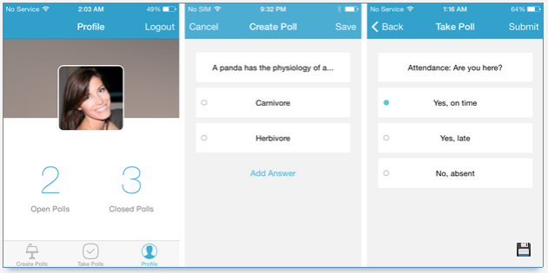
Canvas Poll
http://www.canvaslms.com/higher-education/features
Notes:
i>clicker student response system to promote group discussion, sharing, and collaboration in the classroom.
Canvas Polls integrates with Canvas courses, participation and performance data is saved for every student,

Slide 14
Learning Activities (cont.)
Collaborative learning – learning through social interaction
Informal learning – learning outside a dedicated learning environment and formal curriculum
Learning and teaching support – assist in the coordination of learners and resources for learning activities
Notes:
Collaborative Learning
learning by interacting with peers that are better via conversation, coming up with the meaning
Consume, produce and exchange content, sharing information at any time.
Informal Learning
Mobile devices accompany users in their everyday experiences and become a convenient source of information or means of communication that assists with learning.
Learning and teaching support
So the use of mobile technology is not just for learning activities. It can be used to support learning such as a personal organization tool for students, a tool for instructors to provide course materials just like LMS
Questions
Where do I start in deciding which technology to use?
Define the problem to be solved, and then examine mobile technologies systematically, pointing to their technical capabilities and matching them to their affordance.

Slide 15
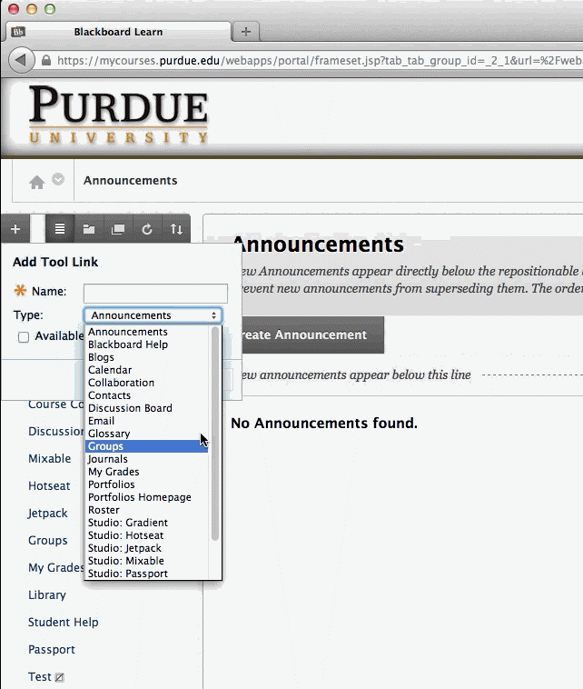
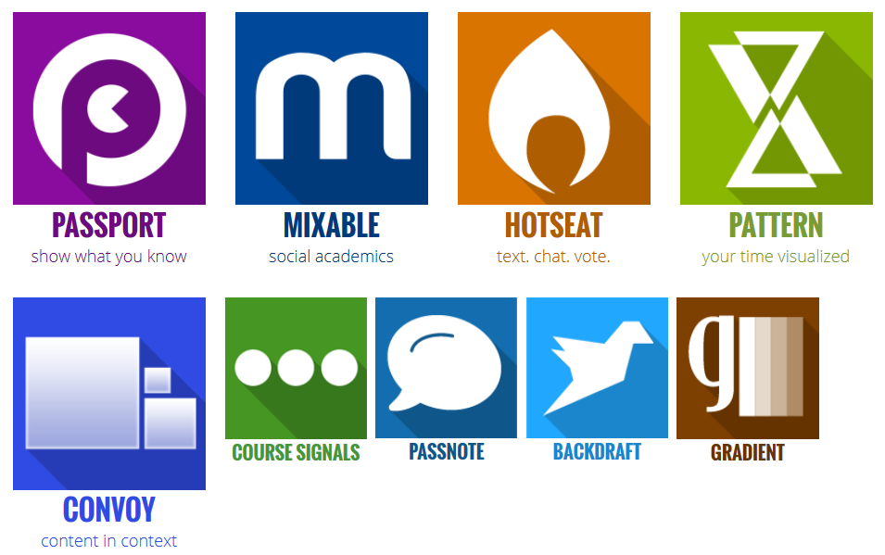
Purdue’s Studio Project
Notes:
Making the higher education learning experience more mobile, social, and altogether part of the modern student's life
Mixable: An easy-to-use online system that follows a familiar social networking model, Mixable allows users to easily hold conversations and share course resources.
Hotseat: Hotseat provides users a place to quickly and easily participate in a productive backchannel discussion during class.
Convoy: Deliver interactive presentations, supplemental materials, and lecture notes.
Pattern: help measure your study habits, providing you analytics and insights to become a better learner.
Course Signal: detects early warning signs and provides intervention to users who may not be performing to the best of their abilities before they reach a critical point.
Instructor can create badges, recognize and validate those skills for students
Digital badges are becoming a popular way to acknowledge professional skills,

Slide 16
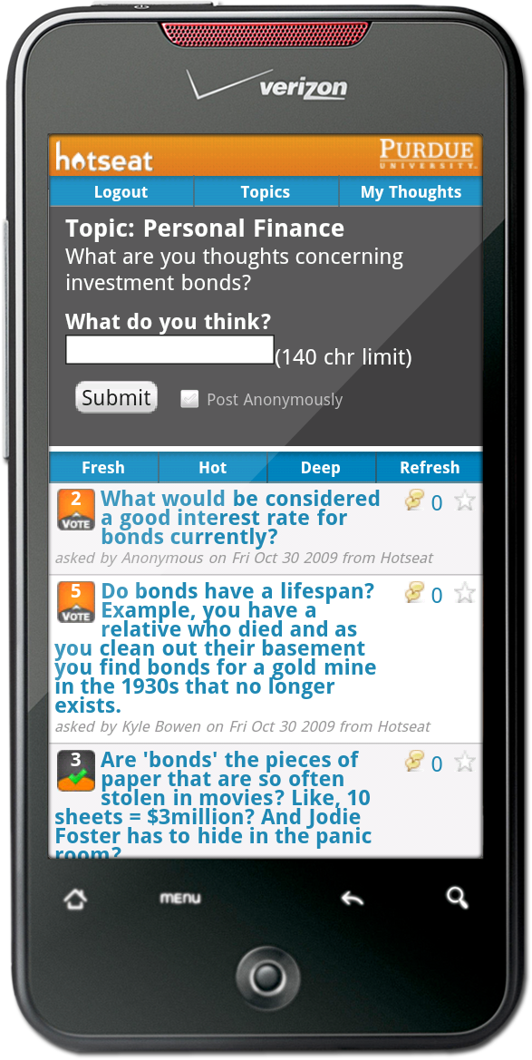
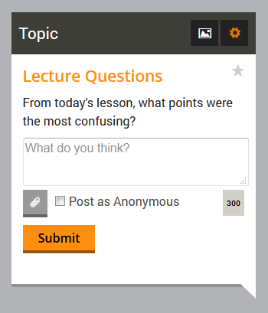
Purdue’s Hotseat
http://www.educause.edu/ero/article/hotseat-opening-backchannel-large-lectures
Notes:
a social networking-powered mobile Web application, which creates a collaborative classroom, allowing students to provide near real-time feedback during class and enabling professors to adjust the course content and improve the learning experience.
Students can post messages to Hotseat using their Facebook or Twitter accounts, sending text messages, or logging in to the Hotseat Web site.”

Slide 17
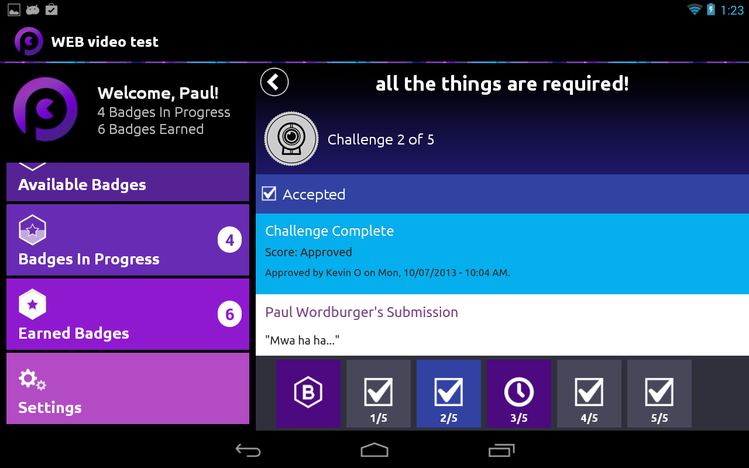
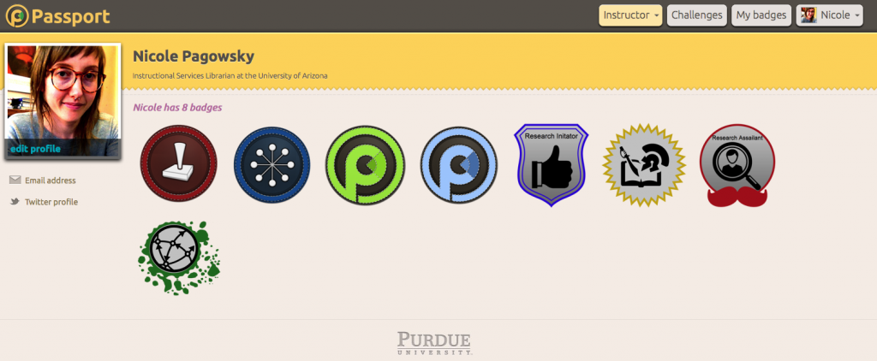
Purdue’s Passport
Notes:
Passport :
More detailed than an academic transcript,
Passport allows users to visually display their work as concrete evidence of their knowledge.
Passport is a learning and e-portfolio system that uses digital badges to demonstrate user’s competencies and achievements.
Way to capture: students gained knowledge and skills not well-represented in college degree

Slide 18
Challenges
Technical Challenges
Reworking existing E-Learning materials for mobile platforms
Slow text input
Multiple sizes, platforms
Social challenges
distraction
Privacy
Other inappropriate behaviors
Notes:
Learning Content:
Content cannot simply be transferred from the desktop format to the mobile format without significant reorganization, reformatting,
and possibly transform it as learning support rather than learning content.
Best Practices:
Create content that is short and to the point
Creating the smallest possible modules consisting of smaller chunks of context-independent content
e.g. Breaking an hour-long web lecture into six 10-minutes segments for mobile devices.
a good checklist could be worth much more than an interactive game
Technical Challenges
Size of the mobile device: small screen size, and slow text input (hard to get substantive feedback from students)
Device supported: New devices continue to become available with varying capabilities and sizes.
Extra: ADL Mobile Learning Instructional Design Reference Model
Web apps Pros for web apps easily support a much wider range of devices. consistent with features of a PC browser
Faster to deploy and update Allows potential access to the same LMS environment (or a specialized flavor of it) that desktop offers
Cons for web apps: · Requires live Internet access. · Can’t push content to the learner. Must notify via some other communications media that the new content that they can pull. Native apps
Pros for native apps
· best-in-class user experience
a rich design and tapping into device features and
offline use.
· Content can be pushed or pulled.
· Content can be downloaded for offline
consumption
Cons for native apps:
· They cannot be easily ported to other mobile
platforms.
· Can take longer to deploy
· Developing, testing, and supporting multiple
device platforms can be costly.
Platform(s) supported: Deloitte estimates the cost of developing for two OSs is 160 percent of the cost of developing for one.
Technology changes: The global mobile industry is now the most “vibrant” and “fastest growing industry” on the planet. Expect improvements and changes Inconsistent Platforms: lack of cross-platform consistency in mobile devices, multiple operating systems.
Social Challenges
Improved Technology—Increased Distraction, Multi-tasking is not always a productive way to learn.
Sending friends text messages during class time.
Personal and private information and content
Other inappropriate behavior e.g.
Sending or receiving test answers.
distributing inappropriate digital photos of students.

Slide 19
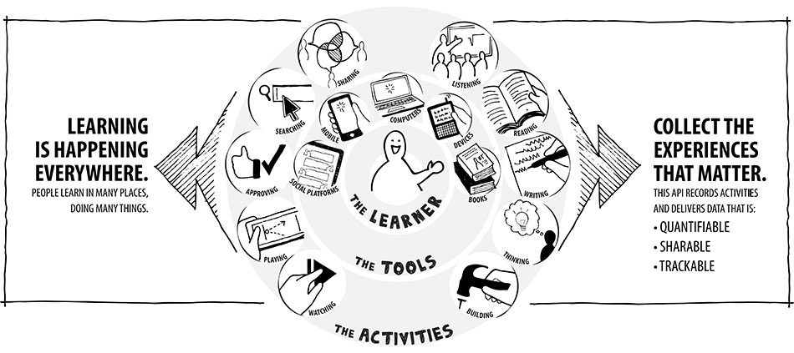
Record Any Learning Experience
Watching a Khan Academy video is a learning experience
Attending a conference session is a learning experience
Asking your social network for advice
Being mentored by an expert
Turning in your homework
Mentoring somebody else
Writing a blog post
Going to class
Reading a book
http://tincanapi.com/overview/
Notes:
We have learned about LTI (IMS LTI (Learning Tools Interoperability)
- standard for communicating between platforms like LMS, portals, or other educational environments.
- Capture students’ assessment score
The problem is that LTI
No support for non-web-based activities
External tool must be launched via LMS
Integration with non-browser application may become complex
Consider Mobile learning where Learning happens everywhere both formally and informally
So if we want to make mobile learning part of the learning tool, it too need to be able to communicate with LMS and other learning environments.
They expect to learn informally and collaboratively, and to be able to use social networks as part of the learning experience.
Users expect that their learning experiences will earn them credit, regardless of whether the learning activities are browser-based or not;
Free learners from being tied to an LMS

Slide 20
Tracking of Mobile Learning: Experience API
Experience API (xAPI or TinCan) by ADL (Advanced Distributed Learning) Initiative
Support a variety of content types.
Learning not tethered to desktop browser or LMS
Record activity statements of the form “actor verb object”
Allow for offline or disconnected scenarios.
Notes:
Another emerging standard is Experience API (formerly known as TinCan) by ADL (Advanced Distributed Learning) group
Growing list of adopters such as Moodle Sakai, and Blackboard
Support a variety of content types.
People learn from interactions with other people, content, and beyond.
These actions can happen anywhere and signal an event where learning could occur. All of these can be recorded with the Tin Can API.
Not tied to browswer / LMS
Provide a method to track learning that involves activities that take place across multiple platforms and devices.

Slide 21
Learning Activity Statements
“Mary read to page 12 in resource [x]”
“Jabbar answered a question asked by Jennifer”
“Rajiv posted to discussion forum [x]”
“Yuan added an image to her learning journal”
“Jose completed learning project [x] and sent it to instructor [y]”
“For learning goal [x], Jermaine reported that content [y] was highly useful”
“Francois liked [learner x]’s blog”
Notes:
Facebook Activity Streams
“Mike posted a picture”
“Tim commented on Mike’s Picture”
“Beth liked Mike’s Picture”
Think of “learning experiences” and “learning evidences”
Allow xAPI enabled generate and capture learning stream data and then organize the data into meaningful learning contexts
We can analyze the learning path of each student.
Identify learning paths that lead to the most successful/problematic outcomes.
Students can link the data

Slide 22
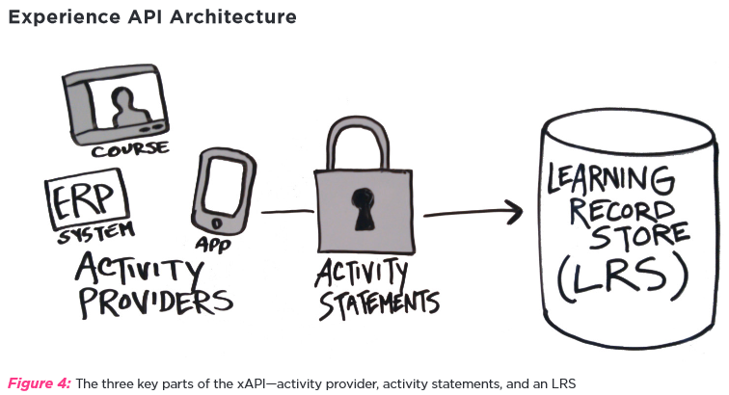
Peter Berking et al. The Experience API – Liberating Learning Design
Notes:
A Learning Record Store (LRS) = a place to store learning records.
This data is available for retrieval by other systems that create reports, perform analytics, and generally
create meaning out of the raw data stored in the LRS in the form of statements.
records that can be accessed by an LMS or a reporting tool.
An LRS can live inside an LMS, or it can stand on its own.
Will this has practical use in higher education?
Concerns about ethical issues ( evading student’s privacy)?

Slide 23
References
ECAR Study of Undergraduate Students and Information Technology, 2014
ADL Mobile Learning Team, Mobile Learning Handbook
Peter Berking et al. The Experience API – Liberating Learning Design
http://www.adlnet.gov/the-affordances-of-mobile-learning/
Gregg Orr, A Review of Literature in Mobile Learning: Affordances and Constraints
Further Readings
Kristy Murray et al. Mobile Learning and ADL’s Experience API
Laura Naismith et al. Literature Review in Mobile Technologies and Learning
Mohamed Ally, Mobile Learning: Transforming the Delivery of Education and Training

