Slide 1
Online Learning Software: Terminology and Concepts
Austin Cory Bart
CS 6604 – Online Education Systems
1/22/2015 at 2PM in Randolph 110

Slide 2
Goals
Define recurring terms and concepts
Create a “glossary” that we can all refer to
tinyurl.com/cs-6604-glossary
Please engage and discuss with the content represented here. If you think I’ve glossed something over or didn’t capture the full picture, we need to figure it out!

Slide 3
Outline
Idea of Virtual Learning Environments
The competing metaphors
Course
Book
Tutorial System
Tool
Forum
Other key concepts
How do big platforms [not] use these concepts?

Slide 4
Learning Environments

Slide 5
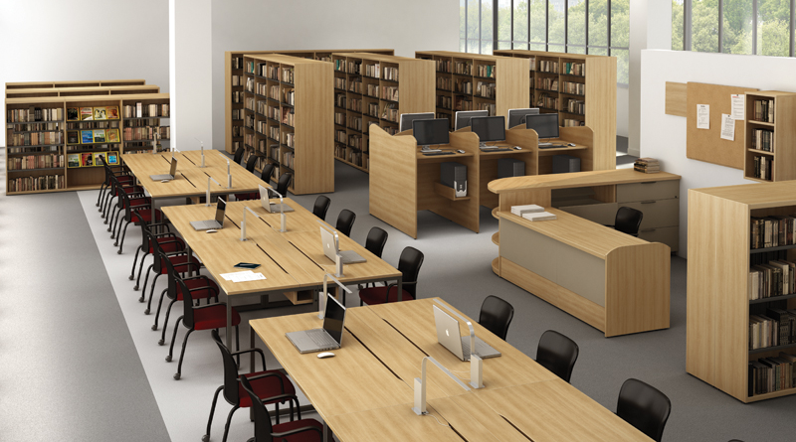
Learning Environments

Slide 6
Formality of the Environment
Formal: School, College, Workplace
Nonformal: Afterschool program
Informal: Your desk at home

Slide 7
Sources of Knowledge
Internet
Exam
Homework
Class/lab work
Textbook/Readings
Student
Teacher one-on-one time
(e.g., Office Hours, emails)
External Knowledge Experts
Prior Knowledge
Teacher's Lecture
Teaching Assistants
Peers/Forum
Quiz
Projects

Slide 8
Virtual Learning Environment
"An electronic educational technology (also called e-learning) education system based on the Web that models conventional in-person education by providing equivalent virtual access to classes, class content, tests, homework, grades, assessments, and other external resources such as academic or museum website links. It is also a social space where students and teacher can interact through threaded discussions or chat." - Wikipedia article
Also known as: Learning Platform

Slide 9
Competing Metaphors
Book
OpenDSA, Runestone
Course
Scholar/Sakai, Moodle
Tutorial System
CodeCademy, Gidget
Tool
Eclipse, Greenfoot, Word

Slide 10
Course Metaphor

Slide 11
Conventional Course
A learning experience that (usually):
Lasts a semester
Situated in a physical site
Led by an in-person instructor(s)
Has a set of students
Supplemented by other materials
Meant to teach a particular slice of a discipline's knowledge
Ends in some kind of summative grade…
… That provides credit, certification, etc.

Slide 12
Virtual Course
An online learning experience that (usually):
Lasts a semester
Situated in a physical site
Led by an in-person instructor(s)
Has a set of students
Supplemented by other materials
Meant to teach a particular slice of a discipline's knowledge
Ends in some kind of summative grade…
… That provides credit, certification, etc.

Slide 13
Course: Courseware vs. LMS
Learning/Course Management Software (LMS/CMS)
“Administration” of resources
Scholar/Sakai, Moodle
CourseWare:
“Kit” of material
Examples: OpenEdX, Coursera

Slide 14
Course: MOOC
Massive
Way bigger than most conventional courses
Open
Ideally, anyone should be able to take it
In practice: many have paywalls, require user registration
Online Course

Slide 15
Course: Roles
Students
[Senior, Guest] Instructor
Teaching/Lab Assistants
Content Creator/Contributor
Observer/Researcher/Guest
Administrator
Staff/Maintenance
Different
Privileges
Students grade professors
Guests can’t view certain materials
Tasks
Students want to view material for certain times
Requirements
Not necessarily discrete!
Membership can fluctuate

Slide 16
Course: Header information
Course Description
Learning Objectives
Course Policies
Etc.

Slide 17
Course: Assignments
Collection of problems
Physical, Virtual artifacts
Timing
Has a start time (can students submit early? Is it visible early?)
Has deadlines (hard, soft, might affect scores)
Assessments
Formative or summative
Often has feedback
Sometimes allows revisions
Mastery (keep trying until you get achieve a certain level of proficiency) vs. Conventional
Points
Worth some number of points
Internally has some distribution of points

Slide 18
Course: Boolean work
Attended class/lecture
Reviewed a video
Read a chapter in the book

Slide 19
Course: Assessment
Some distribution of points among assignments
Students have a summative score
Final grade: A, B, C, D, F, W, I, etc.
Pass/Fail

Slide 20
Course: Shared Assessment
Paired work
Two students work closely together
XP – Paired Programming
Teams
Groups of students working together
Receive same or similar grades
Students grade each other
Cohorts
Looser grouping – no shared grade

Slide 21
Course: Resources
Static content available to the student
PowerPoint slides
Documents
Readings, articles
Videos
Websites
Meant to support learning

Slide 22
Course: Versioning
Courses evolve over time
Changes structure, administration, material
Material used in one semester might need to be modified, removed
New learning objectives
Department expectations evolve over time
Courses may have multiple, slightly different sections
Especially for educational research (the hunt for the mythical “control”)
Different instructors teach the same course differently

Slide 23
Course: Learning Tools Interoperability
Export materials between multiple CMS
LTI Standards
Seductive, but all very questionable

Slide 24
Book Metaphor

Slide 25
Conventional Book
Authoritative source of knowledge
The only state in a book is the reader’s current position
Physical object that can be freely distributed

Slide 26
Virtual Book
Authoritative source of knowledge
State is reader’s current location, completion of interactive content, and observation of static content
Physical object that can be freely distributed
Dynamic

Slide 27
Book: Organization
Prose organized into a hierarchy of
Volumes
Parts
Units/Modules
Chapters and Sections
Paragraphs

Slide 28
Book: Content
Static content
Text, Images
Audio, TTS
Videos, Slideshows, Visualizations
Interactive content [Problems, Interactives, Exercises]
Multiple Choice
Paragraph Response
Programming
Interactive Visualizations

Slide 29
Book: Patterns
Books can be accessed in many different patterns:
Linear scan
Chapter 1, Chapter 2, Chapter 3, …
Non-linear branching
Not many examples in the wild
Skipping around, returning
Some content should reference earlier content, some isn't crucial to understand the first time
Search/Reference
Some content is only needed on-demand
Not at all

Slide 30
Book: Reconfiguration
Use case: “I want to use chapters 4, 7, and 9. Plus new content tailored to my course.”
Modular design of material for reconfiguration
Example: OpenDSA, Runestone
Problem:
Hyperlinking to non-existent sections
Complications
Runestone: “Not many people take advantage of this feature”

Slide 31
Book: Content Creation
Need to be able to contribute new material
OpenEdX: Studio
Runestone,

Slide 32
Book: Versioning
Texts evolve over time
New content added, content removed, content changed
Sometimes even during a course
Forking/Branching/Merging
Wiki:
Pages linked
Idea of revisions (timescale)

Slide 33
Book: Other features
Bookmarking
Notes
Concept maps
Glossaries

Slide 34
Tutorial Systems
Guided completion of problems
Real-time feedback
Usually completely automated
Mastery model

Slide 35
Tutorial System: Apprenticeship Possible physical analogue to Tutorial System
Expert teaches novice
Learn by observation, participation

Slide 36
Tutorial System: Differences
Some similar ideas to a Course and a Book
Students are tracked and given feedback
Authoritative Knowledge delivered Just-In-Time
Some key differences
Not designed around a calendar
Fully interactive
Not meant to be browsed
Typically an immersive experience

Slide 37
Tutorial System: Progression
Have a sense of progression
some exercises depend on prior exercises
Students might want to do some more than once

Slide 38
Tools
Professional tools used to solve tasks
Authentic, situated learning
Important motivational and cognitive goals

Slide 39
Tools: Computer Science
Programming Environments:
Eclipse
PyCharm
Educational Programming Environments:
Dr. Racket
GreenFoot
Other:
Git
Console

Slide 40
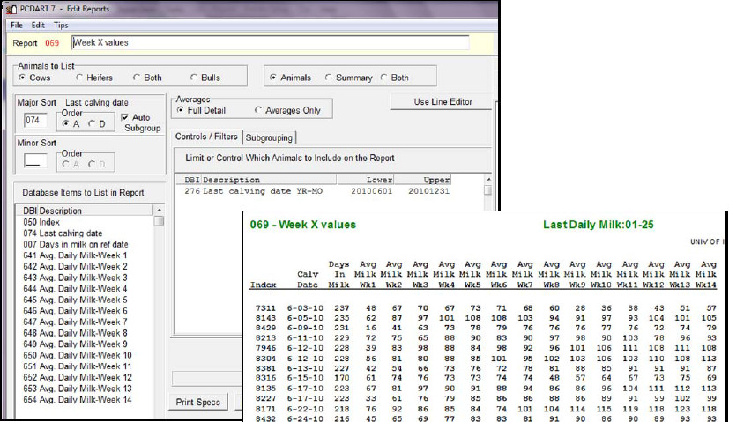
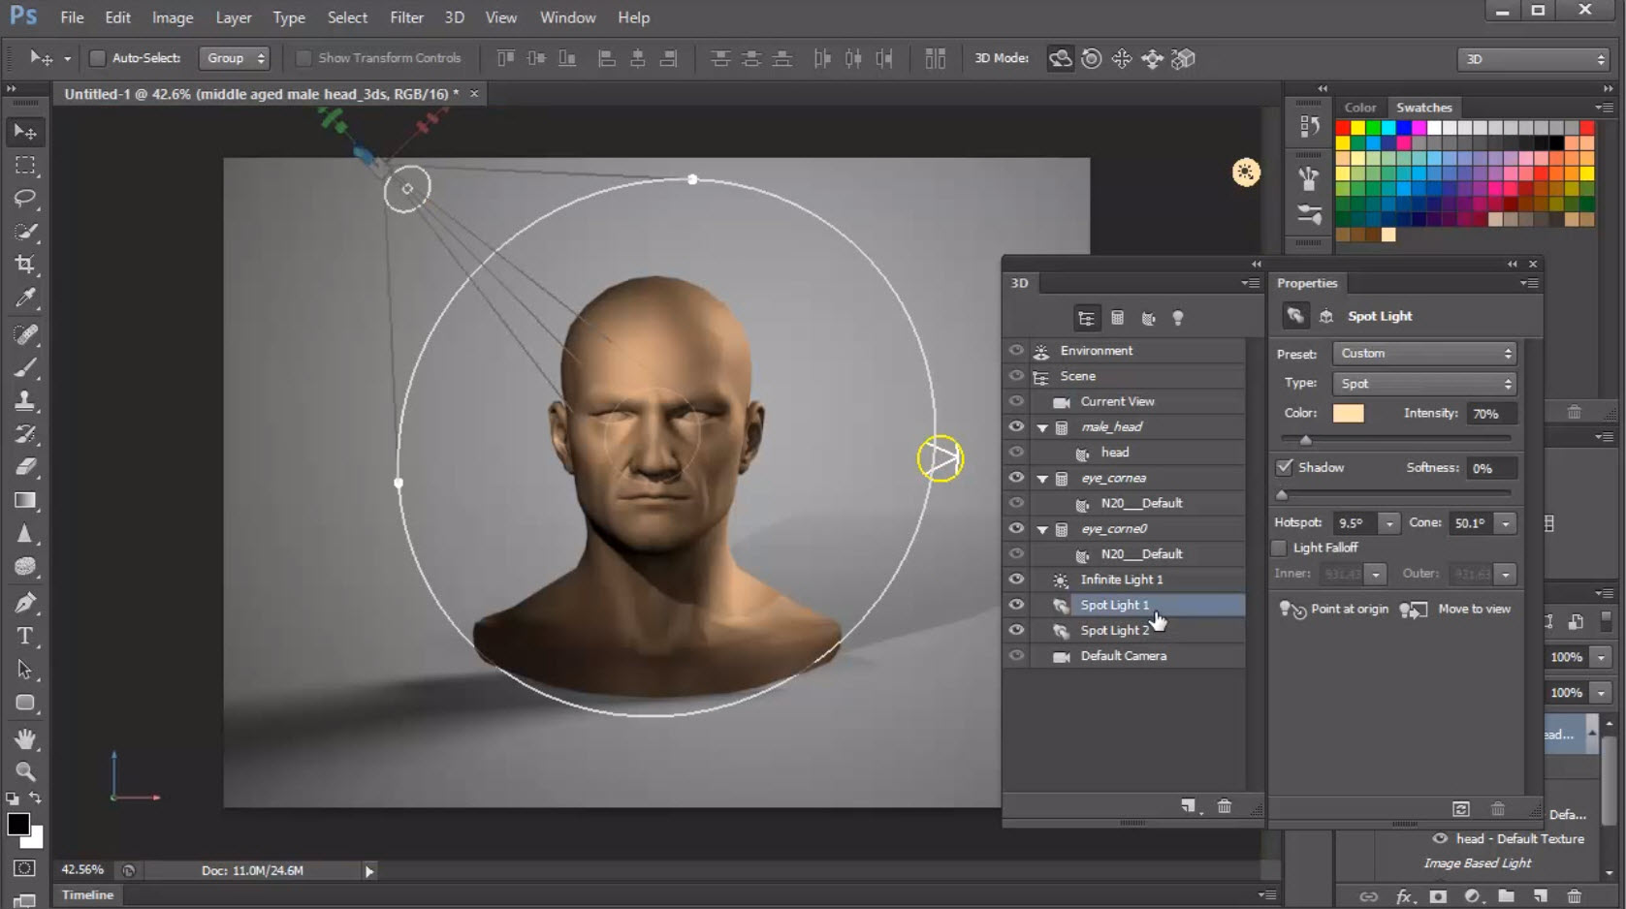
Tools: Other Disciplines
PCDART
PhotoShop

Slide 41
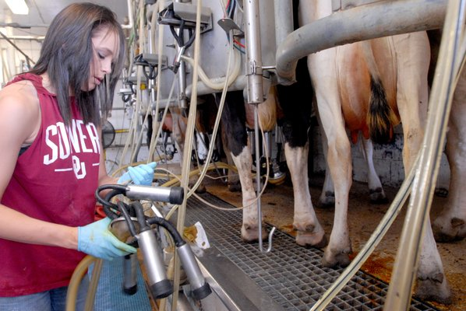
Tools: Physical

Slide 42
Tools: Tie-in
WebCat integration to Eclipse
PyCharm has “classes”
Pythy can store things in the cloud

Slide 43
Forums
Most modern learning theories account for the social nature of humans
Socio-cognitive
Distributed cognition
Situated Learning Theory
We often want students to work together

Slide 44
Forum: Threaded Discussion
Students create topics
Posts on a topic
Sometimes posts can be direct responses to other posts
Instructor/TA role often required to guide discussion

Slide 45
Forum: Piazza
Mash-up of Threaded Forum + Wiki
Students collaborate, but also work towards a single answer

Slide 46
Forum: Social Media
Existing platforms that students already use:
Twitter
Facebook
…
Can be great for engaging outside of typical course concerns
Introduces complications for privacy
Often works organically among students
VT has a number of facebook groups for studying/working on course work

Slide 47
Forum: Chat/Messaging
Many forms
One-on-one
Class
Temporality
On-going, persistent
One-off conversations
Real-time
Privacy
Visible to class
Visible to professor
Anonymous

