Slide 1
OpenDSA Architecture
Clifford A. Shaffer
Department of Computer Science
Virginia Tech

Slide 2
Presentation Goals
Present details for an exemplar system
Raise fundamental issues frequently relevant to “big” online educational system

Slide 3
Issue: What are you?
Open source, open access project
International collaboration
Goal: create collection of online materials for Data Structures and Algorithms (DSA)
Content collection vs. eTextbook
Broadening to other topics: Programming Languages, Formal Languages

Slide 4
What is an Active eTextbook?
We mean a close integration of:
Static text and graphics
Dynamic visual content
Animated slideshows, interactive activities and visualizations, simulations, etc.
Assessment activities
Questions, proficiency exercises, programming exercises, etc., with immediate feedback on progress

Slide 5
Issue: Pedagogical Foundations
Lots of feedback in the form of automatically assessed exercises will fundamentally improve learning
Caveat: We have to deliver meaningful assessment exercises
Corollary: This fits well with existing research
AV research: Interaction is key
No Significant Difference research: Media alone is not signficant

Slide 6
Issue: Who are Your Users?
>20 courses used (of sizes from 15 to 150 students) at >10 universities in 4 countries
Over 1000 students (now used by several hundred per semester)
Over a million questions answered or exercises performed.

Slide 7
Issue: Getting User Feedback
Fall 2013: (similar results thereafter)
4.3/5 on Likert Scale for preference of OpenDSA vs. lecture and textbook.
Score for liking the idea of eTextbook went up after actual use
Numerous unsolicited comments indicating positive view of OpenDSA, especially the visualizations.
Student perceptions of value do not necessarily reflect learning outcomes.

Slide 8
Issue: Pedagogical Effectiveness
Fall 2012, quasi-experiment in CS3114
Two sections: One control, one using OpenDSA
Content on Sorting and Hashing (about 3 weeks)
On post test, about ½ standard deviation, but not quite statistically significant

Slide 9
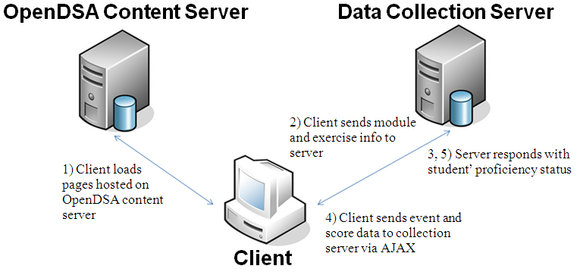
Issue: Communications Architecture

Slide 10
Issue: What fundamental implementation technology?
Ubiquitous access to computers in and out of the classroom
HTML5 technology – solves all of our needs for delivering content, as well as all of our compatibility problems
Our scale is unique for AVs and exercises

Slide 11
Development Infrastructure
JSAV for AVs and proficiency exercises (JavaScript development)
Khan Academy exercise infrastructure
Django backend for “LMS” support
reStructuredText for writing content
Python to glue everything together

Slide 12
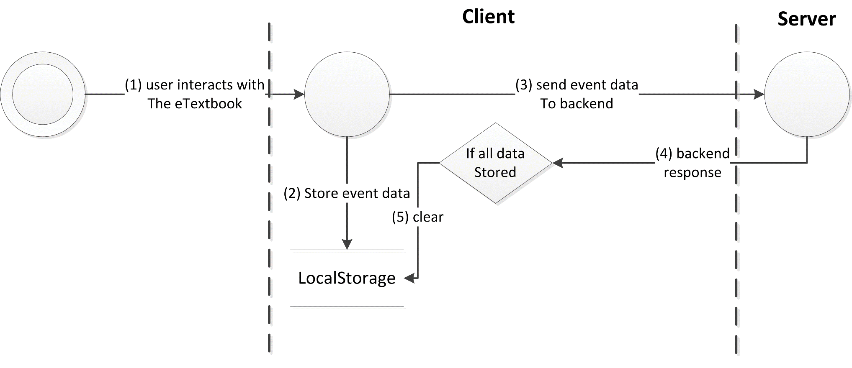
Local Storage

Slide 13
Local Storage
Conclusion: Don’t.

Slide 14
Content Components
Text and Graphics, code displays
“Animated slideshow”
“Standard” assessment (MC questions, etc)
Interactive proficiency exercises
Interactive simulations/explorations
From probing equations to running performance simulations
Programming exercises

Slide 15
Issue: Content Creation
Sub-issue: Who is developing your content?
Authoring system for text: reStructuredText

Slide 16
Issue: Content Creation
Sub-issue: Who is developing your content?
Authoring system for text: reStructuredText
NEVER use a binary format for content.

Slide 17
Issue: Content Creation
Sub-issue: Who is developing your content?
Authoring system for text: reStructuredText
NEVER use a binary format for content. Never.

Slide 18
Issue: Content Creation
Sub-issue: Who is developing your content?
Authoring system for text: reStructuredText
NEVER use a binary format for content. Never.
Visualizations and exercises in JavaScript using JSAV and KA

Slide 19
Issue: Content Creation
Sub-issue: Who is developing your content?
Authoring system for text: reStructuredText
NEVER use a binary format for content. Never.
Visualizations and exercises in JavaScript using JSAV and KA
Book instances are created from configuration files

Slide 20
Issue: Learner Data Analytics
Collect extensive interaction data
Scoring outcomes and all interaction events.
Over one million events during each of Fall 2013 and Fall 2014.
Analyze logs to observe learning behavior
Hope this leads to improvements in the system
We distinguish “credit-seeking” from positive learning behavior

Slide 21
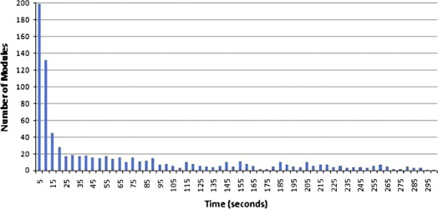
Students Jump to Exercises

Slide 22
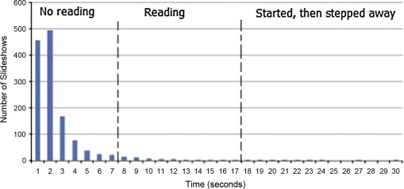
Students Skip Through Slideshows

Slide 23
Students do not Read Analytical Material

Slide 24
Other Observations
If given credit for reading slideshows, they look at more, but skip through them more.
Some attempts to use an AV to solve an exercise (even though it takes longer).
We have lots of data about when students use the system (time of day, day of week, relationship to due dates and exams).
Little interest in using tablets or mobiles.
Mild gamification aspects do motivate

Slide 25
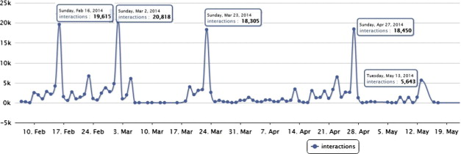
Students use OpenDSA to Study
Specifically, students voluntarily use proficiency exercises for practice.

Slide 26
Doing Exercises Correlates to Test Outcomes
On course midterms, assign students by quartile based on midterm score
Count number of Correct exercises
The difference in mean number of Correct exercises for each quartile is statistically significant
More Correct exercises done by higher quartiles

Slide 27
Issue: Localization
Internationalization and code
Similar mechanisms to implement

Slide 28
Issue: Assessment
OpenDSA uses Khan Academy Exercise Framework for many questions
We have T/F, MCQ, etc.
Parameterization of questions
Proficiency exercises
Programming exercises

Slide 29
Formal Definition of Problems
There are many types of “problems”. It can be overwhelming for a developer to accommodate.
We found it useful to create a formalism for describing the key concepts for a problem specification.

Slide 30
Problem
Problem Statement: A 2-tuple (Problem Template, Problem Instance Generator) where the Problem Instance Generator is a function that generates a Problem Instance.
User Interface: User interacts with to create Student Answer.
Model Answer Generator: A function that takes a Problem Instance and generates a Model Answer.
Answer Evaluator: A function that compares the Student Answer to the Model Answer to determine whether the Student Answer is correct or not.
Variables: These carry information from the Problem Statement to the Model Answer Generator.

Slide 31
Problem Instance
A static statement of a problem in a form that can be presented to the user.
Generated from the Problem Statement by binding any Variables to specific values.
If there are no Variables, then the Problem Instance is merely a copy of the static Problem Statement.

Slide 32
Problem Statement
(Problem Template, Problem Instance Generator).
The Problem Template consists of text and, optionally, Variables.
Example: A uniformly distributed random variable within a specified range, such as for an addition problem.
The Problem Instance Generator: function that takes the Problem Template as an input and returns a Problem Instance.
Only interesting when there are variables.

Slide 33
Student Answer
Constructed by a user through manipulating the User Interface.
User Interface: The User Interface is the mechanism within which the user operates to specify the Student Answer.
Pull-down menu, radio buttons, textbox, something where the user must manipulate the objects.

Slide 34
Model Answer
Generated by the Model Answer Generator from the Problem Instance.
The Answer Evaluator is a function that takes the Model Answer and Student Answer as inputs and determines if the Student Answer matches the Model Answer.
The output might be YES vs. NO, or a score.

Slide 35
Khan Academy
The exercise framework supports all of these concepts.

Slide 36
Issue: LMS
Student gradebook
Instructor support
Linking students to a book instance, with execises, in a “course”
Assignments (collections of exercises)

Slide 37
Issue: Gamification
Student gradebook
Checkmarks and green buttons by slideshows and exercises
“Module Complete” message
Green bars on TOC titles

