Slide 1
Introducing OpenEdX
Hosam Shahin
CS 6604 – Online Education Systems
2/3/2015 at 2PM in Randolph 110
Notes:
This template can be used as a starter file for presenting training materials in a group setting.
Sections
Right-click on a slide to add sections. Sections can help to organize your slides or facilitate collaboration between multiple authors.
Notes
Use the Notes section for delivery notes or to provide additional details for the audience. View these notes in Presentation View during your presentation.
Keep in mind the font size (important for accessibility, visibility, videotaping, and online production)
Coordinated colors
Pay particular attention to the graphs, charts, and text boxes.
Consider that attendees will print in black and white or grayscale. Run a test print to make sure your colors work when printed in pure black and white and grayscale.
Graphics, tables, and graphs
Keep it simple: If possible, use consistent, non-distracting styles and colors.
Label all graphs and tables.

Slide 2
Goals
Introduce OpenEdX Platform
Get you started on how to extend OpenEdX
Notes:
Give a brief overview of the presentation. Describe the major focus of the presentation and why it is important.
Introduce each of the major topics.
To provide a road map for the audience, you can repeat this Overview slide throughout the presentation, highlighting the particular topic you will discuss next.

Slide 3
What is EdX?

Slide 4
What is EdX?
A non-profit organization
A website: http://openedx.org
A platform: Open edX
Notes:
Give a brief overview of the presentation. Describe the major focus of the presentation and why it is important.
Introduce each of the major topics.
To provide a road map for the audience, you can repeat this Overview slide throughout the presentation, highlighting the particular topic you will discuss next.

Slide 5
User View of edX?
Learning management system (LMS):
Student's view
Take the courses
See the progress
Forums
Wiki
Online chat
Many more …
Notes:
Give a brief overview of the presentation. Describe the major focus of the presentation and why it is important.
Introduce each of the major topics.
To provide a road map for the audience, you can repeat this Overview slide throughout the presentation, highlighting the particular topic you will discuss next.

Slide 6
Author View of edX?
Content management system (CMS):
Also known as “Studio”
Author’s view
Create courses
Notes:
Give a brief overview of the presentation. Describe the major focus of the presentation and why it is important.
Introduce each of the major topics.
To provide a road map for the audience, you can repeat this Overview slide throughout the presentation, highlighting the particular topic you will discuss next.

Slide 7
Researcher View of edX?
Researcher’s view:
Analytics
Notes:
Give a brief overview of the presentation. Describe the major focus of the presentation and why it is important.
Introduce each of the major topics.
To provide a road map for the audience, you can repeat this Overview slide throughout the presentation, highlighting the particular topic you will discuss next.

Slide 8
Demo
https://studio.sandbox.edx.org/
https://www.sandbox.edx.org/
OR
http://launcher.appsembler.com/

Slide 9
What is the Internals of EdX?
What are the building blocks
What are the different perspectives
Notes:
Give a brief overview of the presentation. Describe the major focus of the presentation and why it is important.
Introduce each of the major topics.
To provide a road map for the audience, you can repeat this Overview slide throughout the presentation, highlighting the particular topic you will discuss next.

Slide 10
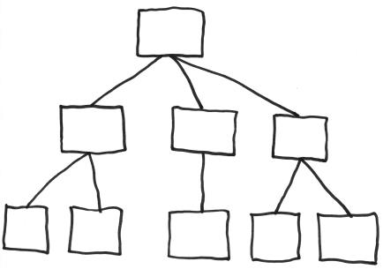
EdX Course:
XBlock is the building block of EdX course.
XBlocks constructs in a hierarchy
Like html <div>’s
Notes:
Give a brief overview of the presentation. Describe the major focus of the presentation and why it is important.
Introduce each of the major topics.
To provide a road map for the audience, you can repeat this Overview slide throughout the presentation, highlighting the particular topic you will discuss next.

Slide 11
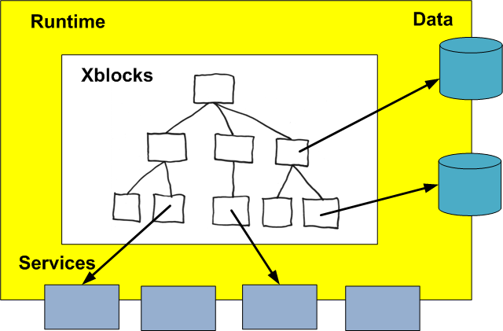
XBlock Runtime:
Container for XBlocks
Provides services and data
Notes:
Give a brief overview of the presentation. Describe the major focus of the presentation and why it is important.
Introduce each of the major topics.
To provide a road map for the audience, you can repeat this Overview slide throughout the presentation, highlighting the particular topic you will discuss next.

Slide 12
Runtime (LMS):
Manages Xblock
Provides
User regisration
Progress tracking
Grading
Forums
Data Storage
Course data in MongoDB
Student data in MySQL
Abstracted by using XBlock class.
Notes:
Give a brief overview of the presentation. Describe the major focus of the presentation and why it is important.
Introduce each of the major topics.
To provide a road map for the audience, you can repeat this Overview slide throughout the presentation, highlighting the particular topic you will discuss next.

Slide 13
LMS: More services
Manages Xblock
Provides
User registration
Progress tracking
Grading
Forums
Data Storage
Course data in MongoDB
Student data in MySQL
Abstracted by using XBlock class.
Notes:
Give a brief overview of the presentation. Describe the major focus of the presentation and why it is important.
Introduce each of the major topics.
To provide a road map for the audience, you can repeat this Overview slide throughout the presentation, highlighting the particular topic you will discuss next.

Slide 14
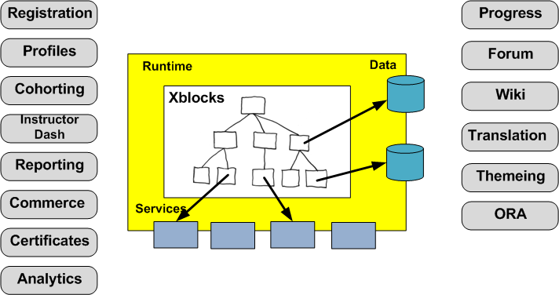
LMS: More services
Notes:
Give a brief overview of the presentation. Describe the major focus of the presentation and why it is important.
Introduce each of the major topics.
To provide a road map for the audience, you can repeat this Overview slide throughout the presentation, highlighting the particular topic you will discuss next.

Slide 15
Studio Internals:
Courses still XBlocks
Mongo Database shared with LMS
Notes:
Give a brief overview of the presentation. Describe the major focus of the presentation and why it is important.
Introduce each of the major topics.
To provide a road map for the audience, you can repeat this Overview slide throughout the presentation, highlighting the particular topic you will discuss next.

Slide 16
How to extend EdX:
XBlocks
LTI
JSinput
Core Code
Custom grader
https://github.com/edx/edx-platform/wiki/Five-ways-to-extend-edX
Notes:
Give a brief overview of the presentation. Describe the major focus of the presentation and why it is important.
Introduce each of the major topics.
To provide a road map for the audience, you can repeat this Overview slide throughout the presentation, highlighting the particular topic you will discuss next.

Slide 17
XBlock:
Most likely used to create courseware components.
http://xblock.readthedocs.org
Notes:
Give a brief overview of the presentation. Describe the major focus of the presentation and why it is important.
Introduce each of the major topics.
To provide a road map for the audience, you can repeat this Overview slide throughout the presentation, highlighting the particular topic you will discuss next.

Slide 18
Learning Tools Interoperability (LTI):
External standard
More like iFrame
EdX provide XBlock to host LTI components
Notes:
Give a brief overview of the presentation. Describe the major focus of the presentation and why it is important.
Introduce each of the major topics.
To provide a road map for the audience, you can repeat this Overview slide throughout the presentation, highlighting the particular topic you will discuss next.

Slide 19
JSinput:
Pure JavaScript problem
http://edx.readthedocs.org/projects/edx-developer-guide/en/latest/extending_platform/javascript.html
Notes:
Give a brief overview of the presentation. Describe the major focus of the presentation and why it is important.
Introduce each of the major topics.
To provide a road map for the audience, you can repeat this Overview slide throughout the presentation, highlighting the particular topic you will discuss next.

Slide 20
LMS Core code:
Download the platform repo
https://github.com/edx/edx-platform
Start to change the runtime directly
Django application
Notes:
Give a brief overview of the presentation. Describe the major focus of the presentation and why it is important.
Introduce each of the major topics.
To provide a road map for the audience, you can repeat this Overview slide throughout the presentation, highlighting the particular topic you will discuss next.

Slide 21
XBlock

Slide 22
XBlock design goals:
Courseware extensions
To add new features (specially interactive) to the course.
Portability
Runs on edX and google CourseBuilder
Notes:
Give a brief overview of the presentation. Describe the major focus of the presentation and why it is important.
Introduce each of the major topics.
To provide a road map for the audience, you can repeat this Overview slide throughout the presentation, highlighting the particular topic you will discuss next.

Slide 23
XBlock not for:
New runtime feature is not XBlock
Notes:
Give a brief overview of the presentation. Describe the major focus of the presentation and why it is important.
Introduce each of the major topics.
To provide a road map for the audience, you can repeat this Overview slide throughout the presentation, highlighting the particular topic you will discuss next.

Slide 24
What is XBlock:
A self contained Python package
A class providing
Data fields
Views for presentation
Handlers for user input
Not a web app but one div at a time
Html, CSS, JavaScript
Run any python code
Notes:
Give a brief overview of the presentation. Describe the major focus of the presentation and why it is important.
Introduce each of the major topics.
To provide a road map for the audience, you can repeat this Overview slide throughout the presentation, highlighting the particular topic you will discuss next.

Slide 25
XBlock
Demo

Slide 26
How to start developing:
Useful XBlock tutorial:
https://antoviaque.org/docs/edx/xblock/tutorial.html
http://xblock.readthedocs.org/
XBlock-SDK
Go through samples in XBlock-SDK repo.
Plan to have the devstack to deploy your XBlock.
https://github.com/edx/configuration/wiki/edX-Developer-Stack
Notes:
Give a brief overview of the presentation. Describe the major focus of the presentation and why it is important.
Introduce each of the major topics.
To provide a road map for the audience, you can repeat this Overview slide throughout the presentation, highlighting the particular topic you will discuss next.

Slide 27
How to get help:
EdX groups on Google groups:
edx-code, openedx-ops, openedx-translation
IRS channels:
#edx-code IRC channel on Freenode
Documentation:
http://docs.edx.org/
EdX github Wiki pages:
https://github.com/edx/edx-platform/wiki
My github account for more Xblocks:
https://github.com/hosamshahin
Notes:
Give a brief overview of the presentation. Describe the major focus of the presentation and why it is important.
Introduce each of the major topics.
To provide a road map for the audience, you can repeat this Overview slide throughout the presentation, highlighting the particular topic you will discuss next.

Slide 28
Questions
Notes:
Is your presentation as crisp as possible? Consider moving extra content to the appendix.
Use appendix slides to store content that you might want to refer to during the Question slide or that may be useful for attendees to investigate deeper in the future.

