Slide 1
MASTERS THESIS DEFENSE QBANK A Web-Based Dynamic Problem Authoring Tool
By
Ann Paul
Advisor: Professor Cliff Shaffer
June 2013
Computer Science Department Virginia Polytechnic and State University

Slide 2
Outline
Background and Motivation
Problem
Dynamic Problems
Related Work
Claims
QBANK – Goals and Features
QBANK – Demos
Usability Study and Feedback
Future Work
Computer Science Department Virginia Polytechnic and State University

Slide 3
QBANK
Web-Based
Dynamic Problem
Authoring tool
? -- Online
?
?
Computer Science Department Virginia Polytechnic and State University

Slide 4
Internet
Background
+
Education
Online Education (eLearning)
=
Need for :
Online Resources – Educational content, eTextbooks.
Assessment – Quizzes, practice exercises, tests.
Computer Science Department Virginia Polytechnic and State University

Slide 5
Importance of Assessment
Measures
Helps
By ungraded tests – Practice concepts & learn from feedback
By graded tests
Remember concepts – Section specific and cumulative
Student’s progress
Effectiveness of online content
Computer Science Department Virginia Polytechnic and State University

Slide 6
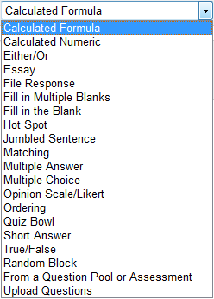
Assessment
Tests / Exams
Surveys
Practice Exercises
Computer Science Department Virginia Polytechnic and State University

Slide 7
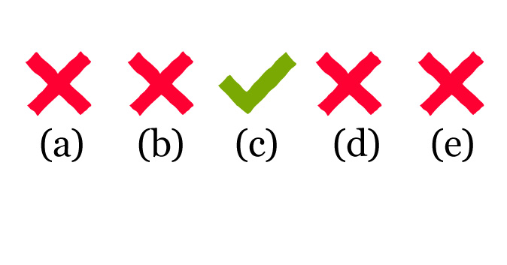
Assessment
Computer Science Department Virginia Polytechnic and State University

Slide 8
Outline
Background and Motivation
Problem
Dynamic Problems
Related Work
Claims
QBANK – Functions and Features
QBANK – Demos
Usability Study and Feedback
Future Work
Computer Science Department Virginia Polytechnic and State University

Slide 9
Problem
Problem Template
Model Answer Generator
User Interface
Answer Evaluator
Variables
Computer Science Department Virginia Polytechnic and State University

Slide 10
A. Problem Template
A function that generates a Problem Instance.
Static text
Static text + Variables
Calculate 23 + 40
Calculate $a + $b
[a = 23, 56 ; b = 123]
Calculate 56 + 123
Computer Science Department Virginia Polytechnic and State University

Slide 11
B. Model Answer Generator
A function that takes a Problem Instance and generates a Model Answer.
Calculate 23 + 40
Calculate $a + $b
[a = 23, 56 ; b = 123]
Calculate 56 + 123
63
$ (a + b)
179
Computer Science Department Virginia Polytechnic and State University

Slide 12
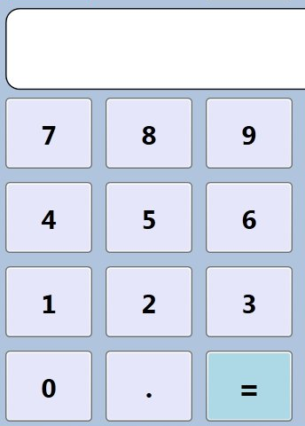
C. User Interface
A mechanism that a user interacts with to create a Student Answer.
Calculate 23 + 40
53
63
27
63
Computer Science Department Virginia Polytechnic and State University

Slide 13
D. Answer Evaluator
A function that compares the Student Answer to the Model Answer to determine correctness.
String comparison
Activity log comparison for interactive exercises
Computer Science Department Virginia Polytechnic and State University

Slide 14
D. Answer Evaluator
Perform insertion sort
Model Answer
Student Answer
Incorrect!!!
Computer Science Department Virginia Polytechnic and State University

Slide 15
E. Variables
These carry information from the Problem Template to the Model Answer Generator.
Calculate $a + $b
[a = 23, 56 ; b = 123]
Model Answer
$ (a + b)
56
123
=
179
56 + 123
Computer Science Department Virginia Polytechnic and State University

Slide 16
Outline
Background and Motivation
Problem
Dynamic Problems
Related Work
Claims
QBANK – Functions and Features
QBANK – Demos
Usability Study and Feedback
Future Work
Computer Science Department Virginia Polytechnic and State University

Slide 17
Dynamic Problem
Problems that support parameterization or variables.
Problem template Is today $day?
Variables $day = “Monday”, “Tuesday”, “Wednesday”
User Interface True False
Model Answer Generator ($day == “Monday”) ? True : False
Problem Instance Is today Tuesday?
Student Answer True False
Answer Evaluator String comparison( Model Answer, Student Answer)
False
False
=> True (Correct!!)
Computer Science Department Virginia Polytechnic and State University

Slide 18
Significance of dynamic problems
Effective learning
Large database of practice questions.
Test questions should have similar level of difficulty.
Same questions for all students could result in unfair practices.
Copy the solution.
Memorize answers.
Computer Science Department Virginia Polytechnic and State University

Slide 19
Significance of dynamic problems
Challenges
Takes a lot of time
Ensuring same level of difficulty would require using the same question with different values. (Redundancy)
Ensuring correctness of solution is tedious.
Solution Dynamic Problem Authoring
Computer Science Department Virginia Polytechnic and State University

Slide 20
Authoring Tools
Tools that used for editing or creating content.
PROBLEMS
Computer Science Department Virginia Polytechnic and State University

Slide 21
Outline
Background and Motivation
Problem
Dynamic Problems
Related Work
Claims
QBANK – Functions and Features
QBANK – Demos
Usability Study and Feedback
Future Work
Computer Science Department Virginia Polytechnic and State University

Slide 22
Related Work
Learning Management Systems
Blackboard, Moodle
Generic Problem Authoring Tool
Adobe Captivate, Question Mark
Computer Science Department Virginia Polytechnic and State University

Slide 23
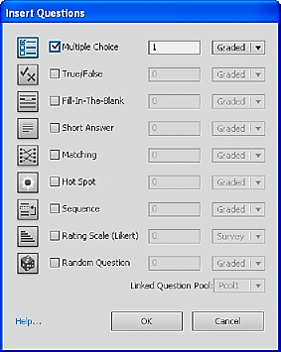
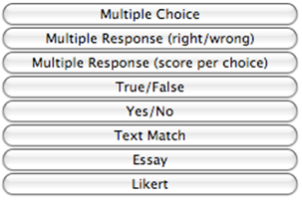
Related Work
Adobe Captivate
Question Mark
Computer Science Department Virginia Polytechnic and State University

Slide 24
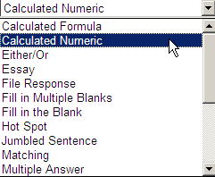
Related Work
Blackboard
Limited to 5 variables.
The values have to be individually added to the list.
Only supports Mathematical calculations.
Computer Science Department Virginia Polytechnic and State University

Slide 25
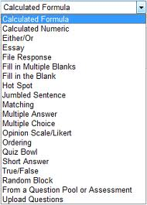
Related Work
Moodle
Dataset of values have to be individually added.
Limited to 100 different values for a variable.
Only supports Mathematical calculations.
Computer Science Department Virginia Polytechnic and State University

Slide 26
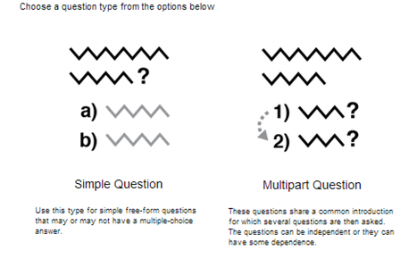
Related Work
QuadBase
Has an option for Dynamic questions but still not implemented yet.
Computer Science Department Virginia Polytechnic and State University

Slide 27
Khan Academy Exercise Framework
Pros
Supports the use of variables (text , numbers)
Complex Problem types {Interactive graphs, geometry}
Written in HTML which supports any functionality that can be written in JavaScript{Visualizations, Mouse interactions, etc}
Computer Science Department Virginia Polytechnic and State University

Slide 28
Khan Academy Exercise Framework
Cons
Need programming expertise.
Simple questions also need a lot of code to work correctly.
No consistent problem authoring format defined.
Computer Science Department Virginia Polytechnic and State University

Slide 29
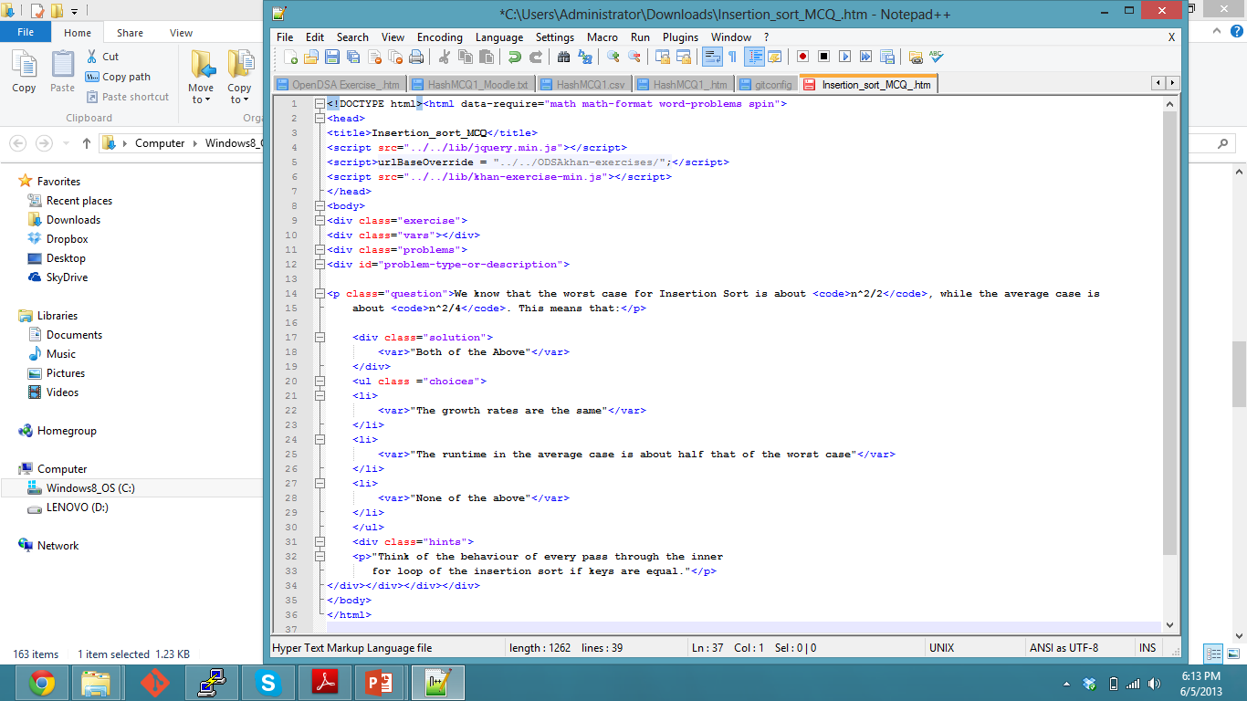
Khan Academy Exercise Framework
Static MCQ
Computer Science Department Virginia Polytechnic and State University

Slide 30
Outline
Background and Motivation
Problem
Dynamic Problems
Related Work
Claims
QBANK – Functions and Features
QBANK – Demos
Usability Study and Feedback
Future Work
Computer Science Department Virginia Polytechnic and State University

Slide 31
Claims
Dynamic problems are advantageous.
Existing tools lack support for dynamic problem authoring.
Khan Academy Exercise Framework is powerful but not user friendly.
Computer Science Department Virginia Polytechnic and State University

Slide 32
QBANK
Computer Science Department Virginia Polytechnic and State University

Slide 33
Outline
Background and Motivation
Problem
Dynamic Problems
Related Work
Claims
QBANK – Goals and Features
QBANK – Demos
Usability Study and Feedback
Future Work
Computer Science Department Virginia Polytechnic and State University

Slide 34
Goals
Build an intuitive user friendly interface for users with different levels of programming expertise.
Consistent user interface for different problem types based on Problem definition.
Capability of exporting Problems in different formats.
Computer Science Department Virginia Polytechnic and State University

Slide 35
Features
Supports Dynamic Problem Authoring
Supports Authoring Domain Specific – Khan Academy Exercise
Export authored problems in generic CSV format and in specific Khan Academy Exercise format.
Computer Science Department Virginia Polytechnic and State University

Slide 36
Problem Types
Static multiple choice problem
Dynamic problems – List and Range type of values that variables can take
Summative problems
Tool specific problem – Khan Academy exercises
Computer Science Department Virginia Polytechnic and State University

Slide 37
Outline
Background and Motivation
Problem
Dynamic Problems
Related Work
Claims
QBANK – Functions and Features
QBANK – Demos
Usability Study and Feedback
Future Work
Computer Science Department Virginia Polytechnic and State University

Slide 38
Computer Science Department Virginia Polytechnic and State University

Slide 39
Computer Science Department Virginia Polytechnic and State University

Slide 40
Computer Science Department Virginia Polytechnic and State University

Slide 41
Computer Science Department Virginia Polytechnic and State University

Slide 42
Computer Science Department Virginia Polytechnic and State University

Slide 44
Outline
Background and Motivation
Problem
Dynamic Problems
Related Work
Claims
QBANK – Functions and Features
QBANK – Demos
Usability Study and Feedback
Future Work
Computer Science Department Virginia Polytechnic and State University

Slide 45
Usability Study
To evaluate the capability of QBank to author dynamic problems.
To determine if the user interface is intuitive and easily navigable.
To compare the effectiveness of QBank in comparison with other authoring tools/frameworks that the participants previously used.
To study the usefulness of providing export to a generic CSV format and a specific Khan Academy Exercise format.
Computer Science Department Virginia Polytechnic and State University

Slide 46
Feedback
Specialized support for dynamic problem authoring was highly appreciated
Problem type specific user interfaces made it easy for the users to navigate and focus on the content of the problem (not overwhelmed by extraneous details to a problem type)
In comparison to other tools, the consistency of UIs across problem types and the extra features to make dynamic problem authoring easy were seen to be very helpful
Generic CSV format lets problems to be imported into other publishing tools (Moodle, Blackboard, QuestionMark, etc)
Computer Science Department Virginia Polytechnic and State University

Slide 47
Outline
Background and Motivation
Problem
Dynamic Problems
Related Work
Claims
QBANK – Functions and Features
QBANK – Demos
Usability Study and Feedback
Future Work
Computer Science Department Virginia Polytechnic and State University

Slide 48
Conclusion and Future Work
Consolidation of interfaces
User accounts
Version control
Rich text area editors
Intelligent syntactic editors for Tool-specific problems.
Computer Science Department Virginia Polytechnic and State University

Slide 49
Thank you!!!!
Special mentions:
Dr. Cliff Shaffer
Eric Fouh
QUESTIONS ???
Computer Science Department Virginia Polytechnic and State University

