Slide 1
MERLOT RESERVE
[CS6804] Paper Review
Presenter: Chiawei Tang
Department of Computer Science
Virginia Tech
02/20/2023
https://reurl.cc/Dmv8dR

Slide 2
Outline what we will lean in this presentation
MERLOT
VATT
MERLOT RESERVE

Slide 3
MERLOT
Multimodal Event Representation Learning Over Time

Slide 4
Visual Commonsense Reasoning
what might happen next
what are people’s intentions

Slide 5
Visual Commonsense Reasoning
what might happen next
what are people’s intentions
Vision
Language
Audio

Slide 6
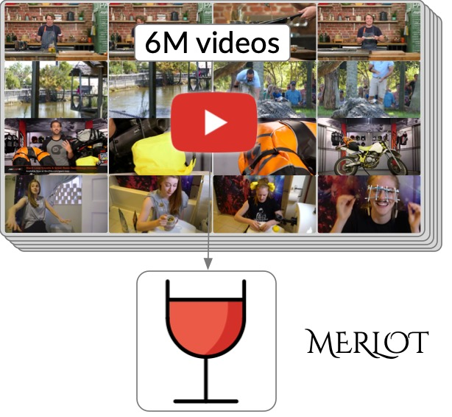
MERLOT
Visual Commonsense Reasoning

Slide 7
Self-Supervised Learning
Supervised
Self-supervised
$$y$$
Loss
$$\hat{y}$$
$$y$$
Loss
$$x^{′′}$$
Model
Model
$$x$$
$$x$$
$$x^{′}$$

Slide 8
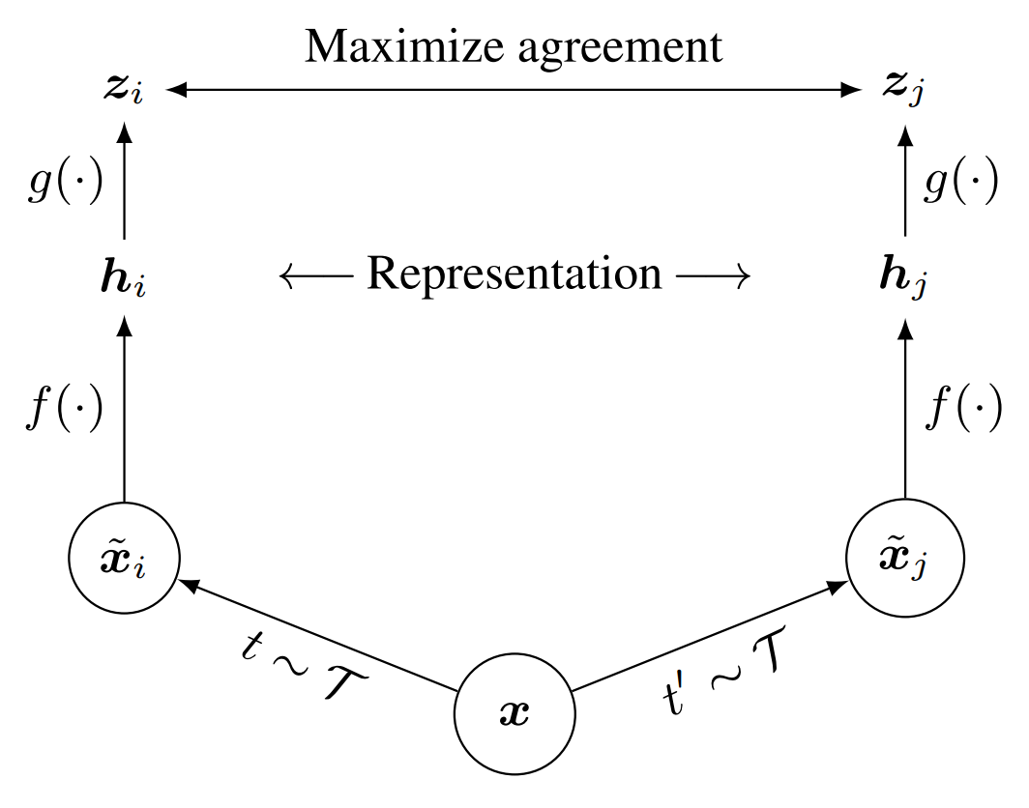
Self-Supervised Learning
Self-supervised
$$y$$
Loss
$$x^{′′}$$
Model
$$x$$
Encoder
Encoder
$$x^{′}$$
SimCLR: Chen et al, 2020

Slide 9
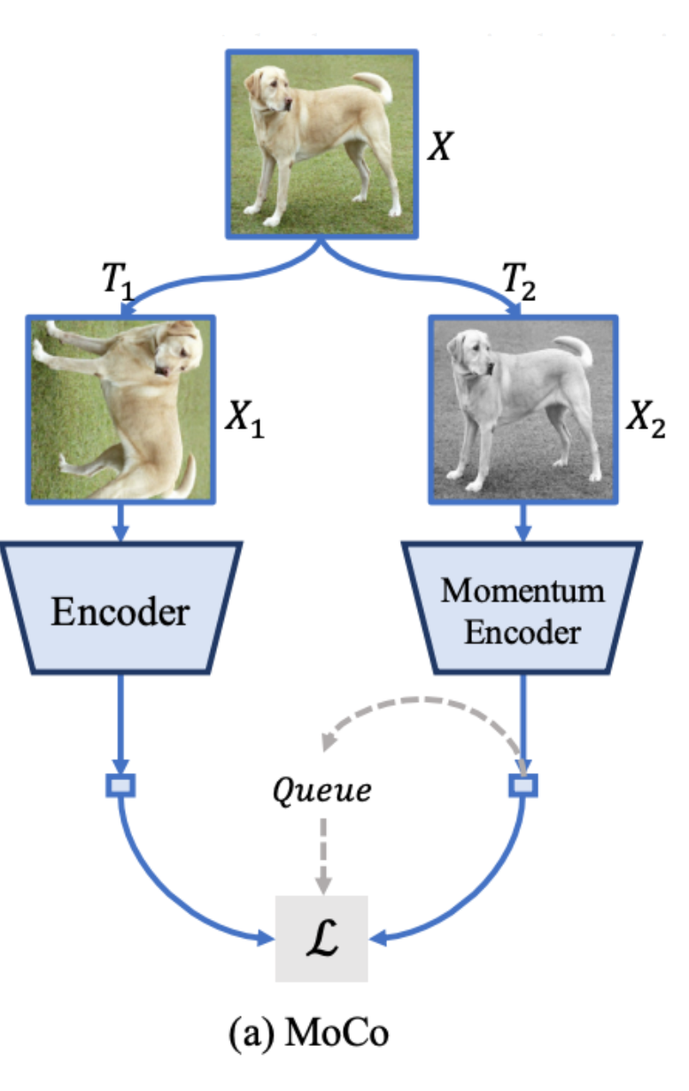
Self-Supervised Learning
Self-supervised
$$y$$
Loss
$$x^{′′}$$
Model
$$x$$
$$x^{′}$$
MoCo He et al. 2020
https://medium.com/geekculture/understanding-contrastive-learning-and-moco-efe491e4eed9

Slide 10
Self-Supervised Learning
BERT
Self-supervised
Learning
Masked token prediction
Next sentence prediction
Fine-tune
Zero-shot
Model for
Task 1
Model for
Task 2
Model for
Task 3
Model for
Zero-shot Task

Slide 11
Self-Supervised Learning
How to empower Vision Transformers with large-scale, unlabeled data?
https://www.youtube.com/watch?v=rgXxAFIBido

Slide 12
Self-Supervised Learning
How to empower Vision Transformers with large-scale, unlabeled data?
Self-supervision from the multimodal videos (video frames, audio, and text)
https://www.youtube.com/watch?v=rgXxAFIBido

Slide 13
MERLOT
A model that learns commonsense representations of multimodal events by self-supervised pretraining over 6M unlabelled YouTube videos

Slide 14
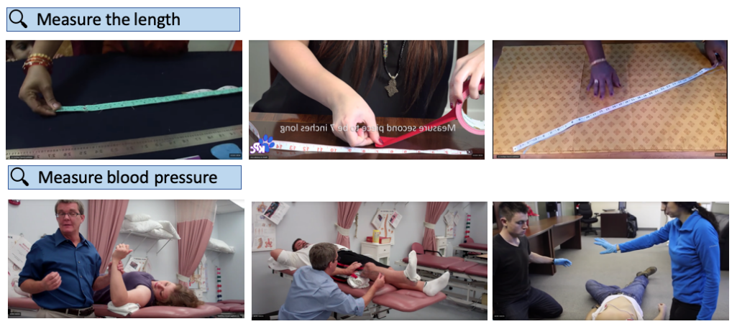
Dataset
To learn about a broad range of objects, actions, and scenes
HowTo100M
YouTube:
Popular Topics
VLOG
With ENGLISH ASR
Not too long (> 20 minutes)
Visually “ungrounded” (video games commentaries)
Unlikely to contain objects
https://www.di.ens.fr/willow/research/howto100m/
https://web.eecs.umich.edu/~fouhey/2017/VLOG/index.html

Slide 15
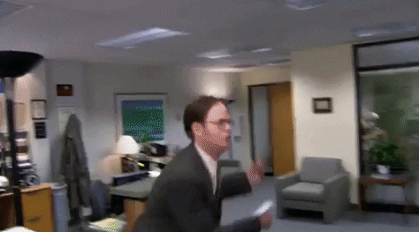
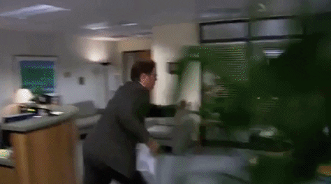
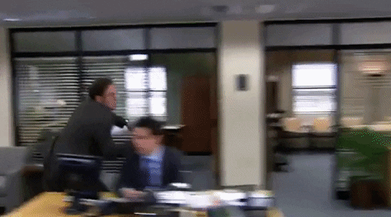
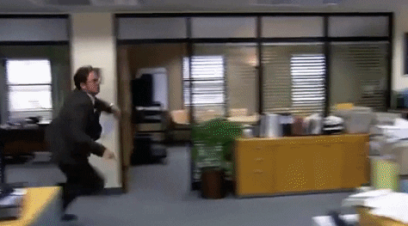
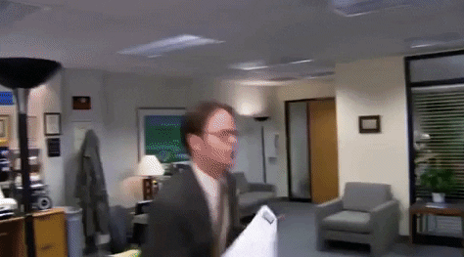
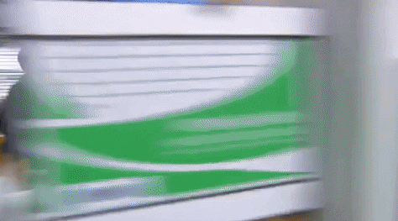
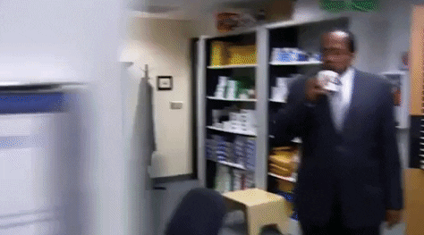
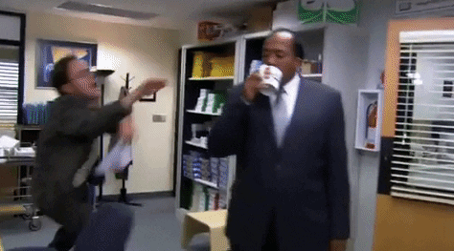
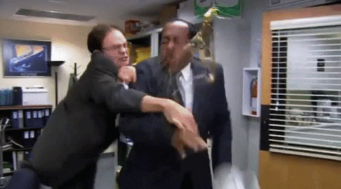
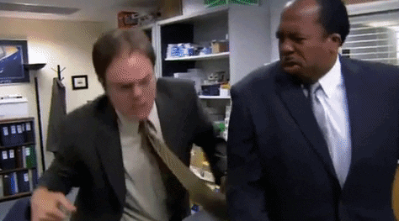
Dataset
A frame $v_{t}$, from the middle of the segment
The Automatic Speech Recognition(ASR) tokens $w_{t}$ spoken during the segment

Slide 16
MERLOT
Segment 1 - $s_{1}$
……
……
Segment 2 - $s_{2}$
……
……
32 Byte Pair Encode(BPE) tokens each
Segment 3 - $s_{3}$
……
……
The Office

Slide 17
MERLOT
Segment 3 - $s_{3}$
…..…
…..…
$$I_{1}$$
$$I_{t−n}$$
$$I_{t}$$
$$w_{1}$$
At 8 a.m. today, someone poisons the coffee.
Do not drink the coffee.
No~~~
…
$$w_{2}$$
$$w_{3}$$
an image frame $I_{t}$, extracted from the middle timestep of the segment
the words $w_{t}$ spoken during the segment, with a total length of L tokens.
The Office

Slide 18
MERLOT
Joint Vision & Language Transformer Encoder
(RoBERTa)
Image Encoder
$$I_{t}$$
Visual Transformer
At 8 a.m. today, someone poisons the coffee.
Word
Embed
$$w_{t}$$
BPE

Slide 19
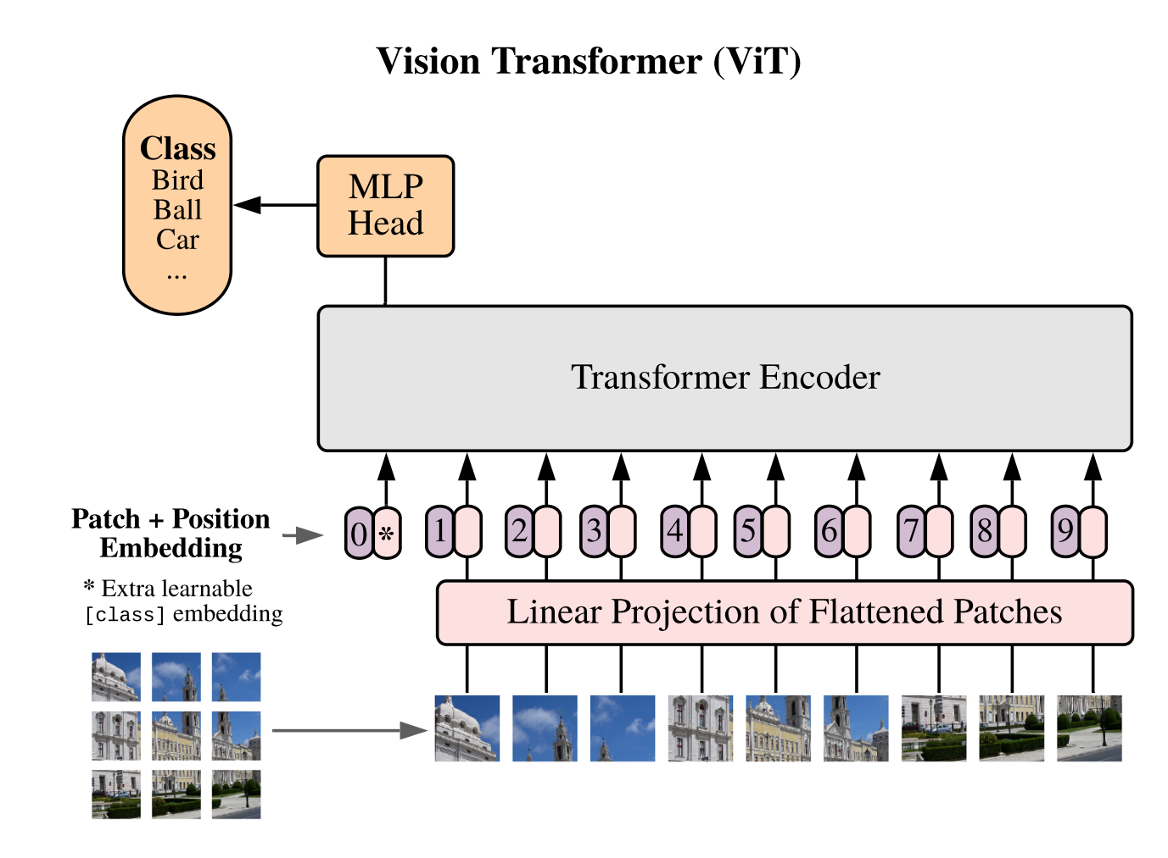
Different image size for videos
MERLOT
Image Encoder
Trainable
https://arxiv.org/abs/2010.11929

Slide 20
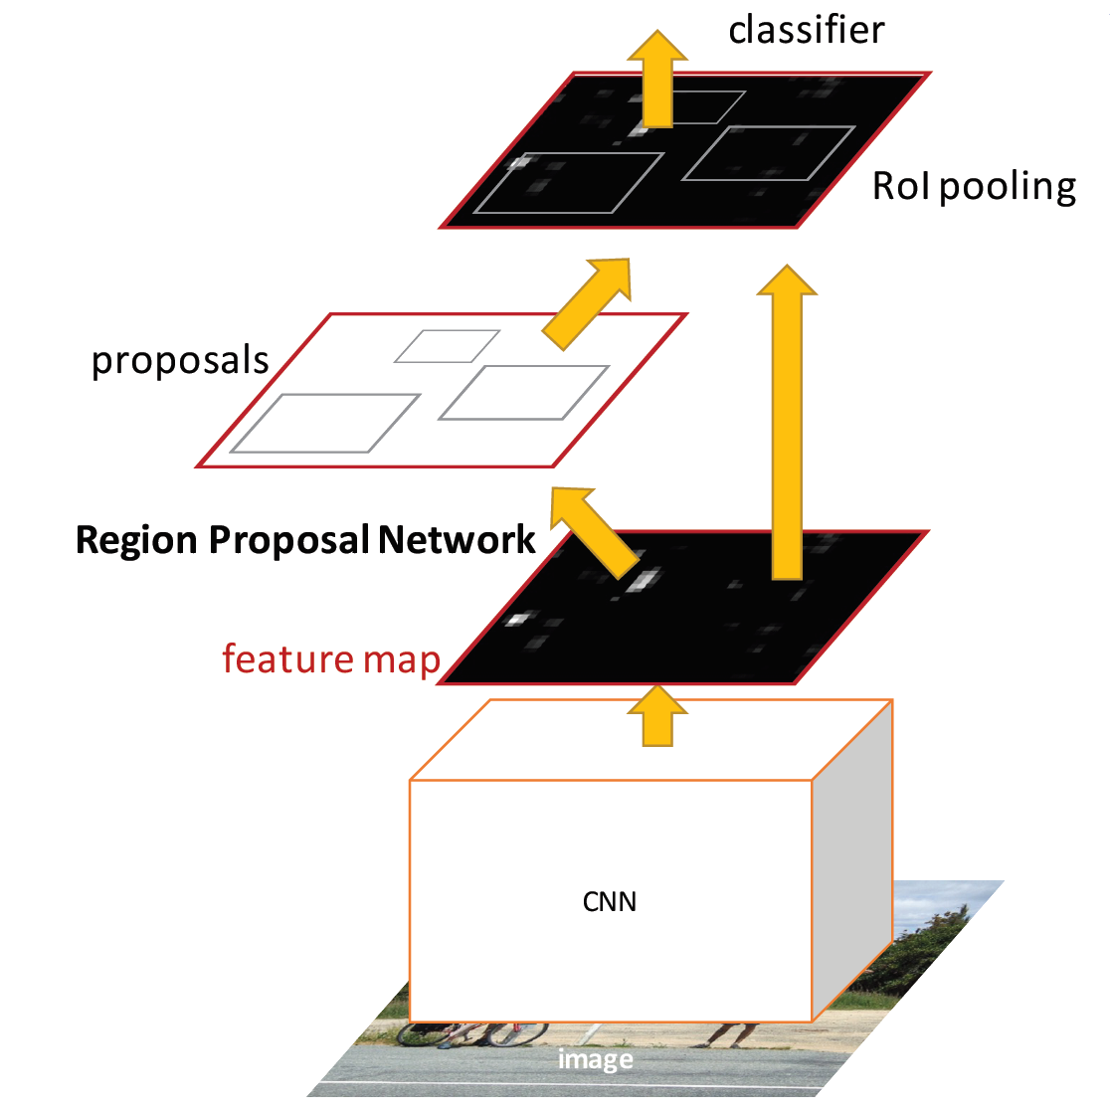
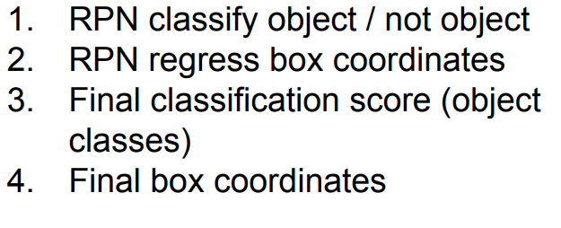
Faster-RCNN
https://arxiv.org/pdf/1506.01497.pdf

Slide 21
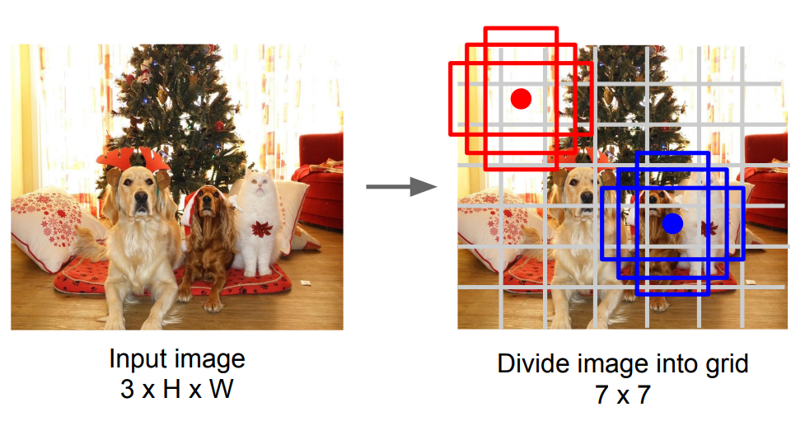
Grid-Based Object Detectors
YOLO / SSD / RetinaNet
(dx, dy, dh, dw, confidence)

Slide 22
Split an image into patches
Flatten the patches
Produce lower-dimensional linear embeddings from the flattened patches
Add positional embeddings
Feed the sequence as an input to a standard transformer encoder
Pretrain the model with image labels
Finetune on the downstream dataset for image classification
Vision Transformer
https://arxiv.org/pdf/2010.11929.pdf
https://theaisummer.com/vision-transformer/

Slide 23
MERLOT
Contrastive frame-transcript matching
(Attention) Masked Language Modeling
Temporal Reordering

Slide 24
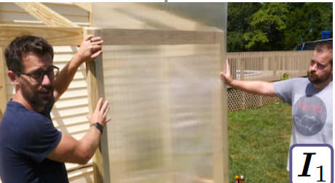
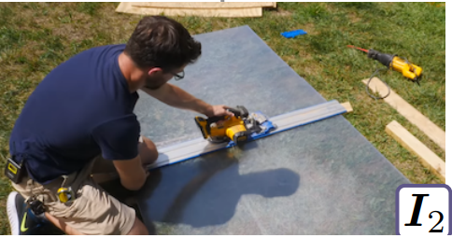
MERLOT
Contrastive frame-transcript matching
Language Only
Encoder
We’re making a greenhouse.
It’s thin plastic, so it’ll be easy to cut.
Image Encoder
Image Encoder
So I’ll cut it with a circular saw.
For my morning routine, I …

Slide 25
MERLOT
Contrastive frame-transcript matching
Language Only
Encoder
We’re making a greenhouse.
CLS
It’s thin plastic, so it’ll be easy to cut.
CLS
CLS
Image Encoder
So I’ll cut it with a circular saw.
CLS
.
.
.
For my morning routine, I …
CLS

Slide 26
MERLOT
Contrastive frame-transcript matching
Language Only
Encoder
We’re making a greenhouse.
CLS
It’s thin plastic, so it’ll be easy to cut.
CLS
CLS
Contrastive Loss
$$(I_{t}, w_{t},{\hat{w}}_{t})$$
Image Encoder
So I’ll cut it with a circular saw.
CLS
.
.
.
For my morning routine, I …
CLS

Slide 27
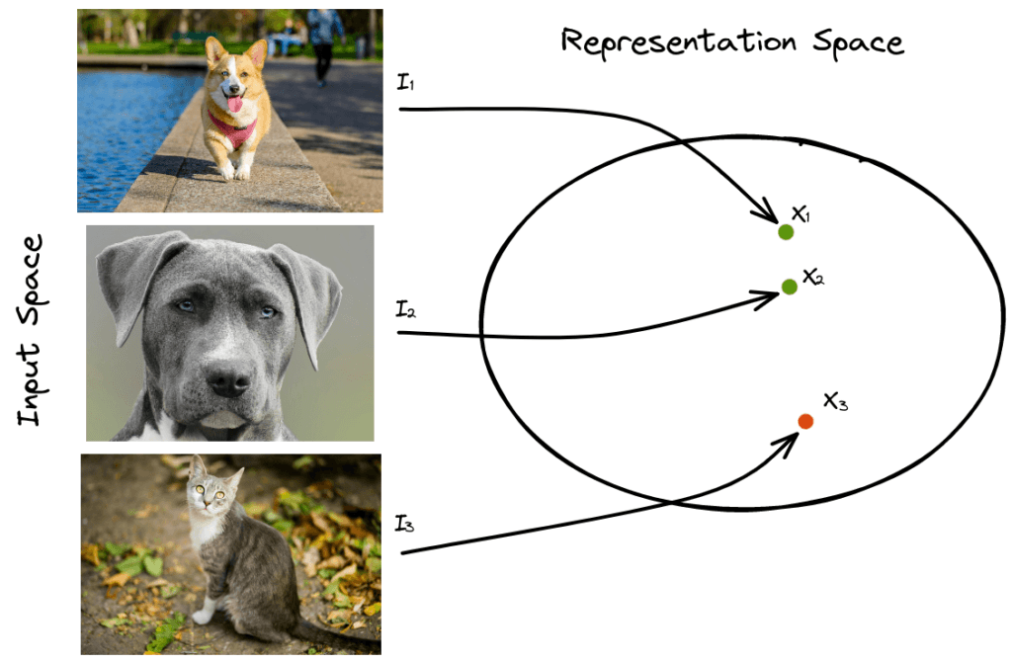
Contrastive loss is one of the first training objectives that was used for contrastive learning. It takes as input a pair of samples that are either similar or dissimilar, and it brings similar samples closer and dissimilar samples far apart.
Contrastive Loss
Contrastive Loss
https://www.baeldung.com/cs/contrastive-learning#:~:text=Contrastive%20Loss,and%20dissimilar%20samples%20far%20apart.

Slide 28
Contrastive loss is one of the first training objectives that was used for contrastive learning. It takes as input a pair of samples that are either similar or dissimilar, and it brings similar samples closer and dissimilar samples far apart.
Contrastive Loss
Contrastive Loss
similar vectors to be as close to 1 as possible, since -log(1) = 0
negative examples to be close to 0 , since any non-zero values will reduce the value of similar vectors
Softmax
https://www.baeldung.com/cs/contrastive-learning#:~:text=Contrastive%20Loss,and%20dissimilar%20samples%20far%20apart.

Slide 29
MERLOT
Contrastive frame-transcript matching
Language Only
Encoder
We’re making a greenhouse.
CLS
It’s thin plastic, so it’ll be easy to cut.
CLS
CLS
Contrastive Loss
$$(I_{t}, w_{t},{\hat{w}}_{t})$$
Image Encoder
So I’ll cut it with a circular saw.
CLS
.
.
.
For my morning routine, I …
CLS

Slide 30
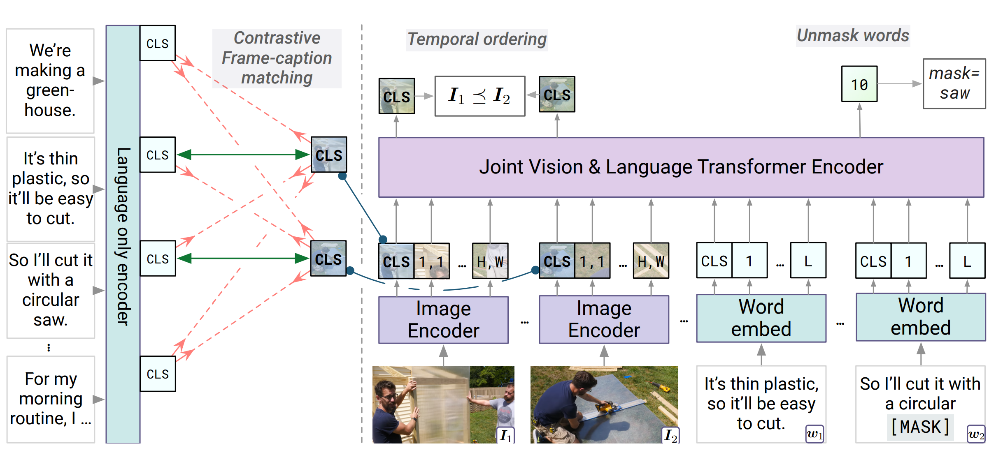
MERLOT
Architecture

Slide 31
MERLOT
(Attention) Masked Language Modeling
Word
Embed
Joint Vision & Language Transformer Encoder
We’re making a greenhouse.
It’s thin plastic, so it’ll be easy to cut.
Word
Embed
So I’ll cut it with a circular [MASK].
Word
Embed
mask = saw

Slide 32
MERLOT
(Attention) Masked Language Modeling
Word
Embed
Joint Vision & Language Transformer Encoder
We’re making a greenhouse.
problems?
It’s thin plastic, so it’ll be easy to cut.
Word
Embed
So I’ll cut it with a circular [MASK].
Word
Embed
mask = saw

Slide 33
MERLOT
(Attention) Masked Language Modeling
Word
Embed
Joint Vision & Language Transformer Encoder
We’re making a greenhouse.
problems?
people tend to ramble,
and often mention key objects multiple times
It’s thin plastic, so it’ll be easy to cut.
Word
Embed
So I’ll cut it with a circular [MASK].
Word
Embed
mask = saw

Slide 34
MERLOT
(Attention) Masked Language Modeling
Word
Embed
Joint Vision & Language Transformer Encoder
We’re making a greenhouse.
problems?
people tend to ramble,
and often mention key objects multiple times
It’s thin plastic, so it’ll be easy to cut.
Word
Embed
Attention Masking
So I’ll cut it with a circular [MASK].
Word
Embed
mask = saw

Slide 35
MERLOT
(Attention) Masked Language Modeling
Language Only
Encoder
We’re making a greenhouse.
Attention Weights
So
I
will
cut
it
with
a
circular
saw.
It’s thin plastic, so it’ll be easy to cut.
So I’ll cut it with a circular saw.
.
.
.
For my morning routine, I …

Slide 36
https://arxiv.org/pdf/1907.10529.pdf
MERLOT
(Attention) Masked Language Modeling
Language Only
Encoder
We’re making a greenhouse.
Attention Weights
So
I
will
cut
it
with
a
circular
saw.
It’s thin plastic, so it’ll be easy to cut.
So I’ll cut it with a circular saw.
.
.
.
SpanBERT
masking contiguous random spans, rather than random tokens
training the span boundary representations to predict the entire content of the masked span.
For my morning routine, I …

Slide 37
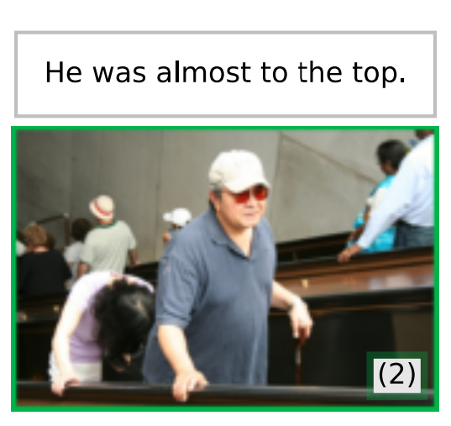
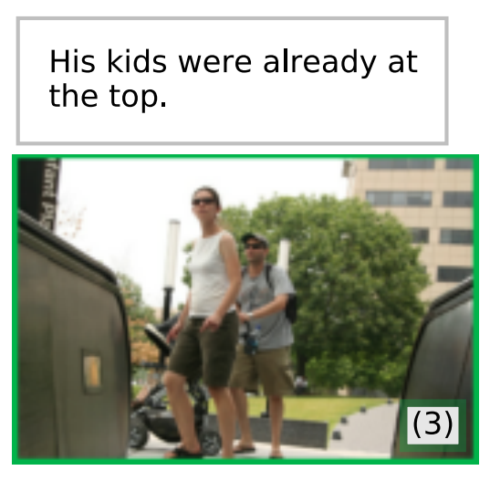
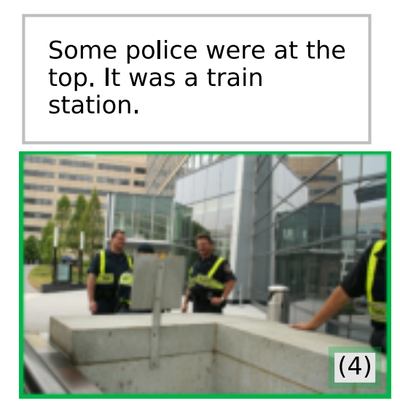
MERLOT
Temporal Reordering
Replace segment-level position embeddings
[image_t] -> [image_unk_0]

Slide 38
MERLOT
Temporal Reordering
Reordering Loss
Cross Entropy
MLP
$$concat(h_{ti},h_{ti})$$
$t_{i}<t_{j}$ or $t_{i}>t_{j}$

Slide 39
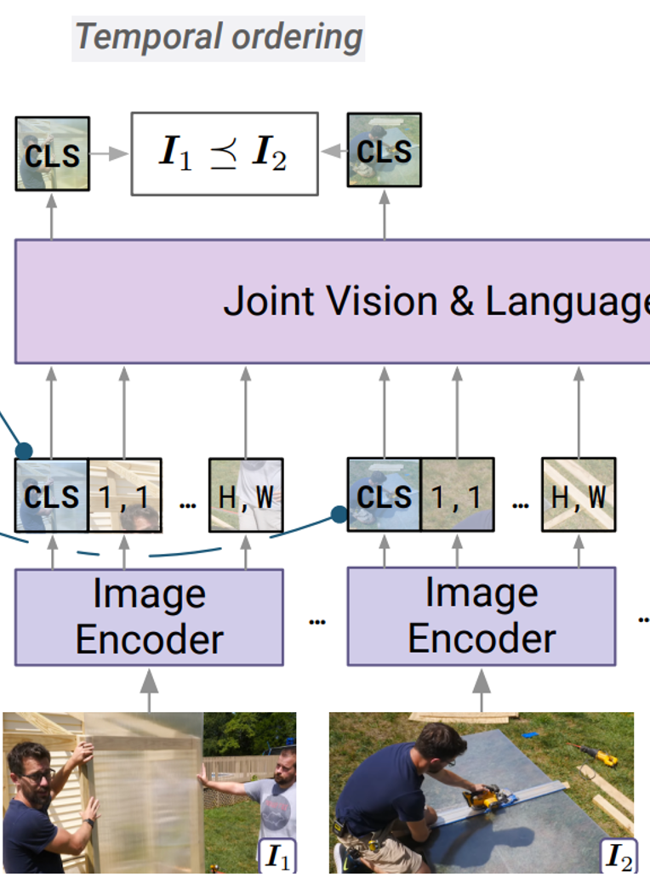
MERLOT
Temporal Reordering
Reordering Loss
Cross Entropy
MLP
$$concat(h_{ti},h_{ti})$$
$t_{i}<t_{j}$ or $t_{i}>t_{j}$

Slide 40
MERLOT
Architecture

Slide 41
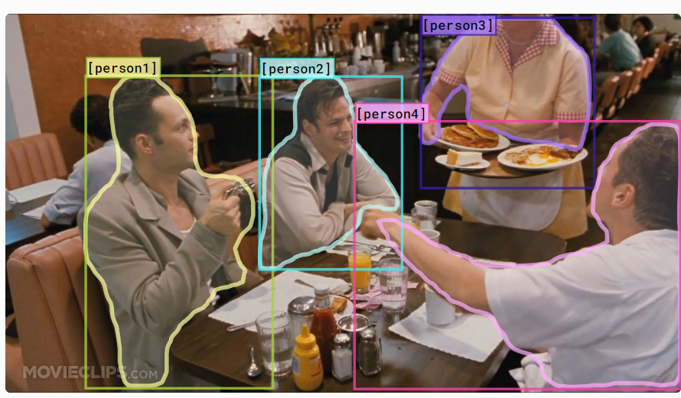
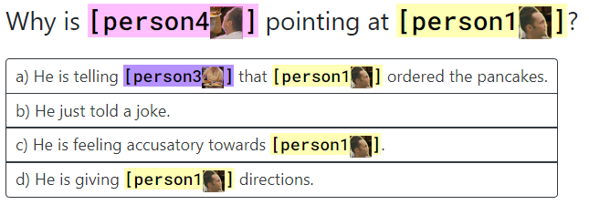
Image Tasks
Visual Commonsense Reasoning
what might happen next
what are people’s intentions
https://visualcommonsense.com/

Slide 42
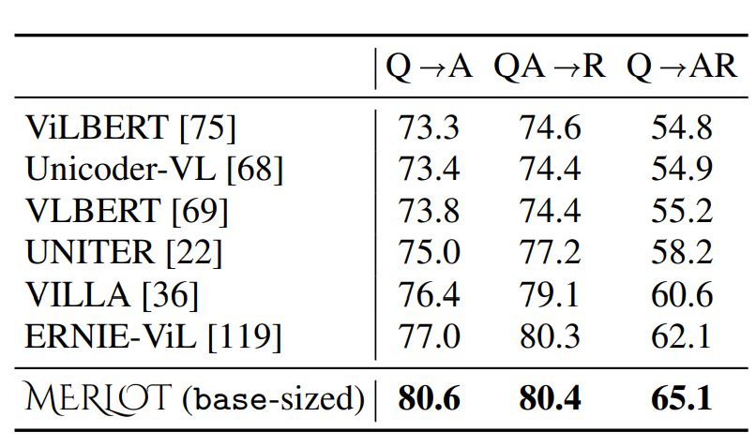
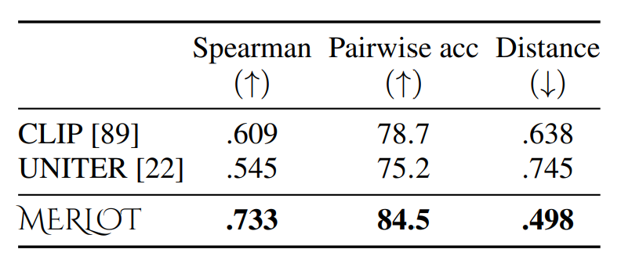
Image Tasks
Visual Commonsense Reasoning
Unsupervised ordering of Visual Stories
https://visualcommonsense.com/

Slide 43
Video Tasks
TVQA
TVQA links depicted objects to visual concepts in questions and answers.
what might happen next
what are people’s intentions
https://tvqa.cs.unc.edu/

Slide 44
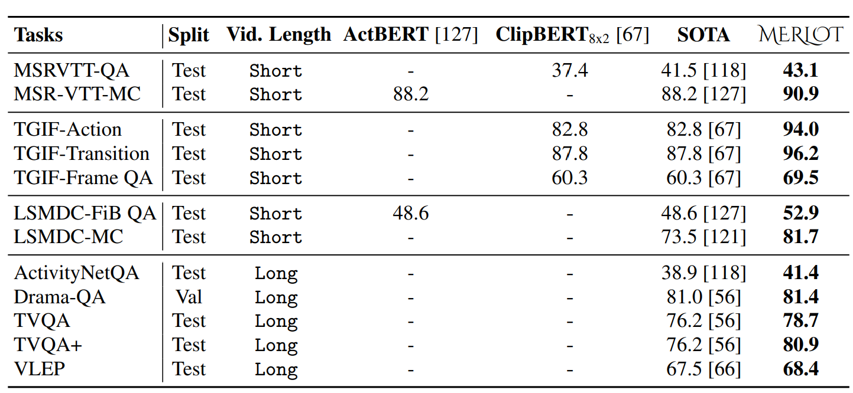
Video Tasks

Slide 45
Zero-shot Ordering

Slide 46
VATT
Transformers for Multimodal Self-Supervised Learning from Raw Video, Audio and Text

Slide 47
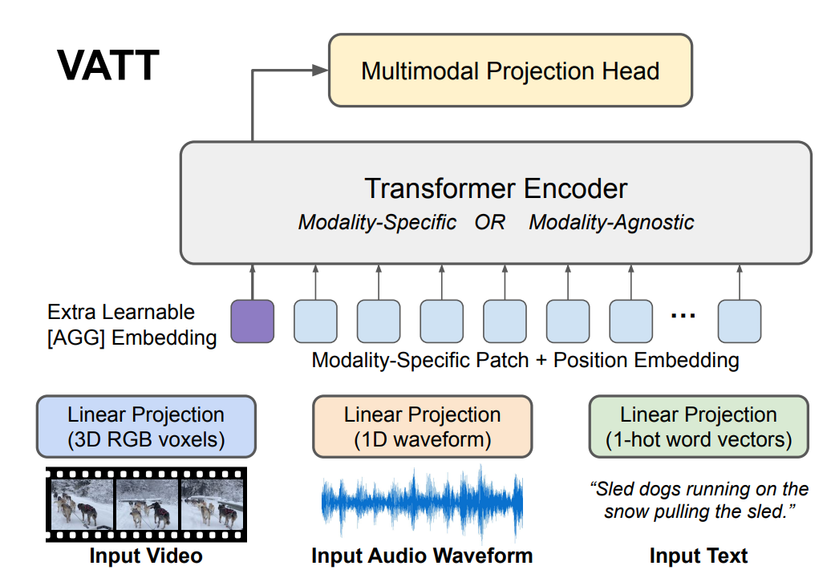
VATT
One backbone share different modalities
https://openreview.net/pdf?id=RzYrn625bu8

Slide 48
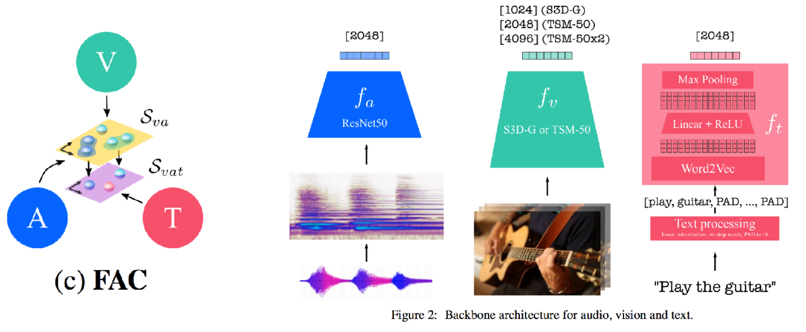
VATT
Modality-Specific
Video, audio, and text inputs have respective feature extractors
Each feature extractor has different architecture according to the modality.
FAC: Fine and Coarse

Slide 49
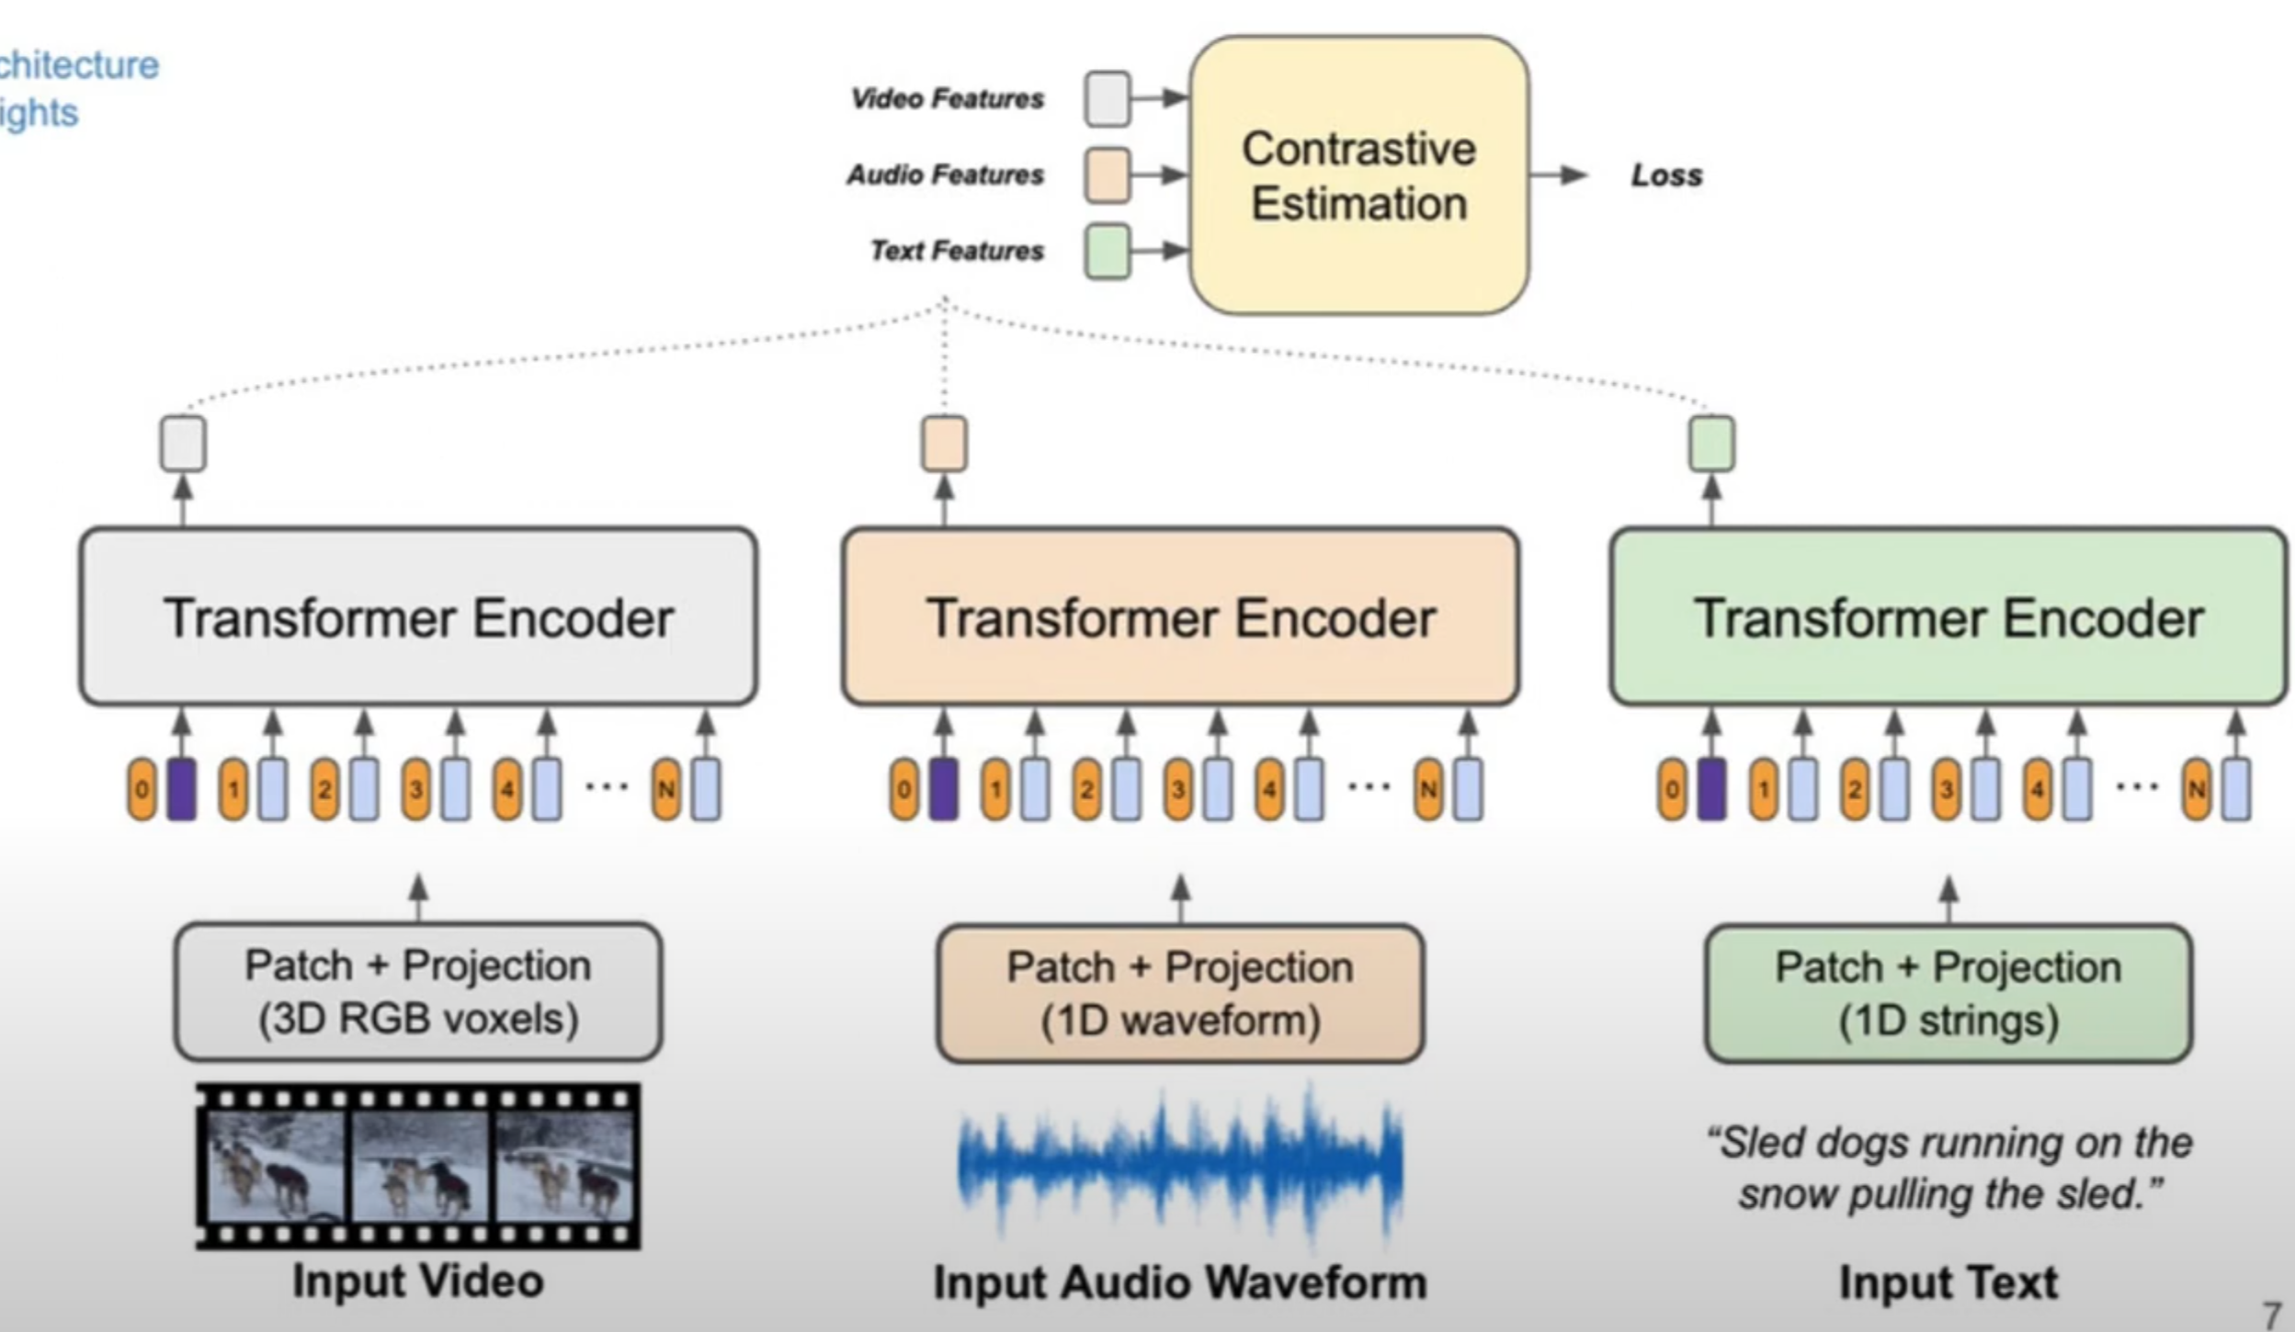
VATT
Modality-Specific
Video, audio, and text inputs have respective feature extractors
Each feature extractor has different architecture according to the modality.
https://www.youtube.com/watch?v=V3gY_hyATU8

Slide 50
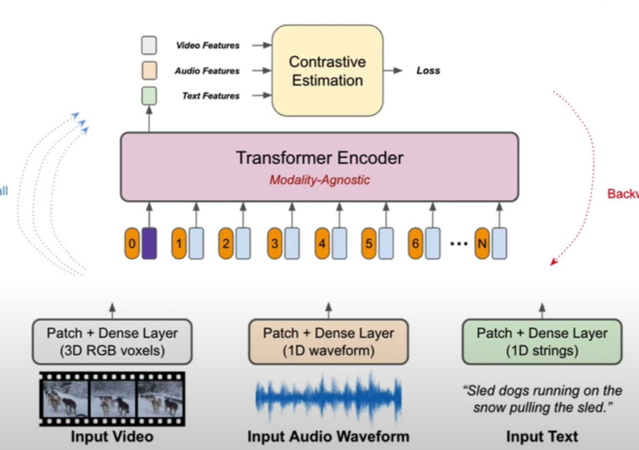
VATT
Modality-Agnostic
https://www.youtube.com/watch?v=V3gY_hyATU8

Slide 51
VATT
Common Space Projection
Multi-modal features need to be projected to common space for feature fusion, but different modalities have different levels of semantic granularity
Vision & audio: fine-grained space
Vision + audio & text: the lower dimensional coarse-grained space.
https://arxiv.org/pdf/2006.16228.pdf

Slide 52
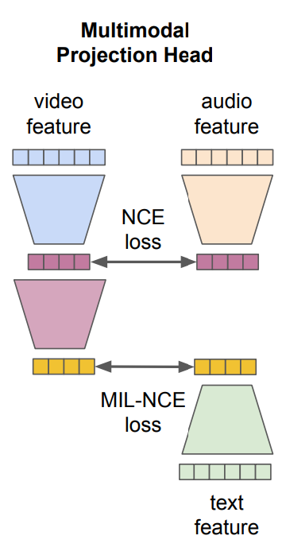
VATT
Multimodal Contrastive Learning

Slide 53
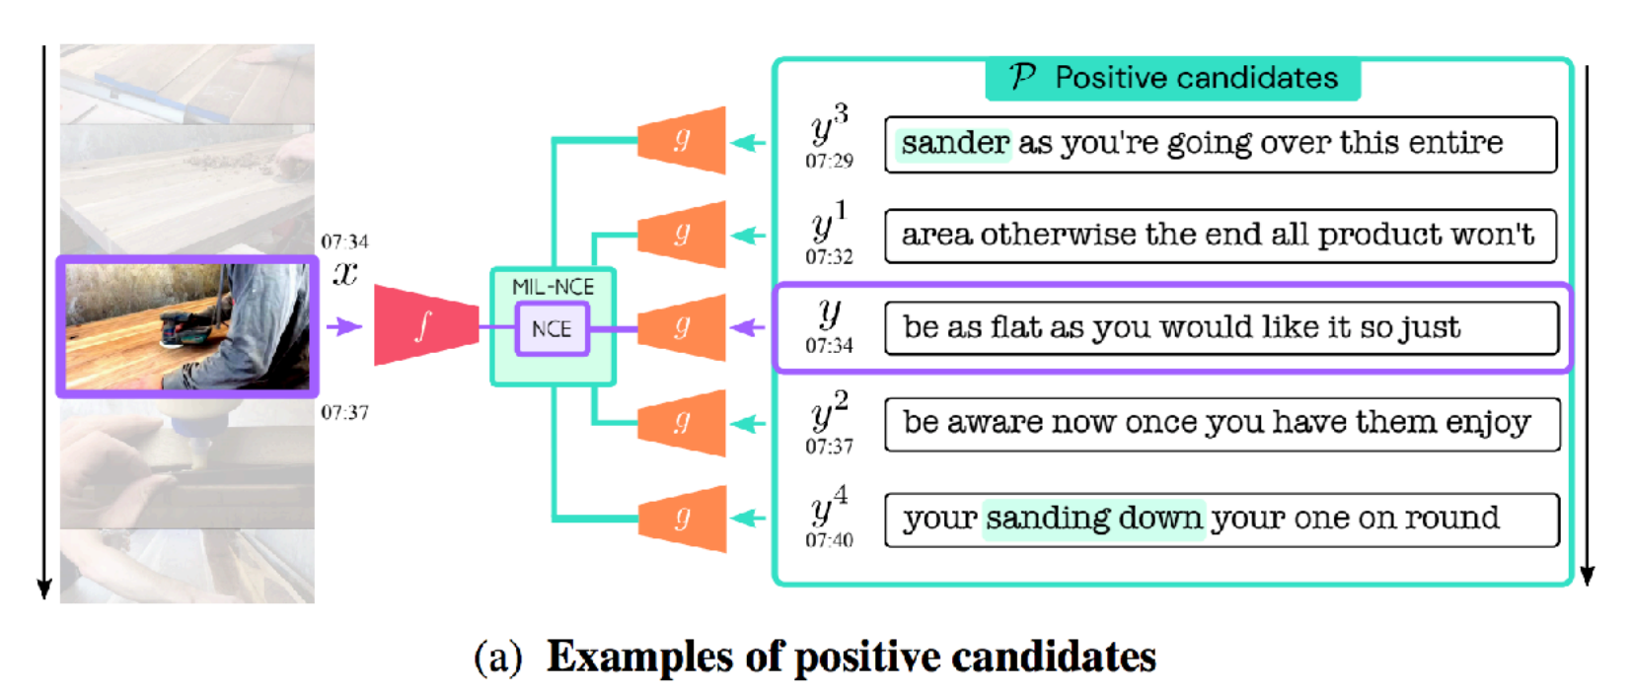
VATT
Multimodal Contrastive Learning
Vision & Text: Multiple-Instance-Learning-NCE (MIL-NCE) loss
For multiple positive pairs of video & text, a video is matched to multiple text inputs that are temporally close to the video input.
End-to-End Learning of Visual Representation from Uncurated Instructional Videos (CVPR’20)

Slide 54
MERLOT RESERVE
Neural Script Knowledge through Vision and Language and Sound

Slide 55
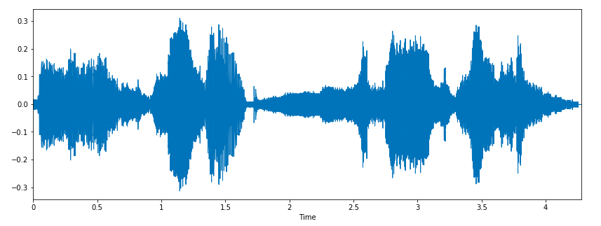
MERLOT RESERVE
Segment 3 - $s_{3}$ (5 seconds)
…..…
…..…
$$v_{1}$$
$$v_{t−n}$$
$$v_{t}$$
$$w_{1}$$
At 8 a.m. today, someone poisons the coffee.
Do not drink the coffee.
No~~~
…
$$a_{t}$$
$$w_{2}$$
$$w_{3}$$
A frame $v_{t}$, from the middle of the segment
The ASR tokens $w_{t}$ spoken during the segment
The audio $a_{t}$ of the segment.

Slide 56
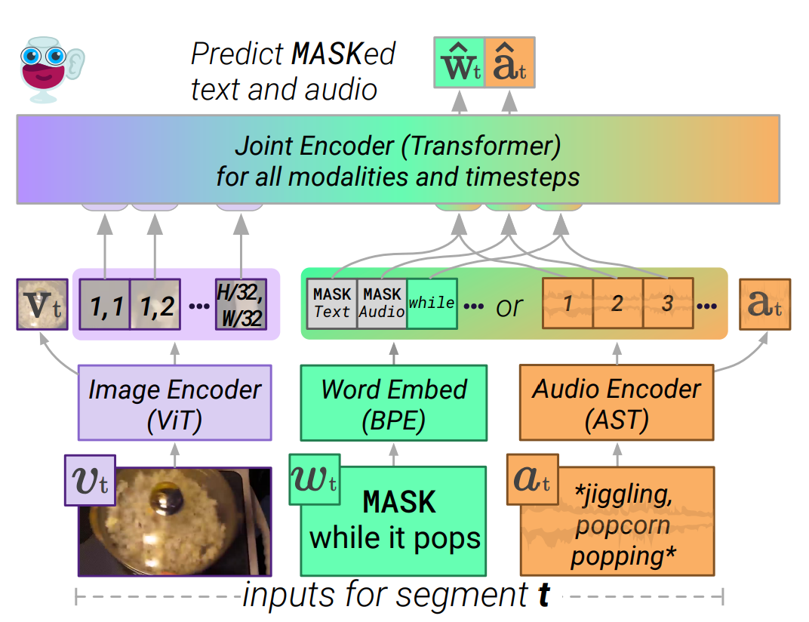
As the text $w_{t}$ was automatically transcribed by a model given audio $a_{t}$, it is reasonable to assume that it contains strictly less information content. Thus, for each segment $s_{t}$, the paper provides models with exactly one of text or audio.
Contrastive Loss
MERLOT RESERVE

Slide 57
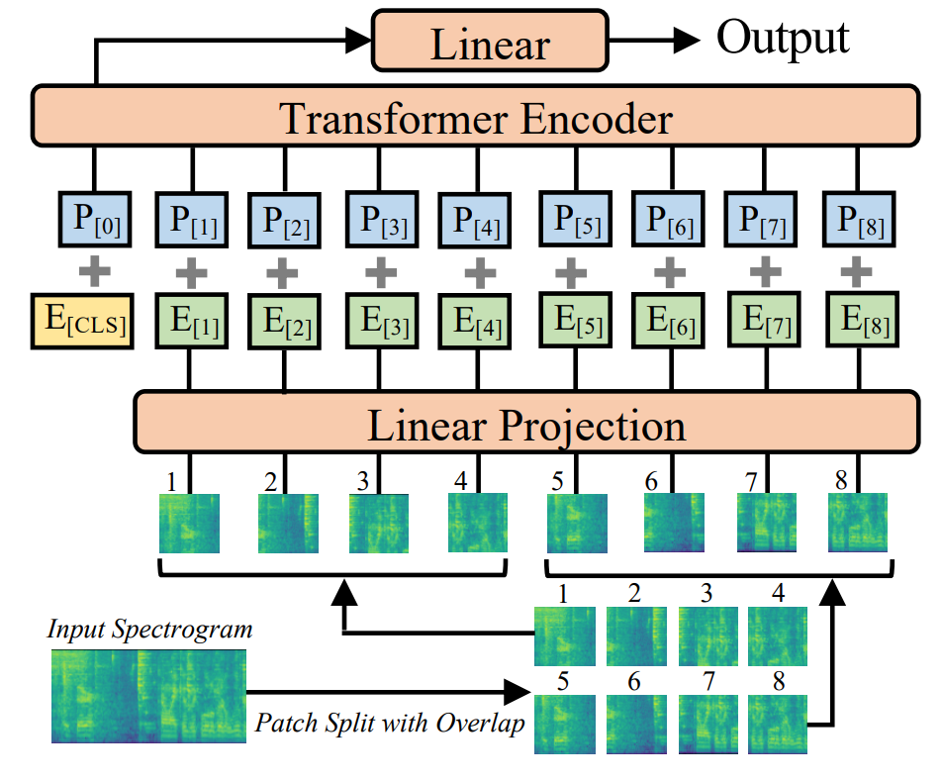
AST:Audio Spectrogram Transformer
Contrastive Loss
MERLOT RESERVE
Audio Encoder
Split the audio $a_{t}$in each segment into three equal-sized subsegments
https://arxiv.org/pdf/2104.01778.pdf

Slide 58
MERLOT RESERVE
Independently-encoded targets

Slide 59
MERLOT RESERVE
Vision-Language-Audio
Temporal
Encoder
Frame Encoder
Do not drink the coffee.
Audio Encoder

Slide 60
MERLOT RESERVE
Vision-Language-Audio
Temporal
Encoder
Frame Encoder
MASK
Do not drink the coffee.
Audio Encoder
MASK
Sound of water splashing
Speech of person saying the timer is starting

Slide 61
MERLOT RESERVE
Vision-Language-Audio
Temporal
Encoder
Frame Encoder
Do not drink the coffee.
Audio Encoder

Slide 62
MERLOT RESERVE
Vision-Language-Audio
Temporal
Encoder
Frame Encoder
Do not drink the coffee.
Audio Encoder
Frame Encoder
MASK

Slide 63
MERLOT RESERVE
Vision-Language-Audio
Temporal
Encoder
Frame Encoder
Do not drink the coffee.
Audio Encoder
Frame Encoder
Do not drink the coffee.
Spilling coffee
MASK

Slide 64
MERLOT RESERVE
https://arxiv.org/pdf/2201.02639.pdf

Slide 65
MERLOT RESERVE
Frame Encoder
Vision-Language-Audio
Temporal
Encoder
Do not drink the coffee.
Audio Encoder
Frame Encoder
MASK
$${\hat{a}}_{t}$$

Slide 66
MERLOT RESERVE
Vision-Language-Audio
Temporal
Encoder
Audio Encoder
Spilling coffee
$${\hat{a}}_{1}$$
$$a_{1}$$
Maximize similarity $a_{1}$
to versus all other targets
$$log\frac{exp⁡({{\hat{a}}_{1},a}_{i})}{\sum_{i}{({{\hat{a}}_{1},a}_{i})}}$$

Slide 67
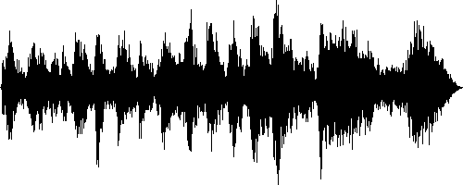
MERLOT RESERVE
Vision-Language-Audio
Temporal
Encoder
Audio Encoder
Spilling coffee
$${\hat{a}}_{1}$$
$$a_{1}$$
Audio Encoder
$$a_{2}$$
Maximize similarity $a_{1}$
to versus all other targets
Audio Encoder
$$log\frac{exp⁡({{\hat{a}}_{1},a}_{i})}{\sum_{i}{({{\hat{a}}_{1},a}_{i})}}$$
$$a_{3}$$

Slide 68
MERLOT RESERVE
Vision-Language-Audio
Temporal
Encoder
Text Encoder
$${\hat{t}}_{1}$$
$$t_{1}$$
At 8 a.m. today, someone poisons the coffee.
Text Encoder
$$t_{2}$$
Do not drink the coffee.
Maximize similarity $t_{1}$
to versus all other targets
Text Encoder
$$log\frac{exp⁡({{\hat{t}}_{1},t}_{i})}{\sum_{i}{({t_{1},t}_{i})}}$$
$$t_{3}$$
Print out the memo

Slide 69
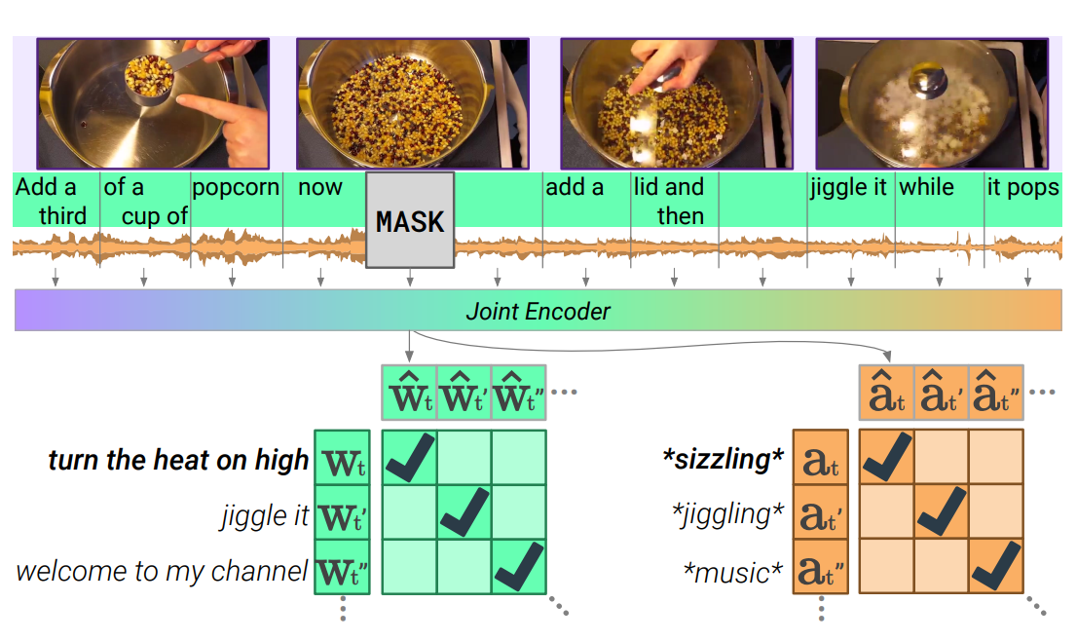
MERLOT RESERVE
Contrastive Span Training
maximize the similarity to the encodings of the text $w_{t}$ and audio $a_{t}$

Slide 70
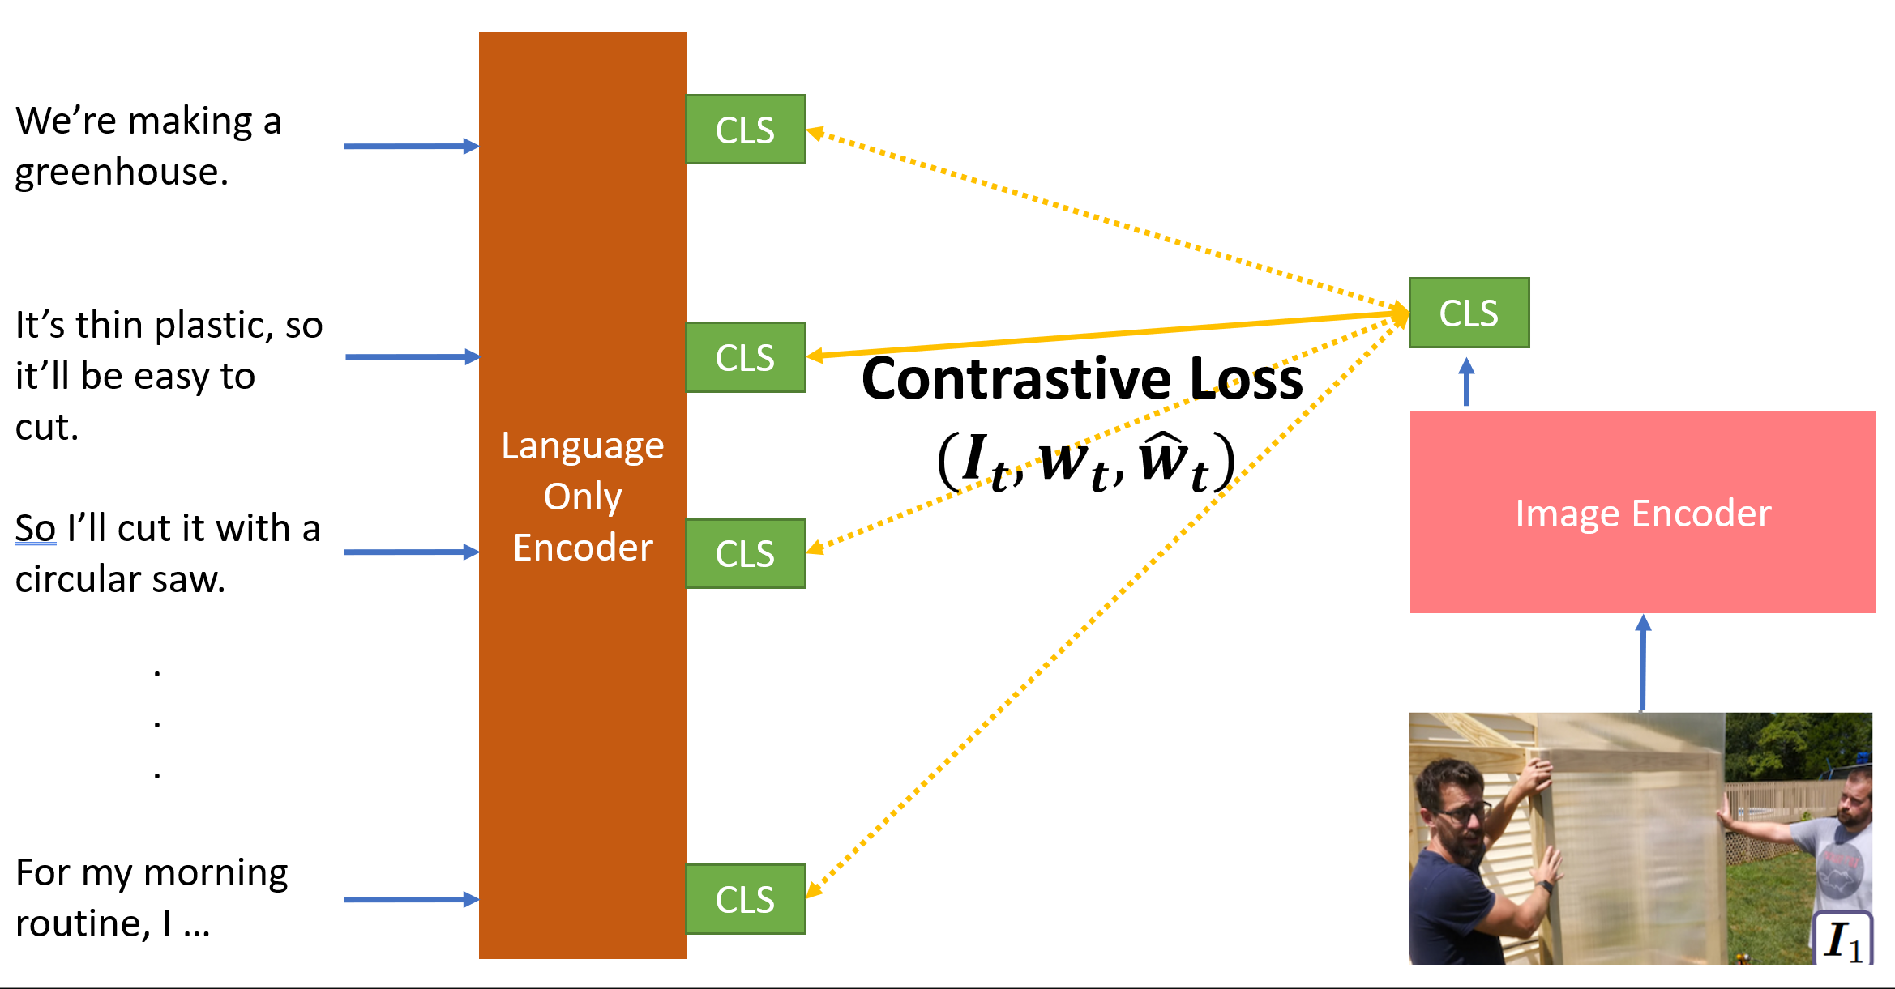
MERLOT RESERVE
$$L= L_{text}+ L_{audio}+ L_{frame}$$

Slide 71
Shortcut Learning
A frame $v_{t}$, from the middle of the segment
The ASR tokens $w_{t}$ spoken during the segment
The audio $a_{t}$ of the segment.

Slide 72
NCE
Contrastive Span Training
A frame $v_{t}$, from the middle of the segment
The ASR tokens $w_{t}$ spoken during the segment
The audio $a_{t}$ of the segment.

Slide 73
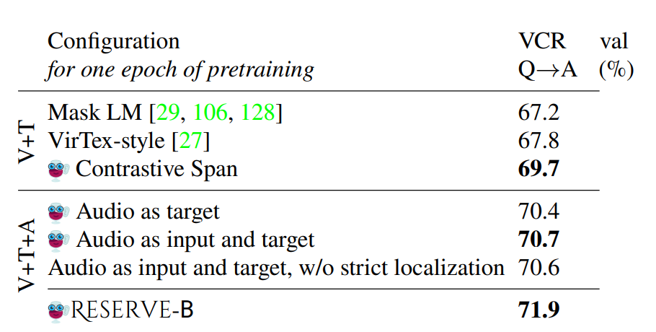
Ablations
Visual Commonsense Reasoning
contrastive span pretraining outperforms mask LM
improved performance when audio is used both as input and target

Slide 74
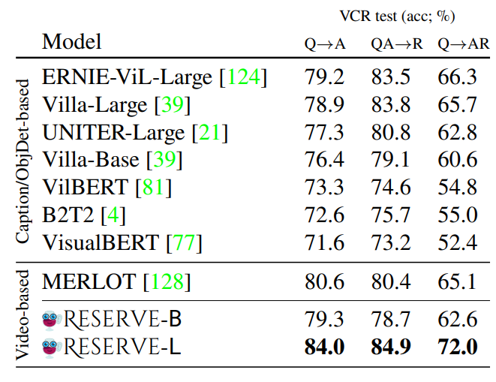
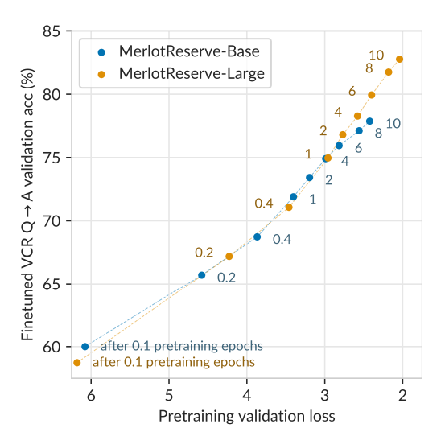
Image Tasks
Visual Commonsense Reasoning
Dataset - YT-Temporal-1B.
Pretraining progress
Results on VCR
The joint encoder is a 12-layer, 768-dimensional Transformer

Slide 75
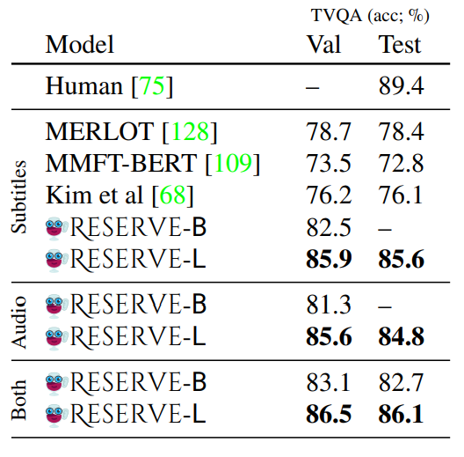
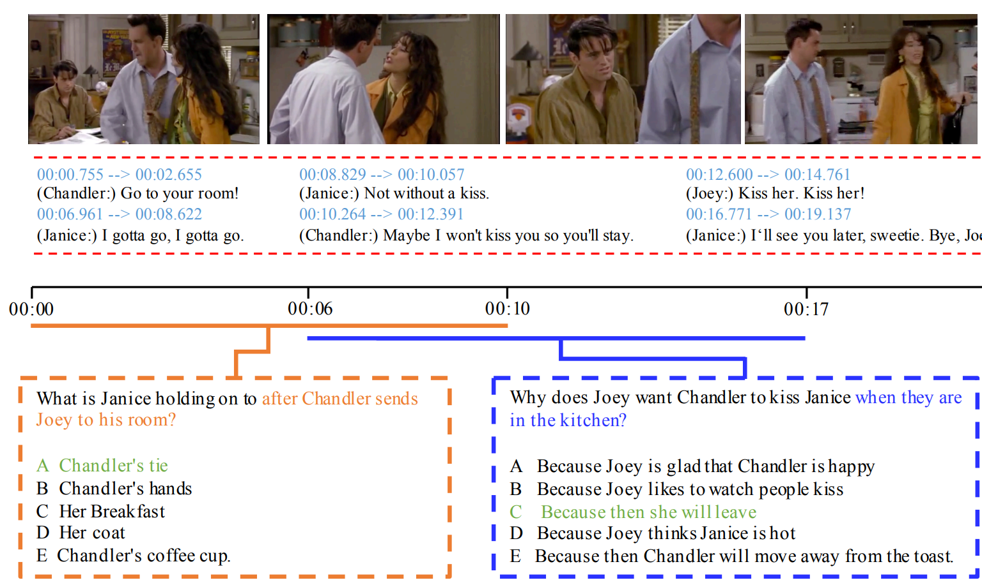
Video Tasks
TVQA
TVQA links depicted objects to visual concepts in questions and answers.
Results on TQVA
https://tvqa.cs.unc.edu/

Slide 76
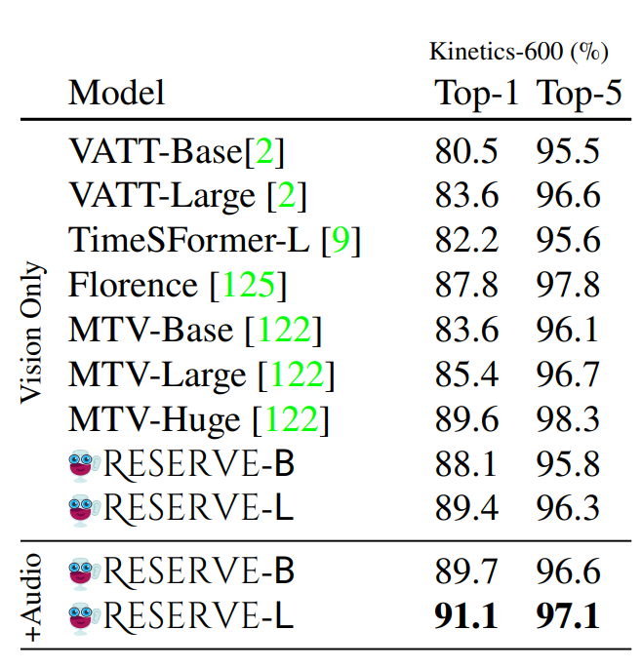
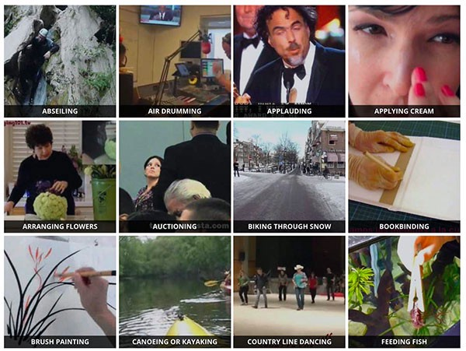
https://www.deepmind.com/open-source/kinetics
Activity Recognition
Kinetics-600
No Transcripts
The Kinetics-600 is a large-scale action recognition dataset which consists of around 480K videos from 600 action categories. The 480K videos are divided into 390K, 30K, 60K for training, validation and test sets, respectively.
Results on Kinetics-600

Slide 77
Zero-Shot
Situated Reasoning (STAR): The model is given a video, a templated question, and 4 answer choices.
Action Anticipation in Epic Kitchens: Here, the goal is to predict future actions given a video clip
LSMDC: Videos with captions (with a MASK to be filled in)
MSR-VTT QA: Open-ended video QA

Slide 78
Why does audio help?

Slide 79
Strength
A new, extensive dataset named YT-Temporal-1B has been introduced as a competitor to HowTo100M and YT-Temporal-180M, which offers broader content coverage beyond just instructional videos.
A new multimodal model to acquire knowledge from vast amounts of videos featuring accompanying vision, language and audio, achieving new SOTA.
A new objective learning function that maximize the similarity of positive text and audio pair
https://openreview.net/forum?id=CRFSrgYtV7m

Slide 80
Weakness
The paper discusses the model training process using millions of YouTube videos, which has sparked privacy apprehensions. Moreover, accessing the dataset may be challenging, as the only provided links to the associated YouTube videos are unlikely to ensure long-term availability of the data.
The visual representations are not evaluated
Since the model only utilizes a single frame per segment as input, it remains unclear how it can effectively represent dynamic scenes.
we would argue that in the context of learning multimodal script knowledge, giving the model a single frame might actually be a strength. The reason being is that our goal is for MERLOT to infer what’s going on in the world, temporally, through (partial) observations of both vision and language.
https://openreview.net/forum?id=CRFSrgYtV7m

Slide 81
Future Works
An end-to-end model with feature extractions
Multiple frames per segment
Contrastive loss to align image and text/audio pair
https://openreview.net/forum?id=CRFSrgYtV7m

Slide 82
Q&A

