Slide 1
Ontological Distance Based on
Spatial Point Patterns
Ray Dos Santos – Mar 24, 2013

Slide 2
Mapping to an ontology
A fisherman suffered an accident when his boat broke in Anchorage.
C
A
boat
VEHICLE
PEOPLE_BY_VOCATION
B
truck
clerk
police_officer
CATASTROPHE
fisherman
plane
train
crash
tragedy
car
mishap
casualty
accident
There were 1.2 million car mishaps reported by the police of Fairbanks.

Slide 3
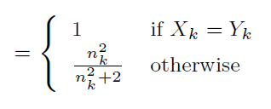
Related Works
S(X_{K},Y_{K})
Frequency, probability

Slide 4
Ripley’s K
Ripley’s K function: expected number of events within distance d of an event, divided by mean intensity in the study area
crash
accident
λ
1
λ
λ
sum of number of objects with attributes i and j that fall within distance d
λ = # points / area

Slide 5
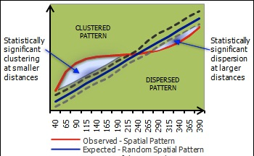
N(1m)
Ripley’s K
2
3
2
1
d=1m
2
1
0
2
1
2
5m
16
E(N) = 16 / 10 = 1.6
λ = 10 / 25= 0.4
K(1) = 1.6 / 0.4 = 4
5m
4
λ
1
1
λ
λ

Slide 6
Conclusion
B
CATASTROPHE
4
crash
tragedy
mishap
casualty
accident
dist(crash,accident) = 4
must also compute:
dist(crash,tragedy)
dist(crash,casualty)
dist(tragedy,mishap)
dist(tragedy,accident) …
source 1
A fisherman suffered an accident when his boat broke in SF Bay.
source 2
Last year there were 1.2 million car crashes reported by police in downtown SF.
sim(source1,source2) = sim(crash,accident) + sim(boat,car) + sim(fisherman,police)

Slide 7
Conclusion
Ripley’s K function
allows scaling: 0 to 5m, 0 to 10m, 0 to 100m, …
PCR: pair correlation function
per segment: 0 to 5m, 5m to 10m, …

