Slide 1
Object Placement for High Bandwidth Memory Augmented with High Capacity Memory
Mohammad Laghari and Didem Unat
https://parcorelab.ku.edu.tr
SBAC-PAD 2017 @ Campinas, Brazil 17-20 October 2017

Slide 2
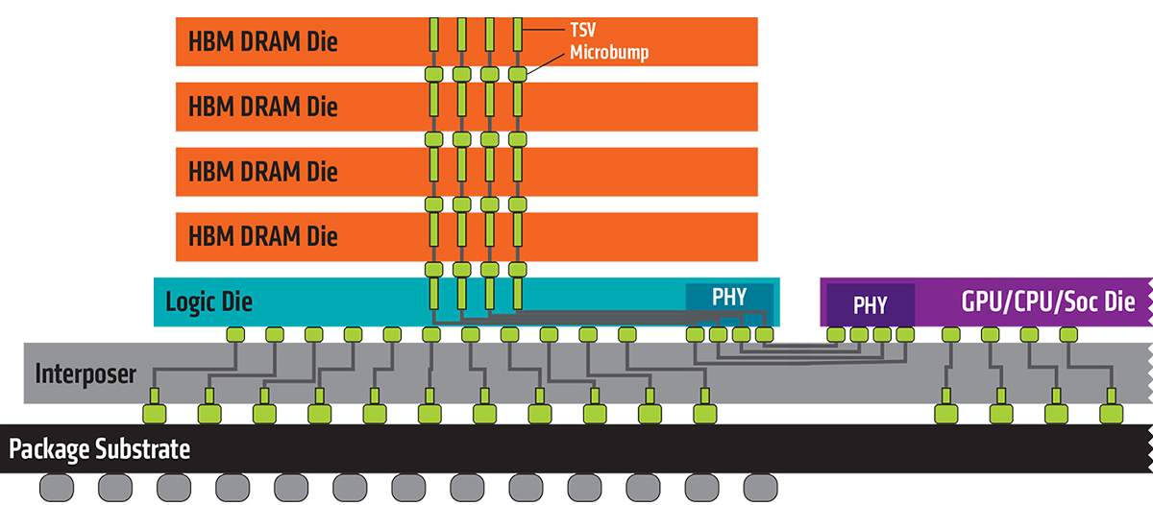
Introduction
To overcome memory bandwidth limitations, multiple memories with different characteristics are introduced
Data locality for applications on heterogeneous memory systems (High Bandwidth Memory + High Capacity Memory)
High Bandwidth Memory (HBM)
  High bandwidth
  Limited capacity
  3D structure (connected with TSVs)
  Expensive (due to technology limitations)
  Eg. MCDRAM on Intel Knights Landing
High Capacity Memory (HCM)
  Low bandwidth
  Huge capacity
  Eg. DDR
Image taken from: http://www.amd.com/en/technologies/hbm
Notes:
The question arises of how to intelligently place data on such systems such that the overall application performance is maximized.

Slide 3
Data Placement on HBM
?
HBM
How to allocate objects in systems with multiple memory types
Memories have different properties
CPU
HCM
Only single memory type
Place data on HCM
?

Slide 4
Data Placement on HBM
?
HBM
Part of the HBM acts as the Last Level Cache (hardware prefetching)
CPU
HCM
?
Cache

Slide 5
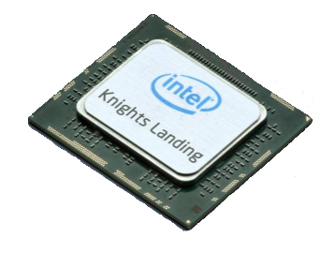
Intel Knights Landing (KNL) overview
MCDRAM
MCDRAM
MCDRAM
MCDRAM
2 VPUs
Cache/Home Agent
2 VPUs
Core
Shared 1MB L2
Core
EDC
EDC
EDC
EDC
3
DDR4
Channels
PCIe Gen. 3
DMI
3
DDR4
Channels
2 cores per tile
8 High Bandwidth Memory modules (2 GB each)
8 access channels to HBM
6 access channels to HCM
Up to 36 Tiles connected by 2D interconnect mesh
DDR MC
DDR MC
misc.
EDC
EDC
EDC
EDC
MCDRAM
MCDRAM
MCDRAM
MCDRAM
Notes:
Selfboot: no PCIe bottleneck
Binary compatibility: runs legacy code, unlike KNC, no recompilation
Improved vector density: 3+ Tflops DP, 6+ Tflops SP

Slide 6
Intel KNL Overview – cont.
Intel KNL Memory Modes
HBM as addressable 12 GB
HBM as 16GB addressable
HBM as 16GB L3 Cache
DDR
HBM as 4GB L3 Cache
DDR
DDR
Flat Mode
Cache Mode
Hybrid Mode
HBM is separately addressable
HBM acts as a hardware managed cache
HBM acts as a combination of Flat and Cache mode
Notes:
Selfboot: no PCIe bottleneck
Binary compatibility: runs legacy code, unlike KNC, no recompilation
Improved vector density: 3+ Tflops DP, 6+ Tflops SP
All-to-All: memory addresses are uniformly distributed across all TDs on the chip
Quadrant: Memory addresses served by a memory controller in a quadrant are guaranteed to be mapped only to TDs contained in that quadrant
SNC:

Slide 7
Placement Algorithm
Placement is suggested by our variation 0-1 Knapsack dynamic algorithm
  We don’t break the object (whole object is placed on one of the memory types)
F
Size: 10
Value: 20
HBM
A
Item Size: Object Size
Item Value: Object reference Count
E
Size: 10
Value: 50
Size: 50
Value: 10
B
Size: 8
Value: 20
D
Size: 5
Value: 200
Knapsack Size: HBM Size
C
Size: 50
Value: 40

Slide 8
Memory Benchmarks
Perform benchmarking of Intel MCDRAM (HBM) to find out its performance capabilities
We used well-known Stream benchmark
  Problem size
    Array size = 80M elements
    Total memory required = 1.8 GB
  KNL configuration
    SNC4 + Flat
    64 cores (not 68)
  Execution
    KMP_AFFINITY=scatter

Slide 9
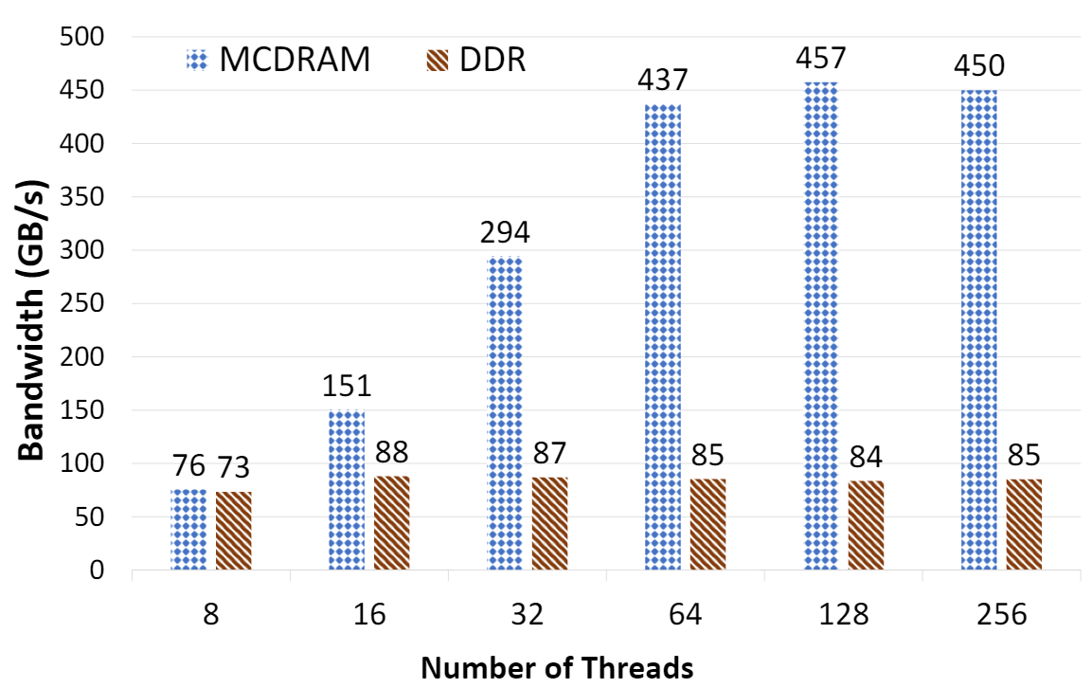
Stream Benchmark
A[i] = B[i] + α*C[i]

Slide 10
Stream Benchmark
A[i] = B[i] + α*C[i]
MCDRAM peak tested bandwidth: 450+ GB/s
DDR peak tested bandwidth: 85+ GB/s

Slide 11
Bandwidth Studies on HBM
A[i] = B[i] + α*C[i]
Bandwidth (GB/s)
Number of threads
Memkind: release version 1.6.0

Slide 12
Bandwidth Studies on HBM
A[i] = B[i] + α*C[i]
Bandwidth (GB/s)
Number of threads
Memkind: release version 1.6.0

Slide 13
Bandwidth Studies on HBM
A[i] = B[i] + α*C[i]
Bandwidth (GB/s)
Number of threads
Memkind: release version 1.6.0

Slide 14
Bandwidth Studies on HBM
A[i] = B[i] + α*C[i]
Bandwidth (GB/s)
Number of threads
Memkind: release version 1.6.0

Slide 15
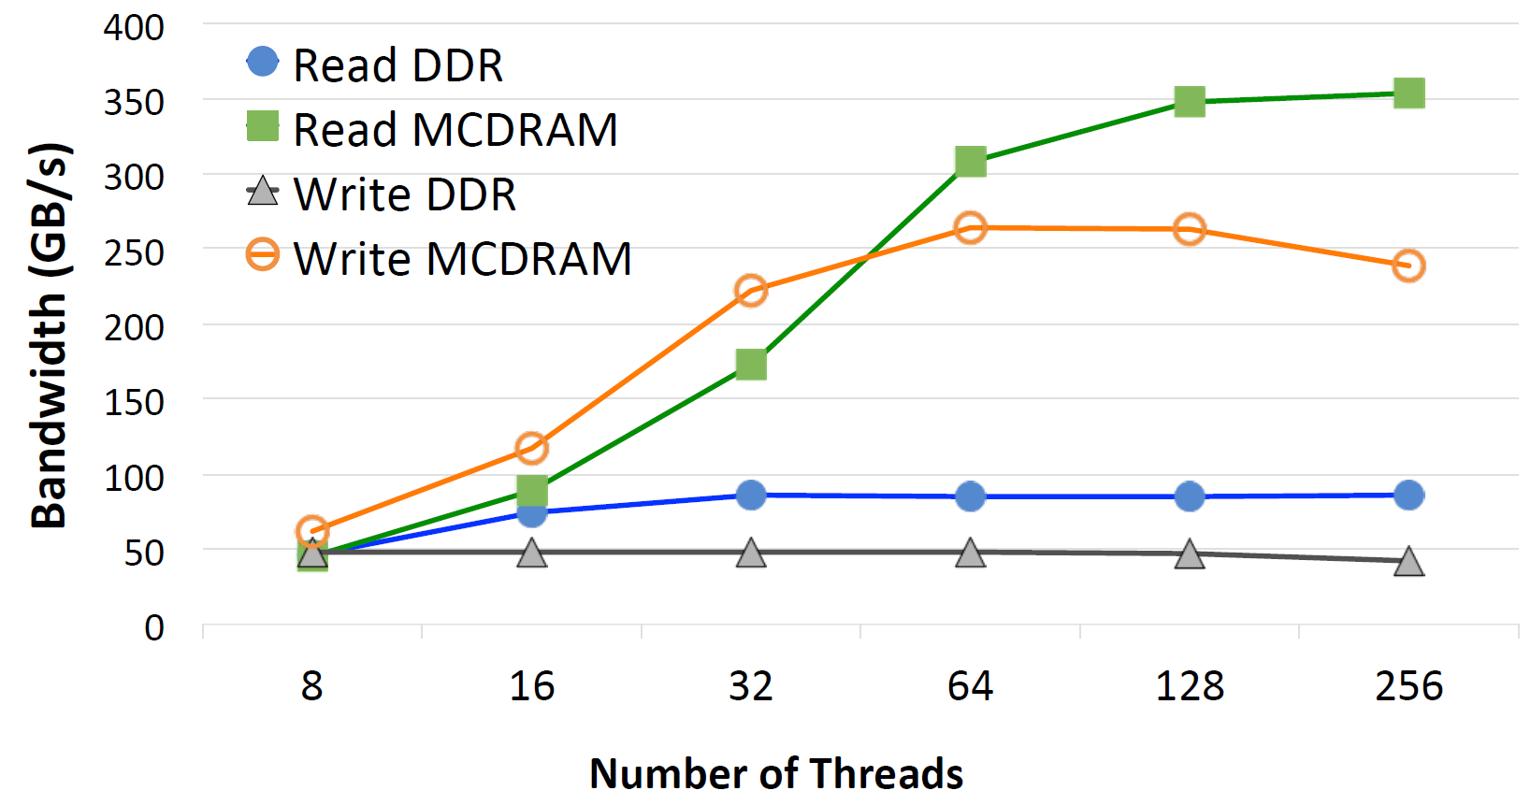
Bandwidth Studies on HBM
Notes:
In this section we investigate the read and write bandwidths of MCDRAM and DDR. The experiments show MCDRAM bandwidth of 350 GB/s and 270 GB/s for read and write, respectively. It seems that up to 32 cores, the benchmark is not bandwidth-limited on MCDRAM. In general write operations have slightly less overhead than reads in terms of data movement. The higher cost of write at the memory controller or in the memory shows up only when the application becomes bandwidth-limited. We see this trend on MCDRAM up to 32 cores, when the write performance is better than read. Bandwidth on DDR is more stable with varying number of threads, 88 GB/s and 50 GB/s for reads and writes, respectively.

Slide 16
Bandwidth Studies on HBM
Generally write bandwidth is lower on both memories
Notes:
In this section we investigate the read and write bandwidths of MCDRAM and DDR. The experiments show MCDRAM bandwidth of 350 GB/s and 270 GB/s for read and write, respectively. It seems that up to 32 cores, the benchmark is not bandwidth-limited on MCDRAM. In general write operations have slightly less overhead than reads in terms of data movement. The higher cost of write at the memory controller or in the memory shows up only when the application becomes bandwidth-limited. We see this trend on MCDRAM up to 32 cores, when the write performance is better than read. Bandwidth on DDR is more stable with varying number of threads, 88 GB/s and 50 GB/s for reads and writes, respectively.

Slide 17
Placement Algorithm
MCDRAM_{WRITE_BW} > DDR_{WRITE_BW} , so place write-intensive data on MCDRAM?
Application performance limited to DDR_{WRITE_BW}
Two flavors of the placement algorithm
  Write Agnostic:
    Does not differentiate between reads and writes
  Write Sensitive:
    Considers write accesses different from the reads
    MCDRAM on Intel KNL has varying Read/Write bandwidths
    We prioritize writes with a factor of 1.5 over reads

Slide 18
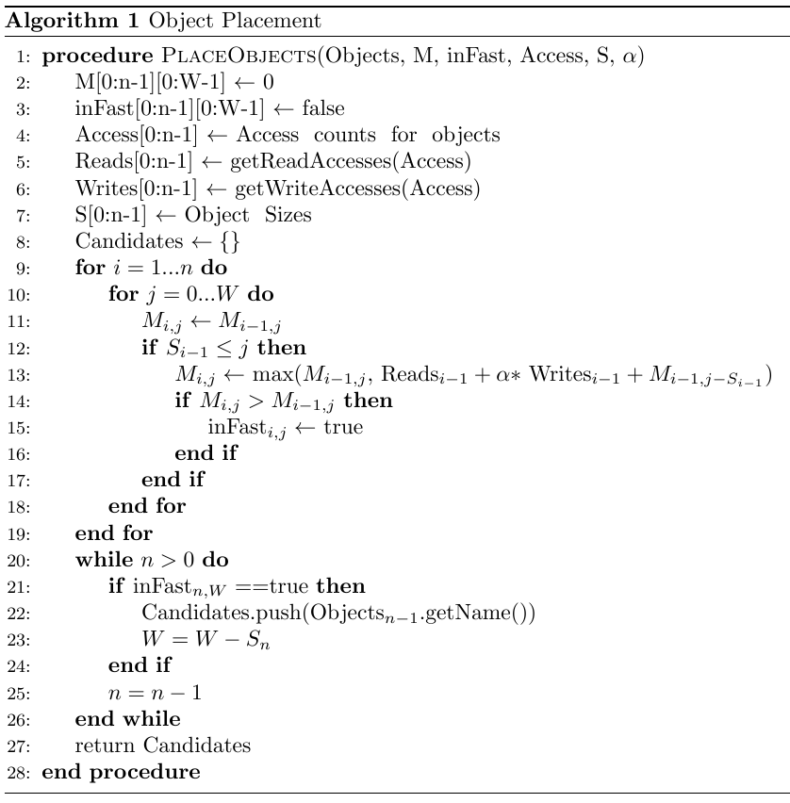
Placement Algorithm – cont.
Typical knapsack algorithm returns the candidate object list for HBM.
Added a coefficient α to prioritize writes over read references
We used α= 1.5 for KNL.

Slide 19
Obtaining Object Reference Counts
Tried Intel Pin Tool
Provides object memory access trace for an application
Slows down application runtime by a factor of 100
Advanced DAta Movement ANalysis Toolkit: ADAMANT (v2.0)
Provides object level statistics including references to objects
Statistics are based on sampled events
Obtain Reference Counts using ADAMANT
Find placement strategies using the Our Placement Algorithm
Apply placement strategies by allocating objects to suggested memory types
Notes:
Adamant: sampling
Pintool: complete profile, can be slow

Slide 20
Evaluation of Placement Algorithm

Slide 21
Applications Used
Applications | Description | # of Objects | Footprint (GB)
Triad | Triad kernel of STREAM benchmark | 3 | 6.00
Matrix Transpose | Transpose of a matrix is stored in another matrix | 2 | 6.00
Conjugate Gradient (CG) | Conjugate Gradient solves unstructured sparse linear systems | 13 | 5.23
HotSpot | Approximates processor temperature and power by solving PDEs | 3 | 6.00
Image Segmentation | Divides and recolors an image into segments to identify boundaries | 7 | 5.55
Breadth-First Search (BFS) | Breath first search graph traversal algorithm | 6 | 9.74

Slide 22
Comparing with All-DDR or ALL-MCDRAM
Application data divided between DDR and MCDRAM
All application data in DDR
All application data in MCDRAM
MCDRAM
MCDRAM
MCDRAM
CPU
CPU
CPU
DDR
DDR
DDR
All configurations have a Flat Memory configurations i.e. Code modification is required
Our placement
(without the presence of cache)

Slide 23
Comparing with All-DDR or ALL-MCDRAM
We achieve up to 2.5x speedup over All-DDR using placement suggested by our algorithm only using 4GB of HBM

Slide 24
Comparing with All-DDR or ALL-MCDRAM
Matrix Transpose shows the effect of the MCDRAM latency.
Applications such as BFS do not perform well because of their latency sensitive nature (MCDRAM has a higher latency than DDR)
Notes:
BFS and Matrix transpose: Irregular accesses, MCDRAM high latency
Matrix Transpose: Strided Access effect

Slide 25
Comparing with 4GB Cache
All application data in DDR, MCDRAM acting as Cache (4GB)
Application data divided between DDR and MCDRAM
MCDRAM
CPU
MCDRAM as 4GB Cache
DDR
CPU
DDR
MCDRAM as Cache allows hardware prefetching i.e. no code modifications
Our placement
(without the presence of cache)

Slide 26
Comparing with 4GB Cache
Our placement vs 4GB cache in Cache Mode (automatic hardware prefetching with no modifications to the source code)

Slide 27
Placement augmented with some cache
All application data in DDR and MCDRAM acting as Cache (8GB)
Application data divided between DDR and MCDRAM (12 GB)
Our placement (with cache)
MCDRAM
CPU
MCDRAM as 8GB Cache
DDR
CPU
MCDRAM as 8GB Cache
DDR
MCDRAM as Cache allows hardware prefetching i.e. no code modifications

Slide 28
Placement augmented with some cache
Our placement (+4GB Cache) vs 8GB cache in Cache Mode (automatic hardware prefetching with no modifications to the source code)

Slide 29
Summary and Future Work
Our object placement algorithm
  Chooses the right objects in the case HBM capacity is not sufficient to hold all objects
  Performs better than when HBM is used as a cache
Other observations
  Accessing objects placed in different memory types in the same loop does not seem to be a good idea
  Write-sensitive placement is better because of the low write bandwidth of DDR
  Latency sensitive applications enjoy cache and prefers DDR
Future Work
  Conduct experiments on more complex applications with varying number of threads
  Automate the placement of objects

Slide 30

Thank you
ParCore Lab @ Koç University
Istanbul, Turkey
https://parcorelab.ku.edu.tr
This project is supported by TUBITAK with project number 116C066. Authors from Koç University are supported by TUBITAK Grant No: 215E185. Authors would like to thank Dr. Pietro Cicotti from San Diego Supercomputer Center for his input in project

Slide 31
Extra Slides

Slide 32
High Bandwidth Memory (HBM)
HBM consists of DRAM stacked on top of each other
  3D structure of DRAMs
  Can be housed on the same package as the chip
HBM on Intel Knights Landing (KNL)
  Capacity vs Stream Bandwidth
    MCDRAM: 16 GB and 450 GB/s
    DDR4: 384 GB and 85 GB/s
    Latency of MCDRAM is slightly higher than DDR4
  Configurable at boot
    Flat Mode
    Cache Mode
    Hybrid Mode
Image taken from: http://www.amd.com/en/technologies/hbm
Notes:
MCDRAM: 150 ns
DDR4: 125 ns

Slide 33
Data Placement on HBM
Memkind library (latest release 1.6.0) or hbwmalloc library
Provides interface for explicit allocation on HBM
Double *a = (double *)malloc(sizeof(double) * 100)
Double *a = memkind_malloc(MEMKIND_DEFAULT, sizeof(double)*100)
OR
Double *a;
memkind_posix_memalign(MEMKIND_INTERLEAVE, &(void*)a, 1024, sizeof(double)* 100)

Slide 34
Experiment Configurations
 | Fast Memory | Slow Memory | Cache (L3) | Boot Mode
All-DDR | --- | 384GB | --- | Flat
All-MCDRAM | 16GB | --- | --- | Flat
4GB Cache | --- | 384GB | 4GB | Hybrid
8GB Cache | --- | 384GB | 8GB | Hybrid
Our Placement (w/o Cache) | 4GB | 384GB | --- | Flat
Our Placement (w/ Cache) | 4GB | 384GB | 4GB | Hybrid
(64 Cores with Sub-NUMA 4 Clustering Mode)

Slide 35
Memory Copy

Slide 36
Memory Copy
Peak MCDRAM bandwidth achieved is 165 GB/s because read operation from DDR becomes a bottleneck

Slide 37
Experimental Setup
Intel KNL equipped with 68 cores
Sub-NUMA 4 clustering mode
Scattered thread affinity
4GB of MCDRAM used as maximum (unless stated otherwise)
384GB of DDR

Slide 38
Optimization Notes
Streaming stores is set to bypass cache for writes
  -qopt-streaming-stores always
Vectorization flag is set
  -Xmic-AVX512
Aligned memory during allocation
  memkind_posix_memalign()
Big pages (2MB)
  Got allocation error with hbw_*
Compilation report is checked if everything is expected
  -qopt-report5
Experimented with different OpenMP schedule chunksize
  Best is not to specify a chunksize

Slide 39
Overall picture
Understanding the application characteristics
Analyze application read-write pattern by ADAMANT tool
Run our algorithm
Allocate objects on the memory suggested by the placement algorithm

Slide 40
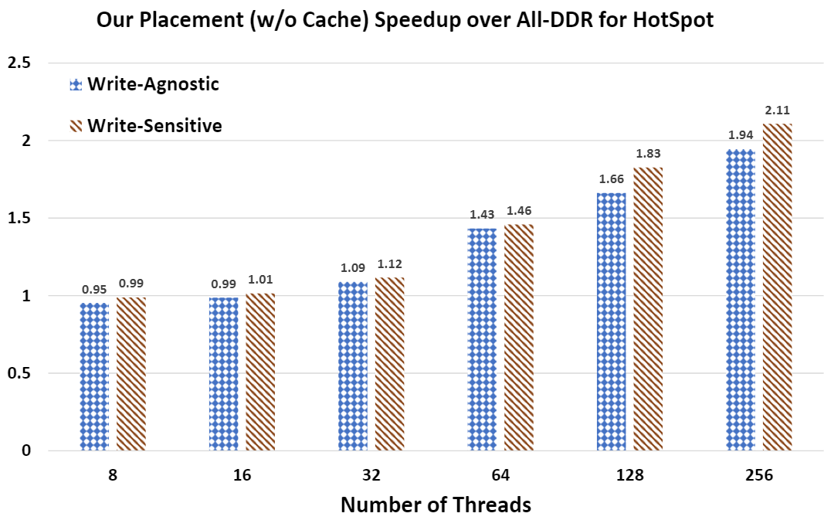
HotSpot with varying thread count

