Slide 1
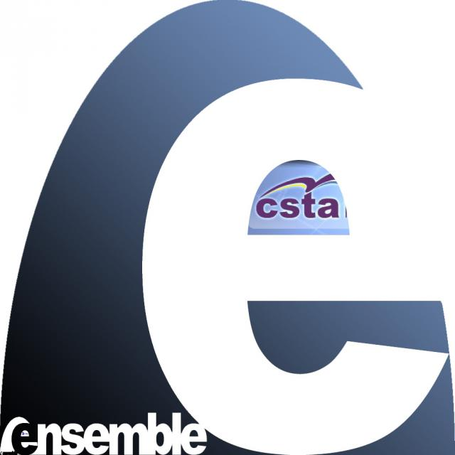
Building an Online Educational Community
Monika Akbar, Alexander Joel Alon, Michael Stewart, Clifford A. Shaffer, Stephen H. Edwards
Department of Computer Science, Virginia Tech
Email: {amonika, alon, tgm, shaffer, steve.edwards}@vt.edu
Factors of Success for Online Education Community
Successful online education communities need more than a digital library model.
An online community can succeed only if there is a sufficient level of contribution and of community activity.
To gain critical mass of activity
Lower barriers to participation – build system to encourage community activity
Site reliability
Ease of Use
Provide active incentives to participate
Example: Amazon - A successful online community
User ratings and reviews add major value
Education Material
Service:
To encourage member participation
System:
To support community activity
Other Education Communities
Connexions Project – online, open access textbooks
MERLOT – collection of online learning material
ENSEMBLE –a distributed portal for computing education resources.
CSTA –Computer Science Teachers Association
Online Education Community: AlgoViz Portal
Static Content: Documentation for over 500 AVs, their description and evaluation
Community-driven content
User reviews and ratings of Algorithm visualizations,
Discussion of best practice
“Field Reports” – actual experiences with algorithm visualization in the classroom
OpenAlgoViz: Open Source AVs contributed by developers
Lower Barriers to Participation
Easy registration and login mechanism
OpenID
RPX login
Content Management System (Drupal)
Database support for better search
Members can create or edit contents
Easy mechanism for ratings and comments
Better connectivity with other sites and members
Twitter and Facebook integration
Notification, email, instant messaging for members
Track user activity
Better tracking allows us to provide better services
Encourage User Contribution
Introduce community-oriented services: forums, ratings, field reports, tagging, bookmark, notifications.
Field Reports: descriptions of how individual instructors used specific AVs in their course.
Notification: Mechanism for notifying the community members of
information from online content
Information from community contributions
Notification streams: Notifications come in ways that the participants naturally use
Traditional dissemination mechanism – forum, email, blogs, newsletter
Social networking streams: Facebook, Twitter, RSS feeds, etc.
NSDL Grant No: DUE-0937863

