Slide 1
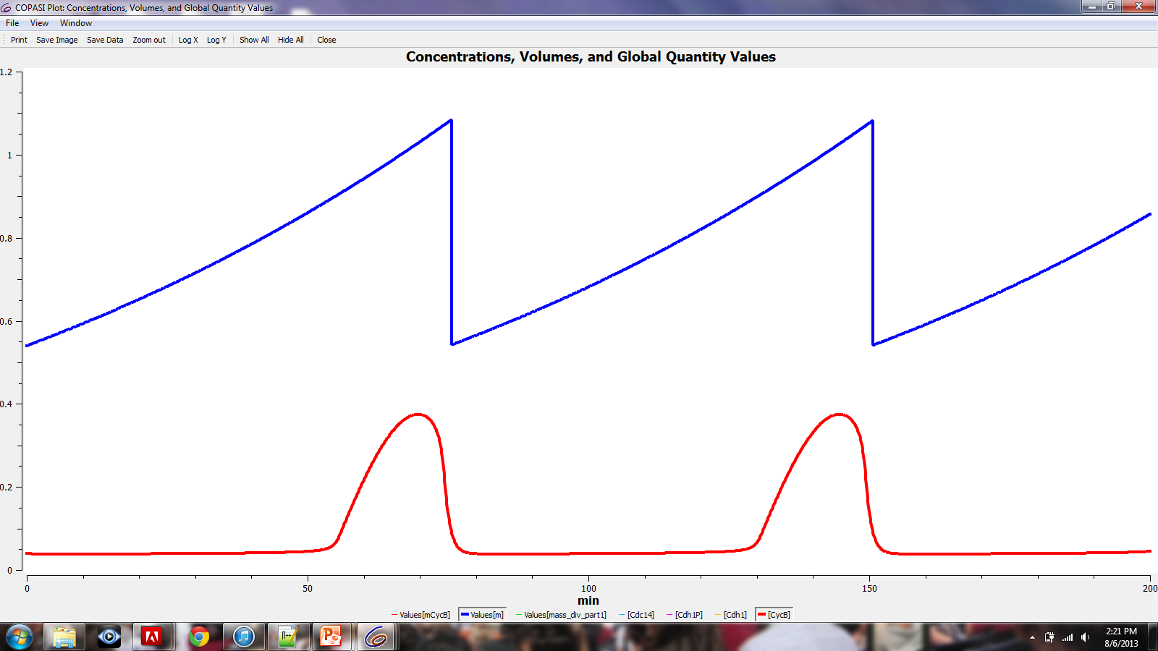
Aggregation Connector: A Tool for Building Large Molecular Network Models from Components Thomas C. Jones Jr¹, Clifford A. Shaffer¹, Alida Palmisano², Stefan Hoops³, and John J. Tyson² ¹Department of Computer Science, Virginia Tech, Blacksburg, VA ²Department of Biological Sciences, Virginia Tech, Blacksburg, VA ³Virginia Bioinformatics Institute, Virginia Tech, Blacksburg, VA {tjones21, shaffer, alida.palmisano, shoops, tyson}@vt.edu
Synopsis
The ever-growing size and complexity of molecular network models makes them difficult to construct and understand. Our approach to modeling is to build large models by combining together smaller models, making them easier to comprehend. At the base, the smaller models (called modules) are defined by small collections of reactions. Modules connect together to form larger modules through clearly defined interfaces called ports[1]. We present the Aggregation Connector, a software tool that supports large-scale molecular network modeling.
Interface
Cell Cycle Model
TreeView
Displays the hierarchical structure of the model and submodules.
DrawingBoard
Displays the graphical representation of the model and submodules.
ModelBuilder
Displays the reactions, species, etc. of the model.
Original Model [3]
CycB
Cdh1P
Cdh1
Cdc14
Model created using the Aggregation Connector
ModelBuilder for Submodule1
Model Components
Submodule Components
1. Synthesis and Degradation of CycB
2. Synthesis and Degradation of Cdc14
3. Hill function
4. Phosphorylation and Dephosphorylation of Cdh1
The Process
ModelBuilder for Submodule2
Container Model
CycB
Submodule
Cdh1P
Cdh1
Ports
ModelBuilder Events Tab
Functionality
Construct large models by connecting smaller modules together
Create a module template and import it multiple times
Complete models can be saved and later imported as submodules
Import models in Systems Biology Markup Language (SBML) format
Export models in SBML format, using the new SBML Hierarchical Model Composition and Layout packages
Once exported, the SBML files can be imported into COPASI for further analysis[2]
COPASI simulation results
CycB
Cell mass
Modularization: group reactions together as a single module with a defined set of inputs and outputs
[CycB]
Cdh1P
Cdh1
Original Model
Model built with the Aggregation Connector
Model1
References
Submodule1
CycB
[1] R. Randhawa, C. Shaffer, and J. Tyson. (2008) Model Composition for Macromolecular Regulatory Networks. IEEE/ACM Trans. Comput. Biol. Bioinform., 99
[2] Hoops S., Sahle S., Gauges R., Lee C., Pahle J., Simus N., Singhal M., Xu L., Mendes P. and Kummer U. (2006). COPASI: a COmplex PAthway SImulator. Bioinformatics 22, 3067-74.
[3] Fall, Christopher P., Eric S. Marland, John M. Wagner, and John J. Tyson. "Cell Cycle Controls." Computational Cell Biology. New York: Springer, 2002. 261-84.
Aggregation: connect modules together (using ports) to create a larger model
Submodule2
Cdh1
For More Information:
http://www.copasi.org/softwareProjects
Cdh1P
Supported by NIH grant 5R01GM078989-07

