Slide 1
A Step-by-Step Tutorial for Making Presentation Videos

Slide 2
1. GETTING PREPARED

Slide 3
Creating Your Zoom Account
You are encouraged to use Zoom to record a professional-looking video for your SIGSPATIAL 2020 talk. If you don’t have a Zoom account yet, the first step is to sign up for one. All you need to do is to visit https://zoom.us, click the SIGN UP, IT’s FREE button to get started. Use your work email address to sign up for an account.

Slide 4
Downloading Zoom
You will need to download the Zoom client (the desktop client version, not the Web version) for your operating system before using it for recording your talk. Go to https://zoom.us/download to download and install the Zoom Client for Meetings.

Slide 5
Turning on Automatic Recording
After you sign in your Zoom account, click Account Settings in the ADMIN section on the left, then click the Recording tab at the top, and look for Automatic Recording. Turn it on.

Slide 6
Enable HD (1080p) for Your Video
Sign into your Zoom desktop client, in Home, click settings button, then click VIDEO in the left menu, and enable HD on the right.

Slide 7
2.
RECORDING YOUR TALK

Slide 8
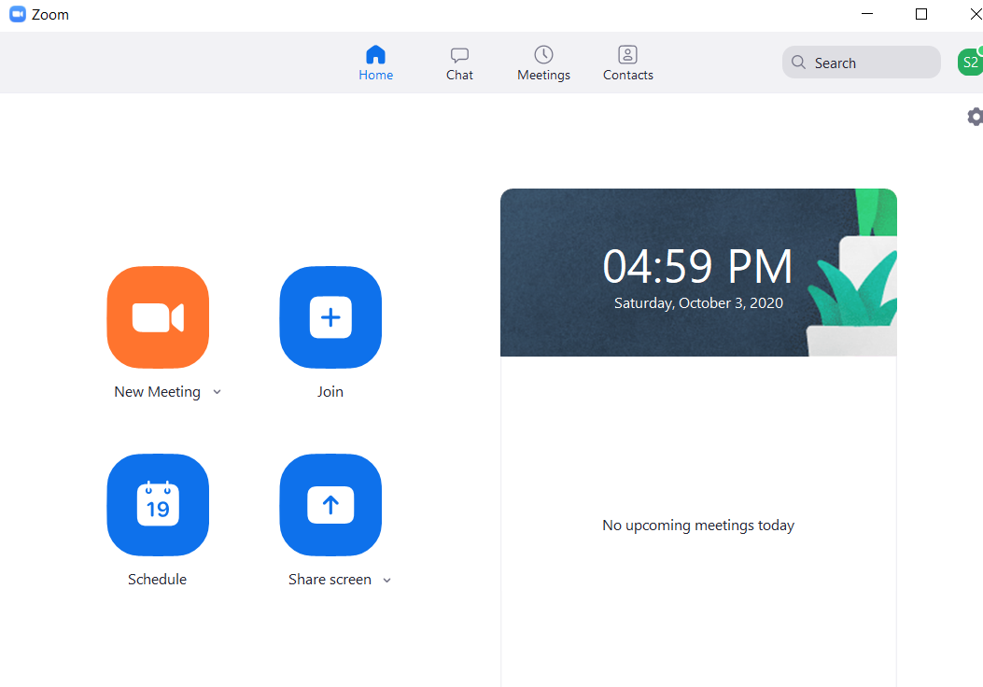
Notes on Presentation and Sharing Your Screen
One
To get ready to record your video, make sure that you are using a computer with a front-facing camera and a microphone. Most laptop computers should be fine.
Two
Now, prepare and start the application you will be using for presenting slides in your talk, such as PowerPoint or Keynote.
Three
Then open the Zoom client and sign in your account. Click New Meeting. Local recording should start automatically.
Four
Make sure you start your video in Zoom and introduce yourself first. For example, My name is…, I am a student from University of …, the paper I will be presenting today is titled ...
Five
The video you are recording will always include a small picture-in-picture window with you inside. Use Zoom virtual background if you do not want to show your room.

Slide 9
Presentation and Sharing Your Screen
After your brief opening introduction, click Share Screen to start to share the window with your presentation application, such as PowerPoint or Keynote. Do not share the entire desktop; just share the window with PowerPoint or Keynote.
Do not select Share computer sound or Optimize Screen Share for Video Clip at the bottom.

Slide 10
Tips for High-Quality Talks
Now you can present your paper just as you would in a typical international conference. It may feel strange talking to yourself, but rest assured, your presentation will have a live audience during the online conference. Here are some tips for giving a high-quality talk
Keep it simple. Do not try to squeeze a lot of material into each presentation slide. You have a time limit of 12 minutes, but you do not have limits on the total number of slides you have. Keep each slide as simple as possible and explain one idea at a time. Use large font sizes. If you feel that you must cover a lot of material in the same slide, use builds to show your material a step at a time.
Avoid having too much technical detail. Your talk should be designed to get the audience interested in your paper, rather than replacing the paper. Do not try to present all the technical detail you have in your paper; instead, try to present only a few highlights of your original contributions in your paper, and emphasize high-level ideas on why your contributions are original in the context of related work.
Start strongly. The beginning of your talk is the most important as you need to grab the attention from your audience. Start from a compelling introduction of the background of your work and motivate your ideas with convincing arguments.
Use examples. Your talk will be more understandable if you use a few simple examples, and work through your algorithm or theoretical proof in the context of your examples. Examples are your best friend in a high-quality talk.
Keep a calm pace. Do not rush through your presentation slides with a breakneck pace. Deliver your talk at a leisurely pace.
Use a timer. When you are presenting your slides, it is easy to lose track of time. Use a timer on your side and be keenly aware of the amount of time left.

Slide 11
Tips for Editing mp4 Videos
.mp4 Video Editing (Cutting and Merging)
You might find you need to edit your videos (e.g., removing the beginning or ending part, merging multiple clips). The following recommended software can help you.
ffmpeg: Open source and supports Windows/Linux/MacOS.
Download: https://ffmpeg.org
MKVToolNix: a free GUI tool for editing videos under Linux, Unix and Windows.
Download: https://mkvtoolnix.download
Freemake Video Converter: a free windows-based app to edit and convert videos:
Download: https://www.freemake.com/free_video_converter/
Examples with ffmpeg:
Cut a mp4 video:
Command: ffmpeg -i input.mp4 -ss 00:00:10 -to 00:12:10 -c copy output.mp4
Concatenate multiple mp4 videos:
Command: ffmpeg -i "concat:talk1.mp4|talk2.mp4" -c copy talkall.mp4

Slide 12
3.
UPLOADING YOUR VIDEO

Slide 13
Testing and Uploading Your Video
When you are done with your presentation, end the meeting and your video recording will be processed by Zoom and stored in a local folder (typically Documents/Zoom) as an .mp4 file. Play your video several times to make sure that it is below the time limit, and both audio and video play out correctly.
To upload your video, rename the file (File Name: Oral_Your-LName_Your-F_Name.mp4), and upload it to the Google link for the exam.

Slide 14
Checklist
That’s it! Use the checklist below to make sure all requirements are met.
Requirements | Done?
The video length is within the limit the required.
The resolution of the video is at least 720p.
The audio is clear.
The format of the video is .mp4.
Audio and video tracks are in sync at all times.
A picture-in-picture video window of the presenter is always visible throughout the video.
Your video file is named properly.

Slide 15
THANK YOU!

