Slide 1
Clustering Spatial Data Using Random Walk
David Harel and Yehuda Koren
KDD 2001

Slide 2
Introduction
Advances in database technologies resulted in huge amounts of spatial data
The characteristics of spatial data pose several difficulties for clustering algorithms.
Clusters may have arbitrary shapes and non-uniform sizes.
Different clusters may have different densities.
The existence of noise may interfere the clustering process and should be identified.
Regarding complexity, the huge sizes of spatial databases imply the need for very efficient clustering algorithms

Slide 3
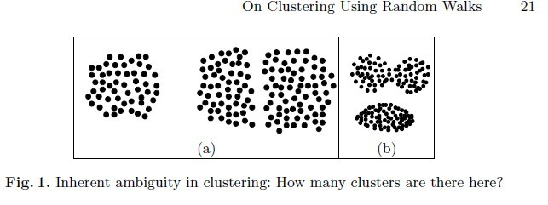
Motivation
Partitional approach
Minimize the overall squared distance between each data point and the center of its related cluster.
K-mean, k-medoid
Robustness to outliers and quick running time.
Tendency to produce spherically shaped clusters of similar sizes, which prevents the finding of natural clusters. And Predetermine the number of k
Notes:
Figure a has three clusters, but one could argue that there are only two, since the two on the right hand side are close enough to be thought of as one.
Figure b , one could argue for and against dividing the points in the top dense region into two highly connected natural clusters.

Slide 4
Motivation
Hierarhcical algorithm
Create a sequence of partitions in which each partition is nested into next partition in the sequence.
Agglomerative clustering
Starts from the trivial partition of n points into n clusters of size 1 and continue by repeatedly merging pairs of clusters.
At each step the two clusters that are most similar are merged, until the clustering is satisfactory.
Single-link cluster similarity : similarity between the most similar pair of elements, one from each of clusters; it can be easily fooled by outliers, merging two clusters that are connected by a narrow string of points.
Complete-link cluster similarity : least similar pair of elements; break up a relatively large cluster into clusters
Notes:
For example, in the figure, it will fail, since the distance between the left hand side grid and the right hand side grid, is equal to the distance between any two adjacent subgraphs.

Slide 5
Approach Proposed
Present an approach to clustering spatial data, based on deterministic exploration of random walks on a weighted graph associated with the data.
The heart is to apply the method iteratively.
To sharpen the distinction between the weights of inter-cluster edges (those that ought to separate clusters) and intra-cluster edges (those that ought to remain inside a single cluster) by decreasing the former and increasing the latter.

Slide 6
Basic Notion(Graph-theoretic notions)
Let G(V, E, w) be a weighted graph, which should be viewed as modeling a relation E over a set V of entities.
The set of nodes V is {1….n}.
w: E -> R⁺, measures the similarity between pairs of items.
Let S V. The set of nodes that are connected to some node of S by a path with at most k edges is denoted by .
The degree of G, denoted by deg(G), is the maximal edges incident to some single node of G.
The subgraph of G induced by S is denoted by G(s).
The edge between i and j is denoted by <i, j>.
The probability of a transition from node i to node j, is where
is the weighted degree of node i.
A random walk is a natural stochastic process on graphs. Given a graph and a start node, we select a neighbor of the node at random, and “go there ”, after which we continue the random walk from the newly chosen node.

Slide 7
Basic Notions (Cont.)
Given a weighted graph G(V,E,w), the associated transition matrix, denoted by M^{G}, is the n×n matrix in which, if i and j are connected, the (i, j)’th entry is simply p_{ij}. Hence, we have
Denote by the vector whose j-th component is the probability that a random walk originating at i will visit node j in its k-th step.
Thus, is the i-th row in the matrix (M^{G})^{k}, the k’th power of M^{G}
The escape probability from a source node s to a target node t, denoted by P_{escape}(s,t) is defined as the probability that a random walk originating at s will reach t before returning to s. The probability can be computed.
For ever , define a variable satisfying:
Then the escape probability is given by

Slide 8
Clustering using random walks (Cluster Quality)
The main idea to identifying separators is to use an iterative process of separation.
Separation reweights edges by local considerations in such a way that the weight of an edge connecting “intimately related” nodes is increased, and for others it is decreased.
Sharpening pass: in it, the edges are reweighted to sharpen the distinction between separating and non-separating edges.
When the separating operation is iterated several, a sort of “zero-one” phenomenon emerges, whereby the weight of an edge that would be a separator notably diminished.

Slide 9
NS: Separation by neighborhood similarity
A helpful property of the vector is that it provides the level of nearness or intimacy between the node i and every other node.
generalizes the concept of weighted neighborhoods.
is exactly the weighted neighborhood of i.
is not very interesting for large values of k. We will actually be using the term
To estimate the closeness of two nodes v and u, fix some small k(=3) and compare
The smaller the difference the greater the intimacy between u and v.

Slide 10
NS: Separation by neighborhood similarity (Cont.)

Slide 11
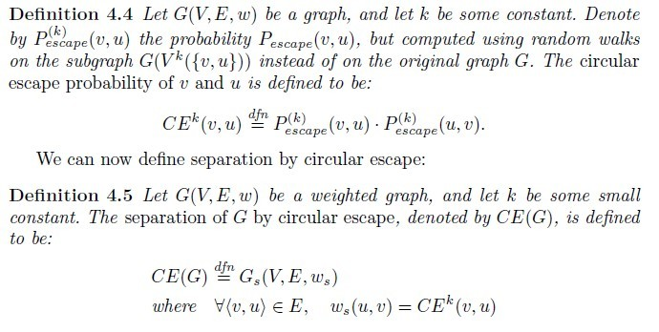
CE: Separation by circular escape.
A random walk that starts at v visits u exactly once before returning to v for the first time.
If v and u are in different natural clusters, the probability of such an event will be low, since a random walk that visits v will likely return to v before reaching u.
The notion is symmetric, since the event obtained by exchanging the roles of v and u has the same probability.
The probability of this event is give by

Slide 12
Clustering by Separation
Notes:
This figure contains almost uniformly weighted graph. Using the NS, let k is equal 3. Using the CE: the k is equal to 2

Slide 13
Clustering by Separation

Slide 14
Clustering by Separation

Slide 15
Clustering by Separation

Slide 16
Clustering by Separation

Slide 17
Clustering Spatial Points
Dataset 1 shows the inherent capability to cluster at different resolutions at once,.
Dataset 2 demonstrates the ability to separate the two left hand side clusters, despite the fact that the distance between these clusters is smaller than the distance between points inside the right hand side cluster.
The data set 3 exhibits the capability to take into account the structural properties of the data set, which is the only clue for separating the set evenly spaced points.
Notes:
This figure shows the 2D sets of points, although the method works well in higher dimensions too, because two dimensions are easier to visualize and evaluate.
This figures shows the clustering decomposition of three data sets using the new methods.
Dataset 1 shows the inherent capability of our algorithms to cluster at different resolutions at once, i.e., to detect several groups with different intra-group densities. This ability is beyond the capabilities of many clustering algorithms that can show the denser clusters only after breaking up the sparser clusters.
Data set 2 demonstrates the ability to separate the two left hand side clusters, despite the fact that the distance between these clusters is smaler than the distance between points inside the right hand side cluster.
The data set 3 exhibits the capability to take into account the structural properties of the data set, which is th only clue for separating theset evenly spaced points.

Slide 18
Clustering Spatial Points

Slide 19
Conclusion
Propose a novel approach to clustering
Based on the deterministic analysis of random walks on a weighted graph generated from the data.
Decompose the data into arbitrarily shaped clusters of different sizes and densities, overcoming noise and outliers that may blur the natural decomposition of the data.
Experiment shows it is efficient.

