Slide 1
Automatic Gender Identification using Cell Phone Calling Behavior
Presented by David

Slide 2
Motivation
Existing gender classification
  Based on voice
  Based on image
  Violate user privacy
Purpose of this work
  understanding how phone usage associated with gender id
  evaluating common approaches for gender id

Slide 3
Call Data Records
Dataset
  2 M calls
  10 K phone numbers
Features
  encrypted cell phone numbers of caller and callee
  the date and time of the call
  the duration of the call
  The initial and final location of the caller while making the call

Slide 4
Variables
Behavioral Variables
  Number of Calls
  Average Duration of Calls
  Expenses
Social Variables
  In Degree
  Out Degree
  Degree
Mobility Variables
  Talk Distance
  Route Distance

Slide 5
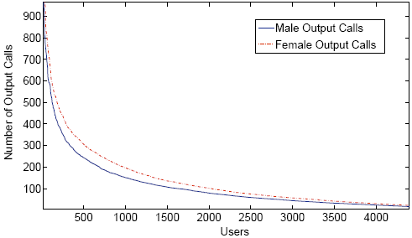
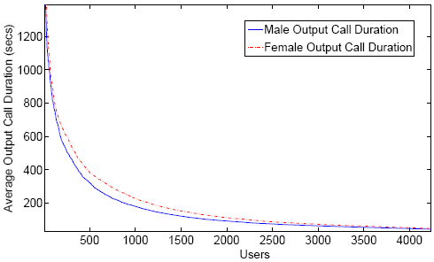
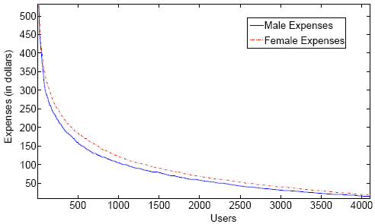
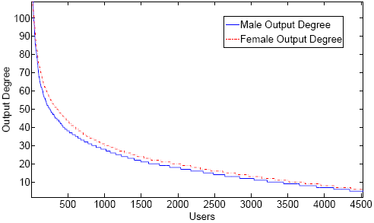
Behavior vs. Gender
Ranked distributions charts

Slide 6
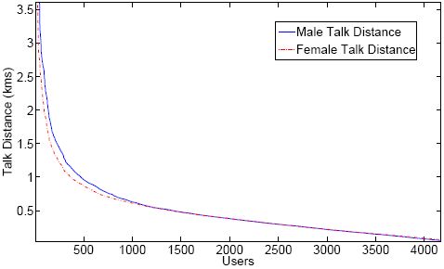
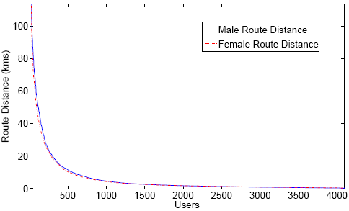
Behavior vs. Gender (Cont.)
Ranked distributions charts
Selected features
  number of incoming calls
  Number of outgoing calls
  average duration of incoming calls
  average duration of outgoing calls
  Expenses
  Degree

Slide 7
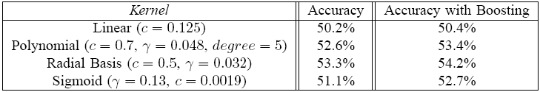
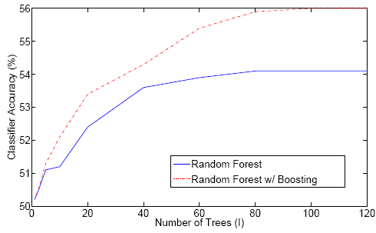
Gender Classification
SVM
Random Forests

Slide 8
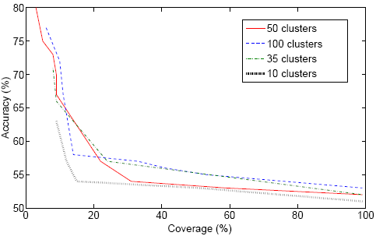
Gender Classification (Cont.)
Semi-supervised (K-means + Labeling + KNN)

