Slide 1
Mining, Indexing, and Querying Historical Spatiotemporal Data

Slide 2

Motivation
Spatio-temporal data, applications
Discovering periodic patterns is used to analyze the behavior regularity and facilitate querying
somewhere else on Mon. Tue. after school
meeting
Bob gets up at about 7:00am on weekdays
arrives at school at about 8:00am
course time
following the similar route
....

Slide 3
Outline
Challenge
Mining periodic patterns
Indexing using periodic patterns
Experimental results
Conclusion
References

Slide 4
Challenge
Existing work on detecting periodicity is done on sequence containing categorical data
  Count occurrences of each element at each period position
  E.g. time series abcdeabcdfcbcdf
  Element b appears every T=5 time intervals in the 2nd period shift *b***
The element in spatiotemporal data sequence is numerical location
  (l₀t₀), (l₁t₁),..., (l_{n-1}t_{n-1})
  l_{i} is in the form of spatial coordinates(x_{i},y_{i})
  (x_{i},y_{i}) can not repeat itself exactly every T(period) time intervals

Slide 5
Mining periodic patterns
Brute force method(Cell/Grid method)
Formal problem definition
Finding frequent singular patterns
Level-wise, bottom–up approach
Two-phase, top-down algorithm

Slide 6
Cell/grid method
Sequence
  l₀l₁l₂l₃l₄l₅l₆l₇l₈l₉l₁₀l₁₁l₁₂l₁₃l₁₄l₁₅l₁₆l₁₇
  AACCCG|AACBDG|AAACHG
Patterns:
  support(AA***G)=3
  support(AAC**G)=2
  support(AA*C*G)=2
Disadvantage
  The 3rd object position for the three days
Automated discovery of patterns and their descriptive regions

Slide 7
Mining periodic patterns
Brute force method(Cell/Grid method)
Formal problem definition
Finding frequent singular patterns
Level-wise, bottom–up approach
Two-phase, top-down algorithm

Slide 8
Formal problem definition
Let S be a sequence of n spatial locations {l₀l₁...l_{n-1} }, T<<n be an integer called period. A periodic segment s is l_{i}l_{i+1}...l_{i+t-1} where i modulo T=0
  There are exactly m segments in S, where m = ⎣n/T⎦
  Let s^{j} denote the segment starting at position l_{j.T} ; s_{i}^{j}= l_{j.T+i}
E.g., given S= l₀l₁ l₂l₃ l₄l₅ l₆l₇ l₈ , T=4.
  m= ⎣9/4⎦=2
  s⁰ = l₀l₁ l₂l₃, s₀⁰= l₀, s₁⁰= l₁ , ...
  s¹ = l₄l₅ l₆l₇ , s₀¹= l₄, s₁¹= l₅ , ...

Slide 9
Periodic Pattern P = r₀r₁...r_{T-1} , where each r_{i} is a spatial region or wildcard *.
  length(P): the number of non-* regions in P
Segment s^{j} complies with P, if for each r_{i}∈P, r_{i} =* or s_{i}^{j} is inside r_{i}
  Given P= AA*G, s⁰ = AACG, s¹ = AACC
  s⁰ complies with P, but s¹ does not
Support of pattern P, |P|, is the number of periodic segments that comply with P.
A pattern P is frequent if its support is bigger than the given threshold min_sup

Slide 10
Till now, no control over the density of region r_{i} in P
  flaw: if each r_{i} is the whole map, the pattern will be always frequent, but it’s useless
Let S^{P} be the set of segments that comply with P, each region r_{i} is valid if the locations {s_{i}^{j}| s^{j} ∈ S^{P}} form a dense cluster
  Dense cluster is concept borrowed from DBSCAN in [1]
  Two parameters: ε and MinPts
  Example
Aim: find frequent patterns(min_sup) and their descriptive regions(ε and MinPts), given S and T

Slide 11
A valid pattern with ε=1.5 and MinPts=4

Slide 12
Mining periodic patterns
Brute force method(Cell/Grid method)
Formal problem definition
Finding frequent singular patterns
Level-wise, bottom–up approach
Two-phase, top-down algorithm

Slide 13
Finding frequent singular patterns
Get T datasets , R₀, R₂,...R_{T-1}, from sequence S: l₀l₁l₂l₃l₄l₅l₆l₇l₈l₉l₁₀l₁₁l₁₂l₁₃l₁₄l₁₅l₁₆l₁₇
  T=6, R₀₌{l₀ , l₆ , l₁₂}, ..., R₅₌{l₅ , l₁₁ , l₁₇}
Finding dense clusters from each R_{i} given suitable MinPts and ∈
  From R₀, we find r₁₁,
  From R₁, we find r₂₁, ...
Given min_sup=2, singular frequent patterns are
  r₁₁***** , *r₂₁****, ...
DBScan: Expensive
Regular grid approach

Slide 14
Mining periodic patterns
Brute force method(Cell/Grid method)
Formal problem definition
Finding frequent singular patterns
Level-wise, bottom–up approach
Two-phase, top-down algorithm

Slide 15
STPMine1
Basic idea:
  Starting from 1-length patterns, get k-length patterns from (k-1)-length patterns

Slide 16
Step 1: (k-1)-length pattern pair <P₁, P₂> could generate k-length pattern candidate if
  The same first k-2 non-* positions
  Differs on the (k-1)th position
    e.g., P₁=r₁₁ r₂₁ **** , P₂= r₁₁ ** r₄₁**
  may generate P_{cand} = r₁₁ r₂₁ *r₄₁ **
  Join segment id for P₁ and P₂
    P₁= r₁₁ r₂₁ ****, P₂= r₁₁ **r₄₁**
    P_{cand} = r₁₁ r₂₁ *r₄₁ **
    segment id set for P₁={1,2,3}
    segment id set for P₂={1,3}
    segment id set for P_{cand} ={1,3}
  Number of segment ids is checked for P_{cand}

Slide 17
Step 2: validate pattern
  P₁= r_{1x} r_{2y} *, P₂= r_{1w *} r_{3z}
  After Joining the segment id set for P₁ and P₂, some points maybe deleted from some region
  The remaining points do not form dense clusters
  Re-clustering and pattern refinement

Slide 18
Mining periodic patterns
Brute force method(Cell/Grid method)
Formal problem definition
Finding frequent singular patterns
Level-wise, bottom–up approach
Two-phase, top-down algorithm

Slide 19
STPMine2
Two phases, top-down algorithm
  Sequence transformation
  Discover and validate patterns from transformed sequence

Slide 20
Phase 1: Transform sequence
S = l₀l₁l₂l₃l₄l₅l₆l₇l₈l₉l₁₀l₁₁l₁₂l₁₃l₁₄l₁₅l₁₆l₁₇
S’= r₁₁ r₂₁ r₃₁ r₄₁* r₆₁ r₁₁ r₂₁ r₃₁ * * r₆₁ r₁₁ r₂₁ r₃₁ r₄₁* r₆₁

Slide 21
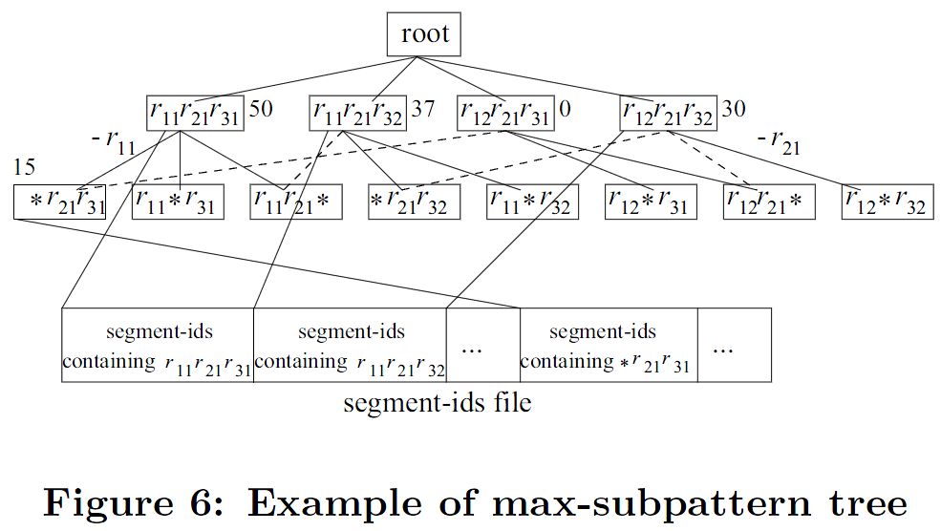
Phase 2
Build Max-subpattern tree
Breadth First

Slide 22
Phase 2
Use max-subpattern tree in [2] to discover longer frequent patterns
r₁₁ r₂₁ r₃₁ r₄₁* r₆₁ (min_sup=2)
  But, they are not the last results!
  In P = r₁₁r_{21 *} , r₂₁ is no longer a valid region
Pattern validation
r₁₁ r₂₁ r₃₁ r₄₁* r₆₁
r₁₁ r₂₁ r₃₁ * * r₆₁
r₁₁ r₂₁ r₃₁ r₄₁* r₆₁
r₁₁
r₂₁

Slide 23
Indexing using periodic patterns
Indexing schema
Query processing

Slide 24
Indexing schema
Let S be the set of moving objects
Period Index(PI) stores trajectories for objects that follow some periodic pattern, it contains two parts
  Pattern Index: organize the periodic patterns found for each object o∈S
  Location Index: stores actual locations for each object o∈S that has some pattern in PI.
Exception Index(EI) stores all the other points using 3D-Rtree (The third dimension is Timestamp)

Slide 25
Pattern Index:
  P = r₀r₁...r_{T-1} for an object o, for each r_{i}∈P, get MBR M_{i} for it. The Pattern Index is a 2D R-Tree on M_{i}
Location Index:
  Hash table indexed on object id
  Each entry h contains: period T of the object o and a pointer to the fist disk page that contains locations of o
  The locations in each page are organized as an array ordered by the timestamps and stored sequentially
o₁ | o₂ | ...
l₀l₁l_{2...} l₉
l₁₀l₁₁l_{12...} l₁₉
l₀l₁l_{2...} l₉

Slide 26
Exception Index
Exception Index(EI):
  Locations of objects which do not follow any periodic movement
  Locations for * positions of periodic segment in patterns
  Locations of periodic segments that do not apply with the periodic pattern
  Typical 3D R-tree

Slide 27
Indexing using periodic patterns
Indexing schema
Query processing

Slide 28
Query
Aim: Find objects that are contained in q_{R} during q_{T}, given a query region in space q_{R} and time interval q_{T}=[t_{s} , t_{e}]

Slide 29
Query processing
Step1: Run query on EI, get the set of objects A that satisfy the query. Say, A= {o₁,o₂}
Step2: Run query on Pattern index using only q_{R}. For each MBR that intersects q_{R}, keep object id and the offset of the MBR. Let B represent the set of objects found in this step. B= {o₁,o₃}
Step3: C=B-A, e.g., {o₃}, contains all the objects that must be checked using the Location Index.
Result = A + remaining of C after step 3

Slide 30
Experimental results
Generator for generating long object trajectories which exhibit periodicity
Parameters:
  n time history in timestamps
  T period
  l length of the maximal frequent patterns
  f probability with which a periodic segment comply with no hidden pattern
  e.g., n=100,000, T=20, l=15, f=0.2 will generate a sequence with length 100,000, the period of its hidden pattern is 20, the length of the maximal pattern is 15, 80% of the segment complies with the pattern

Slide 31
Effectiveness evaluation
n = 1000
T = 20
min_sup = 30

Slide 32
Mining Efficiency(1)
n=1M
T=100
min_sup = 0.7*n
∈ = 0.005
MinPts = 200

Slide 33
Mining Efficiency(2)
n = 1M
l = 0.5*T
min_sup = 0.7*n

Slide 34
Mining Efficiency(3)
T = 100
l = 50
min_sup = 0.7*n

Slide 35
Indexing effectiveness
Data sets: 200,000 objects, n=1000, T =10, l=9, f=0.2
Query workloads: Each set contains 100 range queries,
(query region q_{R}, time interval q_{T})
q_{R} covers 1% of the space and q_{T} is from 5 up to 20 time instants

Slide 36
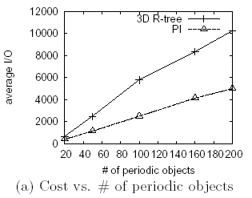
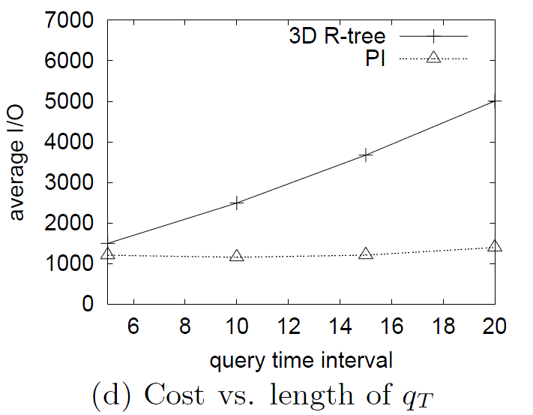

Slide 37
Conclusion
Present a framework for mining partial periodic patterns from historical spatio-temporal data
  Periodic pattern in spatiotemporal database
  Effective and efficient mining techniques
Use the periodic patterns discovered to build effective index for object movements

