Slide 1
Nearest Neighbors in High-Dimensional Data – The Emergence and Influence of Hubs
Milos Radovanovic, Alexandros Nanopoulos, Mirjana Ivanovic.
ICML 2009
Presented by Feng Chen

Slide 2
Outline
The Emergence of Hubs
  Skewness in Simulated Data
  Skewness in Real Data
The Influence of Hubs
  Influence on Classification
  Influence on Clustering
Conclusion

Slide 3
The Emergence of Hubs
What is Hub?
  It refers to a point that is close to many other points, Ex., the points in the center of a cluster.
K-occurrences (N_{k}(x)): a metric for “Hubness”
  The number of times x occurs among the k-NNs of all other points in D.
  Nk(x) = |RkNN(x)|
p4
Hub
N2(p0)=4, N2(p4)=3, N2(p5)=0
p1
p0
|R2NN(p0)|=|{p1, p2, p3, p4}|=4
|R2NN(p4)|=|{p0, p1, p3}|=3
|R2NN(p5)|=|{}|=0
p5
p2
p3

Slide 4
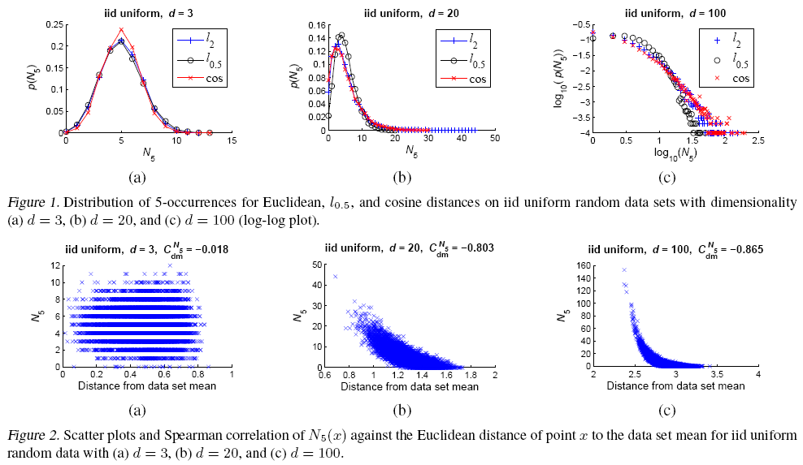
The Emergence of Hubs
Main Result: As dimensionality increases, the distribution of k-occurences becomes considerably skewed and hub points emerge (points with very high k-occurrences)

Slide 5
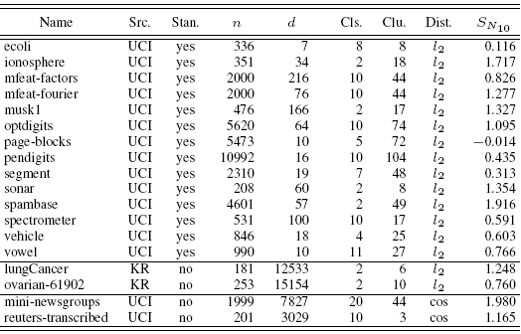


The Emergence of Hubs
Skewness in Real Data

Slide 6
The Causes of Skewness
Based on existing theoretical results, high dimensional points are approximately lying on a hyper-sphere centered at the data set mean.
More theoretical results show that the distribution of distances to the data set mean has a non-negligible variance for any finite d. That implies the existence of non-negligible number of points closer to all other points, a tendency which is amplified by high dimensionality.

Slide 7
The Causes of Skewness
Based on existing theoretical results, high dimensional points are approximately lying on a hyper-sphere centered at the data set mean.
More theoretical results show that the distribution of distances to the data set mean has a non-negligible variance for any finite d. That implies the existence of non-negligible number of points closer to all other points, a tendency which is amplified by high dimensionality.

Slide 8
Outline
The Emergence of Hubs
  Skewness in Simulated Data
  Skewness in Real Data
The Influence of Hubs
  Influence on Classification
  Influence on Clustering
Conclusion

Slide 9
Influence of Hubs on Classification
“Good” Hubs vs. “Bad” Hubs
  A Hub is “good” if, among the points for which x is among the first k-NNs, most of these points have the same class label as the hub point.
  Otherwise, it is called a bad hub.

Slide 10
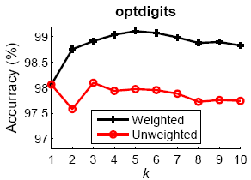
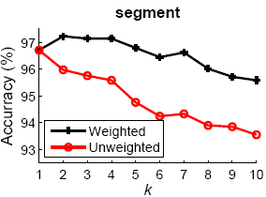
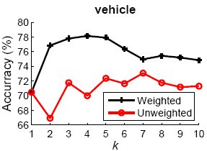
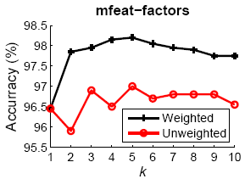
Influence of Hubs on Classification
Consider the impacts of hubs on KNN classifier
  Revision: Increase the weight of good hubs and reduce the weight of bad hubs

Slide 11

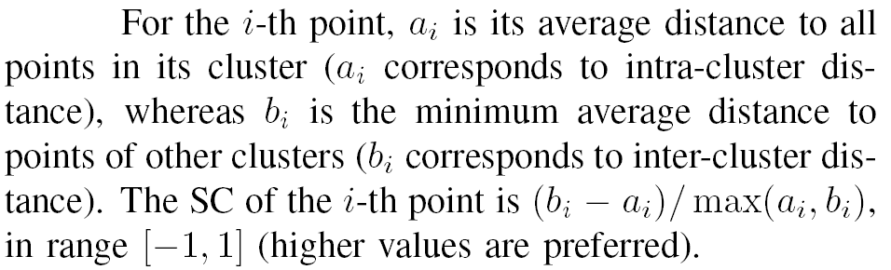
Influence of Hubs on Clustering
Defining SC, a metric about the quality of clusters

Slide 12
Influence of Hubs on Clustering
Outliers affect intra-cluster distance
Hubs affect inter-cluster distance
Hub Point
Outlier
Decreases
increases

Slide 13
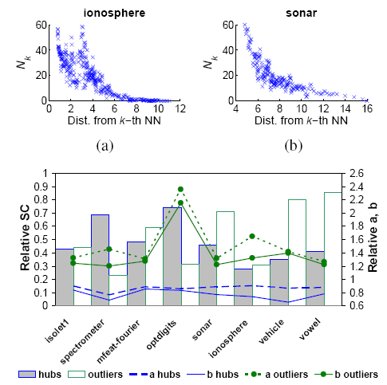
Influence of Hubs on Clustering
Relative SC: the ratio of the SC of Hubs (outliers) over the SC of normal points.

Slide 14
Conclusion
This is the first paper to study the patterns of hubs in high dimensional data
Although it is just a preliminary examination, but it demonstrates that the phenomenon of hubs may be significant to many fields of machine learning, data mining, and information retrieval.

Slide 15
What is k-occurrences (Nk(x))?
Nk(x): The number of times x occurs among the k NNs of all other points in D.
Nk(x) = |RkNN(x)|
p4
Hub
p1
p0
p5
p2
p3
N2(p0)=4
N2(p4)=3
N2(p5)=0
|R2NN(p0)|=|{p1, p2, p3, p4}|=4
|R2NN(p4)|=|{p0, p1, p3}|=1
|R2NN(p5)|=|{}|=0

Slide 16
Introduction
The emergence of
  Distance concentration
  What else?
This Paper Focuses on the Following Issues
  What special characteristics about nearest neighbors in a high dimensional space?
  What are the impacts of these special characteristics on machine learning?

Slide 17
Outline
Motivation
The Skewness of k-occurances
Influence on Classification
Influence on Clustering
Conclusion

Slide 18
What is k-occurrences (Nk(x))?
Nk(x): The number of times x occurs among the k NNs of all other points in D.
Nk(x) = |RkNN(x)|
p4
Hub
p1
p0
p5
p2
p3
N2(p0)=4
N2(p4)=3
N2(p5)=0
|R2NN(p0)|=|{p1, p2, p3, p4}|=4
|R2NN(p4)|=|{p0, p1, p3}|=1
|R2NN(p5)|=|{}|=0

Slide 19
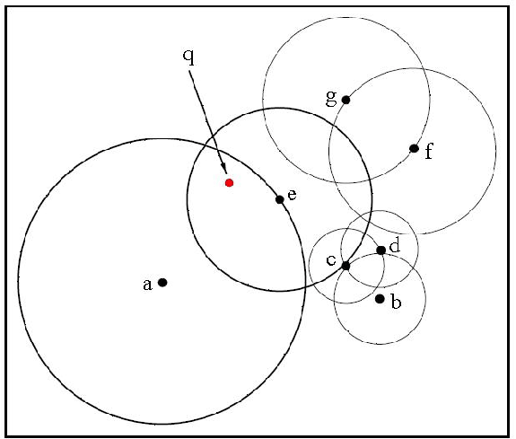
Dim ↑ ⇒ Nk(x) ↑
In ℜ¹, the maximum N₁(x) = 2
In ℜ², the maximum N₁(x) = 6
…

Slide 20
The Skewness of k-occurances

