Slide 1
Structure Preserving Embedding
Blake Shaw, Tony Jebara
ICML 2009 (Best Student Paper nominee)
Presented by Feng Chen

Slide 2
Outline
Motivation
Solution
Experiments
Conclusion

Slide 3
Motivation
Graphs exist everywhere: web link networks, social networks, molecules networks, k-nearest neighbor graph, and more.
Graph Embedding
  Embed a graph in a low dimensional space.
  What used for? Visualization, Compression, and More.
  Existing methods: Planar Embedding (no crossing arcs); Spectral Embedding (preserve local distances); Laplacian Eigenmaps (preserve local distances).

Slide 4
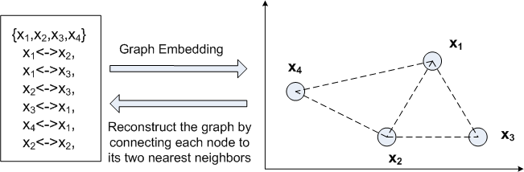
Problem Statement
Given only the connectivity of a graph, can we efficiently recover low-dimensional point coordinates for each node such that these points can be easily used to reconstruct the original structure of the network?

Slide 5
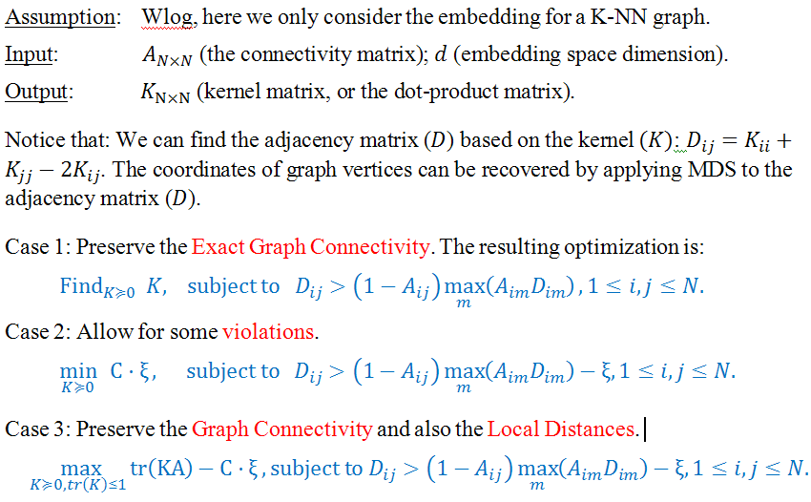
Optimization Formulation

Slide 6
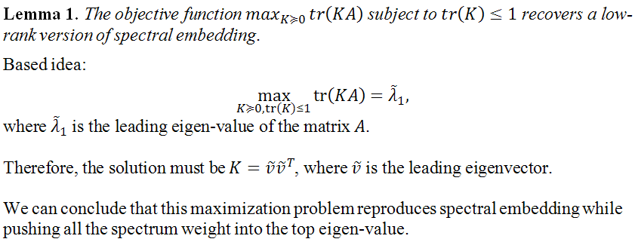
Justifications
Why can preserve the local distances?

Slide 7

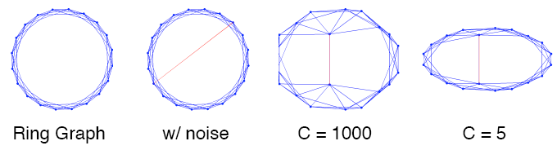
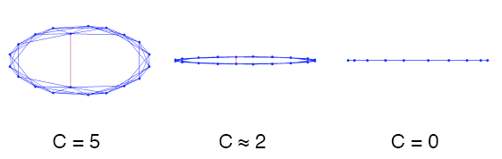
Justifications
Interpret the slack variable ξ

Slide 8
Implementation
It is about finding a positive semi-definite matrix that can maximize an objective function, subject to some constraints about the matrix.
This category of optimization problem is called “Semi-definite Programming”
Available MATLAB tools include CSDP and SDP-LR.

Slide 9
Related Work
Spectral Embedding
  Find the d leading eigen-vectors of the adjacency matrix A as the coordinates.
Laplacian Eigenmaps
  Employ a spectral decomposition of the graph Laplacian L=D-A, where D=diag(A1), and use the d eigenvectors of L with the smallest nonzero eigenvalues.
  Look weird? But this approach has the fundamental from manifold theories in the field of topology!!

Slide 10
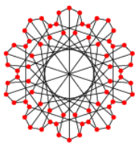
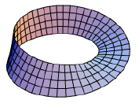
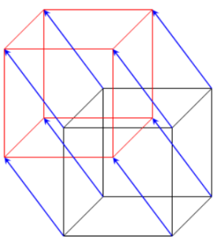
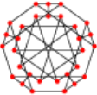
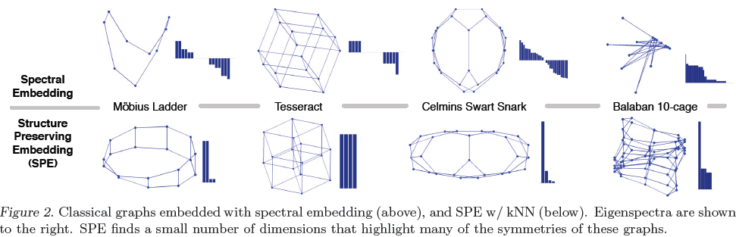
Experiments

Slide 11
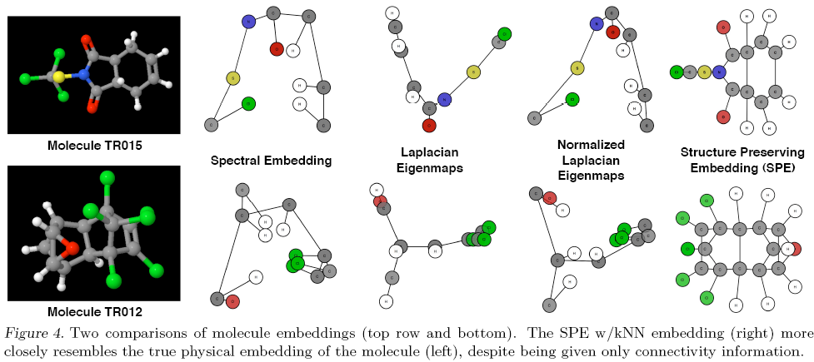
Experiment

Slide 12
Conclusion
Innovative idea!
Technically simple!

Slide 13
Thank You!
Any Question?

