Slide 1
Collaborative Strategic Board Games as a Site for Distributed Computational Thinking
Matthew Berland, UTSA
Victor R. Lee, USU

Slide 2
Motivation
“Contemporary strategic board games represent an informal, interactional context in which complex CT takes place”
CT can be easily observed if it is distributed among several participants trying to achieve a common goal (collaborative work/play)
Board games might be profitable for anyone who wishes to understand CT and learning
Notes:
Author’s quote
Collaboration allows behavior involving CT to be expressed and observed, as opposed to individual play
Players have to learn and follow the rules, instead of having the computer impose the rules

Slide 3
Contribution
“…description and evidence that complex computational thinking can happen spontaneously using non-traditional, non-computational media like strategic board games”
Before reading the paper, and considering the other readings, did you think CT can exist outside of a computer? Examples?
Notes:
Examples beyond Scratch and Snap and AgentSheets

Slide 4
Evidence of CT
Quantitative analysis of the student’s CT makeup
Quantitative analysis of code counts for instances of ‘global’ and ‘local’ CT
Descriptive examples of CT
Revisit these to discuss if they actually constitute evidence of CT…

Slide 5
Methodology
Create a coding framework for distributed CT
Observe/record 3 groups of players (3-4 players) play a strategy board game
Decode recorded discourse using the coding scheme
Extract qualitative examples of CT during gameplay

Slide 6
Pandemic
Goal: eliminate four viruses by discovering their cure
How: coordinate moves and utilize resources
Different roles having different powers
‘Epidemic’ cards – spread diseases/outbreaks
‘Player’ cards – get resources and additional powers (rule exemptions)

Slide 7
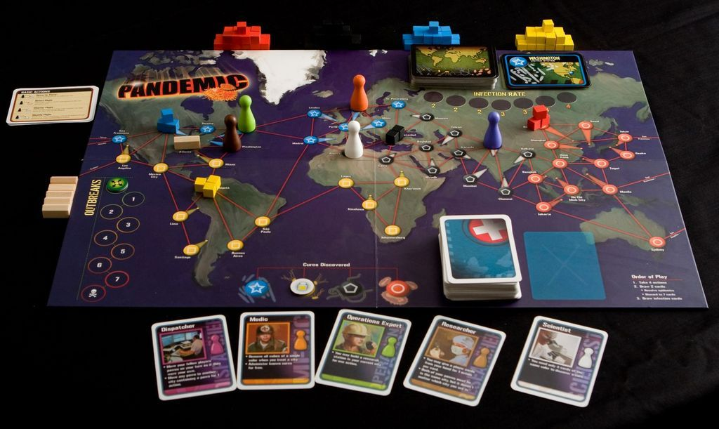
Pandemic board

Slide 8
Coding for CT
Empirically-based approach where data have motivated the creation of the categories
Interpretive analysis of recording excerpts was used to develop CT codes
Data-driven vs research-driven approach to CT; What are the pros and cons?
What if they have decided upon the CT concepts beforehand? Maybe longer list?
Notes:
Codes were refined using multiple passes with data subsets
E.g. research-driven approach would include deciding the CT concepts and looking for them in various board games
Other CT constructs that might have been exhibited during gameplay?

Slide 9
Coding categories
Category | Description | Rationale
Conditional logic | Conditional logic is the use of an “if-then-else” construct. | Wing (2006); National Research Council (2009)
Algorithm building | An algorithm is a data “recipe” or set of instructions. | Papert’s (1980) “procedural thinking”
Debugging | Debugging is the act of determining problems in order to fix rules that are malfunctioning. | Papert (1980); Wing (2006), NRC (2009); Abelson, Sussman, and Sussman (1996)
Simulation | Simulation is modeling or testing of algorithms or logic. | Wilensky and Reisman (2006)
Distributed computation | Distributed computation applies to rule-based actions. | National Research Council (2009)
Notes:
CL: It requires a student to think globally about the local consequences of the truth-value of a given statement.
AB: Fundamentally, computer programs consist of algorithms and data. Algorithms often contain sets of related conditional logic. In its simple form, it is the planning of actions for events that are taking place; in its complex form, it is planning for unknown events.
Debugging is the act of determining problems in order to fix rules that are malfunctioning.
Simulation is used in debugging in order to determine problems, and it uses algorithm building to test a model. We are defining simulation as the enactment of algorithms or plans.
DC: For instance, if 3 people act together through a rule-based plan, this is distributed computation as considerations, contingencies, and strategy formation involve multiple parties with different knowledge resources.

Slide 10
Distinguishing categories I
Algorithm building vs Simulation
“...I could move ... here, that’s
1. And then take out 1 there,
then go to Tokyo, so 3. Wait,
1, 2 ... I could move here; and
then just not do anything there;
and then move to Tokyo; and
then fly from Tokyo to where
A is; and then give him this
card so the beginning of his
next turn ... he can play.”
“...Essen, I have [the Essen
card], so I could fly, I could
take care of that during my
turn. [I could address] that
London outbreak after I take
care of that. ‘Cause that would
take one, then I can fly to Essen, then move there. And then I can take the rest of that.”
“...Essen, I have [the Essen
card], so I could fly, I could
take care of that during my
turn. [I could address] that
London outbreak after I take
care of that. ‘Cause that would
take one, then I can fly to Essen, then move there. And then I can take the rest of that.”
Notes:
In what respect are these two different?
Authors mention: “Simulation is used in debugging in order to determine problems, and it uses algorithm building to test a model”

Slide 11
Distinguishing categories II
Algorithm building vs Conditional logic
“...I could move ... here, that’s
1. And then take out 1 there,
then go to Tokyo, so 3. Wait,
1, 2 ... I could move here; and
then just not do anything there;
and then move to Tokyo; and
then fly from Tokyo to where
A is; and then give him this
card so the beginning of his
next turn ... he can play.”
“...if I moved here, then that’s one. And if I take out one there, then go to Tokyo, so 3. Wait,
1, 2… If I could move here, and then just not do anything there;
and then move to Tokyo; and then fly from Tokyo to where
A is; and then give him this
card so the beginning of his
next turn ... he can play.”
“...if Milan gets one more,
that means Istanbul gets one,
and if Istanbul had 3, that
means Istanbul would start
infecting ones next to it, too,
and it would be like a chain
reaction.”
Notes:
What happens if I rephrase the example sentence about algorithm building? Isn’t it more like a conditional statement now?
Authors mentions: “Algorithms often contain sets of related conditional logic.”

Slide 12
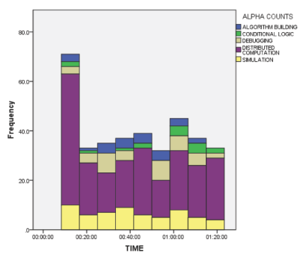
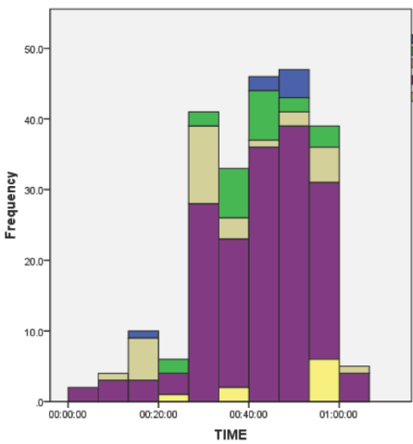
Results
“Distributed computation was consistently the most frequently occurring computational discourse for all groups.”
Notes:
How can they differentiate between distributed computation and other categories, considering most actions were negotiated?
e.g. since simulation is usually coordinated from all participants, how can you distinguish if it involves DC or not?

Slide 13
Distinguishing categories III
Distributed computation vs rest
Patrick: “Okay, for my turn first off I’m going to cure Lima... And then I’m going to move LJ. ... I’ll move you here because that way you’re only two away.”
L.J.: “You can move me to one of your cards, and then I’ll teleport there.”
Michael: “But you can only trade the card of the one you’re standing in.”
L.J.: “Oh, that’s right.”
Michael: “Just because you have one, you can’t turn all of them in
Patrick: “Okay, for my turn first off I’m going to cure Lima... And then I’m going to move LJ. ... I’ll move you here because that way you’re only two away.”
L.J.: “If you move me to one of your cards, and then I’ll teleport there.”
Michael: “But you can only trade the card of the one you’re standing in.”
L.J.: “Oh, that’s right.”
Michael: “Just because you have one, you can’t turn all of them in…”
<- Simulation/algorithm
<- Conditional logic
<- Debugging
Notes:
What happens if I rephrase the example sentence about algorithm building? Isn’t it more like a conditional statement now?

Slide 14
Local and Global Logic
Local logic relates directly to immediate actions being taken
Global (abstracted) logic involves “higher order” relationships
How can algorithm building be local? Isn’t the abstraction that makes algorithms reusable?
Global logic more similar to multi-agent programming or parallel processing?
Notes:
…and the structure of the logic or processes is not identified as applicable to a future course of action
…that require players to make a set of predictions for potential actions or decision in the game, given past evidence, and to act on these predictions
A multi-agent system (M.A.S.) is a computerized system composed of multiple interacting intelligent agents within an environment. Multi-agent systems can be used to solve problems that are difficult or impossible for an individual agent or a monolithic system to solve. Intelligence may include some methodic, functional, procedural or algorithmic search, find and processing approach.
Parallel computing is the simultaneous use of more than one CPU or processor core to execute a program or multiple computational threads. Ideally, parallel processing makes programs run faster because there are more engines (CPUs or Cores) running it.

Slide 15
Discussion I
CT quality and quantity depends on:
Internalizing a set of rules by the players (conditional logic & debugging)
Devise strategies for optimizing behavior (algorithm building & debugging)
Do you see other CT constructs that could potentially manifest through board games?
Notes:
Conditional logic and debugging was mostly used when reading and internalizing rules of the game
Algorithm building and simulation was used to find the best solution through behavior optimization
Parallel processing, …more…

Slide 16
Discussion II
Board games advantages:
Coordination for rule understanding and group strategy formation (distributed comp.)
Debugging is associated with the process of internalizing and learning the rules.
Do you consider distribution of labor or cognitive load a CT component?
Notes:
Because coordination is necessary to win the game, it makes the development of rule understanding and group strategy formation an important part of the thinking and reasoning that takes place; distributed computation is explicitly verbalized.
Find a bug through negotiations with others, flag the error by someone else, revise the program to conform to rules
The authors mention that the NRC “describes distributed computational thinking as one social aspect that distinguishes computational thinking from computer science.”
Is that so? (did not find such reference in the NRC report) Why is this unique in CT?

Slide 17
Discussion III
Strategic board games should be intentionally designed to develop CT
Increase participation to computational activities through their diverse appeal
Researchers either seek new ways to teach CT or instill CT concepts in other domains. What is the best approach?
What are the trade-offs of teaching CT with board games instead of using a computer?
Notes:
e.g. CT course last year where we were trying to solve problems using CT (math, social studies, science)
We have seen such examples on Tuesday. What more off-line CT games have to offer, if anything?

Slide 18
Evidence of CT (revisited)
Quantitative analysis of the student’s CT makeup
Quantitative analysis of code counts for instances of ‘global’ and ‘local’ CT
Descriptive examples of CT
Were the authors convincing in their consideration of these evidence as CT?

