Slide 1
Computational Thinking: Assessment in Alice
Class Overview

Slide 2
The Fairy Performance Assessment
How do we assess Computational Thinking?
2 year study using Alice with Middle Schoolers
Premise: Debug faulty programs based on design patterns learned in class

Slide 3
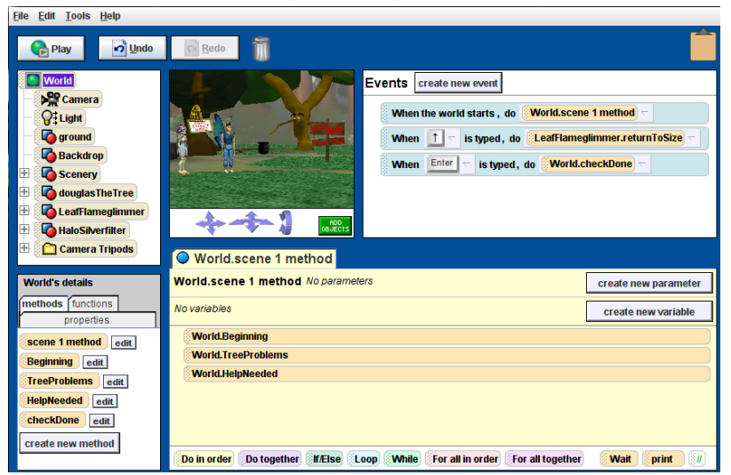
Alice

Slide 4
Purpose
Assess Knowledge
Why is there variation among students?
-> Strengthen efforts to engage K-12 in CT

Slide 5
Demographic Data
325 students - 311 assessed
60% in-school
36% female
52% white, 37% latin[oa]

Slide 6
Other Factors
Age,
Gender,
Race/Ethnicity,
Language,
Parents computer usage,
Parental education levels,
Grades,
Favorite subject
Confidence with Computers,
Attitude towards Computers,
Frequency and Type of Computer Use,
Simple Alice Content
Attendance Data,
Hours spent paired programming

Slide 7
Semester Protocol
Challenges
Free Design
Fairy Assessment
* Self-paced
* Second half
* First Half
* 11 + 6 bonus
* Debug programs
* Complete control

Slide 8
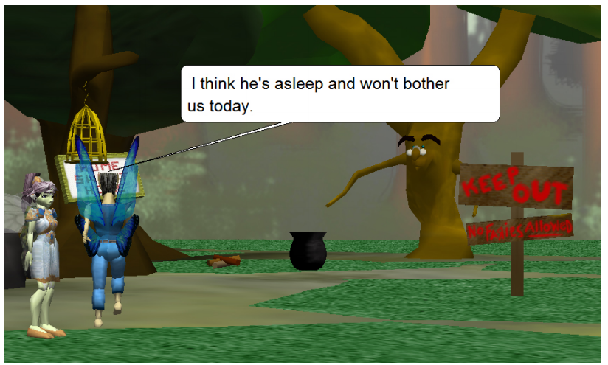
Fairy Assessment

Slide 9
Computational Thinking Definition
“Thinking Algorithmically”
“Making effective use of Abstraction and Modeling”
“Considering and Understanding Scale”

Slide 10
Assessment Progression
Use
Modify
Create
Manipulating Parameters
Removing/Adding Instructions
The two fairies escape
First Fairy Walks into Forest
Fairy regrows when key is pressed
Coding their own method, plus manipulating and using
“complex conditionals”,
“methods with multiple parameters”, and
event handling

Slide 11
Results
Paired Programming -> Better results
More computer usage -> Better results
Higher grades -> better results
Confidence with Computers -> better results
…

Slide 12
More important results
Assessment was motivating (90% return rate)
Claim that it was positively correlated with another assessment of content knowledge
But no details provided!

Slide 13
Criticisms
Very narrow definition of CT
Only focused on programming
How do we know it measured anything?

Slide 14
Mediated Transfer: Alice 3 to Java
2 year study of CS1 to Java
Eclipse Plugin to convert Alice code to Java
Exam scores went up ~20%
Bridging vs. Hugging

