Slide 1
Computational Thinking
Computational Thinking for
Computer Science (CT4CS)
Students

Slide 2
Background
An undergraduate course at Virginia Tech
Offered twice as an alternative to a required problem-solving class
Experience report at SIGCSE, 2011 in paper co-authored with Deborah Tatar

Slide 3
Summary
Motivation
  Aspirational: help computer science students develop intuitions, mental models, and patterns of thinking about computation (“think like a computer scientist”)
  Pragmatic: engage students in learning experiences related to recurring, fundamental concepts about computation
Means
  A non-programming entry level CS course
  An array of editing/visualization/simulation tools and physical simulations
Results
  Survey of first offering (N=17) and experiential evidence
  Sufficiently encouraging to pursue a (current) second offering
  Able to deal with many core computing concepts
  No good approach (yet) to algorithmic concepts
URL: www.cs.vt.edu/~kafura/ComputationalThinking

Slide 4
Overview
Motivation
Class Outline
An example
Evaluation
Conclusions

Slide 5
Motivation
Computational Thinking
Computer Science
conveys essential thought processes
about computation
usually to non-CS students
informs discipline-specific ways of
looking at the world
elevates computational sophistication
improves collaboration with computer
scientists
it is “not just programming”
accessible regardless of background
approaches
  contextualized programming
  problem-solving
  great ideas/principles
  survey of discipline
Computational Thinking for Computer Science
conveys essential thought processes about computation
to computer science students
without requiring or using programming
in concrete, tangible forms

Slide 6
Class outline
Wks | Topic |  | Concepts/Tools
.5 | Modeling | Definition of CS | Guided discussion
2 |  | State,behavior | Finite state machines, acceptors, grammars; Tools: JFLAP, ANTLR
2 |  | Abstraction | Abstraction, generalization, composition using Venn/tree/UML diagrams, XML; Tools: XMLSpear, physical simulation
1.5 |  | Relationships | Representing, inferring, visualizing relationships, ontologies; Tool: Protege
1.5 | Engineering | Concurrency | Race conditions, synchronization, Petri nets; Tool: Snoopy, physical simulation
1 |  | Abstraction | Layered systems/protocols; Tool: Snoopy
2 |  | Binding, scope | Lambda calculus; Tool: Lambda Teacher
1 |  | Testing | Developing test cases, coverage; Tools: applet, WebCAT
1 |  | Debugging | Puzzle solving with backtracking; Tool: Sodoku system
1 |  | Data structures | Mapping complex structures to memory; Tool: physical simulation

Slide 7
Example (1)
Concepts
  Finite states --- transitions --- inputs/events
Assignment
  Develop a finite state acceptor to recognize if a DNA sequence is a possible gene
Tool
  JFLAP

Slide 8
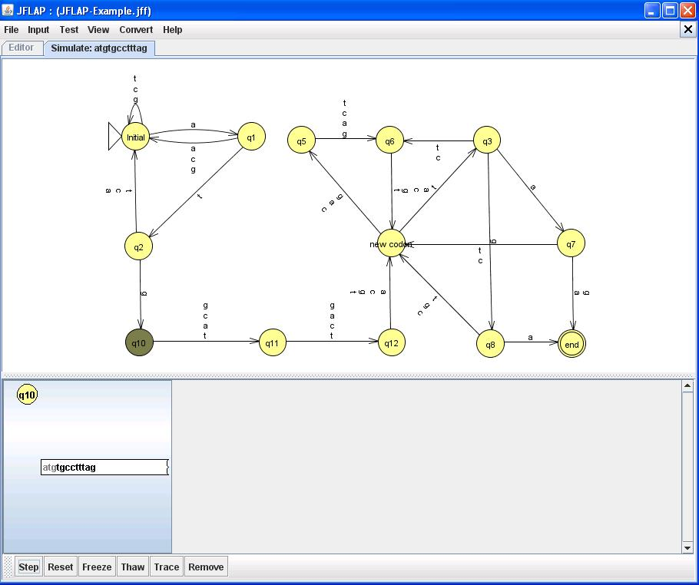
Gene Acceptor in JFLAP

Slide 9
Example (2)
Concepts
  Languages – structure – grammar
Assignment
  Develop a BNF grammar for US Currency
Tool
  ANTLR

Slide 10
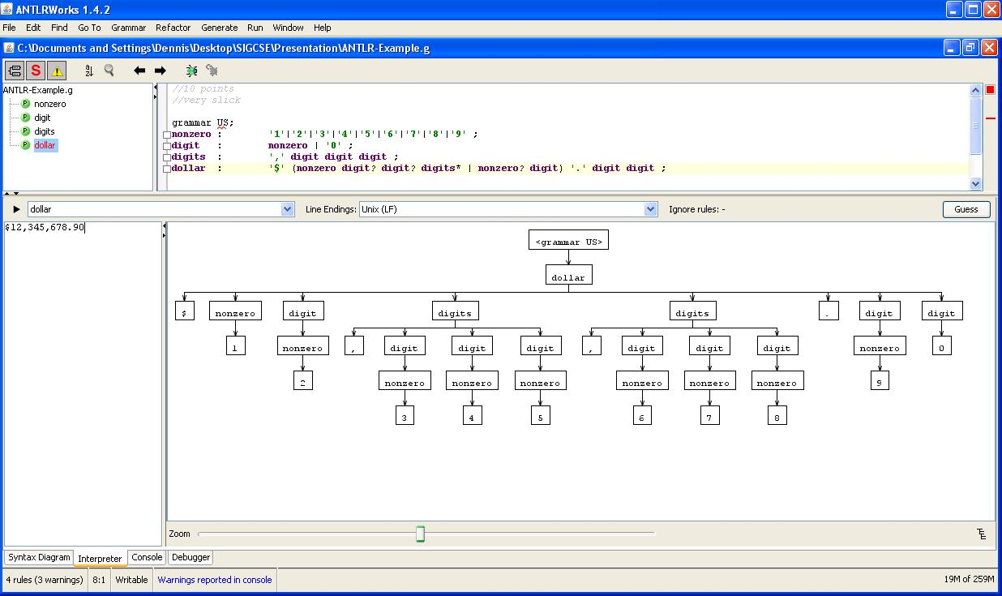
Grammar in ANTLR

Slide 11
Example (3)
Concepts
  Concurrency – synchronization– asynchrony
  Petri nets
Assignment
  Develop solutions for simple mutual exclusion and more complex traffic intersection
Tools
  Physical simulation
  Snoopy (Petri net simulator)

Slide 12
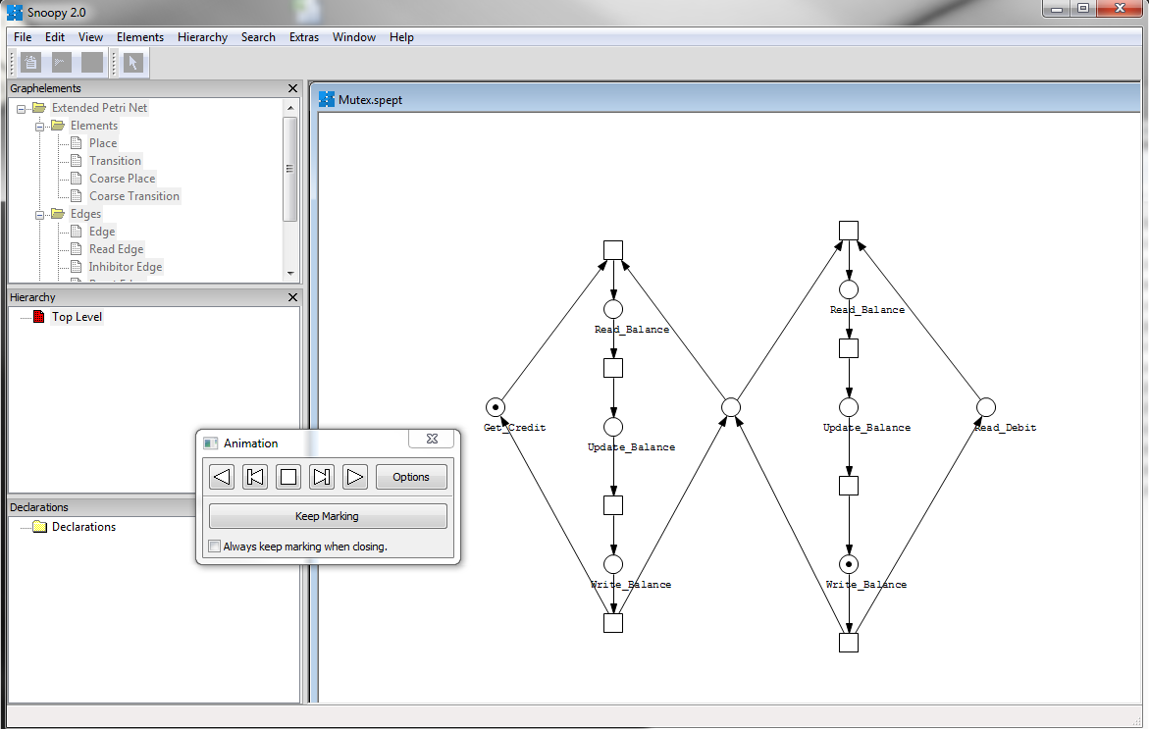
Mutex in Snoopy

Slide 13
Discussion
Finite state acceptor
→ junior level computational biology course
Grammars/languages
→ senior level compiler course
Concurrency
→ junior level systems course
Question: What is the relationship between acceptors and grammars?
→ senior level formal languages course

Slide 14
Evaluation
An end of term reflections/survey (N=17)
Key observations - The students reported that the course/topics…
  deepened their knowledge and perspective on computer science.
  offered a number of new (to them) concepts and/or improved their understanding of concepts they had already seen.
  helped them develop a better vocabulary for explaining computer science issues.
Place in curriculum
  The students expressed divided opinions on the ordering of this course with respect to an introductory programming course in computer science.
  Room for adoption flexibility

Slide 15
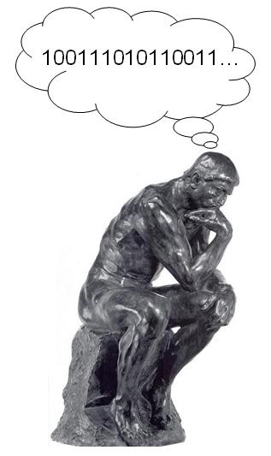
Conclusions
Concretely engage students in a wide variety of sophisticated computing concepts without the entanglements of programming
    We need to show students that CS is more than programming
    Tools are available
CS is about ideas
  Students need the opportunity to struggle with deep(er) aspects of representation and process
  Appealing to students for deeper reasons
is there a set of “right” topics
possibilities for continuation (at VT) and/or adoption (elsewhere)
<your question here>

Slide 16
<end> Thanks! </end>

