Slide 1
Developing a Learning Progression for Scientific Modeling: Making Scientific Modeling Accessible and Meaningful for Learners
Christina V. Schwarz, Brian J. Reiser, Elizabeth A. Davis, Lisa Kenyon,
Andres Ache´r, David Fortus, Yael Shwartz, Barbara Hug, Joe Krajcik
Presented by :
Bushra Tawfiq Chowdhury
Engineering Education, Virginia Tech

Slide 2
Me : Bushra
Undergrad: Computer Science,
Dhaka University
Graduate school: Security Informatics, Johns Hopkins
Teaching: BRAC University
Consulting: UNDP, Government of Bangladesh
Now: PhD student, Engineering Education, Virginia Tech
Future: Work with a group of people with same beliefs: technology should make things easier not harder

Slide 3
What is the paper about ?
How is it relevant to Computational Thinking

Slide 4
This paper is about
Scientific modeling
Learning progression

Slide 5
Annotation paragraph
The paper is good starting point for understanding modeling and its implications. The findings of the paper defines 4 levels of use of models as generative tools for explaining and predicting and another 4 levels which shows the differences between changes in models as understandings improve.
……will add a line or two after presentation

Slide 6
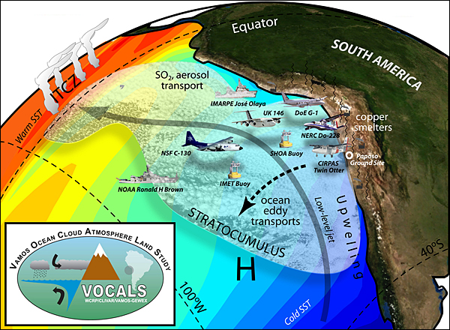
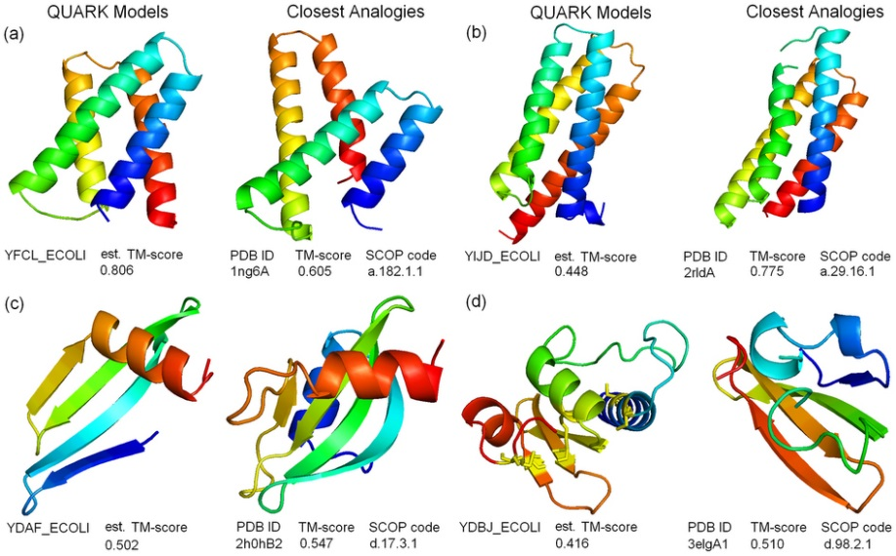
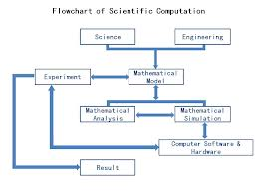
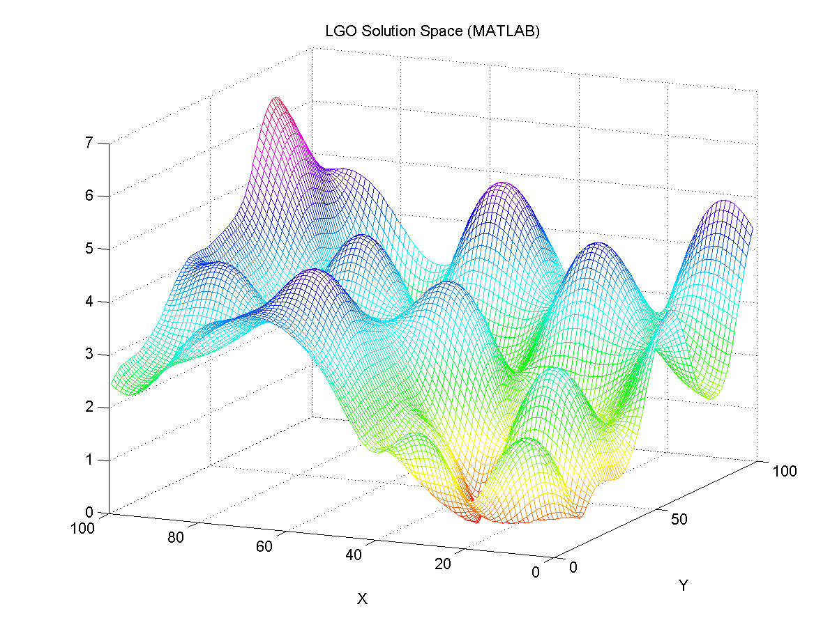
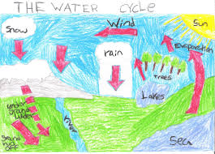
Scientific Modeling is…..

Slide 7
What is scientific modeling ?
Abstracts
Simplifies a system
Focuses on key features
Explain
Predict
scientific phenomena
Notes:
Lesh and Doerr(2003, p. 10), a model consists of ‘‘elements, relations, operations, and rules governing interactions that are expressed using external notation systems.’’ The elements are the conceptual elements used to represent important aspects of phenomena.

Slide 8
Learning progression
WHEN
WHY
HOW

Slide 9
This paper investigates the following questions
What aspects of modeling practice can be made meaningful and productive for science learners?
What successes and challenges emerge when students engage in modeling practices?

Slide 10
The framework used
Integration of
metamodeling knowledge and elements of the practice
sensemaking and communicative aspects of the practice

Slide 11
What is metamodeling knowledge ?
how models are used
why they are used
what their strengths and
limitations

Slide 12
For this study “the practice of modeling” means
Students construct models consistent with prior evidence and theories to illustrate, explain, or predict phenomena.
Students use models to illustrate, explain, and predict phenomena.
Students compare and evaluate the ability of different models to accurately represent and account for patterns in phenomena, and to predict new phenomena.
Students revise models to increase their explanatory and predictive power, taking into account additional evidence or aspects of a phenomenon.

Slide 13
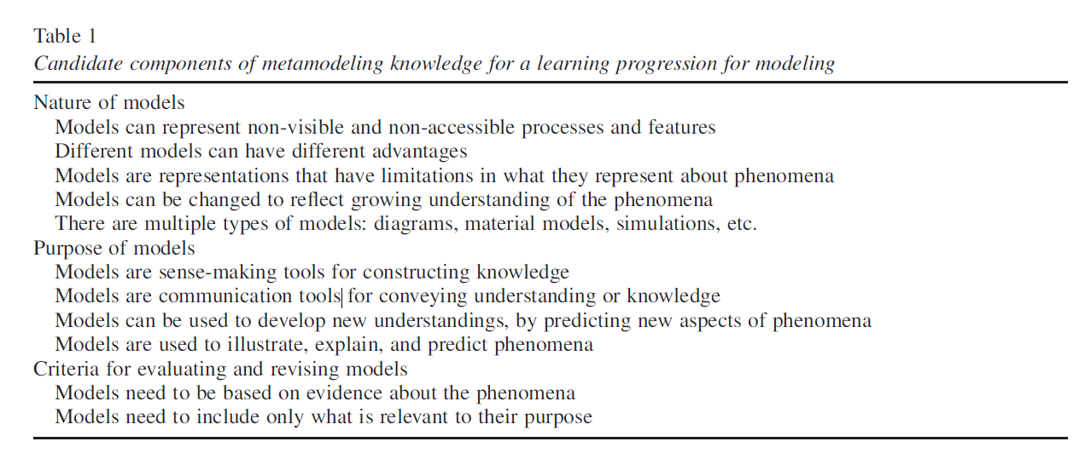

Slide 14
Sensemaking and communicative aspects of the practice
Sensemaking
for themselves
to try to understand a phenomenon
articulating their understanding as an expressed model to help
clarify their thinking and
develop group consensus
Communicative
the learners are at the point where they are readyto share their ideas with others,
articulating their model to see if others agree
try to persuade others or help
them understand the phenomena.

Slide 16
How ?
5th and 6th grades students
Modeling evaporation and condensation phenomena, Can I believe my eyes? How can I smell things from a distance?
Focus group interviews by the researchers

Slide 17
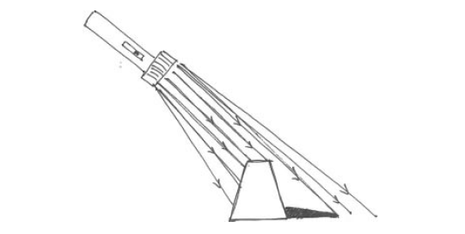
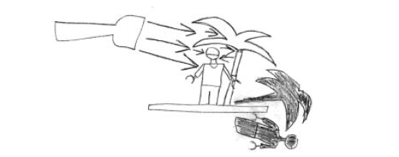
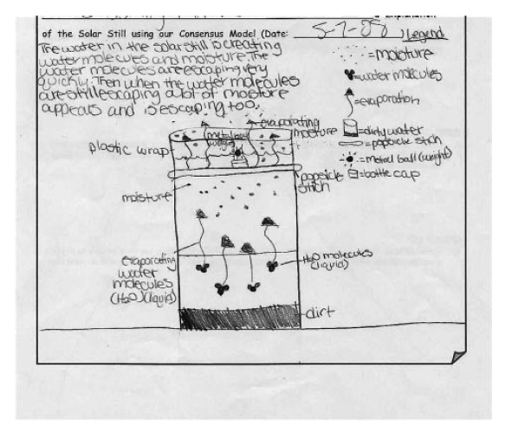
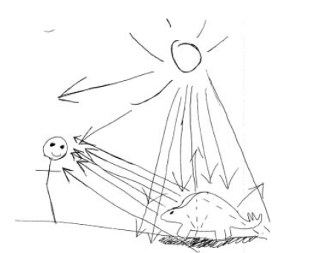

Slide 18
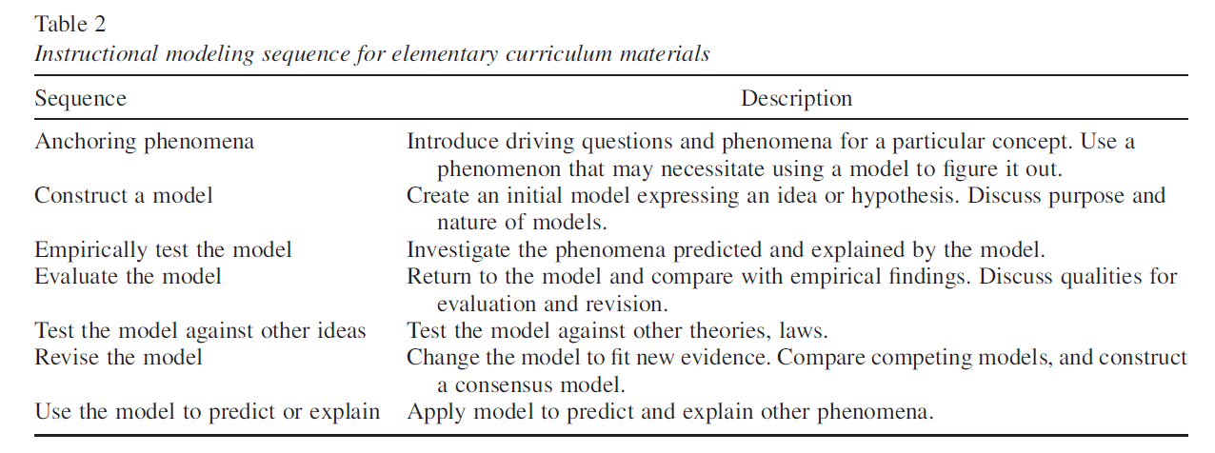

Slide 19
What are the differences ?

Slide 20
Results
Models as Generative Tools for Explaining and Predicting
Models Change as Understandings Improve

Slide 21
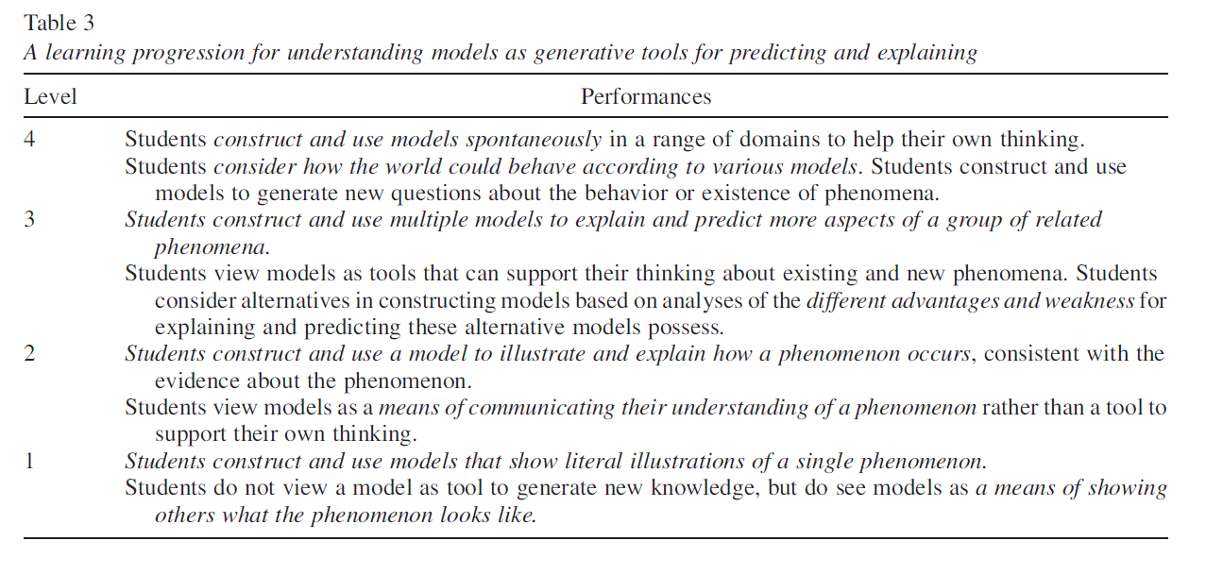

Slide 22
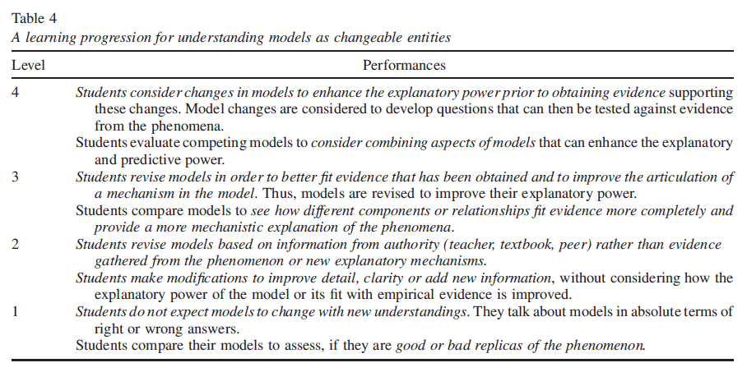

Slide 23
Where do you see Computational Thinking ? Or Elements of Computational thinking ?

Slide 24
The definition of scientific modeling
The learning progression
The way it has been assessed
Can computational thinking help students to model better ?

Slide 25
Thank you

