Slide 1
Computational Thinking
Class Overview
web site: www.cs.vt.edu/~kafura/CS6604

Slide 2
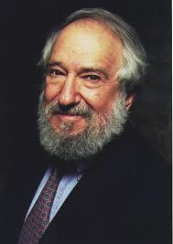
Origins
Term first used by Seymour Papert (1996) [Snow 2012]
“In both cases the computer used as a tool effectively leads to a solution, but in neither does the computational representation make the mathematics more perspicuous. ... The goal is to use computational thinking to forge ideas that are at least as ‘explicative’ as the Euclid-like constructions (and hopefully more so) but more accessible and more powerful.”

Slide 3
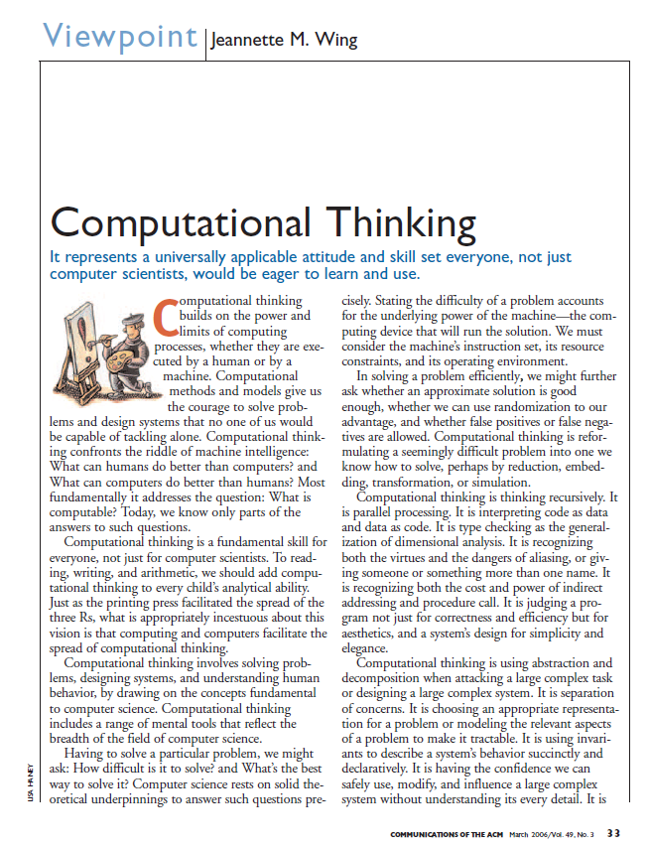
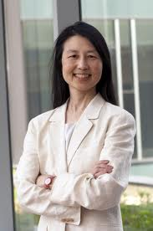
Origins
Recent popularization by Jeannette Wing [Wing 2006]
“Computational thinking involves solving problems, designing systems, and understanding human behavior, by drawing on the concepts fundamental to computer science. Computational thinking includes a range of mental tools that reflect the breadth of the field of computer science.”

Slide 4
Purposes of Course
Understand what “computational thinking” means
at a university level
specifically in the VT context
Develop ideas
on courses and curriculum elements that provide a means of learning (some aspect of) computational thinking.
about how to measure/assess the extent to which a student has gained an ability to engage in computational thinking
You will not learn anything “new” about computing but rather reflect on what you know and how you use that knowledge creatively

Slide 5
Organization
Topic areas:
Model (What is computational thinking?)
Pedagogy (How can it be taught?)
Assessment (How can it be measured?)
Requirements
Active participation in discussions
Presentation
Term paper
one section for each topic area
Intermediate due dates (TBA) for first two sections
Final version due on December 17, 2013

Slide 6
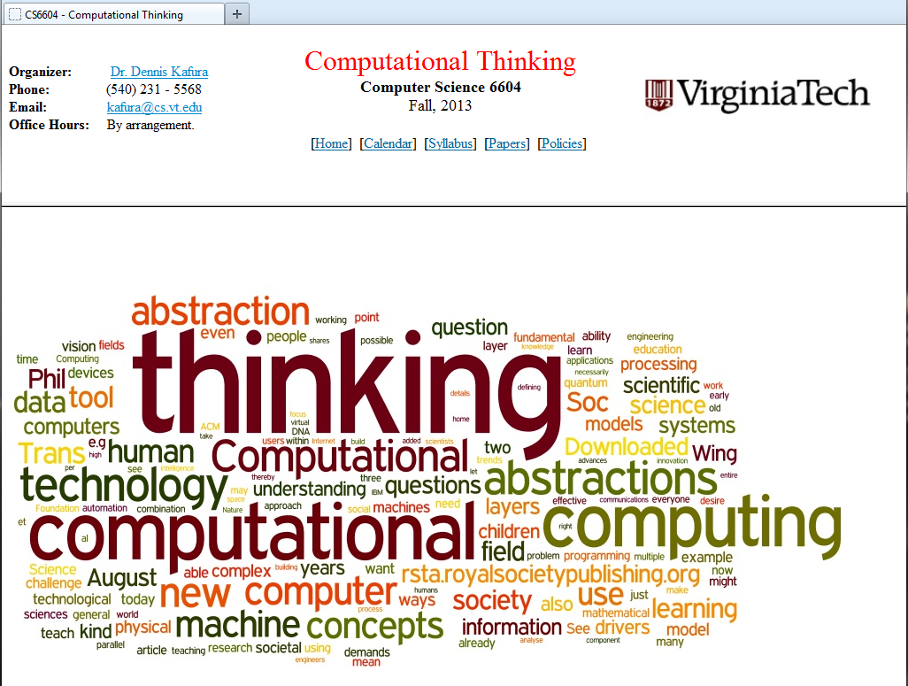
Materials
www.cs.vt.edu/~kafura/CS6604

Slide 7
Discussion
Who are you?
Why are you interested in computational thinking?
What do you think computational thinking is?
What experiences have you had related to computational thinking?

Slide 8
Abstraction
“Thinking like a computer scientist means more than being able to program a computer. It requires thinking at multiple levels of abstraction.” [Wing 2006]
“Mental” vs. “metal” [Wing 2008]
“And so the nuts and bolts in computational thinking are defining abstractions, working with multiple layers of abstraction and understanding the relationships among the different layers.”
“We operate by mechanizing our abstractions, abstraction layers, and their relationships.”

Slide 9
Abstraction
“The abstraction process—deciding what details we need to highlight and what details we can ignore–underlies computational thinking.” [Wing 2008]
Computational thinking abstractions:
Extremely general: symbolic not just numeric
Have to worry about edge cases and failures
Defining the ‘right’ abstraction is critical
Helps manage complexity
By reducing aspects represented
By layering to
Separate concerns
Allow reasoning at different levels of abstraction

Slide 10
Reflections
Is abstraction the defining mode of computational thinking?
If so, what do we make of abstractions in other areas?
statistical models
paintings
maps
If not, what are the others?
Is it the “automatic processing” that distinguishes computational thinking abstractions?
Is a focus on information (processed automatically) more fundamental?
Is symbolic more basic than information?

Slide 11
Starting a framework
Computational thinking is the cognitive ability necessary to engage in creative work using the automatable manipulation of information.
Cognitive – a fundamental mental ability, not just skill in tool use
Information+automation – what distinguishes computational thinking from other ways of thinking
The ability is derived from sufficient mastery of a conceptual framework. The conceptual framework includes:
abstraction
…

Slide 12
References
[Snow 2012] Snow, E., et al., Assessing Computational Thinking, in NSF-CE21 Community Meeting. 2012: Washington, D.C., USA.
[Wing 2006] Wing, J.M., Computational thinking. Communication of the ACM, 2006. 49(3): p. 33-35.
[Wing 2008] Wing, J.M., Computational Thinking and Thinking About Computation. Philosophical Transactions of the Royal Society A, 2008. 366(1881): p. 3717-3725.

