Slide 1
A Model Curriculum for K-12 Computer Science
HI!

Slide 2
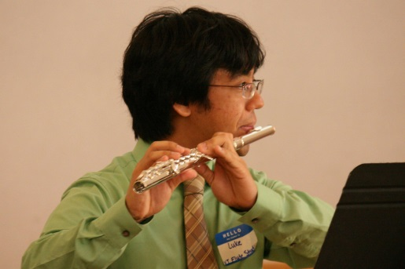
Luke Satoru Gusukuma
Virginia Tech 2nd Computer Science Masters Student
Undergraduate Degrees in Music (Flute Performance) and Computer Science (from Tech)
Hobbies: Swing Dance, Ballroom Dance, Flute, Origami
Half Okinawan, half Filipino
Luke Gusukuma: Composer, Computer Scientist, Student
Notes:
My name is Luke Gusukuma. I’m a 2nd year masters student in Computer Science, with undergraduate degrees in Music Flute Performance and Computer Science, both degrees from Virginia Tech.
My Hobbies are Swing Dance, Ballroom Dance, Flute, and Origami. I’m Half Okinawan and half Filipino.
My current occupations are as a Composer, Computer Scientist, and of course, student.
As far as my research interests go, I am interested in HCI with relation to the Arts, and with relation to education. I have worked with Michael Evans for a brief amount of time on an Educational math game for pre-K students, and worked with Professor Francis Quek on the motion painting project, as part of a Creativity grant, which involved engaging students of the fourth grade level in creative story telling. Currently I am working with Professor Yong Cao on a project that involves Crowd Simulation for evacuation planning of Lane Stadium.

Slide 3
Summary
Tucker, Allen, et al. "A model curriculum for K-12 computer science: Final report of the ACM K-12 task force curriculum committee." ACM, New York (2003).
This report, proposes a 4 level K-12 curriculum for Computer Science, via integrating CS principles into the curriculum from K-910, and offering elective courses at the high school level. The report first summarizes the current state of Computer Science Education in public school systems in the US, comparing it with other school systems in other countries, and then brings up the term IT Fluency and its distinction from CS, and then goes into the details of the proposed 4 level curriculum. The four levels are outlined as follows: the first level is to establish the foundations of CS; the second level informs students about CS’s place in the modern world; the third level explores Analysis and design within CS; and the fourth level covers specialized topics in Computer Science. In an appendix to the report, there is a list of several samples of what activities that would be part of this curriculum might be.
Notes:
So the style of this discussion is that I will summarize a portion of the paper, and then I’ll bring up a couple of points of discussion.
So for this discussion I’m not going to quite go in linear order with respect to the paper, just FYI

Slide 4
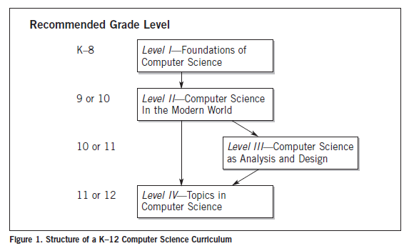
The Four Level framework – Summary Point

Slide 5
The Four Level framework – Summary Point
The first two levels should be taught to everyone
The last two levels are for those with interests in computer science
Notes:
I could go into the latter two levels, but since we are only generally talking about general university education and not those specializing in CS, I won’t spend much time on the latter two levels

Slide 6
The Four Level framework: Level One – Summary Point
Foundations of Computer Science, K-8
Foundational concepts in CS should be taught by
Integrating basic skills in technology with simple ideas about algorithmic thinking
Adding short modules to
Science
Mathematics
Social studies

Slide 7
The Four Level framework: Level One – Summary Point
Out of middle school:
“students should have gained experience using computers … They should have used, modified, and created files for a variety of purposes, accessed the Internet and databases for both research and communication, and used other tools such as spreadsheets and graphics. Finally, they should have been introduced to the basic idea of algorithmic thinking and its uses in their daily lives.”
Notes:
2nd grade kids, developmental psych ethics

Slide 8
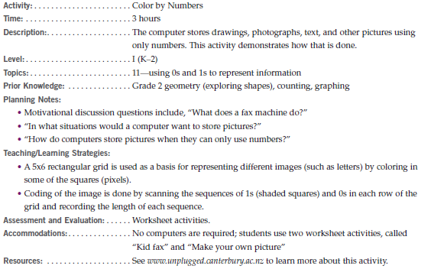
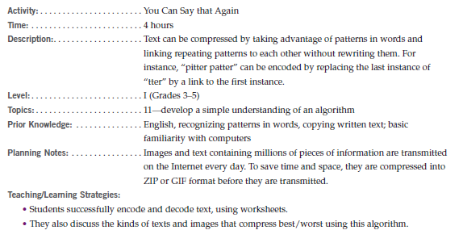
The Four Level framework: Level One – Discussion Point
Items that popped out to me as odd:
“Develop a simple understanding of an algorithm, such as text compression, search, or network routing, using computer-free exercises” (page 44)
“Understand how 0s and 1s can be used to represent information, such as digital images and numbers” (page 43)
Demonstrate an understanding of concepts underlying hardware, software, algorithms, and their practical applications” (???)
Notes:
===============================Forget about this=====================================
So one thing that again strikes me is that these are in the realm of IT Fluency. However, one thing that also triggered in my mind is, what do we need to teach and how do we need to teach it for children to learn Computational Thinking.
===============================Forget about this=====================================
So as said in the previous slide, these changes should be, according to the paper, “Adding short modules Science, Mathematics, and Social studies.”, at least for the level 1 course.
However, looking at what they give as an example (such as on page 44 of the PDF, the “You can Say that Again” activity), I can’t see how that at all links to science, math, or social studies.
Note that many of the activities for the grade school curriculum come from the CS unplugged website, and while as activities, they certainly are great for getting across concepts of computational thinking, don’t really support the curriculum, at least in my opinion.
Do any of you have ideas of how this can be worked into the Science, math, or social studies?

Slide 9
The Four Level framework: Level Two – Summary Point
Computer Science in the modern world
one-year course accessible to all students, college bound or not
“In this course, high school students can acquire a fundamental understanding of the operation of computers and computer networks and create useful programs implementing simple algorithms. By developing Web pages that include images, sound, and text, they can acquire a working understanding of the Internet, common formats for data transmission, and some insights into the design of the human computer interface. Exposure to career possibilities and discussion of ethical issues relating to computers should also be important threads in this course.”

Slide 10
The Four Level framework: Level Two – Summary Point
This course provides the first opportunity to view computer science as a coherent field of study and professional engagement. That is, while IT fluency focuses on technological skills and their uses in other academic subjects, this course is a study of computer science as an academic subject per se.

Slide 11
The Four Level framework: Level Two – Summary Point
computer organization and the major components (input, output, memory, storage, processing, software, operating system, etc.)
basic steps in algorithmic problem solving
basic components of computer networks
Organization of Internet elements, Web page design and hypermedia
The notion of hierarchy and abstraction in computing, including high-level languages, translation (compilers, interpreters, linking), machine languages, instruction sets, and logic circuits.
connection between mathematics and computer science, including binary numbers, logic, sets, and functions.
notion of computers as models of intelligent behavior (e.g. robot motion, speech recognition, and computer vision), and what distinguishes humans from machines.
Examples that identify the broad interdisciplinary utility of computers and algorithmic problem solving in the modern world.
Ethical issues that relate to computers and networks (e.g. security, privacy, intellectual property, reliability) and the positive and negative impact of technology on human culture.
Identification of careers in computing and their connection with the subjects studied in this course

Slide 12
The Four Level framework: Level Two – Discussion Point
computer organization and the major components (input, output, memory, storage, processing, software, operating system, etc.)
basic steps in algorithmic problem solving
basic components of computer networks
Organization of Internet elements, Web page design and hypermedia
The notion of hierarchy and abstraction in computing, including high-level languages, translation (compilers, interpreters, linking), machine languages, instruction sets, and logic circuits.
connection between mathematics and computer science, including binary numbers, logic, sets, and functions.
notion of computers as models of intelligent behavior (e.g. robot motion, speech recognition, and computer vision), and what distinguishes humans from machines.
Examples that identify the broad interdisciplinary utility of computers and algorithmic problem solving in the modern world.
Ethical issues that relate to computers and networks (e.g. security, privacy, intellectual property, reliability) and the positive and negative impact of technology on human culture.
Identification of careers in computing and their connection with the subjects studied in this course
Notes:
So for the next two slides, which are discussion slides, I’m going to kind of toggle back and forth between the two.

Slide 13
The Four Level framework: Level Two – Discussion Point
Do they really need to know about computer organization?
How deep into Computer Science do we want to go?
How much detail of Computer Science is really necessary to teach computational thinking?
Notes:
What necessitates these things?

Slide 14
The Four Level framework: Level Three – Summary Point
"The major goal of this course is for students to develop the computer science skills of algorithm development, problem solving, and programming while using software engineering principles. While the emphasis of the course will be on programming, students will also be introduced to other important topics, such as interface design, the limits of computers, and societal and ethical issues of software engineering."
Notes:
As I said before, I’m not really spending TOO much time on the other two levels because they were mainly focused on people pursuing careers in Computer Science. But, does anyone have any thoughts on this slide? The major parts that I thought of were….these

Slide 15
The Four Level framework: Level Four – Summary Point
“At this level, interested and qualified students should be able to select one from among several electives to gain depth of understanding or special skills in particular areas of computer science. All of these electives will require the Level II course as a prerequisite, while some may require the Level III course as well. Most important, these courses provide students with an opportunity to explore topics of personal interest in greater depth, and thus prepare for the workplace or for further study at the post-secondary level.”
Notes:
For the most part, it was either, lets go the AP route, or something that seems like a Senior Design Project. But as I said before, and even more so for the level four than the level three, but, as far as the goal of this class goes, I don’t think the level four part of the curriculum has anything interesting to us.

Slide 16
Why teach Computational Thinking? How far should we go?
Notes:
Alright, so here’s what I think is the more interesting part of the discussion, Why teach Computational Thinking?

Slide 17
Computer Science is Important Intellectually – Summary Point
“Computers are fundamentally different from other technological inventions in the past in that they directly augment human thought, rather than, say, the functions of our muscles or our senses.”
“An engineer using a computer to design a bridge must understand how the maximum capacity estimates were computed and how reliable they are.”
“An educated citizen using a voting machine or bidding in an eBay auction should have a basic understanding of the underlying algorithms of such conveniences, as well as the security and privacy issues that arise when information is transmitted and stored digitally.”
“Computer science students learn logical reasoning, algorithmic thinking, design and structured problem solving—all concepts and skills that are valuable well beyond the computer science classroom.”
“Students gain awareness of the resources required to implement and deploy a solution and how to deal with real-world constraints.”

Slide 18
Computer Science is Important Intellectually – Discussion Point
An engineer using a computer to design a bridge must understand how the maximum capacity estimates were computed and how reliable they are.
Engineers already learn and know the math. Reliability knowledge is important, but is that really computer Science?
An educated citizen using a voting machine or bidding in an eBay auction should have a basic understanding of the underlying algorithms of such conveniences, as well as the security and privacy issues that arise when information is transmitted and stored digitally.
How is this different from understanding how any system works? People should know how legislation affects them and their rights, is this any different?
Students gain awareness of the resources required to implement and deploy a solution and how to deal with real-world constraints.
Isn’t this Engineering?
Computer science students learn logical reasoning, algorithmic thinking, design and structured problem solving—all concepts and skills that are valuable well beyond the computer science classroom.
This is the focus of Computational Thinking, right?
Notes:
This would transition well into the whole IT Fluency Portion of discussion, but you may want to cover the next two slides and then go into the IT Fluency
Read the first three questions first…
The point of these questions in general is that, people already have a lot to learn, and already have a lot they already know. Our goal is, regardless of what we actually define as “Computational Thinking”, is what out of Computational Thinking do we want people outside of our field to learn, or more perhaps more tangibly, what out of Computer Science, do we want people to learn, or even more tangibly, what out of Technology do we want people to learn.

Slide 19
Versatilists – Summary Point
Thomas Friedman, in his best-selling book The World is Flat, (2006) argues that our economy most needs "Versatilists," people who have expertise in some domain and in technology. Computer science is the glue that makes it possible for these Versatilists to work together.

Slide 20
Versatilists – Discussion Point
In what cases does a client actually need some domain knowledge of computer science?
“Often a computer scientist works closely with business people, scientists, and other experts to understand the issues, and to define the problem so explicitly that it can be represented in a computer.”
For the application of Computer Science, is it REALLY necessary for clients to have knowledge of Computer Science? Of Computational Thinking?
Can’t we just create an in-between class of “computational [insert subject matter here]” fields? Don’t we kind of do that already?
Notes:
One of the points that we want to get across is WHY we want to teach computational thinking to college students, or rather, at the University level. What benefits does it have.
In one of the earlier discussions in class one person talked about how the CS people couldn't create the system for something because they didn't have a good understanding of the working environment, so instead, it was more effective to teach the actual employees of the company some of the knowledge necessary to draft out the work-flow themselves.
Does this anecdotal evidence suggest that everyone needs some base knowledge in Computer Science, or Computational Thinking, or whatever other label we want to put on it?

Slide 21
IT Fluency – Summary Point
"IT Literacy is the capability to use today's technology in one's own field, the notion of IT Fluency adds the capability to independently learn and use new technology as it evolves throughout one's professional lifetime.“
“Moreover, IT fluency also includes the active use of algorithmic thinking (including programming) to solve problems, whereas IT literacy is more limited in scope."
Notes:
IT Fluency is my next point, so just taking highlight quotes from the report…
Quote

Slide 22
IT Fluency – Summary Point
“the complexity of algorithms is a fundamental idea in computer science but would probably not appear in an IT curriculum. While IT is an applied field of study, driven by the practical benefits of its knowledge, computer science has scientific and mathematical, as well as practical, dimensions.”
"The idea of IT fluency (National Research Council, 1999) was proposed as a minimum standard that all college students should achieve by the time they graduate. A "fluent" graduate would master IT on three orthogonal axes — concepts, capabilities, and skills."

Slide 23
IT Fluency (The Laundry list) – Summary Point
"Concepts are the 10 basic ideas that underlie modern computers, networks, and information:
Computer organization
information systems
networks
digital representation of information
information organization
modeling and abstraction
algorithmic thinking and programming
universality
limitations of information technology
and societal impact of information technology."
Notes:
Modeling and abstraction…what?!
Algorithmic thinking and programming…what?!

Slide 24
IT Fluency (The Laundry list) – Summary Point
"Capabilities are the 10 fundamental abilities for using IT to solve a problem:
Engage in sustained reasoning
manage complexity
test a solution
manage faulty systems and software
organize and navigate information structures and evaluate information
collaborate
communicate to other audiences
expect the unexpected
anticipate changing technologies
and think abstractly about IT."
Notes:
Engage in sustained reasoning! That’s one of the things we want to get across, right?
organize and navigate information structures and evaluate information! Another item we want to get across!
Expect the unexpected :/ okay, well that’s just corny

Slide 25
IT Fluency (The Laundry list) – Summary Point
"Skills are the 10 abilities to use today's computer applications in one's own work:
Set up a personal computer
use basic operating system features
use a word processor and create a document
use a graphics or artwork package to create illustrations, slides, and images
connect a computer to a network
use the Internet to find information and resources
use a computer to communicate with others
use a spreadsheet to model simple processes or financial tables
use a database system to set up and access information
and use instructional materials to learn about new applications or features."
Notes:
And Finally, Skills, the THIRD orthogonal axis of IT Fluency
And that’s what I typically thought of as IT, just this ONE axis

Slide 26
IT Fluency – Discussion Point
Concepts
Modeling and abstraction
Algorithmic thinking and programming
universality
limitations of information technology
societal impact of information technology
Capabilities
organize and navigate information structures and evaluate information
Engage in sustained reasoning
Notes:
Okay, so some of the major points that I saw in the laundry list are the ones on this slide. Note the red stuff! That’s straight out of the list of things we found important in Computational Thinking!!
As far as other useful items that were in the list that I thought were the following.
(See on the list)
I highlighted other important concepts that we covered in green! And something Michael mentioned about, ETHICS, I feel is greatly related to the societal impact portion of IT Fluency
So the actual question I’m posing is, are these points already addressed in this term IT Fluency? And if so, what does that actually mean as far as teaching these concepts are concerned? To me, it seems like we should be teaching IT Fluency instead, or rather, we should jump onto the already defined IT Fluency train. Is that where we want to go?

Slide 27
General Discussion Points
What parts of computational thinking do we actually want to be part of a general curriculum?
What parts of computational thinking are actually necessary to have by the populous.
How do we integrate this into the current curriculum?
Should our focus be on integrating and working with IT Fluency, as defined by the National Research Council?
Notes:
One goal is to engage the students.

