Slide 1
REPRESENTING GEOMETRIC CONSTRUCTIONS AS PROGRAMS
Author: Bruce Sherin
School of Education and Social Policy,
Northwestern University
Presented by:
Mohammad Shabbir Hasan
shabbir5@vt.edu

Slide 2
About Me
Name: Mohammad Shabbir Hasan
Ph.D. Student in the CS department.
Working with Dr. Liqing Zhang in the Computational Biology and Bioinformatics Lab.
Working on predicting Insertions and Deletions (InDel) in Next Generation Sequencing data (main concentration is on Human Genome).
Obtained Masters in CS from the University of Akron, Ohio on Summer 2013.
From Bangladesh.

Slide 3
Overview
Illustrating the ways in which computer environments have transformed to the practice of mathematics or mathematics pedagogy.
A series of geometric constructions made in a Boxer programming environment reflecting on the resultant blended turtle geometric and dynamic geometry environment.
Discusses the role and potential of programmable applications and programming representation of geometric concepts and other sub-domains of mathematics.

Slide 4
Instructing Geometry
Two strands:
  Turtle Geometry
  Dynamic Geometry
In principle, they are related but in practice, they have remained relatively separate worlds.

Slide 5
Turtle Geometry
Had its earliest and most familiar incarnations in the Logo programming language.
Continues to live on in Logo and its descendants.
In turtle geometry activity, students write their own programs, and the constructions they create are often comparatively simple.

Slide 6
Dynamic Geometry
Somewhat recent than Turtle Geometry.
Students create and interact with constructions primarily though a point-and-click interface.
These environments are specifically created for geometry.
So they are extremely powerful within this domain
Allows students to make complex constructions with relative ease.

Slide 7
Objective of this research work
To explore briefly the merging of these two strands.
To look at how, by merging programming and dynamic geometry, “new ways of representing” familiar mathematics can be created.
To illustrate how, through the merging of dynamic geometry and turtle geometry, we may be able to create constructions that would be difficult to construct while working solely with one of the component approaches.

Slide 8
Tools
Programming Environment: Boxer a direct descendent of “Logo”.
It is possible in Boxer to write turtle geometry procedures using Logo’s familiar turtle graphics commands.
It also includes some modern amenities: a programming interface that is hierarchically structured as boxes within boxes (hence the name).

Slide 9
Commands
Primitive | Function
point | Draws and labels a point at current turtle location.
join (p1 p2) | Draws a line connecting points p2 and p2.
circle (p1 p2) | Draws a circle centered at point p1 and through p2.
ccint c1 c2 | Finds the intersection points of circles c1 and c2.
llint l1 l2 | Finds the intersection of the two lines, l1 and l2.
goto p1 | Moves the turtle to point p1.
aimto p1 | Rotates the turtle so that is headed toward point p1.
ml (p1 p2) | Outputs the length of the segment with endpoints p1 and p2.

Slide 10
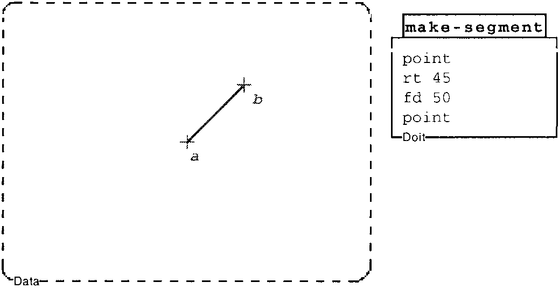
Example 1
Draws a point.
Then tells the turtle to turn right 45. and go forward 50 steps
Makes a second point.

Slide 11
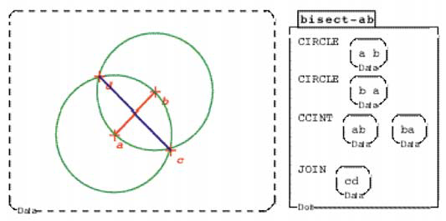
Example 2
First draws two circles, one centered on point a and through point b, and the other centered on b and through a.
Then, in the third line of the program, the ccint command is used to find the intersection of the two circles.
Finally, the last line of the procedure draws a line that connects these two intersection points.

Slide 12
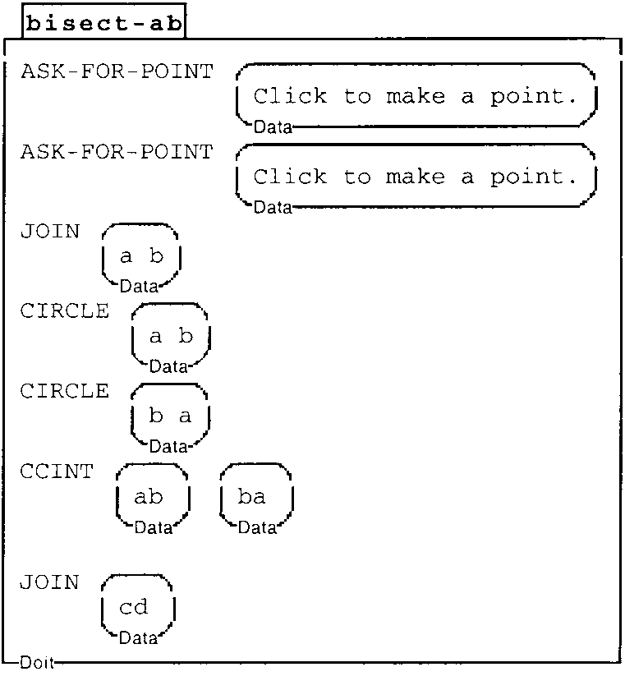
Example 3 (added some Interactivity)
Made two specific additions that are relevant here.
First, we created a command called ask-for-point. When this command is executed, the user is prompted to click somewhere in the graphics display, and a new point is then created at the indicated location.
When this program runs, the user is prompted to select locations for the two initial points. The program then joins these two points, and then constructs the bisector, just as in previous versions of bisect-ab.

Slide 13
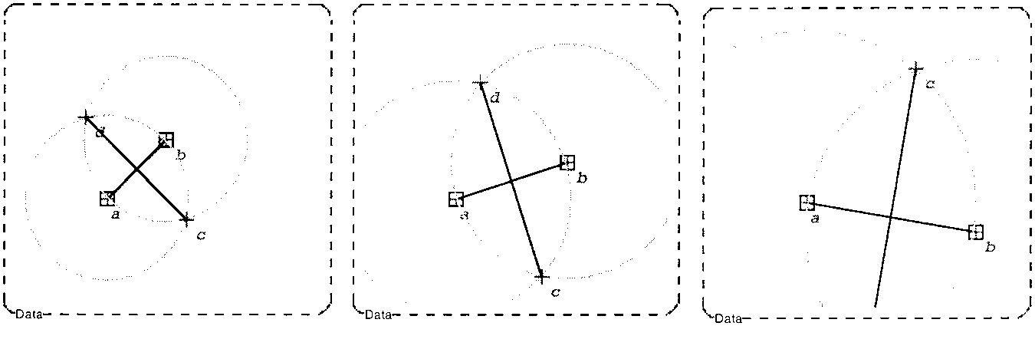
Example 3 (contd.)
Second, we also added the capability for some true dynamic interaction with the graphical display. When this feature is turned on, the user can drag point a or b in our above constructions.
The figure above shows a sequence where point b has been dragged down and to the right.

Slide 14
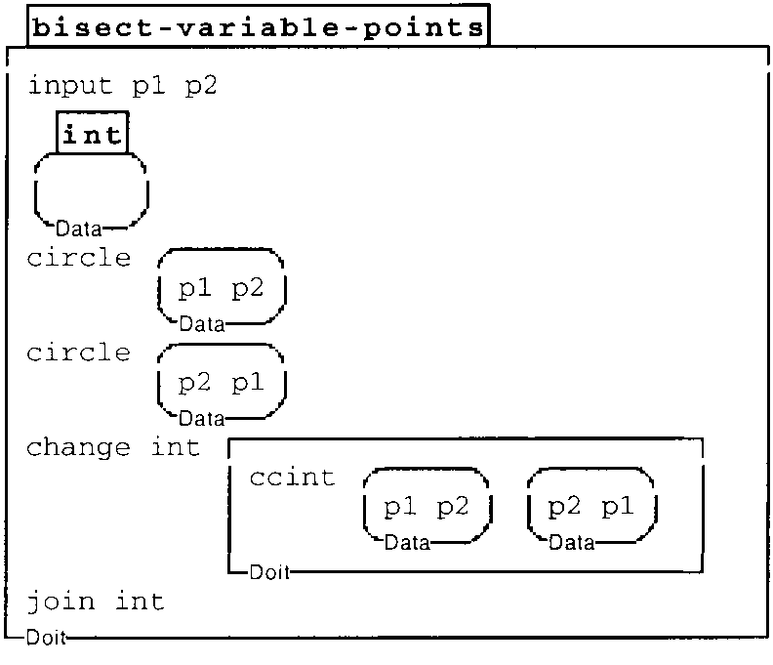
Example 4 (introducing variables)
This new procedure takes two inputs,
named p1 and p2, as specified at the top of the procedure.
The procedure begins by drawing the two circles, as before.
Then it finds the intersections of these two circles and stores them in the local variable named ‘int’.
Finally, int is passed as an argument to join, and the bisector segment is drawn.

Slide 15
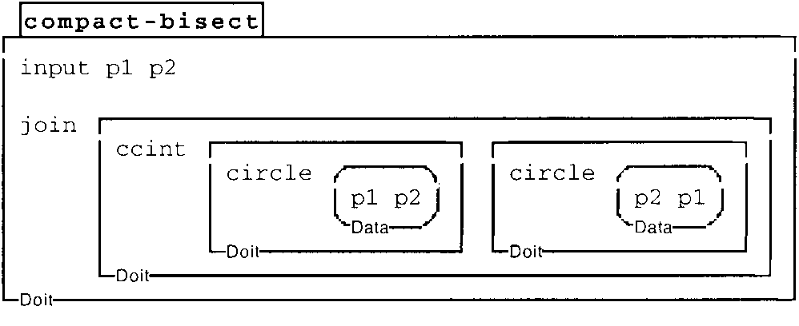
Example 5 (A compact one)
In this procedure, each of the calls to circle produce outputs that serve as the inputs to ccint.
The output of ccint (the intersection points) then, in turn, serves as the input to join.

Slide 16
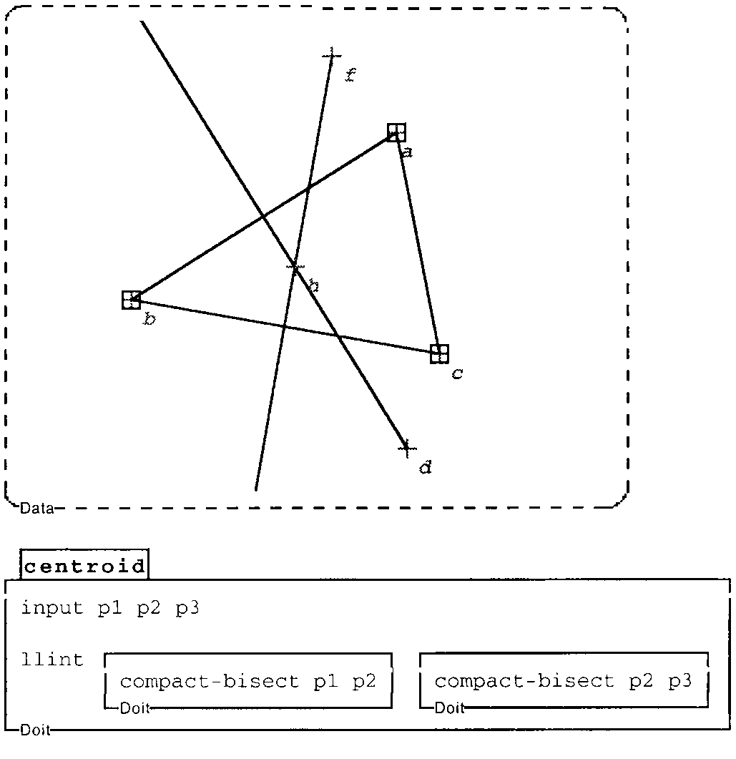
Example 6 (A more complex one)
This figure shows an example in which the compact-bisect program has been used for the construction of the centroid of a triangle.
This program constructs bisectors of two sides of the triangle. The resulting segments are then passed as inputs to the llint command, which finds the intersection of two given lines.
In this Figure, I have suppressed the circles in the construction for clarity.

Slide 17
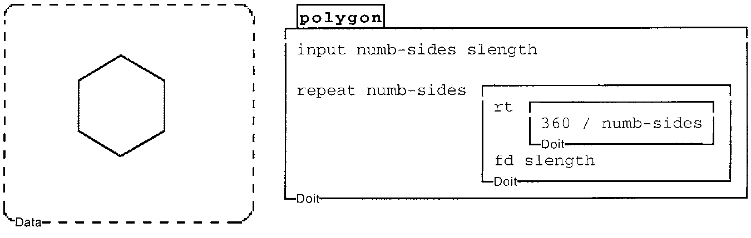
Final Example (With turtle geometry procedure)
This procedure draws a regular polygon given two inputs, the number of sides (number-sides) and the length of a side (slength).

Slide 18
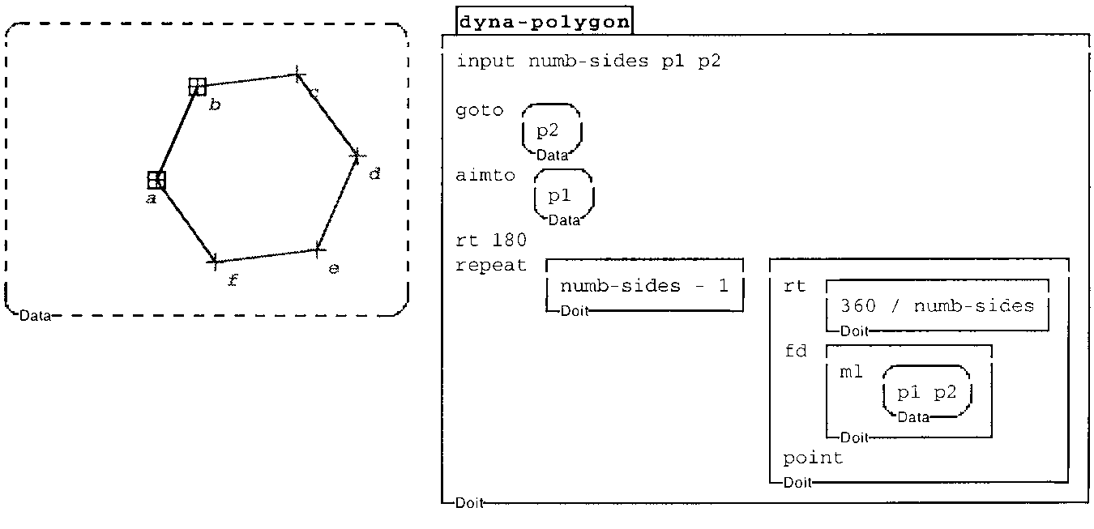
Final Example (with dynamic geometry sub-environment)
The revised procedure, which is shown in this Figure , takes the number of sides as one of its inputs, but the other two inputs are points that will be the endpoints of one side of the polygon.
Using these three inputs, the procedure can construct a regular polygon in which all of the vertices are labeled points.
It uses the goto and aimto commands to position and orient the turtle so that it is prepared to draw the remainder of the polygon, and the ml command outputs the length of the given line segment.

Slide 19
Conclusion
Here the author tried to establish that programming representations can be employed for geometric constructions.
Through the merging of the two approaches, some of the benefits of both turtle geometry and dynamic geometry can be achieved. Some of what is hard in dynamic geometry environments is comparatively straightforward in turtle geometry. Conversely, much of what is hard in turtle geometry is relatively easy with dynamic geometry-like tools.
If it is possible to get significant functionality by enriching programming environments, it may be possible to apply a dynamic geometry-like approach to more sub-domains within mathematics. Such environments might allow teachers and students to harness the power of computation across the range of mathematical sub-disciplines.

Slide 20
Thank You

