Slide 1
Computational Thinking Across Curriculum
Two papers on teaching computational thinking to non-CS students
Pejman Khadivi
CS Department, Virginia Tech

Slide 2
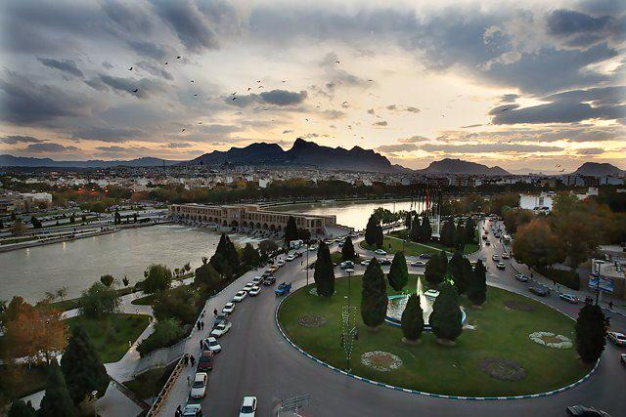
Who am I?
Pejman Khadivi
Ph.D. Student, Computer Science
Working with Prof. Ramakrishnan
B.Sc. Computer Engineering, Isfahan University of Technology,1994-1998
M.Sc. Computer Engineering, Isfahan University of Technology, 1998-2000
Ph.D. Electrical Engineering, Isfahan University of Technology, 2000-2006
Visiting researcher, McMaster University, 2003
Lecturer, Isfahan University of Technology, 2000-2006
Assistant Professor, Isfahan University of Technology, 2006-2011

Slide 3
Papers
S. Hambrusch, et al. “A Multidisciplinary Approach Towards Computational Thinking for Science Majors”, SIGCSE’09, March 3–7, 2009.
L. Perkoviḉ, et al. “A Framework for Computational Thinking across the Curriculum”, ITiCSE’10, June 26–30, 2010.

Slide 4
First Paper
S. Hambrusch, et al. “A Multidisciplinary Approach Towards Computational Thinking for Science Majors”, SIGCSE’09, March 3–7, 2009.
Summary:
This paper is about a course which has been designed to teach CT to students from Physics, Chemistry, and Bioinformatics majors. During the course students learn how to program in Python. Domain-specific examples (from each field) are presented in class and students have to do term-projects.

Slide 5
Main Principles
Lay the groundwork for computational thinking
Formulating problem, abstraction, algorithms, visualization
Present examples in a language familiar to the students
Science majors, conversant in the basics of the classical disciplines, will comprehend computational concepts more easily if those concepts can be motivated by examples from their scientific subdisciplines
Teach in a problem-driven way
Start description from a real world problem
Thermodynamic system → computational perspective → randomized models and Monte Carlo techniques

Slide 6
Main Principles
The programming language should right away allow a focus on computational principles
Write meaningful problems in a short time
Libraries used by scientific community
Make effective use of visualization
Better understand scientific questions
Better understand computational principles and processes

Slide 7
Disciplines
Physics
Better understanding of computation
New computational opportunities for learning and research
New perspective on physics and applied mathematics
Chemistry
Computational methods relevant in chemical research (Monte Carlo, Simulated Annealing and Molecular Dynamics)
Use and integrate existing Fortran programs
Visualizing techniques
Bioinformatics
Use of R for statistical computing and visualization
Program in a language for which bioinformatics software packages exist or can easily be integrated.

Slide 8
Course Syllabus

Slide 9
Course Syllabus

Slide 10
Course Syllabus

Slide 11
Course Projects
Two parts:
Programming part
Experimental part
Students can use their own program or another program
Most of them decided to use their own
All projects asked students to produce visualizations of computational results and provide a write-up on their observations

Slide 12
Course Projects
Manipulating Digital Audio
Computational Experiments on Percolation in Grids
Simulating Physical Systems
Analyzing Protein-Protein Interactions

Slide 13
Evaluation
Spring 2008 with only 13 students
10 Physics, 3 Chemistry
Q1: Taking another computer science course?
Q2: Pursuing a career that requires programming skills?
Answers: 0 to 4
0) not interested
4) very interested

Slide 14
Evaluation
Students interest in taking other CS courses increased
Previous programming experience had no effect
Responses indicate that 60% of the students plan to take another CS course
In other introductory programming courses for majors a decrease in interest in computer science is observed
This is not a fair comparison
Example: Different instructors

Slide 15
Discussion
This course seems to be a special “Programming Course” with a flavor of applications in science fields, not a CT course.
“If all you have is a hammer, everything looks like a nail”
People do not know how to teach CT, so they teach Programming

Slide 16
Second Paper
L. Perkoviḉ, et al. “A Framework for Computational Thinking across the Curriculum”, ITiCSE’10, June 26–30, 2010.
Summary:
This paper is about a framework that helps to integrate CT into different curriculums based on Denning’s great principles of computing. Different domains are considered in arts, sciences, humanities, and social sciences. Authors ultimate goal was to augment people productivity in their fields.

Slide 17
Principles
Computation: execution of an algorithm
Communication: transmission of information from one process or object to another
Coordination: control of the timing of computation at participating processes
Recollection: encoding and organization of data in ways to make it efficient to search and perform other operations
Automation: mapping of computation to physical systems
Evaluation: statistical, numerical, or experimental analysis, and visualization of data
Design: organization (using abstraction, modularization, aggregation, decomposition) of a system, process, object, etc.

Slide 18
Framework
Common Core
First-year, two-course sequence in Math and Technology Literacy
Apply quantitative reasoning and information
Evaluate real-world problems using modern IT
Spreadsheets, databases, programming algorithms, …
Authors think that this is necessary to teach CT in other courses
Domain-specific courses
Courses in various learning domains
Students are required to take 2-3 courses

Slide 19
Re-worked Courses

Slide 20
Re-worked Courses

Slide 21
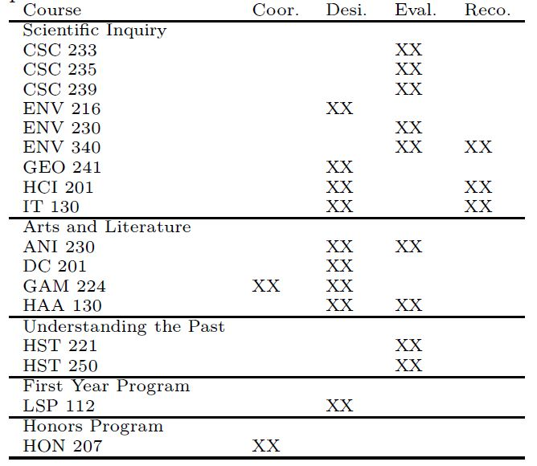
Covered concepts

Slide 22
What discussed for each course
(A) catalog course description
(B) high-level description of the course and computational thinking concepts covered
(C) computational thinking learning goal
(D) a case discussion and several guiding questions
(E) assessment for the specified learning goal

Slide 23
Geographic Information Systems I
An introduction to the fundamentals of geospatial information processing
Introduces basic concepts and methods that underlie information systems designed to deal with geographically referenced data.
Design (data modeling, …)
Comparing two different data representations

Slide 24
Introduction to Game Design
Computer Games from Three Perspectives:
Media: elements, structure, interactive appreciation
Complex software artifact
Cultural artifact
Game rules:
Constituative, operational, and implicit
Design (Abstracting game rules, …)
Relationship between different abstractions of rules, the modeling of game behavior, and the underlying structure of a game

Slide 25
3D Modeling
Introductory modeling and texturing techniques required to construct 3D objects and scenes to be used for animation and gaming
Modularization in 3D modeling
Design, Automation, Computation

Slide 26
Discussion
Proposed method: Talk about a domain specific problem with existing computational solutions to teach a CS/CT skill
Alternative method: which concept is relevant to our problems?
Some simple familiar examples help students to absorb CS concepts not as an “only CS” concept but as a multi-domain concept. Then, domain specific examples can show up and do their magic.

Slide 27
Discussion
Example: Teaching Object Oriented Design

Slide 28
Discussion
Example of alternative method:
Foundation
Concepts and methods: Abstraction, simulation, …
Simple familiar examples
Issues
What is the performance of that physical system?
What agricultural process results in more crops?
Relevancy
Is there any CS concept useful here?
e.g. Can we use simulation to answer those questions?
What will happen when a Mars rover wants to land on Mars?

Slide 29
Discussion
Which approach do you like more: attacking a domain-specific problem (e.g. in Physics) or building a fundation first?
Should we explicitly tell to students that the goal is to learn computational thinking or not?
Should we tell the students that "now you are familiar wit abstraction" or any other concept in CT/CS, or not?

