Slide 1
Participatory Simulation & Emergent Behavior
Author : Uri Wilensky
Presenter : Krunal Doshi

Slide 2
What’s a Participatory Simulation?
Students engaged in participatory simulations act out the roles of individual system elements and then see how the behavior of the system as a whole can emerge from these individual behaviors.
Participatory simulations is intended to refer to such role-play activities aimed at exploring how complex dynamic systems evolve over time.

Slide 3
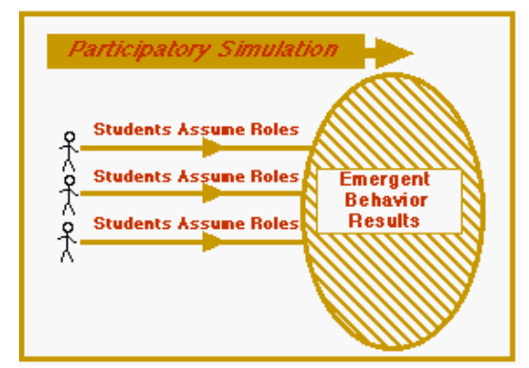
What’s a Participatory Simulation?
It helps to understand systems dynamics and systems learning.

Slide 4
Why do Participatory Simulations and Emergent Activities Matter?
How systems of many interacting elements change and evolve over time?
How global phenomena can arise from local interactions of these elements?
Dynamic system touches on some of the deepest issues in science :
order vs. chaos
randomness vs. determinacy
analysis vs. synthesis.

Slide 5
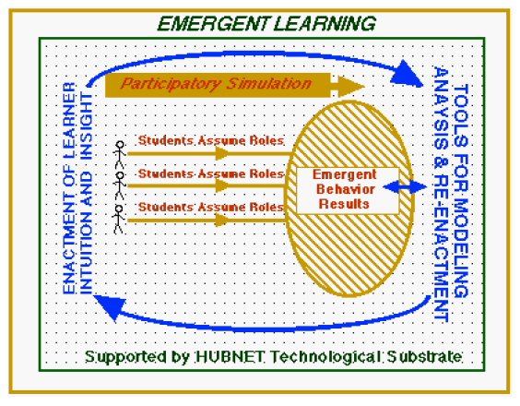
HUBNET: Participatory Simulation Project(PSP)
Learner’s intuitions are connected through network with tools of analysis and modeling.
Learners’ working in the networked environment make overt and visible their strategies in relation to generating different kinds of emergent behavior. In doing so, these strategies become increasingly well-articulated and refined in ways that scaffold both learner understanding of dynamic systems and the actual use by learners of the tools themselves.

Slide 6
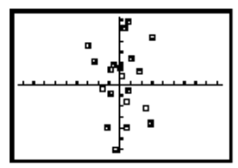
HUBNET in classroom : Function Example
The
The teacher begins the conversation by asking students if there is any pattern in this collection of points.
Although students will occasionally qualify their comments with the observation that there "might" be a pattern, the general consensus is that there is not an obvious pattern.
The Function Example begins with a seemingly random collection of points visible on the up-front projection system.

Slide 7
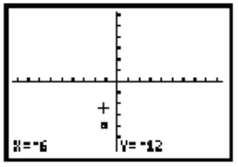
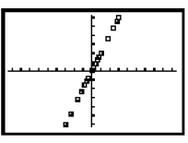
Example
The teacher "hands out" one of these points to each of the students using the network.
A single point is then visible on each student’s screen.
Move until your y-value is two-times your x-value

Slide 8
Interesting observation in the video-tapes
If a particular student realizes that his or her point is "off" the emergent pattern, s/he will sometimes offer an explanation for what happened. Students are willing to try and make sense of other students’ reasoning.
"oh, that person must have just switched his y and his x,"
"she didn’t multiply by the negative."
By using this participatory approach, cognitive scaffolding is provided for moving from "my point" to big ideas related to the concept of a function and to various analytic forms of expressing the functional dependency.

Slide 9
Modeling Nature’s Emergent Patterns

Slide 10
3 Demos - NetLogo
Virus-on-a-Network
Gas-in-a-Box
Wolf/Sheep Predation

Slide 11
NETLOGO
The study of dynamic systems stands as a new form of literacy for all, a new way of describing, viewing, and symbolizing phenomena in the world.
NetLogo enables the rendering, simulation and visualization of the evolution of dynamic and complex systems over time.
A new framework, a new perspective that allows us to see old scientific content in new ways.

Slide 12
Netlogo Pedagogical - 5 phases
Phase I:
The teacher typically leads the students in off-computer activities that provoke thinking about emergent phenomena.
In these activities, students typically enact the role of individual elements of a system.
Then discuss amongst themselves what global patterns they detect and how those patterns could arise from their individual behaviors.

Slide 13
Phase II:
Teacher presents a “seed” model - a simple starting model to the whole class, projected upfront so that everyone can view it. The teacher engages the class in discussion as to what is going on.
Why are they observing that particular behavior?
How would it be different if model parameters were changed?
Is this a good model of the phenomenon it is meant to simulate?

Slide 14
Phase III:
Students run the model (either singly or in small groups) on individual computers and explore the parameter space of the model.
Phase IV:
Students proposes an extension to the model

Slide 15
Phase V:
students are asked to propose a phenomenon and build a model of it from “scratch” using the NetLogo modeling primitives

Slide 16
school settings - phases I, II & III
Working in phase IV & V is the “extensible modeling” approach, allows learners to dive right into the model content. Learners typically start by exploring the model at the level of domain content.

Slide 17
Insightful Remarks
Though there is increased desire for interdisciplinary learning, students studying in a traditional curricular framework find it difficult to see the connections between different domains of knowledge. One strength of the complex systems theory perspective is that it enables us to see common patterns across traditionally separate fields.
By introducing a perspective of complexity and emergent phenomena, science is made more accurate, more inclusive and more accessible to the great majority of students.

Slide 18
Can we consider Emergent phenomena & perspective as one of the separate facet of Computational Thinking?
If then strong or weak facet?

Slide 19
References
Wilensky, U. (2001, updated 2013) Modeling nature's emergent patterns with multi-agent languages. Proceedings of EuroLogo 2001. Linz, Austria.
Wilensky, U., & Stroup, W. (1999). Learning through participatory simulations: Network-based design for systems learning in classrooms. Proceedings of Computer Supported Collaborative Learning (CSCL'99). Stanford, CA, December 12 - 15.

