Slide 1
Computational Thinking
Related Efforts

Slide 2
CS Principles – Big Ideas
Computing is a creative human activity that engenders innovation and promotes exploration.
Abstraction reduces information and detail to focus on concepts relevant to understanding and solving problems.
Data and information facilitate the creation of knowledge.
Algorithms are tools for developing and expressing solutions to computational problems.
Programming is a creative process that produces computational artifacts.
Digital devices, systems, and the networks that interconnect them enable and foster computational approaches to solving problems.
Computing enables innovation in other fields including science, social science, humanities, arts, medicine, engineering, and business.

Slide 3
CS Principles - Practices
Analyzing problems, artifacts, and effects of computation
Creating and using computational artifacts, computational models
Communicating processes and results
Connecting computation with mathematics, science, engineering
Work effectively in teams

Slide 4
Ed Fox Categories
Derived from experience with LIKES project
What others want from CS
Modeling and simulation (prediction, analysis,…)
Representation (data, knowledge,…)
Interaction (HCI, VR, graphics,…)
Algorithms (workflows, procedures,…)

Slide 5
A Perspective on Computer Science
Sponsored by National Research Council
Focuses on research areas
“…the discussion that follows does not aim to explicitly or comprehensively define computer science or to catalog all of the research areas. Instead, the approach is to indicate and illustrate the essential character of the field through a sampling of representative topics.” [p 11-12]

Slide 6
Representative Topics in CS
Computer Science Research [NRC 2004]
Involves Symbols and Their Manipulation,
Involves the Creation and Manipulation of Abstraction
Creates and Studies Algorithms
Creates Artificial Constructs, Notably Unlimited by Physical Laws
Exploits and Addresses Exponential Growth
Seeks the Fundamental Limits on What Can Be Computed
Often Focuses on the Complex, Analytic, Rational Action That Is Associated with Human Intelligence

Slide 7
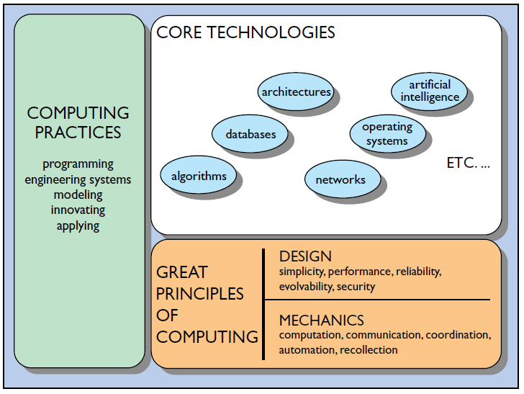
Great Principles
Computing mechanics
The laws governing computations
Design principles
Conventions for designing computations
Computing practices
Standards for implementation
Core technologies
Shared attributes of application domains

Slide 8
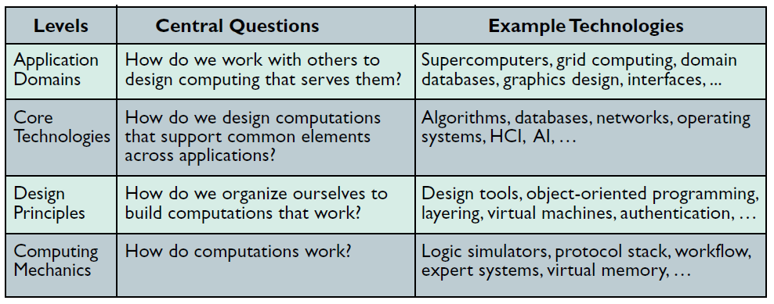
Justification questions
Each major element has a characteristic question that justifies its place in the hierarchy and exposes the integral role of practice.

Slide 9
Great Principles
“The principles of a field are actually a set of interwoven stories about the structure and behavior of field elements.” [Denning 2003]
Computer Science is seen as Computing Mechanics in parallel to the use of the term “mechanics” in other disciplines
“Computing Mechanics deals with the structure and operation of computations. It does so with stories … [that] I could group … into the five categories.” [Denning 2003]
It is “better to view the categories as windows into computing mechanics.” [Denning 2003]

Slide 10
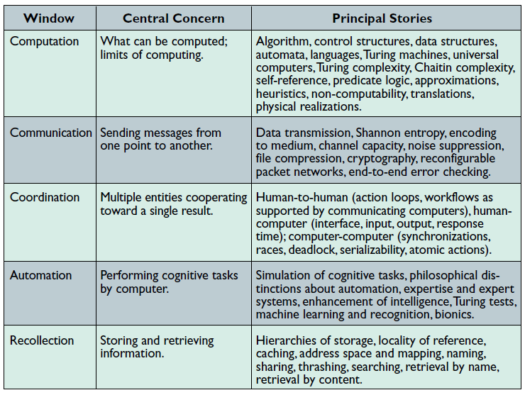
Great Principles: Categories

Slide 11
Great Principles – Design and Practice
Design
“Computing professionals follow principles of design that enable them to harness mechanics in the service of users and customers.”
Principles
Simplicity
Performance
Reliability
Evolvability
Security
Practices
Programming
Engineering of systems
Modeling and Validation
Innovating
Applying

Slide 12
Denning’s Criticism
Premise (possibly misplaced?)
“Computational thinking is seen by its adherents as a novel way to say what the core of the field is about, a lever to reverse the decline of enrollments, and a rationale for accepting computer science as a legitimate field of science.” [Denning 09]
Questions (are these fair questions?) [Denning 09]
“Is computational thinking a unique and distinctive characterization of computer science?”
“Is computational thinking an adequate characterization of computer science?”

Slide 13
Denning’s Criticism
What is CT?
Equates with “algorithmic thinking”
“…it means a mental orientation to formulating problems as conversions of some input to an output and looking for algorithms to perform the conversion.”
Expanded to include:
Multiple levels of abstraction
Algorithms developed using mathematics
Scalability concerns

Slide 14
Denning’s Criticism
Relates computational thinking to computational science
“…computational science is seen in the other sciences not as a notion that flows out of computer science, but as a notion that flows from science itself.”
“Computational thinking is seen as a characteristic of this way of science. It is not seen as a distinctive feature of computer science.”
Does this misrepresent computational thinking?
His conclusion:
“Computation is widely accepted as a lens for looking at the world. We do not need to sell that idea. Computational thinking is one of the key practices of computer science. But it is not unique to computing and is not adequate to portray the whole of the field.”

Slide 15
Interesting Observations
“Computation is present in nature even when scientists are not observing it or thinking about it. Computation is more fundamental than computational thinking.”
“The great principles framework reveals that there is something even more fundamental than an algorithm: the representation. Representations convey information. A computation is an evolving representation and an algorithm is a representation of a method to control the evolution.”
In the great principles framework “… computational thinking is not a principle; it is a practice. A practice is a way of doing things at which we can develop various levels of skill.”

Slide 16
References
[CSP] CS Principles. http://www.csprinciples.org/
[NRC 2004] Computer Science: Reflections on the Field, Reflections from the Field. 2004, National Research Council.
[Denning 2003] Peter Denning, Great Principles of Computing, Communications of the ACM , 46(11), November 2003, p. 15-20.
[Denning 2009] Peter Denning, Beyond Computational Thinking, Communications of the ACM , 52(6), June 2009, p. 28-30.

